Slide 1
SonAI
AI-native audio intelligence for analysis and generation
Input
Drop an audio file and state an objective in plain English.
Analysis
The agent places and runs spectral, temporal, pitch, onset, and segmentation nodes.
A natural-language node editor that turns reference audio into structured analysis, interpretable musical insight, and non-vocal flow-state output.
Generation
SonAI assembles a soundscape graph and renders a new instrumental output.
Investor deck • 5-slide overview
1

Slide 2
SonAI
The workflow gap in modern audio creation
Audio teams still move between disconnected tools for listening, analysis, interpretation, and generation.
Reference audio analysis is fragmented across scripts, plugins, notebooks, and DAWs.
Listen
Reference track, stems, corpus
Generative audio tools produce output quickly, but give little structural control over why a result sounds the way it does.
Frequency, rhythm, pitch, segmentation
Measure
Infer
Scene plan and role mapping
Teams lack a shared canvas that connects musical evidence to generation decisions in a reproducible workflow.
Generate
Texture, instrument, granular, render
SonAI turns this into one agent-driven canvas instead of four disconnected steps.
2

Slide 3
SonAI
Product: a natural-language node editor for audio intelligence
The user provides a file and an objective. The agent constructs the graph, explains each step, and renders output.
Source + Transform
Measure + Infer
Compose + Render
Load audio
Spectral stats
Binaural layer
Preprocess
Temporal stats
Texture layer
STFT
Pitch / tonal
Instrument layer
HPSS
Segmentation + scene plan
Mix render
Differentiation
Interpretable graph state, reusable node outputs, and no-vocals-by-design generation make SonAI more controllable than black-box prompt tools.
3

Slide 4
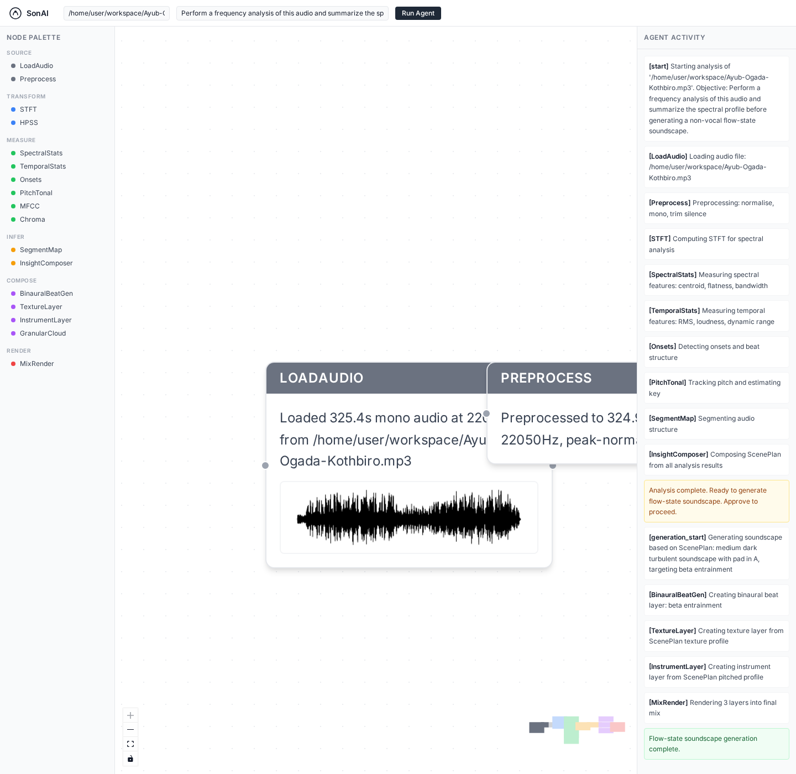
SonAI
Validated demo: analysis to output in one graph
A live run on an uploaded reference track completed the analysis chain, generated a scene plan, and rendered a new WAV file.
Observed output
Input track loaded as 325.4s mono audio at 22050 Hz.
Frequency analysis surfaced a spectral centroid around 881 Hz and a dominant pitch near 110.6 Hz in A major.
The agent completed the graph through MixRender and wrote a real WAV output to disk.
Current state
MVP stack is live with analysis tools, generation tools, agent orchestration, graph UI, and render output validation.
Source: SonAI app · Backend health · Graph API
4

Slide 5
SonAI
Why SonAI can become the workflow layer for intelligent audio creation
The product starts as a power tool for creators and audio R&D teams, then expands into programmable analysis and generation infrastructure.
Wedge
Expansion
Investor thesis
Reference-audio analysis, flow-state generation, and reusable node workflows for creators and wellness audio teams.
API and MCP-native tooling for creative software, agents, and internal audio intelligence pipelines.
Own the interface between understanding sound and generating controlled audio output.
Next conversation
Refine this into a raise-ready version with market sizing, go-to-market milestones, and a funding ask tailored to your stage.
5

