Slide 1
A Dynamic Template Matching Algorithm for the Automatic Extraction of P3 Latencies Sven Lesche¹, Kathrin Sadus¹, Dirk Hagemann¹ ¹ Heidelberg University

Slide 2
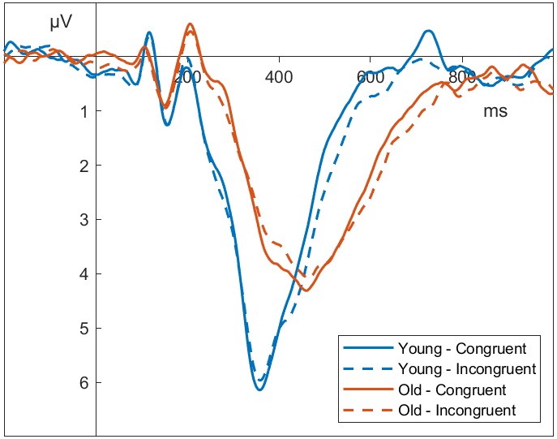
ERP Latencies Flanker Task, P3 at Pz

Slide 3
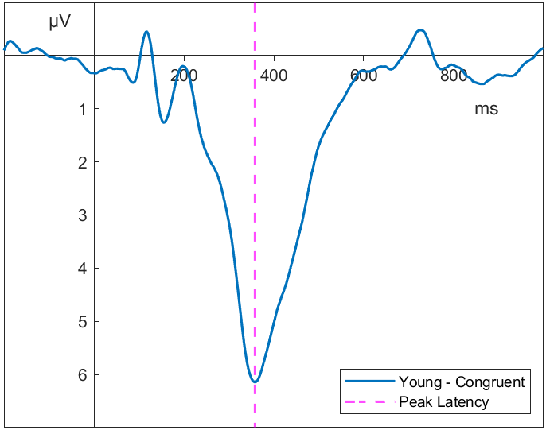
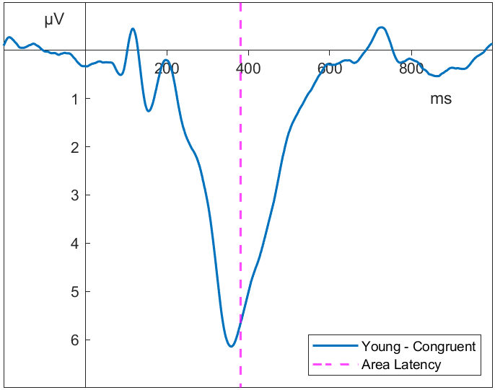
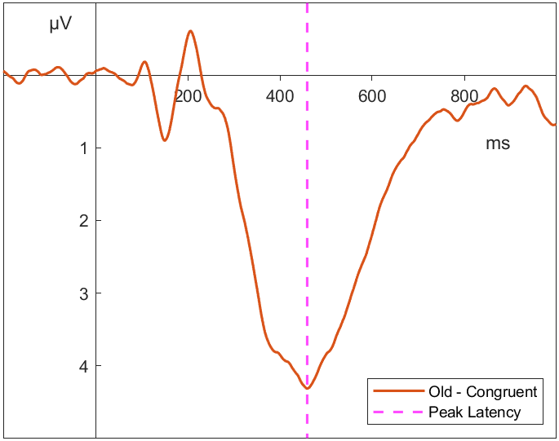
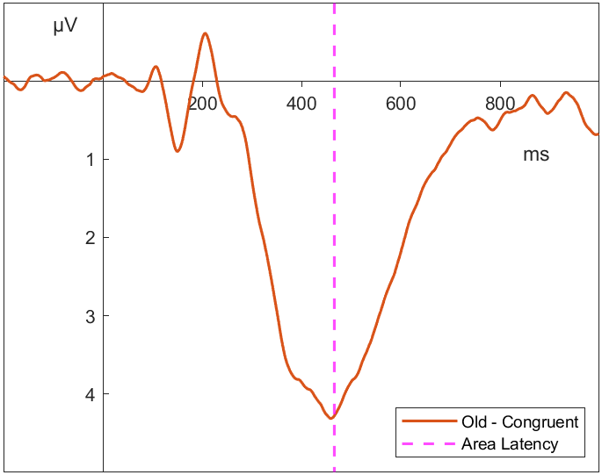
Component Latencies
Peak
Area
Young
Old
Notes:
But how do you test for experimental effects?
Or get individual differences estimates?

Slide 4
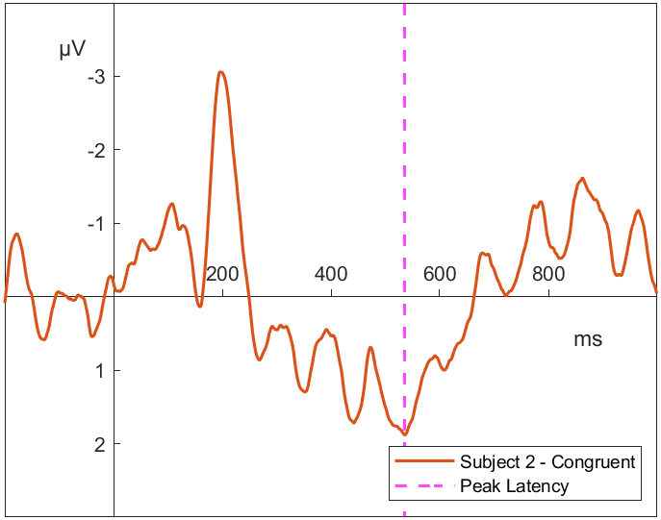
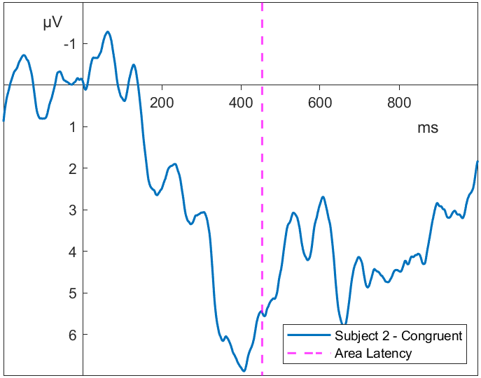
Individual latencies Flanker Task, P3 at Pz
Peak
Area

Slide 5
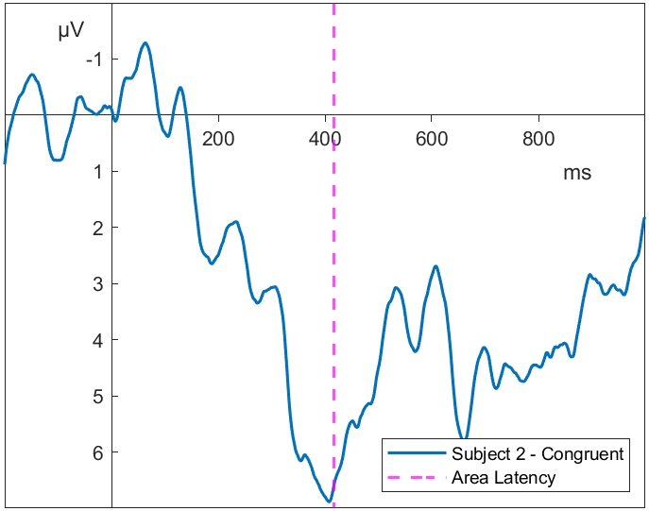
Individual latencies Flanker Task, P3 at Pz
Peak
Area

Slide 6
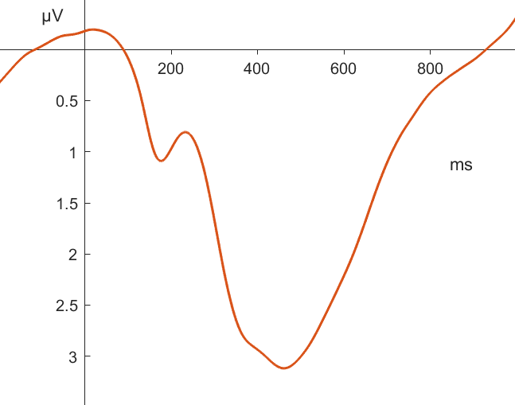
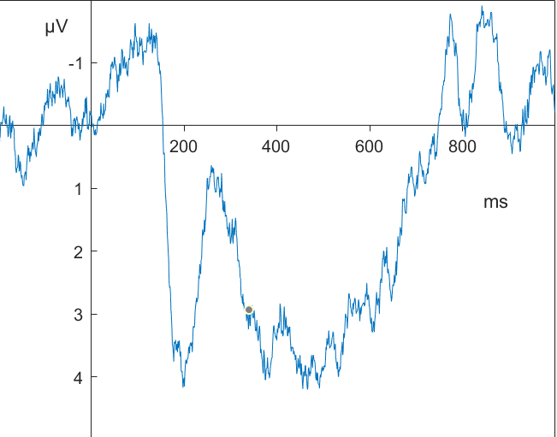
Extracting individual latencies
ERP researchers are best (Sadus et al., 2024)
Humans use additional information
Grand Average
Subject ERP
Notes:
More consistently realiable and valid latency estimates by human researcher
But humans introduce poor objectivity and low efficiency

Slide 7
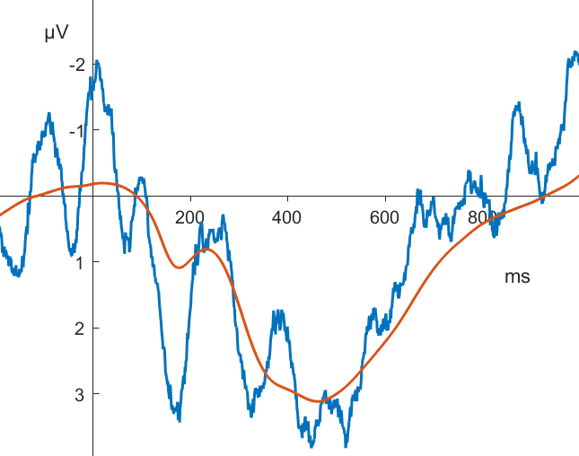
Using the grand average
Use the grand average as a template for the component of interest
Find and maximize similarities between the grand average and the subject‘s ERP
Template Matching
Notes:
Here, add a latency estimate.
Play how the human would do it „Oh well then here must be the latency of the component“
Then Überleitung „lets formalize this“

Slide 8
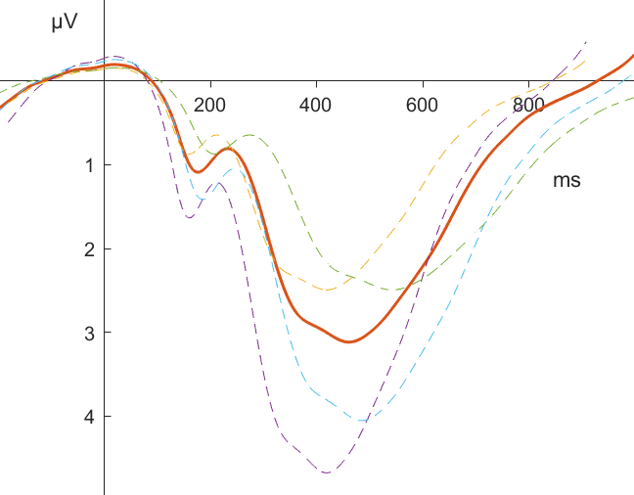
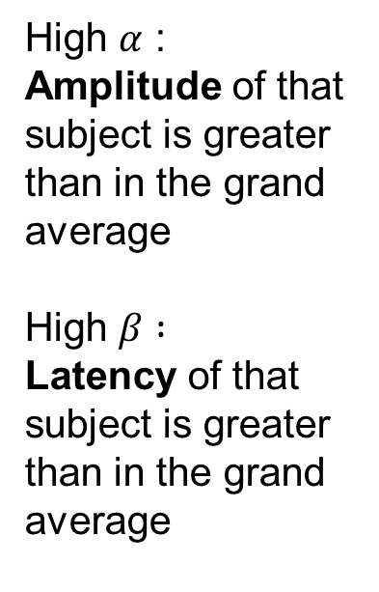


Dynamic Template
High $α$ : Amplitude of that subject is greater than in the grand average
High $β :$
Latency of that subject is greater than in the grand average
$$β$$
$$α$$
Notes:
The stretching and compressing that experts do in their mind

Slide 9
Measuring individual differences
Not all subjects have average latency (and amplitude)
The component of interest may occur later or earlier
This should be reflected in the template
Which transformation of the template fits that particular subject best?
latency
amplitude

Slide 10

Recovering latencies
For a set of optimal parameters $\left[α, β\right]$ and a grand average latency $l_{GA},$
the latency of subject j is $l_{j}=l_{GA}⋅β$

Slide 11
What is the optimal fit? similarity measures
Distance-based (MINSQ):
Minimizes the (weighted) squared distance between template and signal
Correlation-based (MAXCOR):
Maximizes the (weighted) correlation between template and signal
Which transformation of the template maximizes the correlation with the subject‘s ERP?
Brunelli et al. (2009); Mahalakshmi et al. (2012)
Notes:
Gewichtungsfunktionen: Unterschiede nicht

Slide 12
Weighting
irrelevant
important
Not all parts of the signal are of equal importance!
Notes:
Gewichtungsfunktionen: Unterschiede nicht

Slide 13
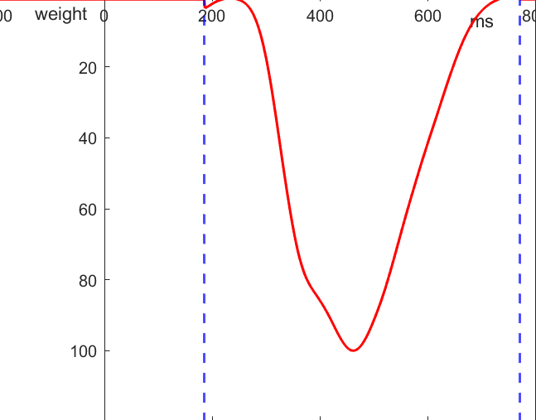
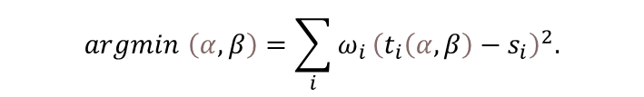
Template Matching Process
$$argmin \left(α,β\right)=\sum_{i}{ω_{i}}{\left(t_{i}\left(α,β\right)−s_{i}\right)}^{2}.$$

Slide 14
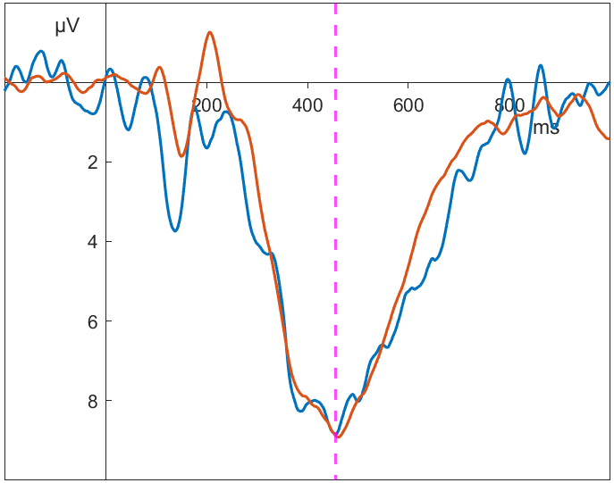
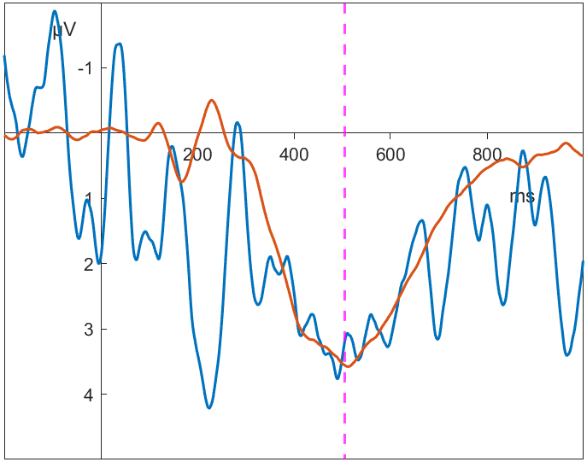
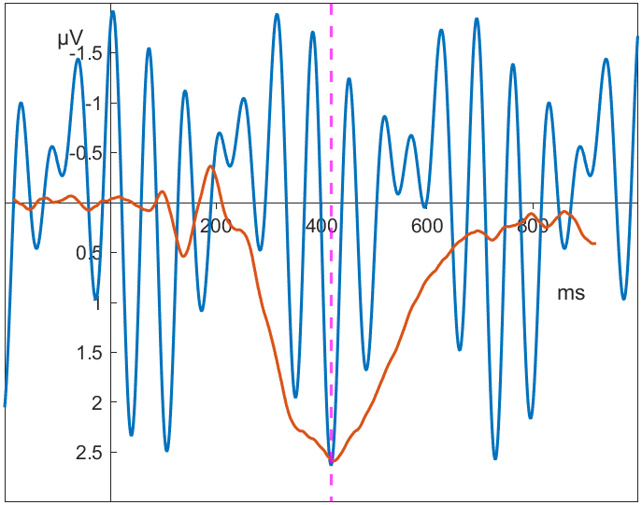
Optimization and fit statistic
Similarity measures can be used as a fit-statistic
High correlation between template and signal -> good fit
Low correlation between template and signal -> bad fit, questionable recovery of free parameters
Fit-statistic as exclusion criterium or indicator for manual review
r = 0.974
r = 0.795
r = 0.270
Notes:
Hier noch Beispiele für PuG

Slide 15
Validation
Based on data from Sadus et al. (2024)
Multiverse study:
3 different tasks (Flanker, Nback, Switching)
5 different low-pass filters (4 Hz, 8 Hz, 16 Hz, 32 Hz, no filter)
Application of peak latency, area latency, MINSQ und MAXCOR algorithms as well as manual extraction
Is the new template matching approach more reliable and valid than older algorithms?

Slide 16
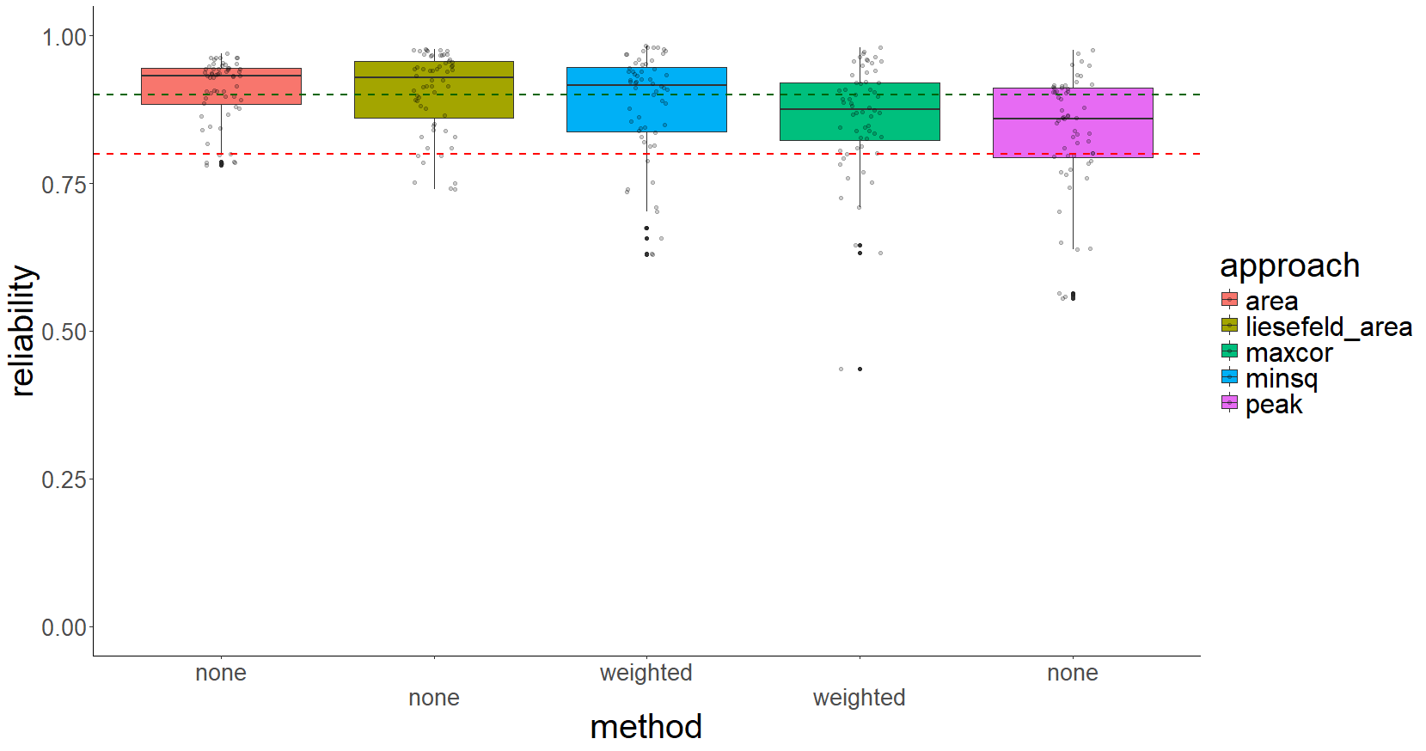
Reliability split-half correlation

Slide 17
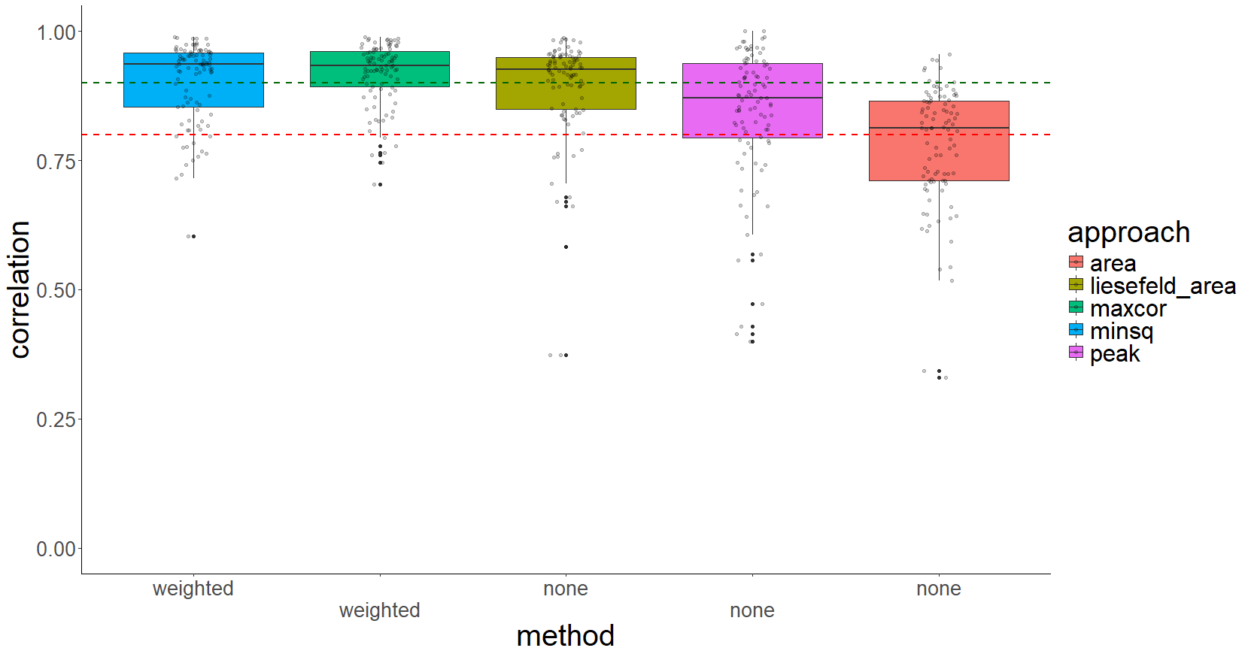
Validity intraclass-correlation with expert rater

Slide 18
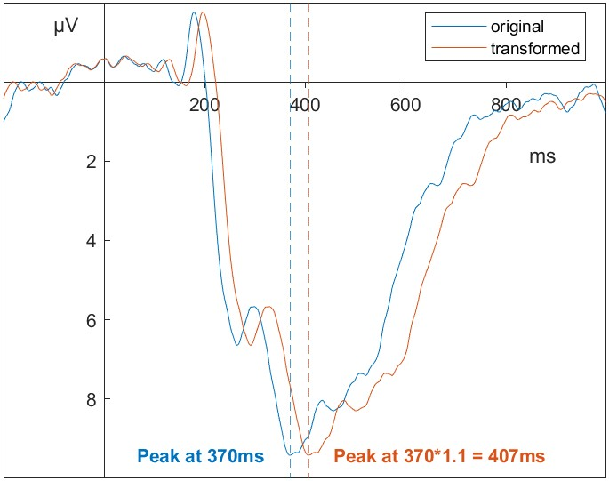
Simulation
Expert raters are not perfect
Better to simulate true experimental effects
Then try and recover those effects using algorithms
Are the template matching algorithms better at recovering simulated latency effects than other algorithms?

Slide 19

Simulation protocol
Draw effect size for a subject from normal distribution
-> to simulate individual differences
Split trials of that subject into control and experimental trials
Simulate latency shift in experimental trials
Measure latency in control and experimental ERPs
Recover estimated latency shift
Average estimated latency shifts per subject
Compute ICC of true latency shift and average estimated latency shift
X 250
Notes:
For this simulation, we used all 150 participants

Slide 20
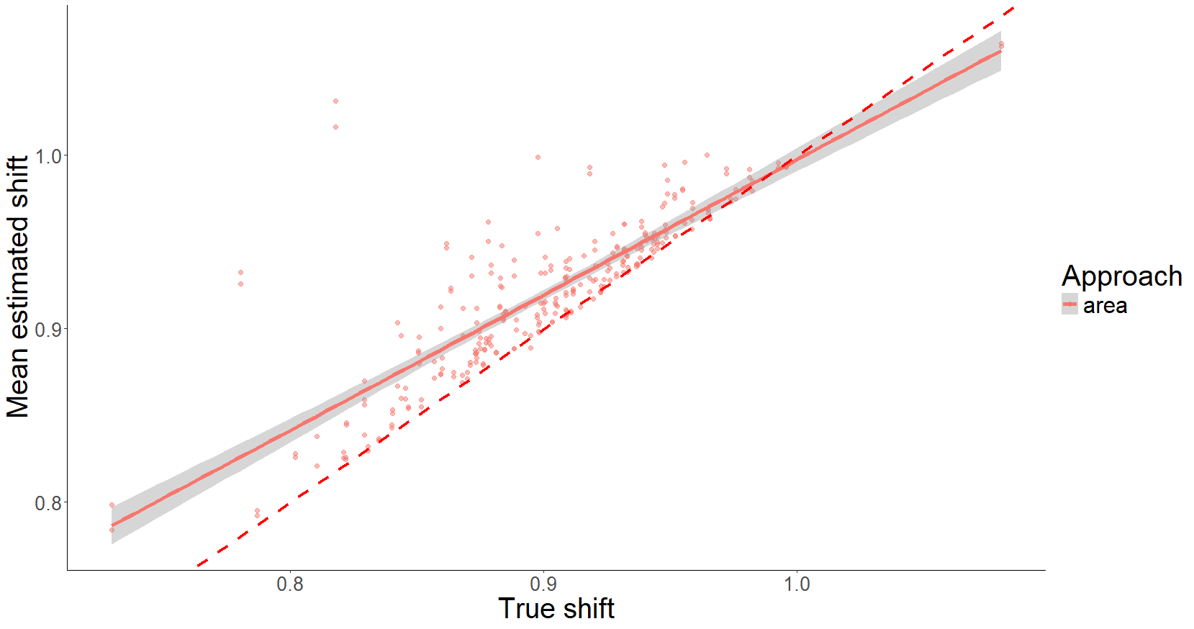
Simulation results

Slide 21
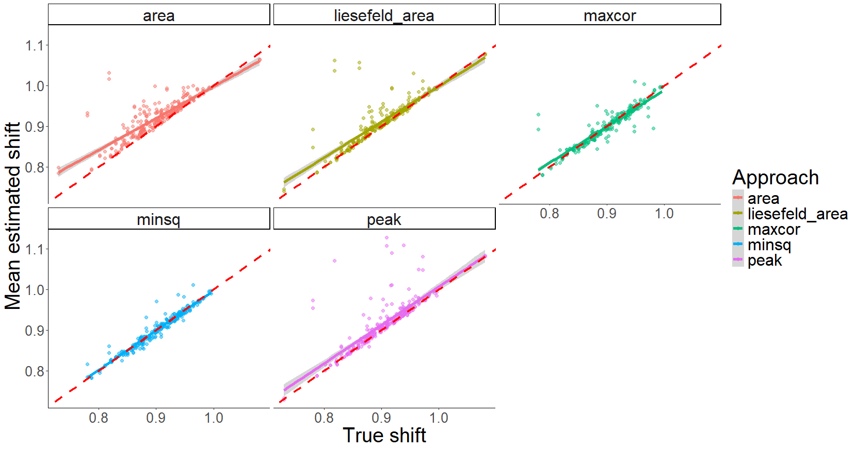
Simulation results

Slide 22
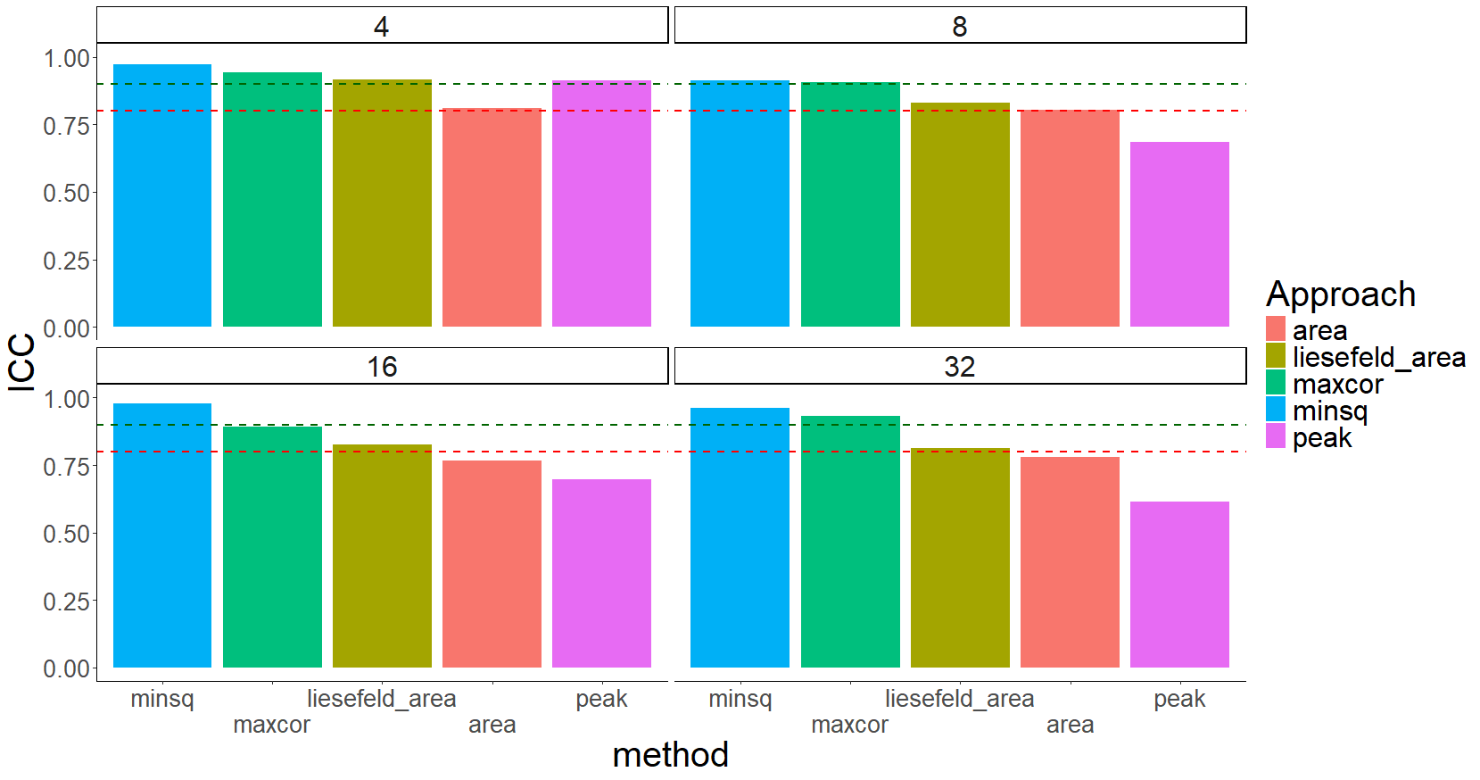
Simulation results
Notes:
MINSQ = 0.95
MAXCOR = 0.93
peak latency = 0.72,
50% area latency = 0.79
modified area latency = 0.84

Slide 23
Conclusion
Worse reliability
Improvements in validity
Low impact of filter settings and tasks
Fit-statistic as an additional benefit
Overall, MINSQ seems to outperform MAXCOR
Notes:
Fractional area latency proposed by Liesefeld (2018) works well across the board
Especially highlight the simulation results
Tabellarische Darstellung hier?

Slide 24
When to apply template matching
Large datasets
Individual latencies are of interest
Testing differences for significance
Getting estimates of between-subject variance
Individual differences research
Enable manual review of the algorithmin only the most „difficult“ cases

Slide 25
Future research
Extend template matching to other components/tasks
Use template matching to recover component amplitudes
Use the fit statistic to integrate template matching and manual review
Make template matching algorithms more accessible (provide defaults, visual interface)

Slide 26
Thank you for your attention and thank you to my collaborators: Prof. Dr. Dirk Hagemann and Kathrin Sadus

Slide 27
References
Brunelli, R. (2009). Template matching techniques in computer vision: Theory and practice. John Wiley & Sons.
Kiesel, A., Miller, J., Jolicœur, P., & Brisson, B. (2008). Measurement of ERP latency differences: A comparison of single-participant and jackknife-based scoring methods. Psychophysiology, 45(2), 250–274.
Liesefeld, H. R. (2018). Estimating the timing of cognitive operations with MEG/EEG latency measures: A primer, a brief tutorial, and an implementation of various methods. Frontiers in Neuroscience, 12, 765.
Luck, S. J. (2014). An introduction to the event-related potential technique. MIT press.
Mahalakshmi, T., Muthaiah, R., & Swaminathan, P. (2012). Image processing. Research Journal of Applied Sciences, Engineering and Technology, 4(24), 5469–5473.
Sadus, K., Schubert, A.-L., Löffler, C., & Hagemann, D. (2024). An explorative multiverse study for extracting differences in P3 latencies between young and old adults. Psychophysiology, 61(2), e14459.
Schubert, A.-L., Löffler, C., Hagemann, D., & Sadus, K. (2023). How robust is the relationship between neural processing speed and cognitive abilities? Psychophysiology, 60(2), e14165.

Slide 28
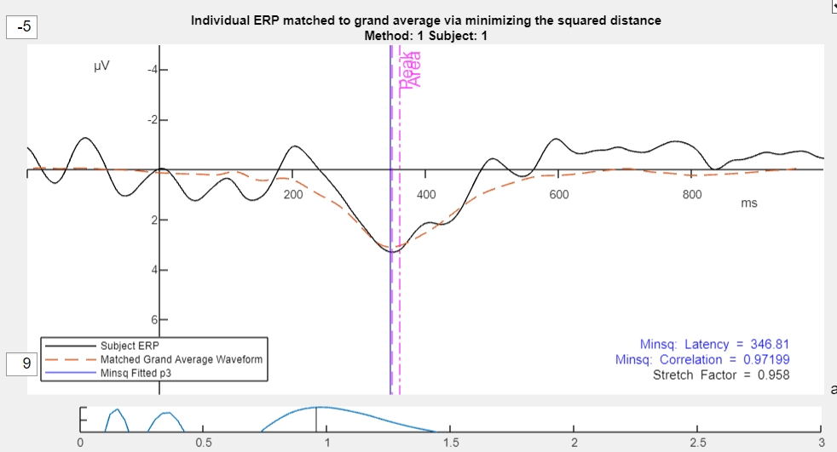
Beispiele (P3 – Pz): MINSQ

Slide 29
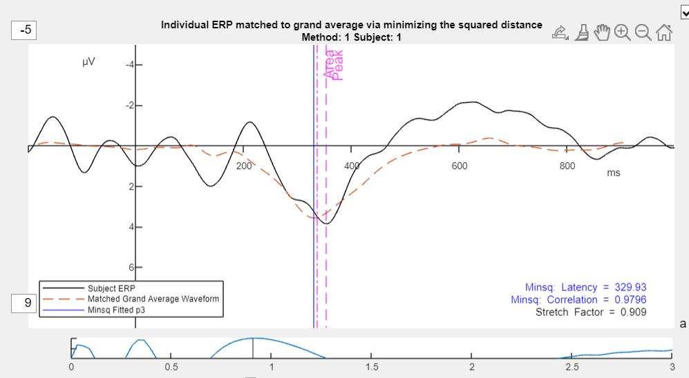
Beispiele (P3 – Pz): MINSQ

Slide 30
Extra Folien
Hier Beispiel-Matches, Volle Ergebnistabellen, Effektstärken, Gewichtungsfunktionen, Similarity measures - Funktionen, Fit-Statistik-Histogramme

Slide 31
Alte Folien

Slide 32
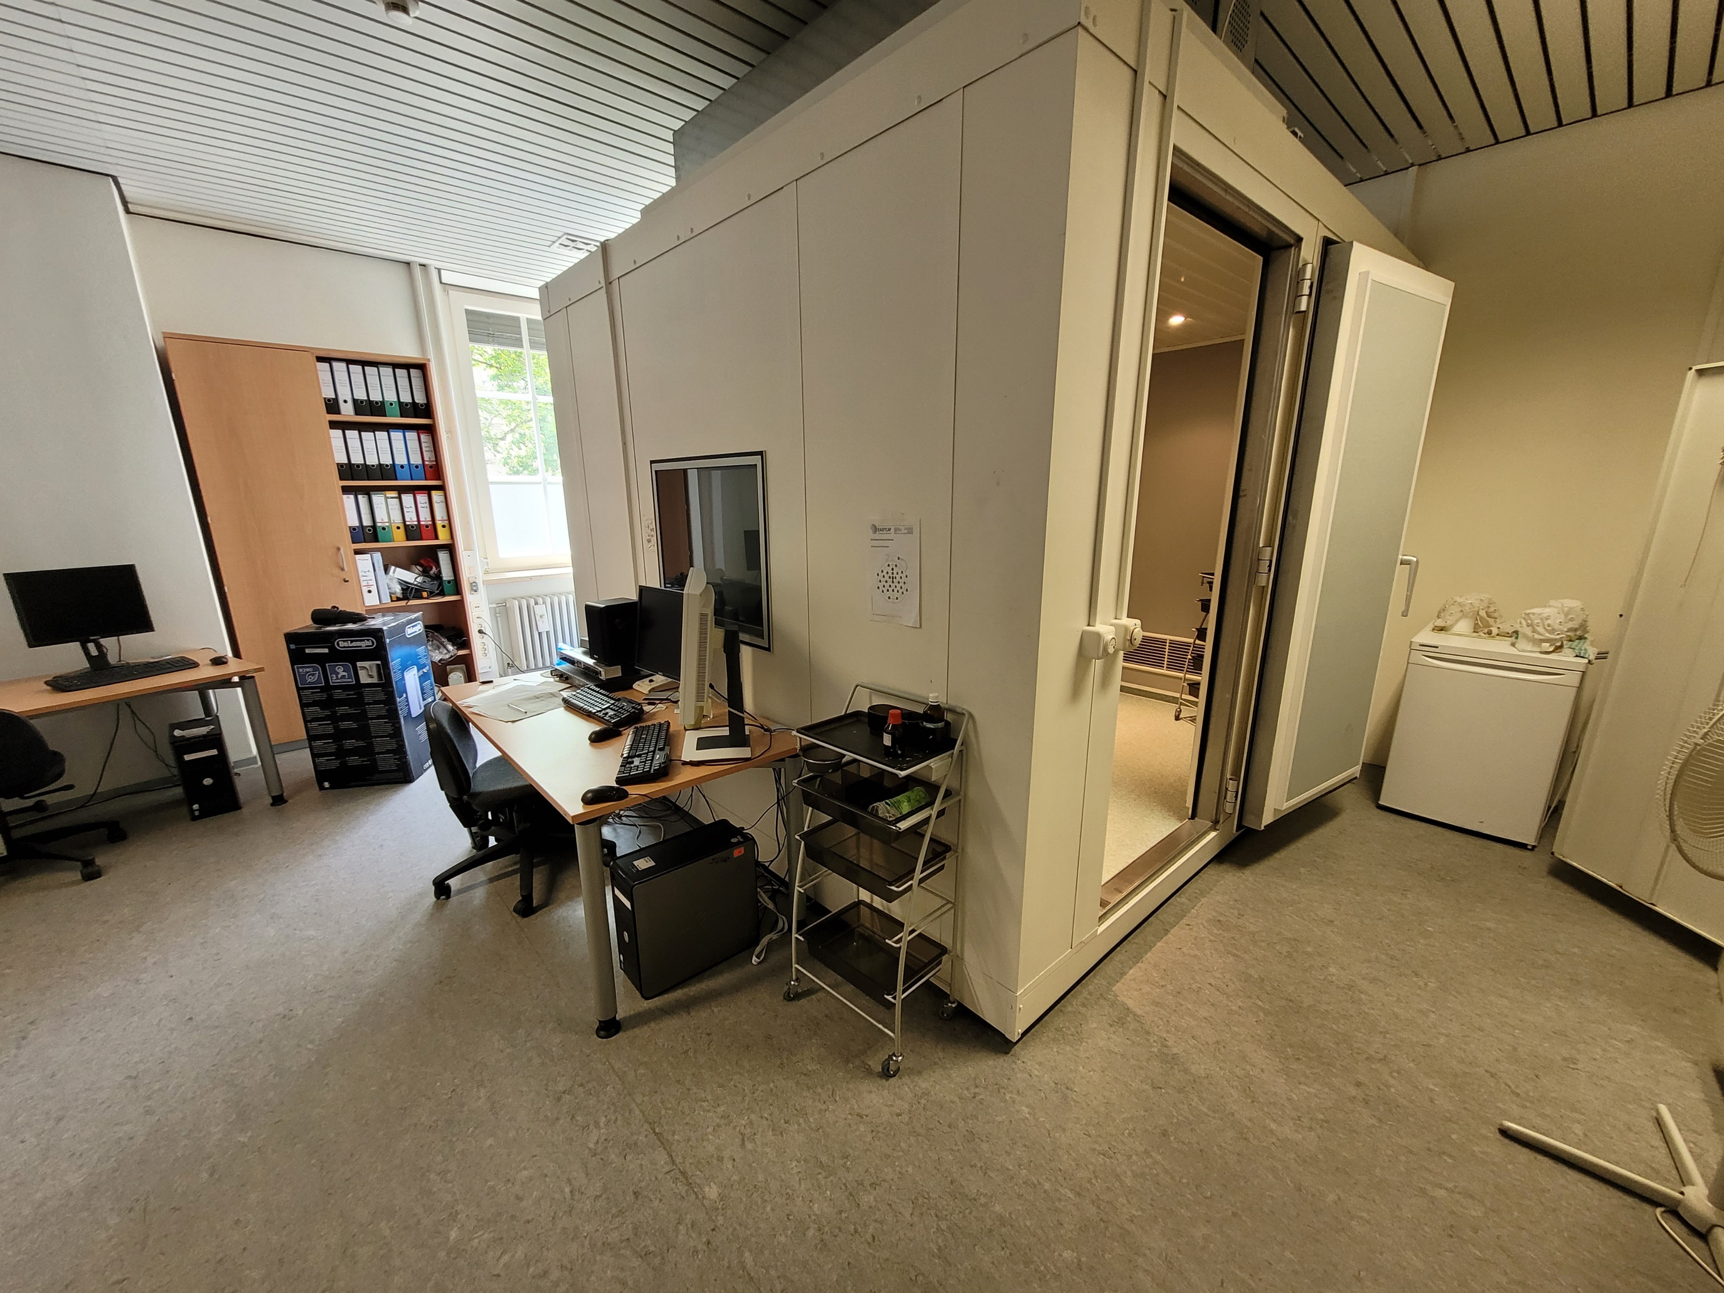
Heidelberg

Slide 33
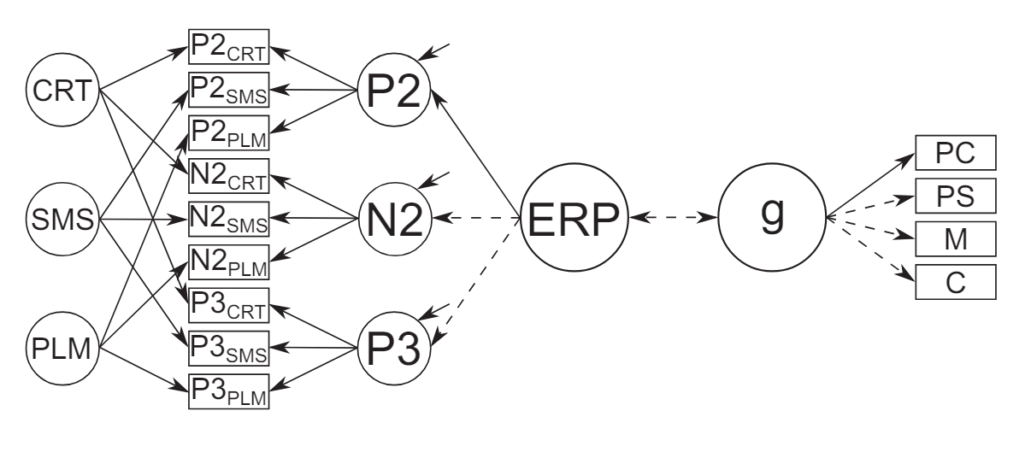
Individual differences in intelligence
Schubert et al. (2023)

Slide 34
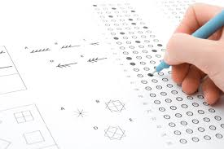
Individuelle Unterschiede in Intelligenz
Schubert et al. (2023)
Notes:
https://psychotherapie-potsdam-kinder.de/intelligenztests-fuer-kinder-und-hochbegabung/

Slide 35
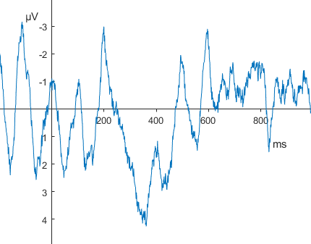
Individuelle Unterschiede in Intelligenz
Schubert et al. (2023)
Notes:
Idealerweise würde man hier einfach einen Algorithmus benutzen

Slide 36
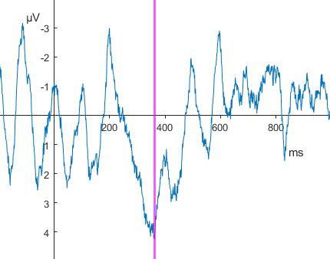
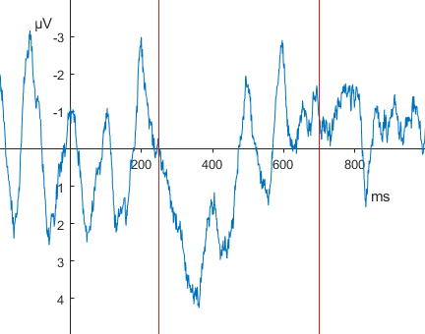
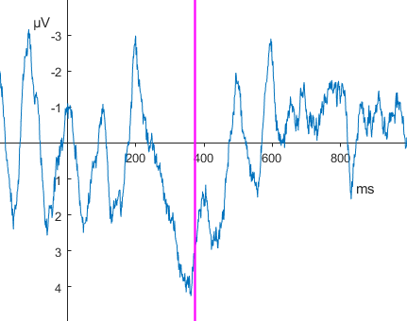
Algorithmen
Peak Latency
Area Latency
Notes:
P3, Pz

Slide 37
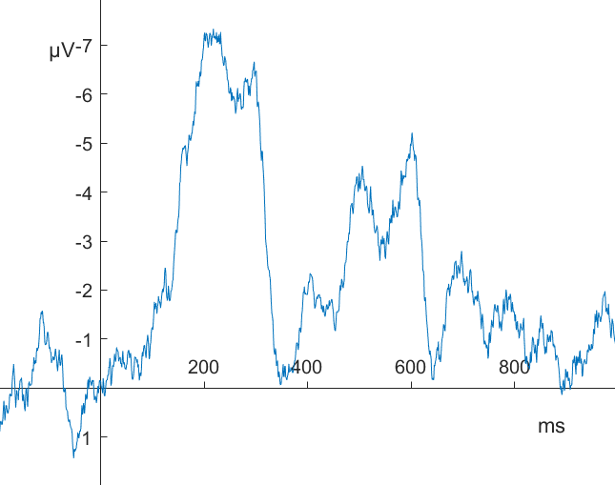
Probleme (Luck, 2014)
Schlechte recovery von simulierten Experimentaleffekten (Kiesel et al., 2008)
Niedrige Reliabilitäten, Validität (Sadus et al. 2024; Schubert et al. 2023)
Notes:
Wahl des Messzeitfensters
Superimpositionsproblem
Hoch-frequentes Rauschen
Peaks != Components
Und vieles mehr (latency jitter, biased noise levels, non-linearität, peaks ~ medians)

Slide 38

Die (traurige) Wahrheit
Menschen können Latenzen besser extrahieren als Algorithmen (Sadus et al. 2024)
150 Versuchspersonen X 3 Aufgaben

Slide 39

Die (traurige) Wahrheit
Menschen können Latenzen besser extrahieren als Algorithmen (Sadus et al. 2024)
150 Versuchspersonen X 3 Aufgaben X 2 Bedingungen X odd-even-splits

Slide 40

Die (traurige) Wahrheit
Menschen können Latenzen besser extrahieren als Algorithmen (Sadus et al. 2024)
150 Versuchspersonen X 3 Aufgaben X 2 Bedingungen X odd-even-splits X 5 Filter-Settings X 2 Messmethoden

