Slide 1
শিখন (Shikhon)
A developing kids’ learning platform.

Slide 2
CSE499a (partial completion report of the platform)
Group: TBA
Sec: 14
Faculty: Md. Shahriar Karim (MSK1)

Slide 3
Jarif al nayem 1721487 Md. Maruf saklain lingkon 1721081 Md. Niaz mahmud shihab 1721274 tasmiah morol nilima 1620148

Slide 4
Initial goal and changes

Slide 5
Initial goals behind the platform
A programming platform for kids.
Made with Scratch programming language.
Having a working community section where users can share their work. (Requires Further Development)
Native Bangla environment for convenience.
Custom sprites and games for attracting kids from Bangladesh.
Make the scratch integration developed enough so it gets the continuous updates from main pipeline.
Offer an offline client so users with low speed internet connection can create and save their projects without any network connection hassle.
Making the site cross platformed (Android, IOS, WEB etc.) (Requires Further Development)

Slide 6
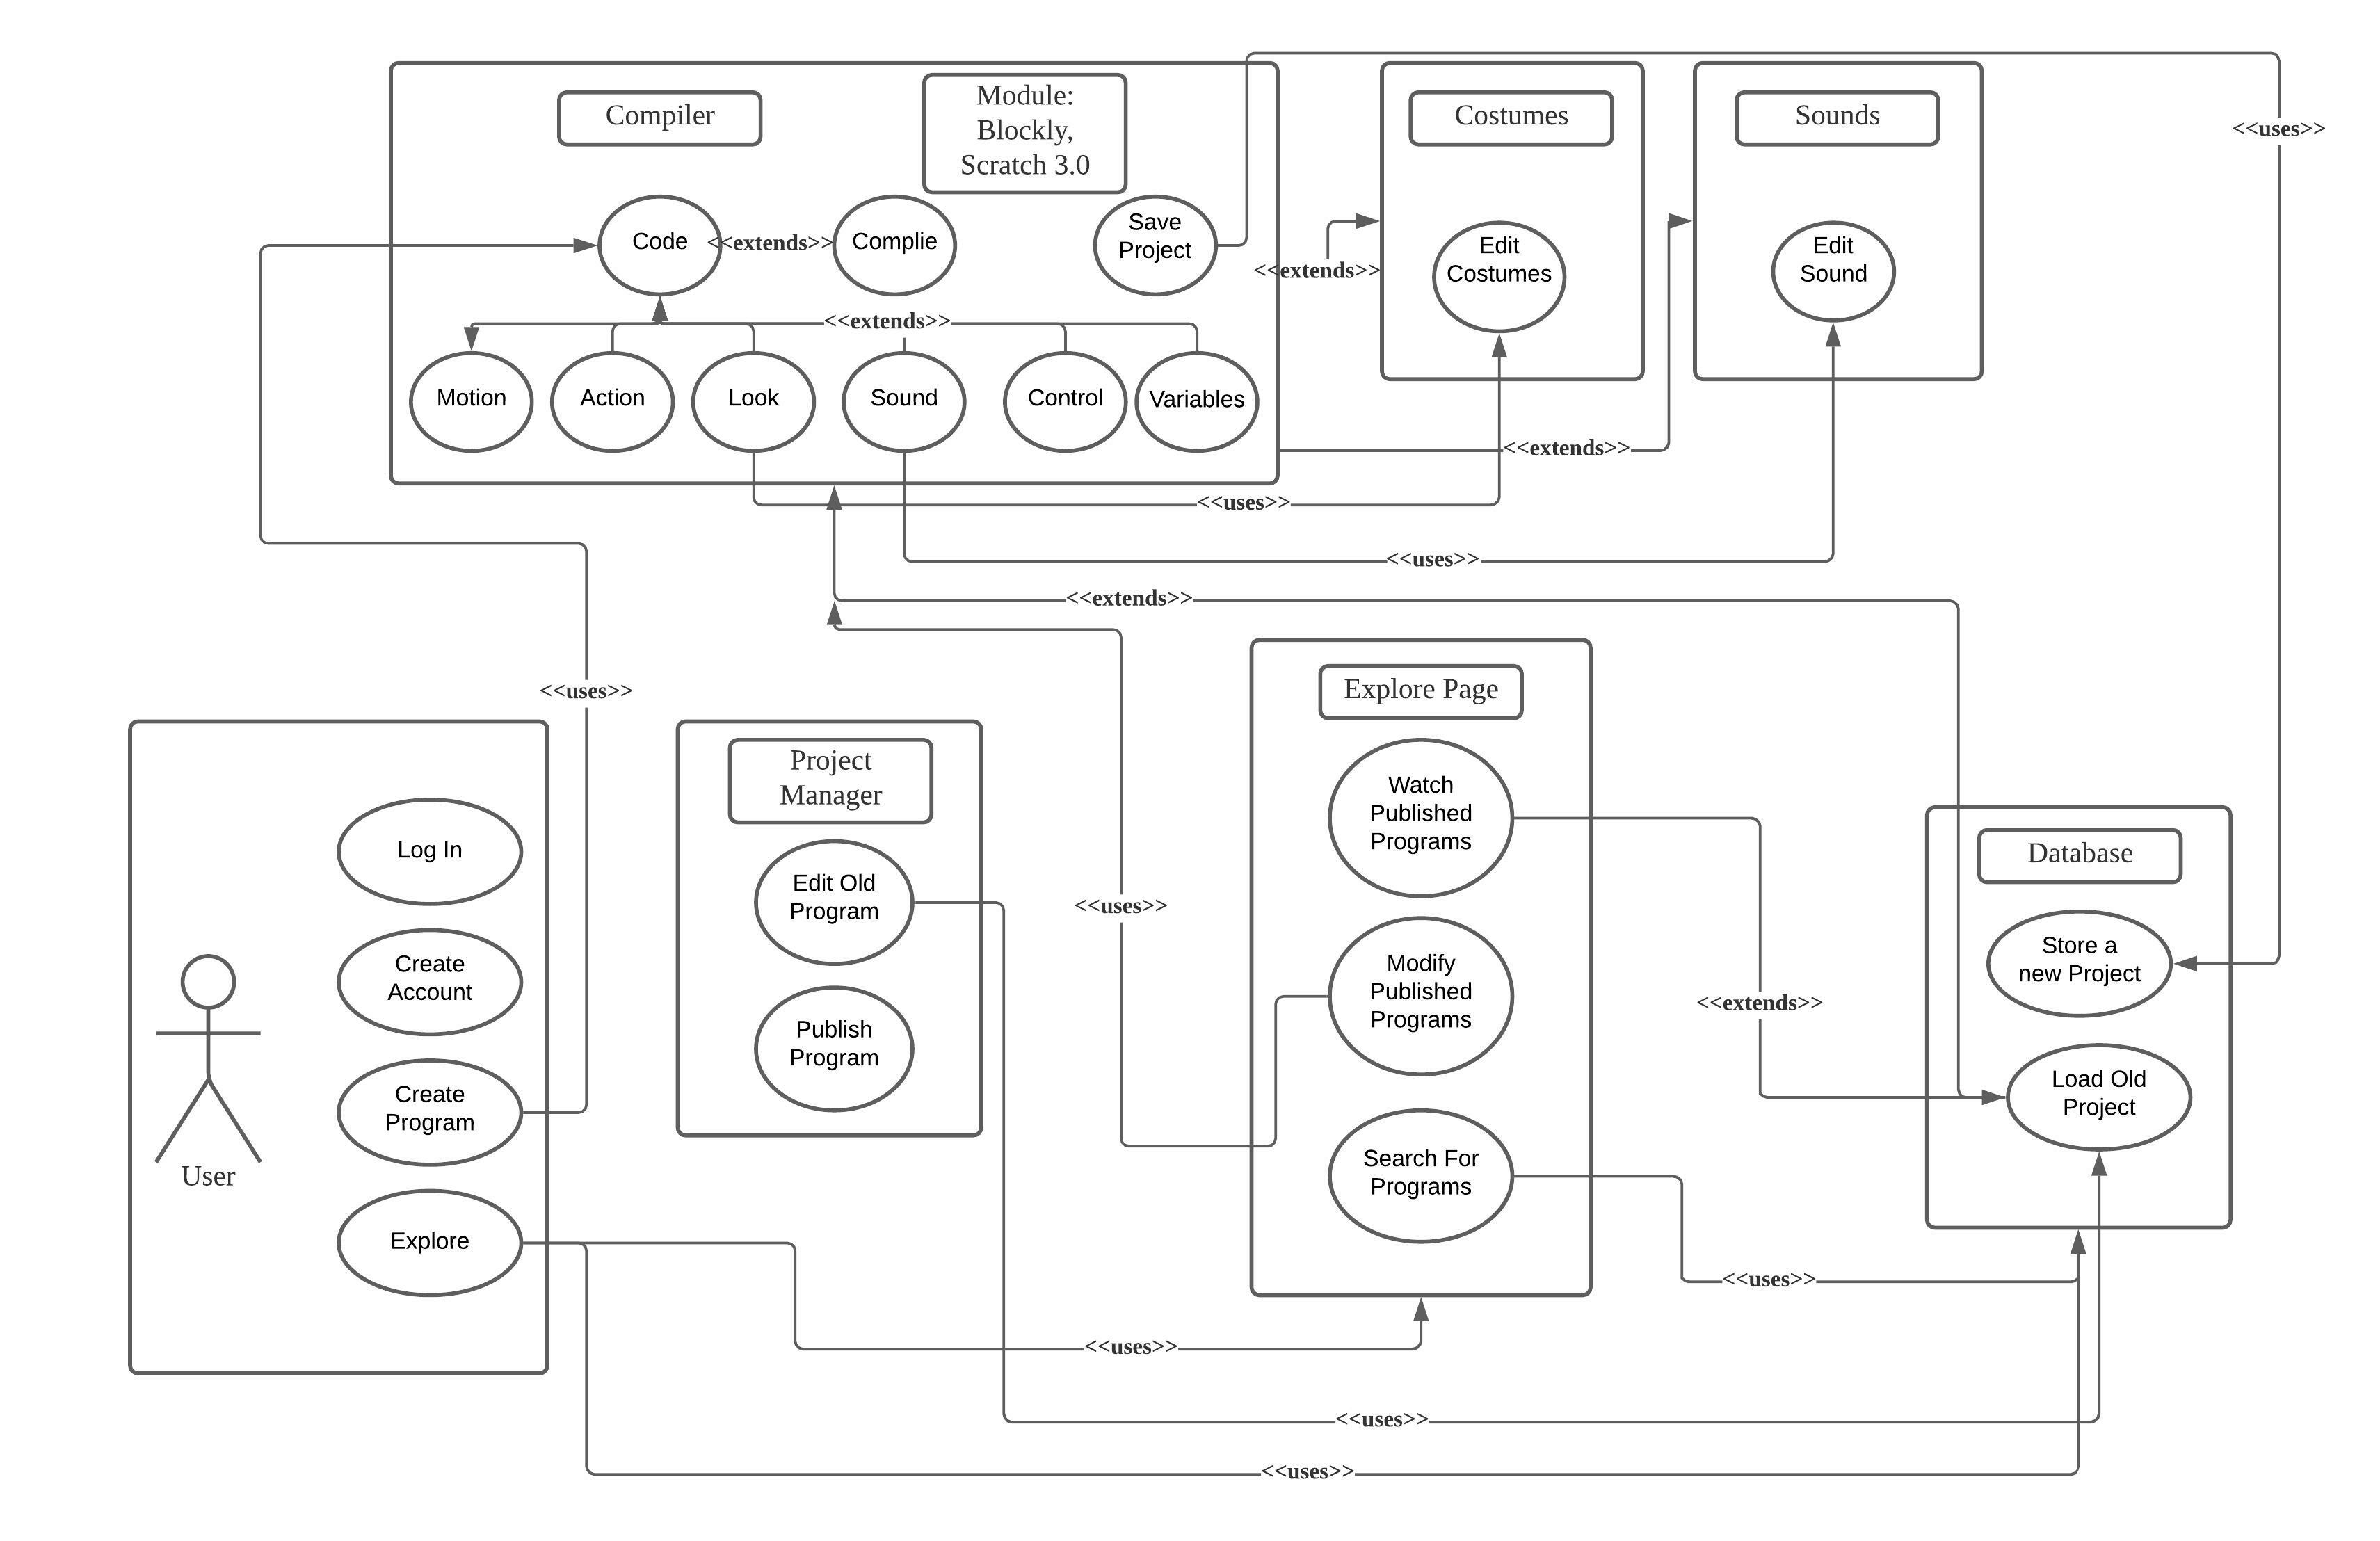
Initial block diagram

Slide 7
Changes and addition
Adding a section for scientific experiment simulation. (Requires Further Development)
Having some pre-made games and animations for grabbing the attention.
Making the simulation part with the same code base as the programming language section. (Requires Further Development)
Adding a parents and teachers section. (Requires Further Development)
Rather than manually translating the blocks of the compilers, using the latest update which include the automatic Unicode translation.

Slide 8
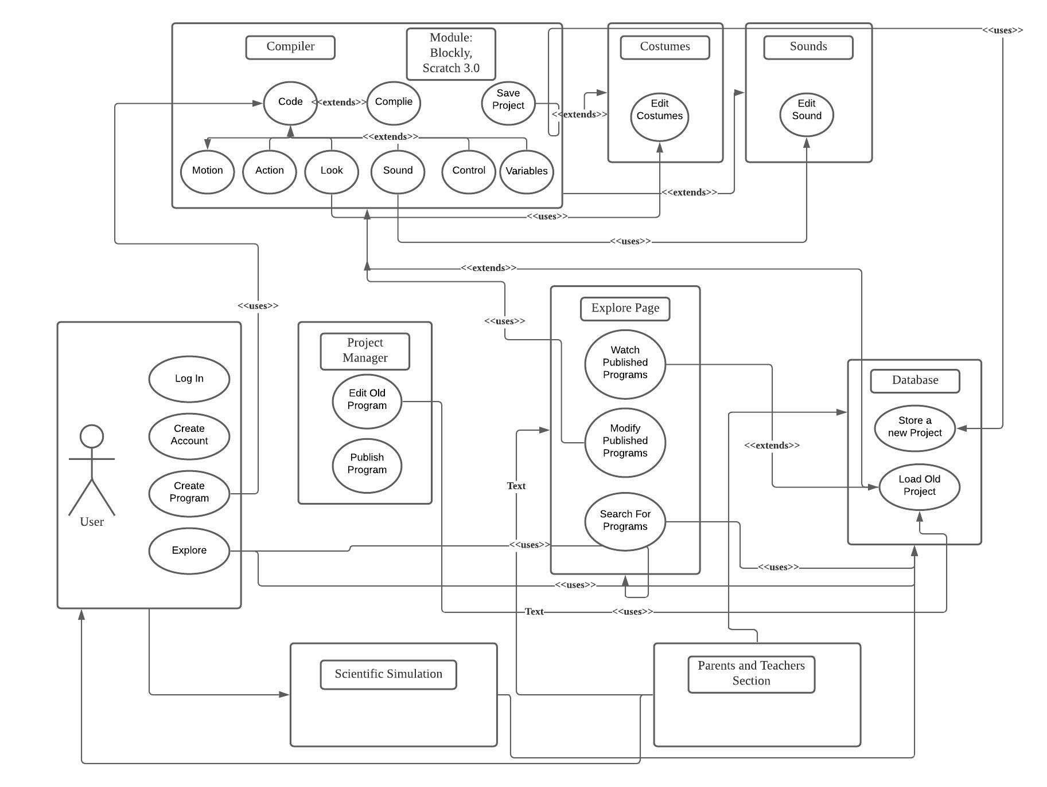














Current block diagram

Slide 9
Things we have done so far

Slide 10
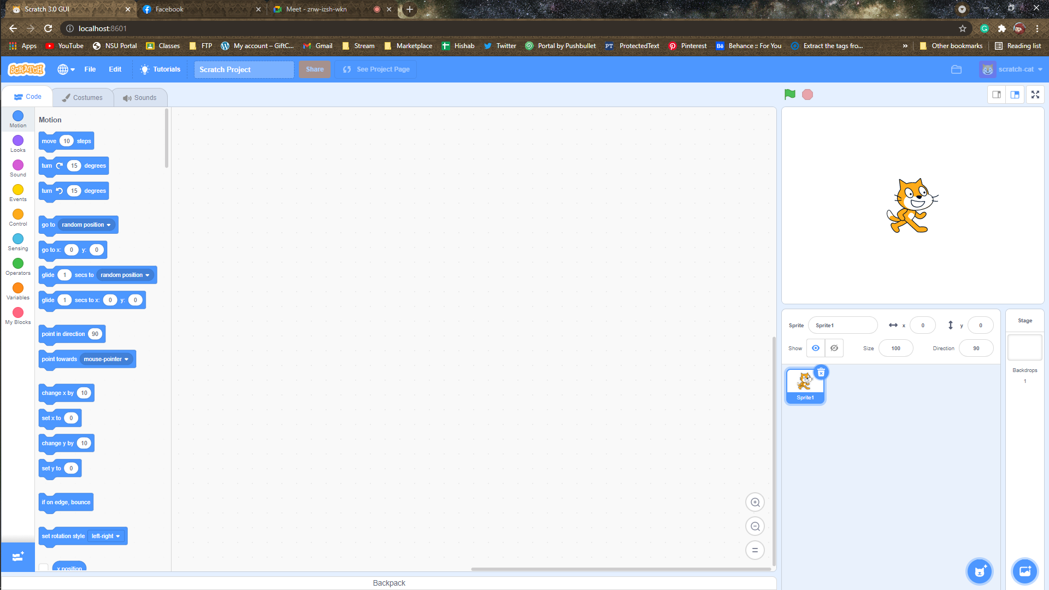
Working Compiler for block-based coding (Scratch 3.0)

Slide 11
Working Compiler for block-based coding (Scratch 3.0 Engine)
Finding the right open source code base of Scratch on which we can develop on further.
Making NODE.JS integration to our other parts of the project as the source code requires NODE.JS to run.
Accessing the dynamic update stream from the scratch update pipeline to make the compiler always up to date.
Connecting all the source codes under SCRATCH GUI using JavaScript so that all kinds of programs are able to run.
Making the compiler fluid enough to load instantly with other traditional HTML and CSS based structure of the platform.

Slide 12
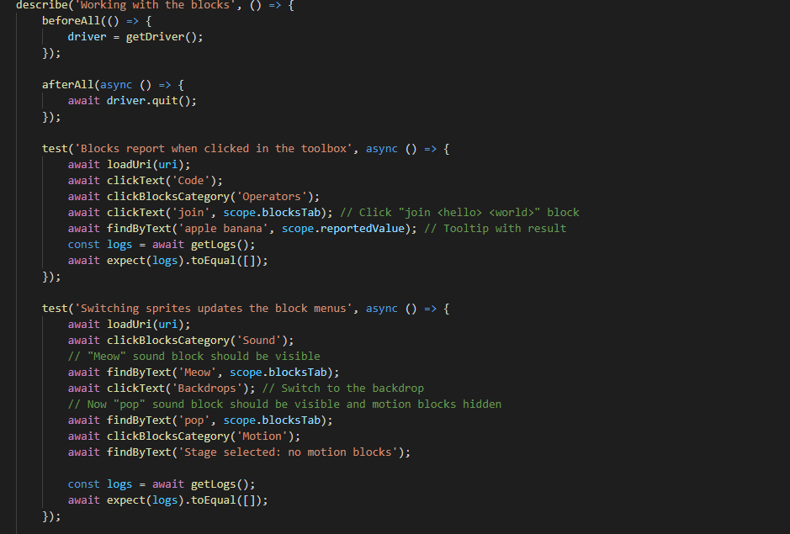
Working Compiler for block-based coding (Scratch 3.0)

Slide 13
Structure around the compiler
Two major part of the project,
Compiler for the Scratch projects.
Simulation tools for science experiments
All other features will be built around these two area.
We’ve created a homepage to give us the introduction to the platform.
We’ve linked the compiler successfully to the other parts of the project.
Environment where compiler tools can be accessed from the front page.
Integrating scratch engine to the homepage to show some pre-made games and animations.
Option to download the offline client with instructions. This is for running scratch project without any internet connection.

Slide 14
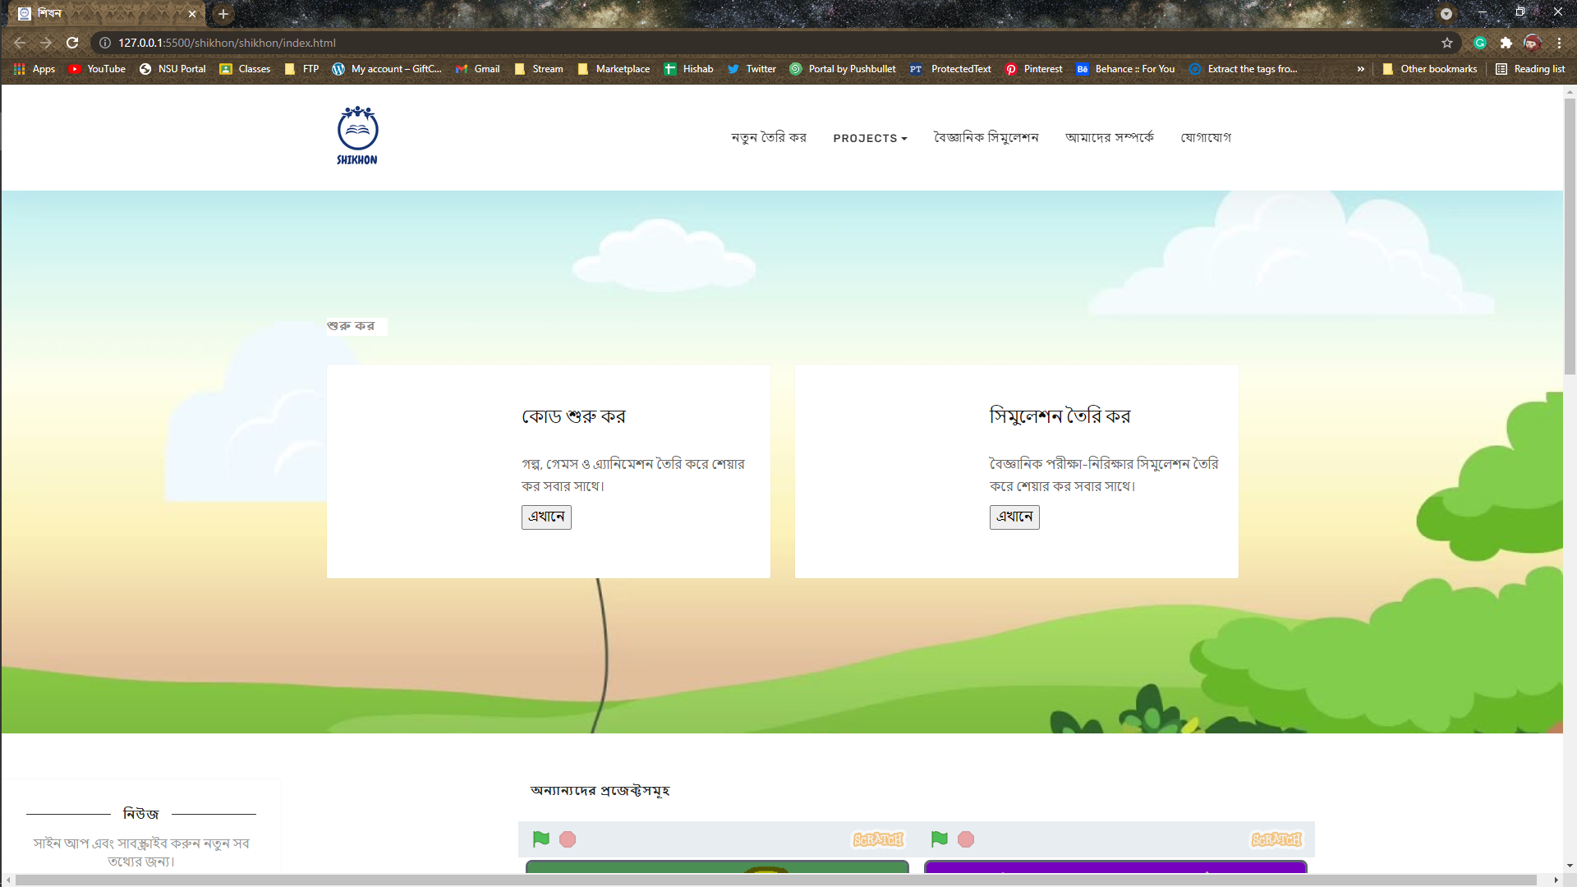
Structure around the compiler

Slide 15
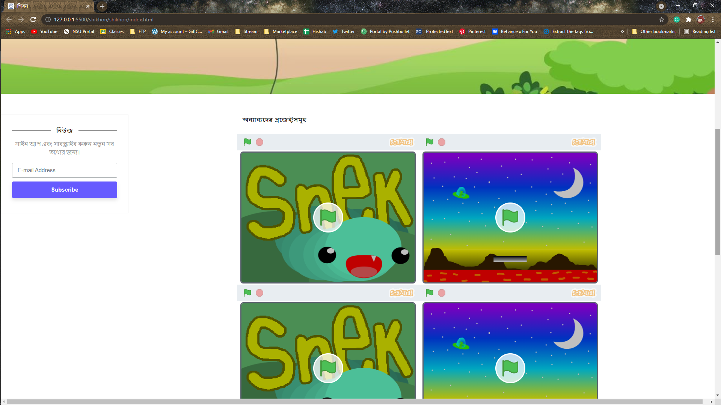
Structure around the compiler

Slide 16
Thank you

