Slide 1
Team Grant’s Calendar
A calendar web-app written in Flask, Python, and JQuery

Slide 2
Overview

Slide 3
High Level
Server (Flask/Python)
The Flask framework acts as a server, managing and maintaining a Calendar object across uses and requests from the client side.
The client is provided information from the calendar object and a means of requesting different days or views.
The client sends out JSON-like data in a POST request, and the server responds with either an acknowledgement (OK/BAD) or a link to another page.
Calls are made using AJAX, with JSON in place of XML. This allows the user to continue to interact with the client-side while waiting on the server to respond.
JSON
HTML
JSON
Client
(HTML/JQuery)

Slide 4
Server-side Detail
Server (Flask/Python)
A logfile holds a day-by-day representation of details.
The logfile is used to populate a Calendar object, which is used for the life of the server running.
Approved changes are updated to the logfile as they come in from client-side
Each ‘view’ has its own HTML template which is populated and rendered by the server based on the focus day and client input.
Signed cookies are used to authenticate a user, and are maintained by Flask between requests to the server.
View:day
HTML with
detail
Client
(HTML/JQuery)

Slide 5
Client-side Detail
Server (Flask/Python)
The client-side is served HTML and the appropriate information for the view selected.
A local copy of the data is injected into each page’s script section, which is then available for use in outgoing requests.
For example, the day view passes along the current day, month, year, and details.
The JQuery and javascript embedded in the HTML can then use these details to tell the server what day any new details belong to.
New
Detail
JSON Ack
Client
(HTML/JQuery)

Slide 6
Division of Labor

Slide 7
Grant:
Calendar object, Logfile interaction
Stephen L. :
Server-side framework, communication between server and client, authentication
Stephen W:
HTML/JQuery Templates, Client-side code and behavior

Slide 8
Challenges, Successes & Shortcomings

Slide 9
Challenges
Grant - Frustrations with object oriented approach and calculating week lists. Also, unfamiliarity with Python, and especially Flask.
Stephen L. - I barely knew how Flask worked. The hardest part was that there wasn’t much feedback if something failed in the underlying framework. I had to build in a lot of feedback for myself.
Stephen W. - HTML, CSS, and JQuery are pretty rough to be productive with.

Slide 10
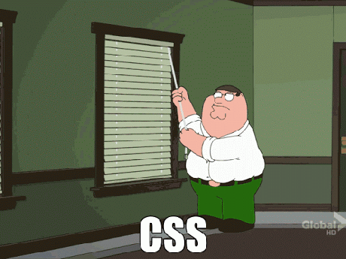
The Good
The Bad
The Ugly
Using a server with a login is easily extensible to multiple users, provided we use a database in place of the logfile.
Flask makes it easy to add new views, behaviors, and features once the initial setup work is done
In retrospect, using a server/client was a bit overboard for the given requirements.
We kind of underestimated how much work was required to get a working product.
Our presentation layer. We are not web developers and it shows.

Slide 11
Moving Forward

Slide 12
Future Features
We want to spend more time making the client side look better. We got stalled getting it functional and ran out of time.
Multiple users would have been great to implement, and would be the logical next step given our single-user login.
The setup we have lends itself well to android/itunes clients. It would be interesting to explore how to do that and how to manage mobile authentication.

