Slide 1
The Plan
We are going to build a Weather Console! The app will get local weather info and a radar image, and display them on the screen.
We will build different parts separately, and put them all together at the end to make our app.
I’ve prepared the skeleton of our app, and once we’re done learning the basics, you fill in the blanks to get it going. Don’t fret if you get stuck or fall behind, I have completed code ready in each part so everyone can finish.

Slide 2
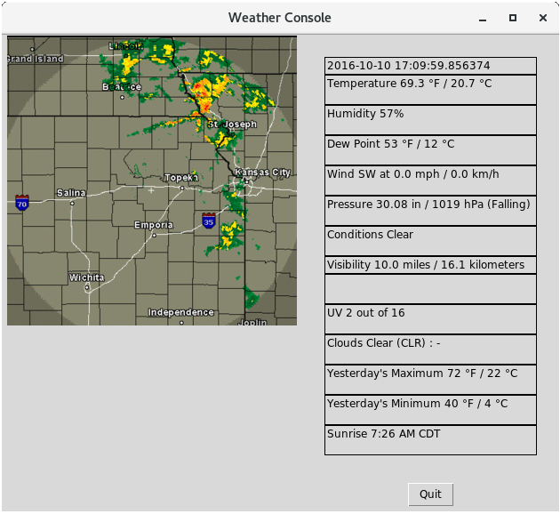
The Project
Trickier than you might think!

Slide 3
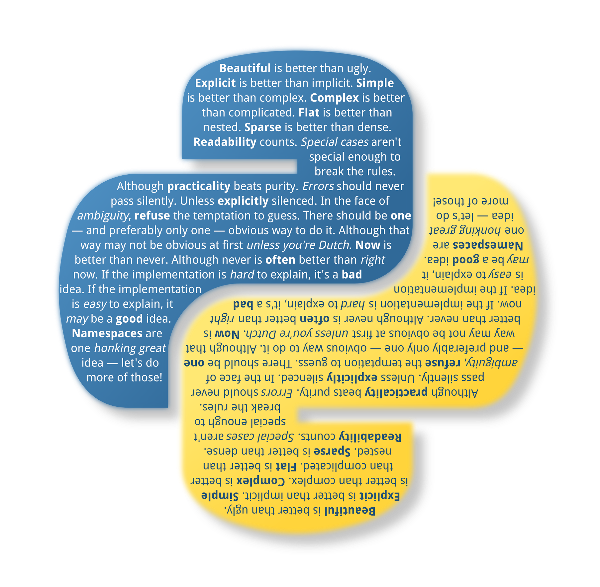
How to Python
Motto: someone else has already done the hard part

Slide 4
Important Python Notes
Python is different than other programming languages in that it is a scripting language. Each file you create is a separate script, which is compiled as you go.
For our purposes, this is important because any errors may not show up until you reach the section of code where the error is. Try to test your code as you go.
For today, I’d recommend NOT using IDLE. This will ensure you understand how your scripts interact with the OS. However, if you need to quickly test something out in the future, IDLE is a great place to experiment.

Slide 5
Python Overview
Concepts to cover:
Variables & Data Types
Conditionals
Loops
Methods
Imports
Classes
File Manipulation

Slide 6
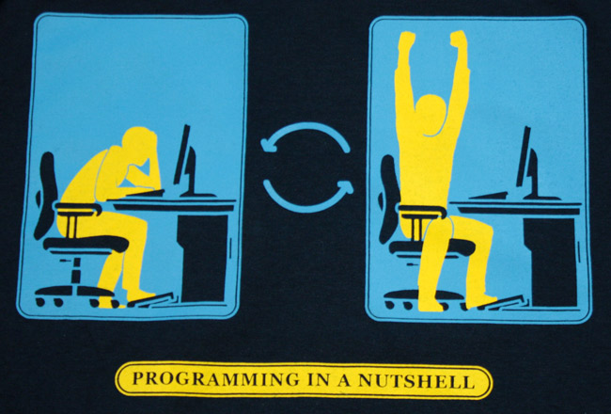
A Few Tips
To avoid falling into a deep pit of despair, try to stay in the habit of writing little tests for everything you write.
There is nothing worse than coding for an hour, running your program, and then spending the next hour trying to figure out what isn’t working.
In general, if you can test it, you should.
(use print!)
© Ian McConville

Slide 7
Variables & Data Types
Variables hold information that may change
Python doesn’t require you to declare a data type, it figures it out on its own
You may want to declare it anyway, to avoid any confusion when doing something tricky
Ex.
myInt = 5
myString = “Hello World”
DefinitelyAString = str(myString)

Slide 8
Variables & Data Types. . .
Besides integers and strings, we will make use of lists, floats, and dictionaries.
Ex.
float: PI = 3.14
list: myFavFoods = [ ]
myFavFoods.append(“Pizza”)

Slide 9
Variables & Data Types. . .
Python allows conversion between certain data types.
myInt = 5
print “The value is: “ + str(myInt)
→ The value is: 5
print float(myInt)
→ 5.0

Slide 10
Variables & Data Types. . .
Other basic types:
MyBoolean = True
Print (myBoolean and False)
→ False
MyDictionary = { }
MyDictionary[‘key’] = 2
Print MyDictionary[‘key’]
→ 2

Slide 11
Conditionals & Loops
Python uses conditionals to make a logical decision
Anything that can be stated as True or False can be a conditional
Ex.
if (“apples” == “Bananas”):
print “This will never print”
if (“apples” != “Bananas”):
print “The condition is true”

Slide 12
Conditionals & Loops. . .
You are not required to include parentheses, but it is a good habit to keep your code easy to read
You can also include else statements, which allow you to make a dichotomy - either this or that
Ex.
if (x == 1):
print “X is one”
else:
print “X is something else”

Slide 13
Conditionals & Loops. . .
For more complicated decisions, use elif to create a series of logical checks:
Ex.
if (x == 1):
print “X is one”
elif (x < 0):
print “X is negative”
else:
print “X is positive”

Slide 14
Conditionals & Loops. . .
Whenever you have a task repeated several times, consider a loop
Three parts: initial value, increments, loop condition
You can also easily generate ranges of integers
“i” can be anything. Choose something that is meaningful to you in the context. Here, I used i for integer.
Ex.
for i in range (0, 3): myRange = range(3)
print i, (i*i*i) print myRange
→ 0 0 → 0
→ 1 1 → 1
→ 2 8 → 2

Slide 15
Conditionals & Loops. . .
Python has some nice shortcuts for strings and lists:
Ex.
myList = {0, 1, 2, 3, 4}
for element in myList: #Python figures out where to stop
print element

Slide 16
Methods
To keep code tidy and organized, some tasks are declared as methods. By doing so, we can repeat those tasks by calling the method by name, and providing arguments if need be.
Consider the for loop we just saw - we could write that as a method called cubed, which takes a number as an argument and returns that number cubed
Ex.
def cubed(number):
return (number*number*number) #also could say number**3
print cubed(5)
→ 125

Slide 17
Methods. . .
Python allows multiple arguments, multiple returns, and even no returns at all.
Ex.
def listOfNums(size, num):
tempList = [ ]
for i in range (0, size):
tempList.append(num)
return tempList
Notice that the list type has a method associated with it - append. This method adds the argument to the end of the list, and returns nothing.

Slide 18
Methods. . .
We will use many objects and types with built-in methods
Built in methods are defined within that object’s definition
Access them like so: myObject.myObjectMethod(arguments)
You may see a problem here: what if two methods have the same name?

Slide 19
Imports & Namespace
Python solves this problem with namespace
If you import an object, class, or package, you have added all the methods in that class to the namespace
If there are matching methods, you can import one of the objects with a specific name (like naming a variable)
By specifying this name, Python knows which one you are talking about.
Ex.
import numpy as np
myEquallyDistributedValues = np.arange(0, 10, 1.0)

Slide 20
Imports & Namespace. . .
Methods and packages often have a very specific order and syntax, so it is a good idea to keep the documentation nearby for reference.
Documentation and the internet are your friends. Python has awesome documentation as far as programming languages go, and you can almost always find examples of what you want to use on Google.

Slide 21
Practice: Python Basics
Write a method that takes a list of integers and prints the float value of that integer if it is even, or the string version of the number otherwise.
Example using myMethod(a) on the list [1,2,3,4]:
MyMethod([1,2,3,4])
→’one’
→2.0
→’three’
→ 4.0

Slide 22
Practice: Python Basics
Look up the ‘os’ module in the Python documentation. Write a program that first creates a folder, then creates a text file, and then moves the text file into the folder.
Example
Before:
Root contents: myScript.py
After:
Root contents: myScript.py myFolder/
MyFolder contents: myFile.txt

Slide 23
Classes
Classes provide a way to structure information and tasks inside a larger object
Python looks up the methods and objects it needs when our program runs - but you have to tell it where to look
We can (and will) use our own custom classes for our project.

Slide 24
Classes. . .
Classes are declared like methods, but the “self” keyword is used for things that only an object of the class will use
Ex.
class WeekEnd( ): #This begins the class definition
self.day1 = “Friday” #This is a member variable – only WeekEnd
self.day2 = “Saturday” #objects can access and use it
self.day3 = “Sunday”
self.currentDay = self.day1
def getDay(self): #This is a member method
return (self.currentDay)

Slide 25
Classes. . .
Using the self keyword can be confusing at first. Here are some helpful guidelines:
Within the class definition, you must refer to the member variables as self.variableName
When defining a member method, you must include self as the first argument
When calling a member method, self is implicit (so only pass in arguments other than self, if the method is expecting them)
Outside of the definition, you refer to member methods and variables using myClass.myClassMethod( ) or myClass.myClassVariable

Slide 26
Classes. . .
One of the benefits of classes is being able to use them as dynamic objects. This means we can rely on them to have certain features and methods, but the values of its features can be changed.
For example, if we added some arguments to a class definition, when we declare it we can use those arguments to make our object unique.
The recommended way to do this is with a special method called “__init__”
Python knows to automatically call this method when a class object is made

Slide 27
Classes. . .
class Hamburger( ):
def __init__(self, condiment, veggie, cheese, bun):
self.sauce = condiment
self.topping = veggie
self.goodness = cheese
def whatsOnMyBurger(self):
print self.sauce + self.veggie + self.goodness
myBurger = Hamburger( “mustard”, “tomato”, “cheddar” )
myBurger.whatsOnMyBurger( )
→ mustard tomato cheddar

Slide 28
File Manipulation
Python makes reading and writing to files very easy
There is a built in method called open( ), which takes a file name and a mode as arguments
The file must be in the same folder as your program, or else you must specify the full path (ex. /home/~jsmith/myFile.txt)
Ex.
myFile = open(“myShoppingList.txt”, “a”)
myFile.write(“Milk\n”)
myFile.write(“Cookies\n”)
myFile.close( )

Slide 29
Part 1
The first step to our application is to fetch and process some weather data
Weather Underground did the hard part (measuring and reporting). getWeather.py has retrieved the raw website data and saved it as testDump.txt. We need to get it into an organized format that our program can use.
Goals:
Modify strip.py to process the website dump saved in testDump.txt
Process data into sections consisting of a label and a value. For example, Temperature: 20C
Save the sections to a file in a format that our GUI can easily read

Slide 30
Part 2
The next step to our application is to fetch and convert an image of the radar in our area.
Weather Underground did the hard part again. The getWeather.py script will locate the radar image on their website. We need to download it, and convert it to a .gif file.
Goals:
Using the URL saved in the variable ‘theImage’ download the image to your working directory
Convert the data into the right format (.gif file, 300x300) using the command line tool ImageMagick

Slide 31
Part 3
The final step is to inject the data and the radar image into our GUI.
The GUI is already written, and we need to generate a new section for each data point. We also need to modify the existing code to use our image, and have the GUI script call the weatherGet.py script to make sure the data is there when we need it.
Goals:
Modify the existing file showWeather.py to read in from a data file and create a section for each label/value within.
Set up the showWeather script to call our getWeather script before it makes and displays the GUI

Slide 32
Exercise
Create your own script for scraping websites
Write a class that takes in an URL as a parameter to __init__()
Use the beautiful soup code in getWeather.py to define a getData() method, which opens the website, grabs the dump, and outputs it to a file.
Create another script that imports your web scraper, and use it to grab data from your favorite safe-for-work website.
To avoid weird import errors, make sure to name your class uniquely.
Importing and using other scripts is very useful in Python. You can download and use other people’s classes to do awesome stuff. See Github for more cool python libraries.

