Slide 1
Etch-a-Sketch™ Clone
Presentation & Overview

Slide 2
Project Description
The project implements a “canvas” on the VGA monitor, and the directional buttons of the Nexys4 are used to draw lines on the canvas.
The switches are used to change the color of the line being drawn, and the center button is used to enable or disable drawing. This allows the cursor to be moved around the screen without drawing, so that more interesting pictures can be drawn.
When the board is shaken, the accelerometer triggers a reset of the canvas, erasing the picture.

Slide 3
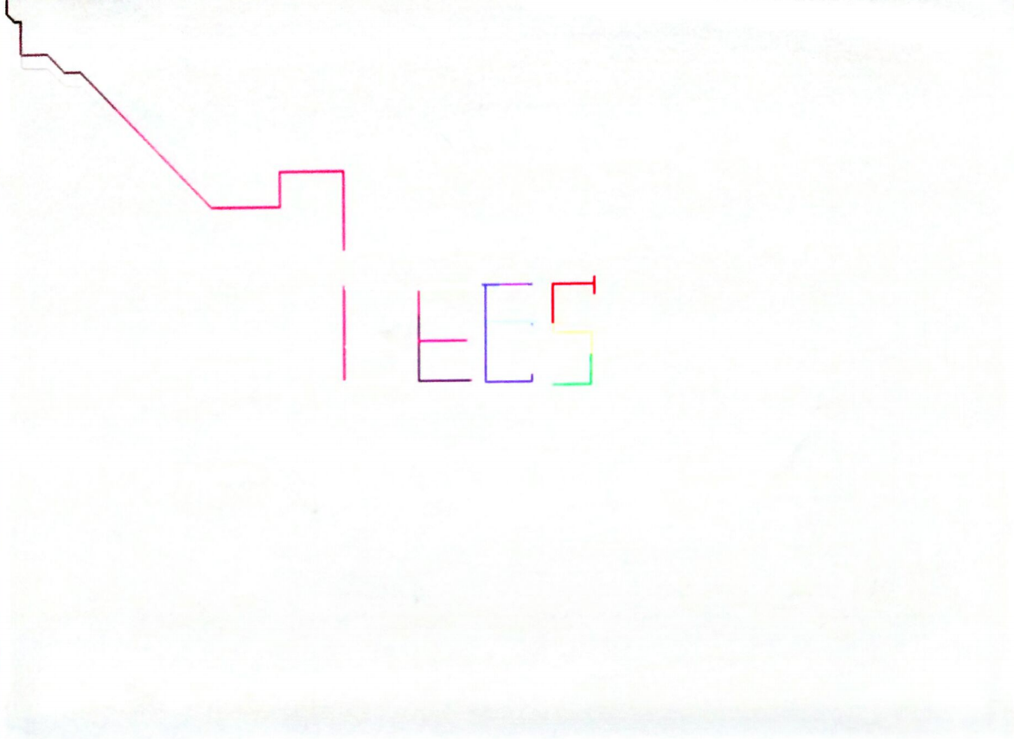
Example of drawing:
Beginning at the top left, the cursor is moved around
the screen via the directional buttons.
Different colors are achieved by flipping 12 switches.
DEMO:
https://youtu.be/eSbEV-jCAHA

Slide 4

High-Level Design
Button Controller
Accelerometer
(Detects Shaking)
Button Debouncer
(Up Button)
Sensor Interrupt
Handlers
SPI Interface
Button Debouncer
(Left Button)
Button Debouncer
(Center Button)
Button Debouncer
(Right Button)
VGA Controller
Button Debouncer
(Down Button)
VGA Memory (Canvas)
Driver Circuit
(Interconnects)

Slide 5
Module Design: Accelerometer Unit
Description & Specification:
The accelerometer unit is responsible for determining when the board is shaking. It uses the Xilinx ADXL362Ctl module to read from the on-board sensor over a SPI interface module (both written by Xilinx developers). The highest magnitude in each of three directions is read, and the logical OR of these signals makes up the output signal.
Inputs: system clock and reset
Outputs: whether or not the board is being shaken

Slide 6
Module Design: Button Debouncer Unit
Description & Specification:
The button debouncer unit is designed to filter out extraneous button presses (debouncing). Each has an internal counter which is used whenever the input signal changes. If after 10ms the signal has the same value, that value is output. Otherwise, the output remains as it was.
Inputs: Logical signals from the physical buttons on the Nexys4 board
Outputs: Debounced signals, or signals that have had the same value for 10 ms

Slide 7
Module Design: VGA Control Unit
Description & Specification: The VGA control defines the interface to the VGA monitor hardware, and tracks the state of a 2-D array (Block RAM) representing the pixels on the canvas. Each array element is a 12-bit vector representing the color of the pixel. The interface follows the VGA specifications and timing per the standards (found online).
Inputs: Logical signals representing what pixel to write and what color to write. An enable/disable bit for writing to the BRAM.
Outputs: Signals to the onboard DAC, which directly drive the VGA hardware

Slide 8
Module Design: VGA Memory UNIT
Description & Specification:
The VGA memory defines a simple write before read style RAM. If the write bit is high, the write data is written to the internal array at the write address passed in. The read data is populated with the data at the read address concurrently.
Inputs: Integer addresses into the internal memory array, a vector representing the data to be written, a bit to enable/disable writing.
Outputs: A vector representing the data read from the internal array at the read address passed in.

Slide 9
Module Design: Button Control Unit
Description & Specification:
The button controller is responsible for keeping track of where the cursor is, and moving it according to input from the five button debouncer units. The coordinates are translated into an address into memory, which is passed to the VGA controller to determine where to write. One of the buttons is a write enable, which is passed directly to the VGA controller to enable or disable writing to the canvas memory.
Inputs: Logical signals representing what pixel to write and what color to write.
Outputs: Signals to the onboard DAC, which directly drive the VGA hardware

Slide 10
Module Design: Driver Unit
Description & Specification:
The driver unit is the top level module, used primarily to link constituent parts together.
Inputs: 12 switches indicating the color values to be passed to the VGA controller, 1 switch for system reset, and one signal from the SPI interface for duplex communication.
Outputs: Signals mapped to the VGA controller, the accelerometer module, and the button controller.

