Slide 1
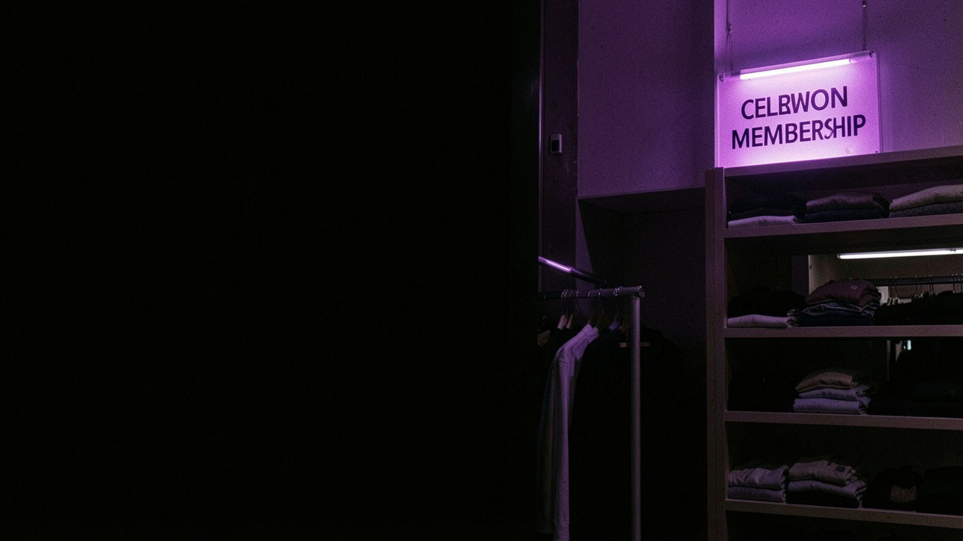

CUSTOMER SHOPPING BEHAVIOR
Subscription is the clearest growth gap
A large, loyal customer base is spending steadily, but subscription penetration remains low and acquisition is thin.
Notes:
1

Slide 2

01 — CUSTOMER BASE
The business already has a strong loyalty engine
Loyal customers dominate the base. Returning customers are the conversion pool. New customers are the acquisition challenge.
LOYAL
RETURNING
NEW
3,116
701
83
79.9% of the base
18.0% · the conversion pool
2.1% · an acquisition challenge
2
Notes:
2

Slide 3
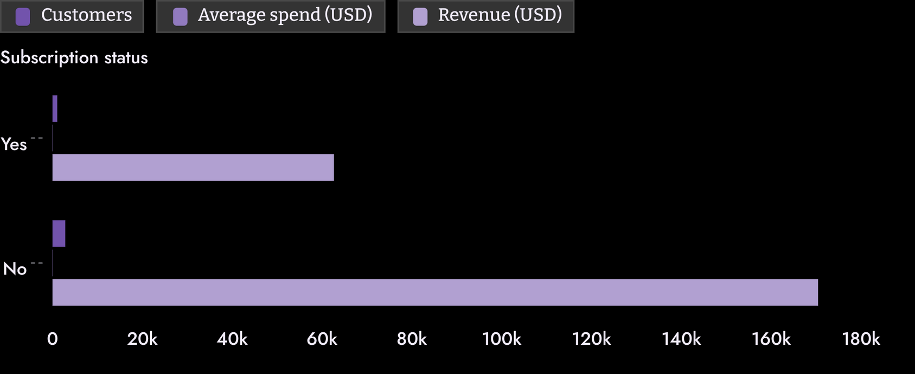
02 — SUBSCRIPTION VALUE
Subscriptions are not yet changing customer value
Only 27% of customers subscribe, while average spend is nearly identical across groups.
Subscribers contribute roughly their share of the customer base, but average purchase value is essentially flat.
3
Notes:
3

Slide 4
03 — SUBSCRIPTION AUDIENCE
Repeat purchasing creates a credible subscription audience
The audience already returns. The gap is making subscription worth choosing.
AMONG SUBSCRIBERS
AMONG NON-SUBSCRIBERS
958 / 1,053
2,518 / 2,847
Repeat buyers · about 91%
Repeat buyers · about 88%
The gap is positive but modest: subscription needs a stronger benefit, not just a loyalty label.
4
Notes:
4

Slide 5
04 — DISCOUNT EFFICIENCY
Discounts are reaching customers who may buy anyway
HIGH-VALUE DISCOUNT USERS
DISCOUNT RATES
839
PRODUCT SIGNAL
47%–50%
Hats
Customers used a discount and still spent at or above the average purchase of about $59.76.
Highly discount-dependent and among the top-rated products.
Hats, Sneakers, Coats, Sweaters, and Pants.
5
Notes:
5

Slide 6
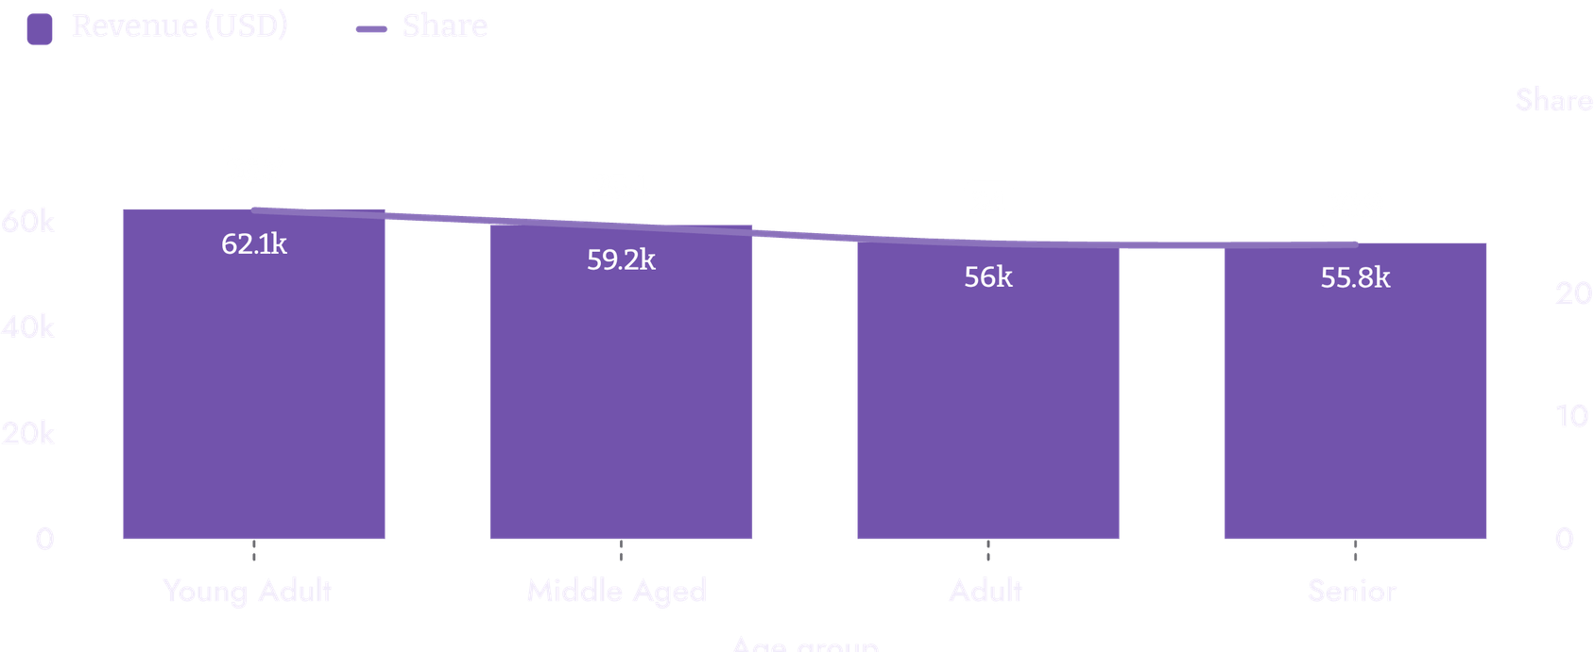
05 — TARGETING PRIORITIES
Target the segments with the most room to grow
Use the strongest revenue groups for targeted campaigns while building a deliberate pipeline for new customers.
Young Adults and Middle Aged customers together contribute about 52%.
6
Notes:
6

Slide 7
06 — COMMERCIAL PLAYBOOK
Turn the dashboard into a sharper commercial playbook
01
02
03
04
Boost subscriptions
Convert returning buyers
Refill the funnel
Protect margin
Lead with exclusive benefits such as early access, free shipping, and members-only pricing.
Prioritize acquisition because only 83 customers are classified as new.
Target discounts more selectively, especially on high-discount products.
Design loyalty milestones that move the 701 returning customers toward loyal behavior.
7
Notes:
7

Slide 8
07 — RECOMMENDATION
The next move is to make loyalty more valuable
RECOMMENDATION
SUCCESS SIGNAL
Pilot a benefit-led subscription offer with repeat buyers, measure conversion and purchase value, and tighten discount eligibility in parallel.
Higher subscription penetration
Without relying on blanket discounts.
DECISION
Approve a focused test across the strongest repeat-buyer and age-group segments.
8
Notes:
8

