Slide 1
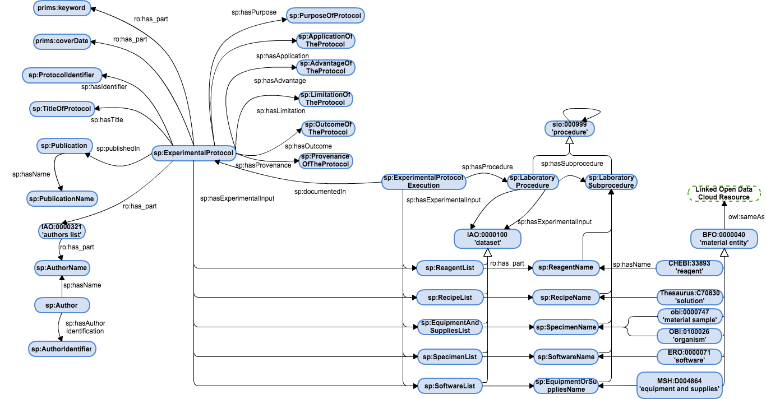
SMART Protocols – Document module
SMART Protocols – Workflow module

