Slide 1
CS 374 Syllabus

Slide 2
Outline
Course goals
Logistics
Teams
What's this class about? – Expanding your toolbox
Methods of evaluation
Types of assignments
What does success in CS 374 look like?

Slide 3
Course Goals - Theoretical
Be able to write proofs about programs.
Be able to compare the asymptotics (Big-O, Big-Theta, Big-Omega, dominance relations) of standard functions, including polynomials, logarithms, exponentials, and the factorial function.
Be able to justify algorithm correctness and analysis formally by relating algorithms to their RAM models.
Be able to reason about concepts of tractability and intractability, like polynomial-time, polynomial-space, and NP-completeness.

Slide 4
Course Goals - Practical
Be able to implement standard data structures and understand how they affect the efficiency of algorithms.
Be able to implement standard sorting algorithms and compare them for performance.
Be able to use graphs to solve algorithmic problems.
Know the use-cases, non-use-cases, and analysis techniques of greedy algorithm & "Divide and conquer" algorithm design.
Be able to solve algorithmic problems and optimize algorithms using dynamic programming.
Be able to compare algorithm runtimes empirically.

Slide 5
The basics: where, when, how
Section -01:
Days: Tuesdays & Thursdays
Time: 1:30-3:10 pm
Location: Galileo 105
Section -97:
Online, asynchronous with synchronous check-ins.

Slide 6
Office Hours
I will be in my office ready to answer questions or talk about anything.
Tuesdays: 10-11:30am
Wednesdays: 11-12:30pm
Location: Galileo 103A
I am available many other times:
  Find a time that works for you.
  Zoom is an option, just let me know.
  Show where the link is on Canvas.

Slide 7
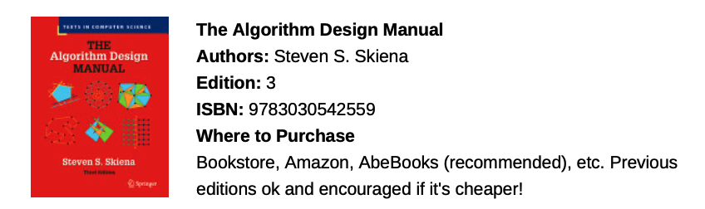
The textbook

Slide 8
Accessibility
I am willing and happy to accommodate for accessibility needs.
Both officially from SDS and other reasonable accommodations.
Let me know as we go if anything comes up that needs adjusting.
If it seems like I've forgotten something, please remind me ASAP.
Lectures are recorded. [Show where the link is.]
I try to post things ahead of time, as best I can.

Slide 9
Teamwork Makes the Dream Work

Slide 10
Teams
For the first ~3 weeks of class, you will be paired up randomly.
  For in-class activities, algorithm history presentations, etc.
  Gives you a chance to meet people
At the start of Unit 2, you will be assigned to a team.

Slide 11
Teams
What a team does:
  Sits together in class
  Works on in-class activities together
  Meets outside of class to discuss (hopefully!)
  Works on projects together
A consistent group for you to work with.
Your preferences will be considered.
  Via Google form, assigned end of week 2.

Slide 12
Go through the syllabus document

Slide 13
What's CS 374 about?

Slide 14
Outline
Expanding your toolbox
Subjectivity
What's a "good" answer?
Communication

Slide 15
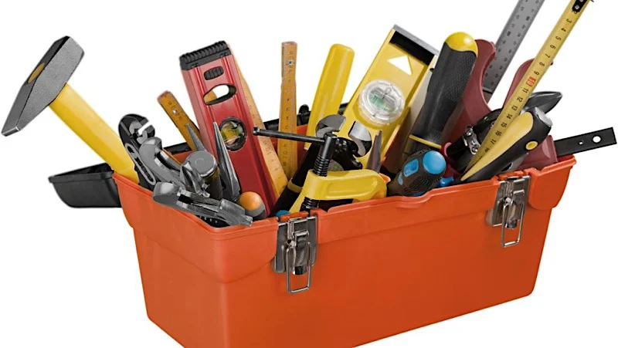
Expanding your tool chest
To solve an algorithmic problem, you need to apply both:
Understanding
Language
Notes:
this class is all about expanding your tool chest. It is about giving you the understanding and language to apply when you go to solve a problem.

Slide 16
Example: Too much to do, too little time
Dr. Roscoe's Tuesday todo list:
  Prep CS 374 Tuesday lecture
  Write a sentence for research paper
  Decide Math 104 homework problems
  Prep Math 104 Tuesday lecture
  Organize Canvas course
  Knit hat
  Read a research paper

Slide 17
Example: Too much to do, too little time
One way to solve: enumerate all possibilities
  How many ways can I order my todo list?
Not useful for getting stuff done.
I need a scheduling algorithm.
Notes:
I can enumerate all the possible ways i can do things, but that doesn't help me actually do it.

Slide 18
What's an algorithm?
An algorithm is a process to accomplish a specific task.

Slide 19
Structure is needed
To get anything done, I need a data structure.
If you work with data, how are you storing it?
  List, graph, queue, etc.
I choose priority queue.
Notes:
To do anything, you need some sort of structure. if you're working with data, how are you storing it?

Slide 20
Priority Queue
I will label my data with priority (1 = high) and estimated time.
Dr. Roscoe's Tuesday todo list:
  Prep CS 374 Tuesday lecture – 1, 1 hour
  Write a sentence for research paper – 2, 30 minutes
  Decide Math 104 homework problems – 3, 20 minutes
  Prep Math 104 Tuesday lecture – 1, 1 hour
  Organize Canvas course – 1, 45 minutes
  Knit hat – 3, 10 minutes
  Read a research paper – 2, 30 minutes
Notes:
my scheduling problem: i need a **priority queue**. Baked into my priority queue is my labeled data, saying this is p1, this is p2, etc. I want it so when I dequeue something from the queue, i'll have the thing i need to do next.

Slide 21
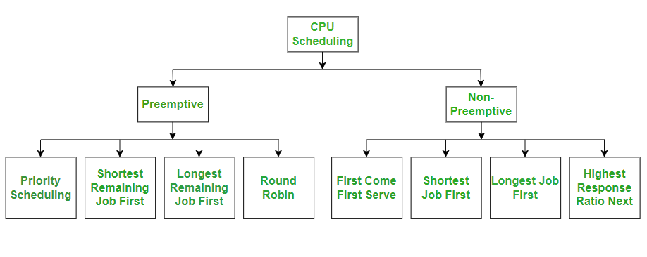
Desired Functionality
When I dequeue from my priority queue, it gives me the next thing I need to work on.
…there are many options.
Notes:
that being said, there's lots of ways i could figure out what i need to dequeue next. show geeks4geeks pic https://www.geeksforgeeks.org/operating-systems/cpu-scheduling-in-operating-systems/

Slide 22
Subjectivity and Biases
Notes:
Which brings me to my next point.

Slide 23
How to choose what to do?
My ordering of tasks may not be what you would choose.
The solution we choose is not necessarily objective.
Conflicting priorities ➔ No easy answers.
Notes:
My ordering of things to do may not be the same as what you choose to do. you may choose x first, then y, then z, while I would choose z then x then y.
That being said... remember that the solutions you design are not necessarily objective.
example: objective = x. subjective =y.

Slide 24
You have assumptions
You bring assumptions to the table about how the structure works.
You have biases about what is "easy" to compute
Others (your peers/industry professionals/the internet) may have differing opinions.
Notes:
Like with scheduling, you bring assumptions to the table about how this structure works. You have biases about what is easy to compute, while others may have differing opinions.

Slide 25

Book recommendation
"An algorithm is an opinion formalized in code."
The tools you use,
How you choose to use them,
They're your decisions.
Notes:
There's a book I highly recommend, weapons of math desctruction (show title). There's a quote there, which says,
(big text)
An algorithm is an opinion formalized in code.
these tools you use, the decisions you make in choosing which tools to use and how you use them, they're *your* decisions.

Slide 26
There are few wrong answers in this class.
…There are simply less good answers.
Scheduling problem alternatives:
  Use hashmap instead?
  Sort by time estimated to take?
Notes:
Which brings me to my next point: How will you be evaluated in this class?
There are few wrong answers in this class.
...there are simply less good answers.
In solving my scheduling problem, I may have chosen to put it into a hashmap, where the priority is the key. Then I choose blaahblahblah.

Slide 27
Specificity is key.
Read between the lines to answer questions and solve problems.
What has been stated to be important?
What could be inferred to be important?
What has not been explicitly stated, but affects a "good" solution?
This class will have broad questions, but your solutions must be specific.
Notes:
**Specificity** is a key thing to work on. In solving an algorithmic problem, what has been stated to be important? What could be inferred to be important? what has not been explicitly stated but critically affects a good solution to the problem?
This class has broad questions.
But your solutions must be specific. You must read between the lines to answer the questions and solve problems. You must investigate. You must be close readers. You must use your brain.

Slide 28
How to get there
Think inside the box.
  Apply your known tools.
  Try to logically approach the problem with what you know.
Think outside the box.
  Be close readers: read between the lines.
  Investigate, is there another way this could be solved?
  Can you structure the problem differently?
  Can you shift your perspective?
Ultimately, you must use your brain.

Slide 29
There are few wrong answers in this class.
…There are simply less good answers.
…Versus…
"An algorithm is an opinion formalized in code."

Slide 30
What does "good" mean, anyway?

Slide 31
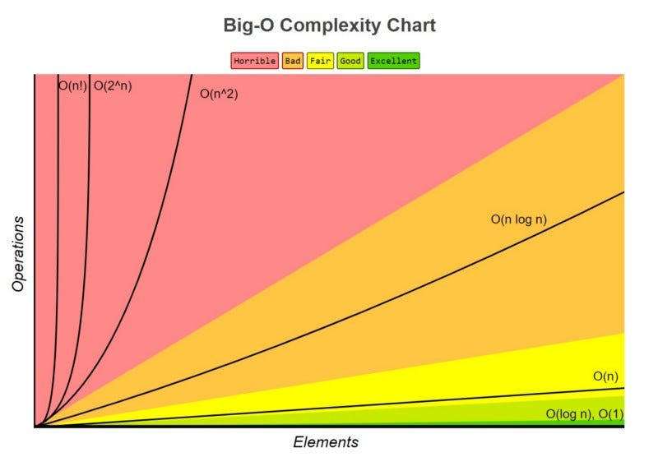
End of CS 222
Notes:
You saw this at the end of 222, and you will see it again here:

Slide 32
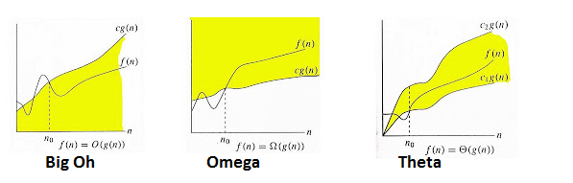
CS 374
Notes:
We have measures for algorithm and data structure efficiency. That is our measure, the way we choose to say what is good or bad.

Slide 33
In Comparison
You submit an answer, correct ➔ It's slow
Your neighbor submits an answer, correct ➔ Much faster
You get less points
Neighbor gets most of the points
Your answer's not technically wrong, just not as good as it could have been.
Notes:
Example: you give a solution that is, in the long term, worse off than one your neighbor gives. If both of these algorithms are correct, your neighbor would get most of the points, while you get less points. Even if it accomplishes the goal, your answer is not wrong. It's just not as good as it could have been.

Slide 34
A warning
Your answers must be correct…
And they must be efficient.
Solutions that differ from mine, but get the job done adequately, in the targeted efficiency range, will get most of the points.
Notes:
So I warn you ahead of time:
Your answers must be correct and thezy must be efficient. z
if you present a solution that is different from intended, but gets the job done adequately, in the targeted efficiency range, you'll get most of the points.

Slide 35
Okay, convince me!

Slide 36
This is not (quite) a writing class
It is a crucible.
You will practice writing and presenting code.
You will practice writing and presenting algorithms.
Notes:
This is not (quite) a class on how to write. It is a crucible, a way for you to practice writing and presenting your code, and your algorithms in general.

Slide 37
Why bother with writing and presentations?
The goal of this class is for you to understand the workings of algorithms.
It's important to know how to implement things.
But in industry and elsewhere, it's not just the code you write.
It's also your ability to explain it to peers, managers, and people with no prior knowledge.
  Succinctly explain
  Determine what to include, what not to include.
Notes:
Not just coding:
The goal of this class is for you to understand the workings of algorithms. Yes, it's important to know how to implement things. But in industry and elsewhere, it's not _just_ about the code you write. It's also about your ability to explain it to peers, managers, and people with no prior knowledge.
If you do coding interviews, they'll want to know that you can succinctly explain things. It's also a practice in figuring out what information to include, and what information to not include for the sake of clarity. These are important skills I hope you develop this semester.

Slide 38
This sucks. It's a lot of work.
Yes, but that's learning.
Stretch yourself to do things you are unfamiliar with.
Notes:
Learning, especially in computer science, is about stretching yourself to do things you are unfamiliar with. It sucks, but it's really really important.

Slide 39
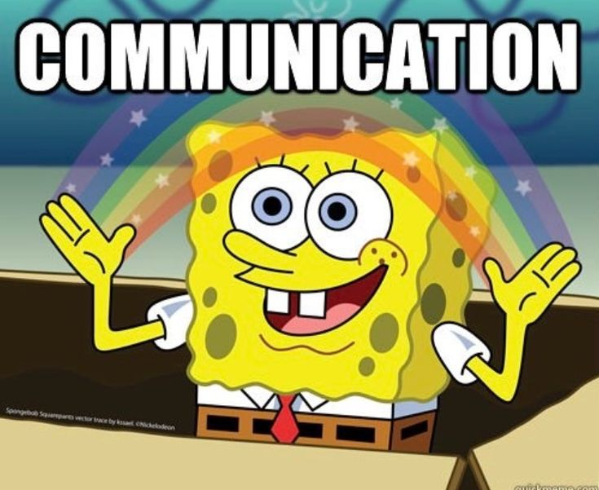
What's a "good" answer?
Technical components, yes…
…also explaining it.
Notes:
One component of having a "good" answer is the stuff we talked about previously: the technical components of the algorithm. But next up is explaining it to people: presenting a clear, solid answer. Communication.

Slide 40
How to communicate effectively
Be concise.
  Simple sentences. Nothing superfluous, nothing over-explained or under-explained.
Be specific.
  Know your audience: be prepared to answer any questions you think they might have.
  Clearly transition to each step of your explanation.
  If you skip any steps, you do so with reasonable knowlege that they are trivial.
Present well.
  Proofread so there are no typos or incomplete sentences.
  Present it nice and not messy.
  Read aloud any sentences with code or math so that it flows.
  (if giving a presentation) Dress professionally.

Slide 41
How to get there: Study Tips
Get your ideas down on paper.
DO NOT turn that version in.
Take a (brief) break. Walk down the hallway and back.
Sit down and read it aloud. Explain it to a rubber duck, or your favorite stuffed animal. Explain it to your roommate, your parent, your housemate.
They probably don't understand it. Assuming they understand all the preliminaries, figure out which most important parts they don't understand.
Go to the writing center.
Revise it.

Slide 42
Where to go from here?
"An algorithm is an opinion formalized in code."
There are few wrong answers in this class…there are simply less good answers.

Slide 43
Methods of Evaluation

Slide 44
Exemplar Rubric: "Give me an algorithm…"
Efficiency of solution
  The proposed solution is completely efficient. There is no possibility of a better implementation.
Completeness of solution
  The proposed solution is complete. Every edge case is considered. There are no cases the writer forgot to consider. Given any possible correct input, the output will be produced as described.
Generality of solution
  The proposed solution is specified with what counts as valid arguments. It will correctly apply to any given arguments, so long as they are valid.

Slide 45
Exemplar Rubric, cont'd
Conciseness of writing
  Writing is perfectly concise. There are no superfluous words and nothing is over-explained.
Specificity of writing
  Solution is perfectly specific; there are no questions that should be additionally answered. Transitions are clear. If there are any skipped steps, they are clearly understood to be trivially inferred by the reader.
Presentation of writing
  There are no typos in the proposed solution. The layout is not messy. All sentences are complete. Any math or code descriptions present flows cleanly with explanations.

Slide 46
Types of Assignments
Written
  Weekly
Verbal/Presentation
  Frequently informal, in class
  Project-based
Coding
  Project-based

Slide 47
What does success look like?

Slide 48
What does success (A) look like?
Show up
Pay attention, close technology
Speak up and ask questions
  There are no stupid questions
Go to office hours frequently
Form a study group
  Perhaps with your team?
Start assignments the day they're assigned.
Check the rubric. Follow all directions.
Turn in on time.
Don't use AI, OR use strictly within defined parameters.
  Only copyediting or brief consideration of other avenues.
  No using for broad interpretation.

Slide 49
What does mediocrity (B-C) look like?
Miss several class periods
Occasional shopping/doing the Seminar reading
Ask only when you have a genuine question.
Go to office hours maybe once.
Do things on your own
  Maybe talk to others when you have a question
Start assignments a few days before it's due.
Glance at the rubric, but do all the instructions.
Turn in on time.
Mostly use AI within parameters.
  Use it to help guide your responses
  Lean a little too much on its interpretation of the questions.

Slide 50
What does failure (D-F) look like?
Miss a majority of class periods
Go to class but rarely pay attention.
Never go to office hours unless required.
Do things on your own
Wait until the last minute to start assignments
Assume that turning something in will give you enough points to pass.
Paste assignment directions into AI

Slide 51
My advice
Decide today where you want to stand.
  This class is a foundation for any career in tech.
Block off your calendar.
Put the time in to make it happen.

Slide 52
I (the instructor) pledge to…
Come to class on time
Be available for questions during class
Be in my office when office hours are scheduled
Communicate if I cannot make a scheduled commitment
Return grading within 1-2 weeks of the due date
Maintain high expectations of you (students)
Apologize when I make a mistake, and work to fix it.

Slide 53
We're doing the best we can with the tools we have.
Let's go expand our set of tools.

