Slide 1

Coloring

Slide 2
Why color?
Helps divide vertices into mutually exclusive groups
If chemicals x, y, and z cannot be stored together, how many different shelves are needed?
If variables are accessed in various lines of a program, how many registers are needed to store all variables?

Slide 3
How to color?
Adapt BFS or DFS.
Modify it, so that each time we process, we add a "color" to the vertex, other than black/white/gray (that's separate)
Color = red/orange/yellow/etc
Color = assigned number
Such that no color can be assigned to two adjacent vertices.

Slide 4
Warm-up: Coloring
A public aquarium has ten species of aquatic life that it wishes to feature in large tanks. However, because some of the species prey on others, they cannot all live in the same tank. We label the species A-J and show each one's "enemy" species that cannot be placed in the same tank. What is the minimum number of tanks the aquarium needs to accommodate all 10 species?
Species | Enemies | Species | Enemies
A | B,E,H,J | F | E,I
B | A, C, G, I | G | B, D, J
C | B, D | H | A, E
D | C, E, G, J | I | B, F
E | A, D, F, H, J | J | A, D, E, G

Slide 5
Tasks
Draw the graph on the board with your neighbors
Decide whether to use BFS or DFS
Adapt the algorithm to color the graph
Report how many tanks are needed.
Discuss
Which feels more intuitive—DFS, or BFS?
Did your algorithm produce the correct answer?

Slide 6
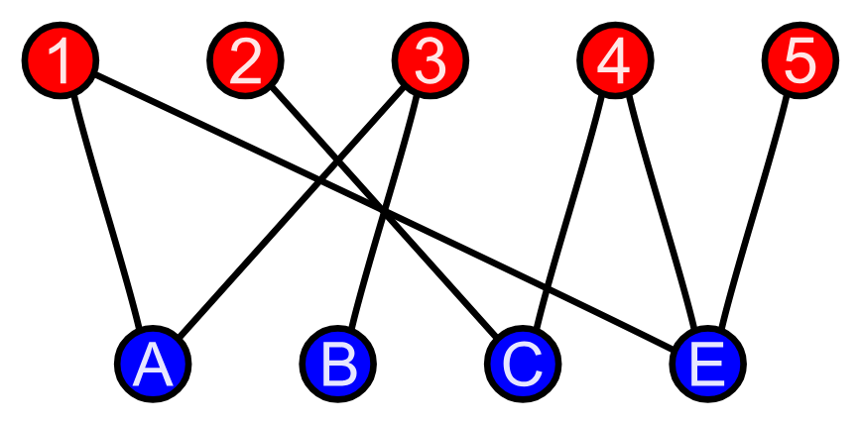
Uses of Coloring
If only 2 colors are needed, the graph is bipartite
Can be separated into 2 (bi) parts (partite)

