Slide 1
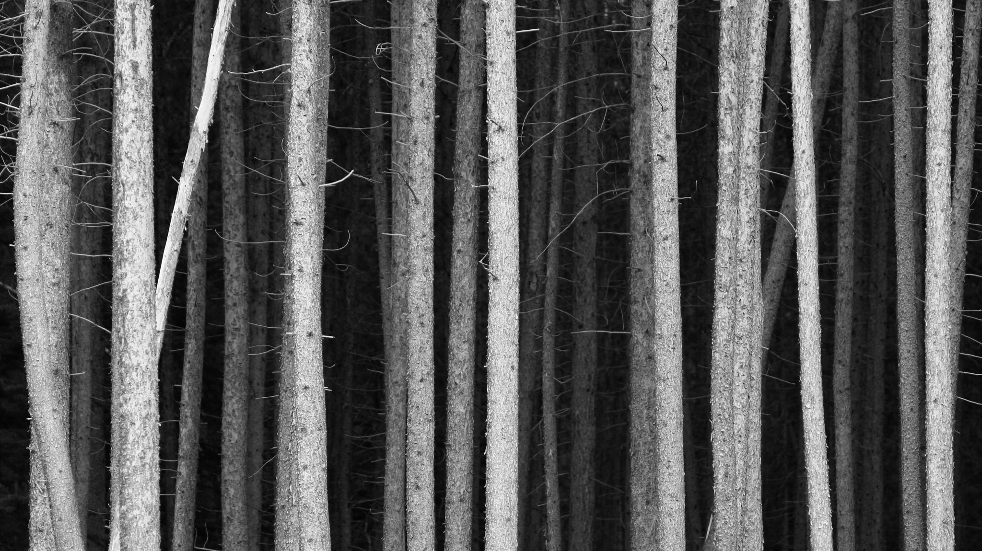
Minimum Spanning Trees

Slide 2
Review: What's a tree?
An acyclic graph.

Slide 3
Review: What's a spanning tree?
A tree which includes every vertex in the graph.

Slide 4
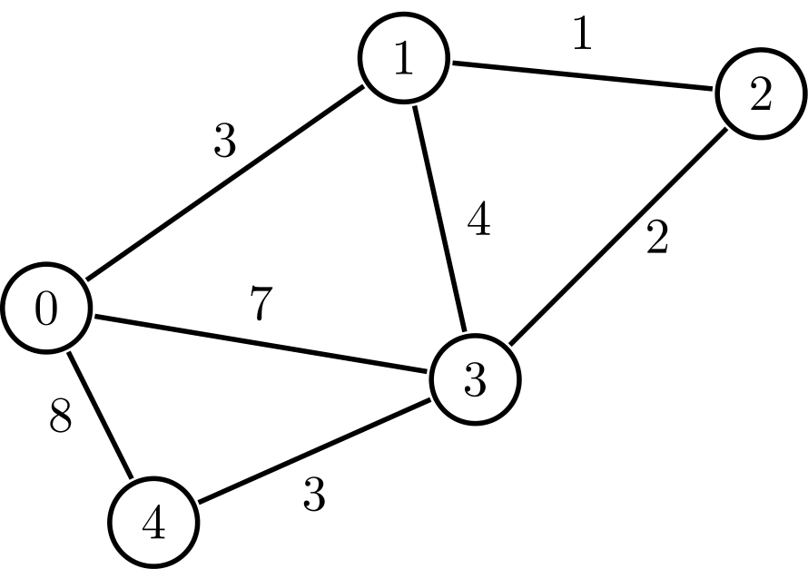
Review: What's a weighted graph?
Graph with numbers on the edges

Slide 5
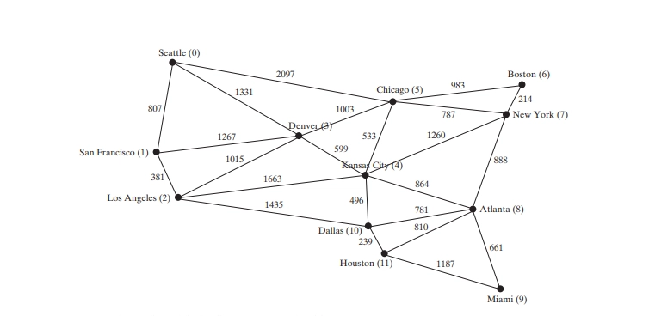

Slide 6
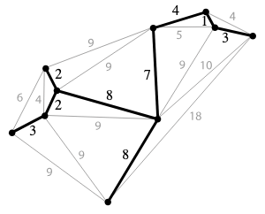
What's a minimum spanning tree?
A spanning tree with minimum weight
We could not find a smaller-weight spanning tree

Slide 7
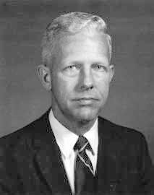
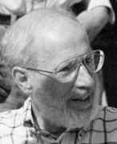
How to get MST?
Two main algorithms (though there are more)
Prim's
Kruskal's
Robert Clay Prim
Joseph Kruskal

Slide 8
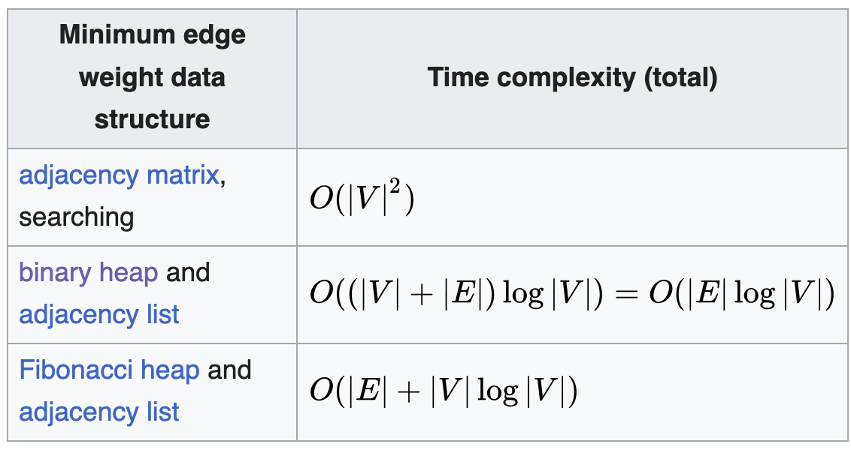
Main Ideas – Prim's
Choose any vertex.
Add next vertex, choose smallest weighted edge among options available, as long as choosing next vertex won't introduce a cycle

Slide 9
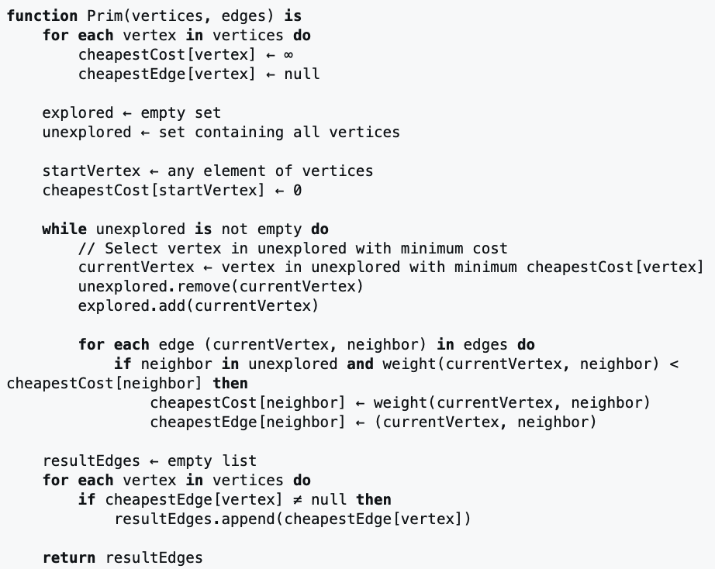
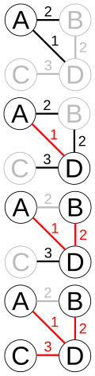

Slide 10
Do an example

Slide 11
You try
With your neighbors:
Choose 2-3 graphs from the sheet you've been given
Draw on the board
Run Prim's algorithm on the graphs

Slide 12
Main Ideas - Kruskal's
Sort edges by weight
Instead of choosing vertices, choose smallest weighted edge in the entire graph. [Choose cheapest edge and ask: are these two vertices already in the subgraph?]
Include if not, as long as the edge won't introduce a cycle
Build entire tree using Union-Find data structure
Complexity: O(|E| log |E|)

Slide 13
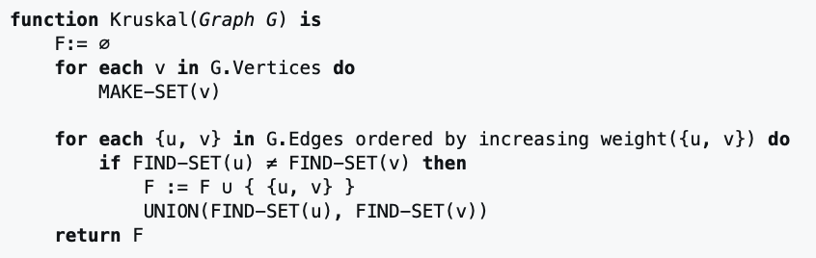

Slide 14
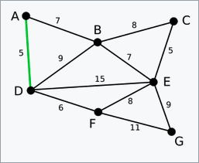
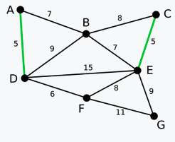
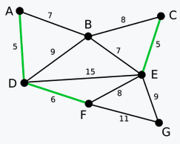
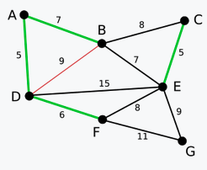
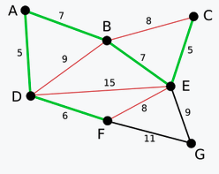
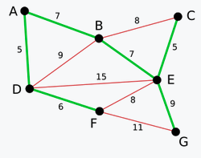
a
b
c
e
f
d

Slide 15
Do an example

Slide 16
You try
With your neighbors:
Choose 2-3 graphs from the sheet you've been given
Draw on the board
Run Kruskal's algorithm on the graphs

Slide 17
Cool-down
I am constructing a unified water pipeline and need to connect every major city to my system. The weights of my graph represent distance. How can I set up my pipeline using the fewest miles of material possible?

