Slide 1
Graph Traversals
CS 374

Slide 2
Terminology Before Warm-up
Vertex = an entity
Node
Plural: vertices
All vertices are collected in the set V.
Edge = an edge (u,v) is present if there is a relationship between the two vertices u and v.
All edges are collected in the set E.
A graph is represented as a pair, G=(V,E).

Slide 3
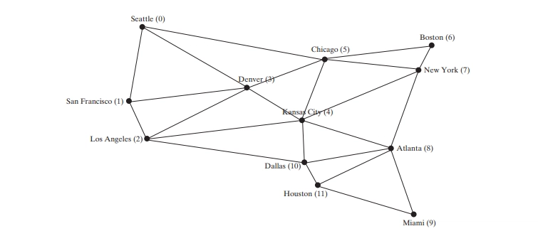
Warm-Up
This graph describes direct routes possible between cities.
With your team, on the board, write a verbal algorithm describing how to visit every vertex of of a graph like this.

Slide 4
Evaluate your own work
Does the algorithm describe…
The input & its format?
Where to start?
How to proceed from the starting point, in a way that reasonably covers the whole graph?
Is the algorithm specific enough? Is there any ambiguity?
Are there errors? Can you poke holes in the solution?

Slide 5
Category | Points
Efficiency | The proposed solution is completely efficient. There is no possibility of a better implementation.
Completeness | The proposed solution is complete. Every edge case is considered. There are no cases the writer forgot to consider. Given any possible correct input, the output will be produced as described.
Generality | The proposed solution is specified with what counts as valid arguments. It will correctly apply to any given arguments, so long as they are valid.
Specificity | Solution is perfectly specific; there are no questions that should be additionally answered. Transitions are clear. If there are any skipped steps, they are clearly understood to be trivially inferred by the reader.
Conciseness | Writing is perfectly concise. There are no superfluous words and nothing is over-explained.
Presentation | There are no typos in the proposed solution. The layout is not messy. All sentences are complete. Any math or code descriptions present flows cleanly with explanations.

Slide 6
Rotate and evaluate:
Give each group a score out of 10 for:
Efficiency: __/10
Completeness: __/10
Generality: __/10
Specificity: __/10
Conciseness: __/10
Presentation: __/10

Slide 7
Your homework questions will be evaluated on this scale.
See table next slide.
Efficiency, completeness, generality, specificity are emphasized.
Conciseness and presentation also considered.
This hinges on your solution being correct.

Slide 8
Category | Points | Share of points
Efficiency | The proposed solution is completely efficient. There is no possibility of a better implementation. | 20%
Completeness | The proposed solution is complete. Every edge case is considered. There are no cases the writer forgot to consider. Given any possible correct input, the output will be produced as described. | 20%
Generality | The proposed solution is specified with what counts as valid arguments. It will correctly apply to any given arguments, so long as they are valid. | 20%
Specificity | Solution is perfectly specific; there are no questions that should be additionally answered. Transitions are clear. If there are any skipped steps, they are clearly understood to be trivially inferred by the reader. | 20%
Conciseness | Writing is perfectly concise. There are no superfluous words and nothing is over-explained. | 10%
Presentation | There are no typos in the proposed solution. The layout is not messy. All sentences are complete. Any math or code descriptions present flows cleanly with explanations. | 10%

Slide 9
Do an example HW question
Imagine you have a closet full of shirts. What can you do to organize your shirts for easy retrieval?

Slide 10


Traversals

Slide 11
What is traversal?
travel across or through
move (something) back and forth or sideways
For graphs: this is equivalent to
"searching"
"querying"
We want to record/process/visit every vertex in the graph.

Slide 12
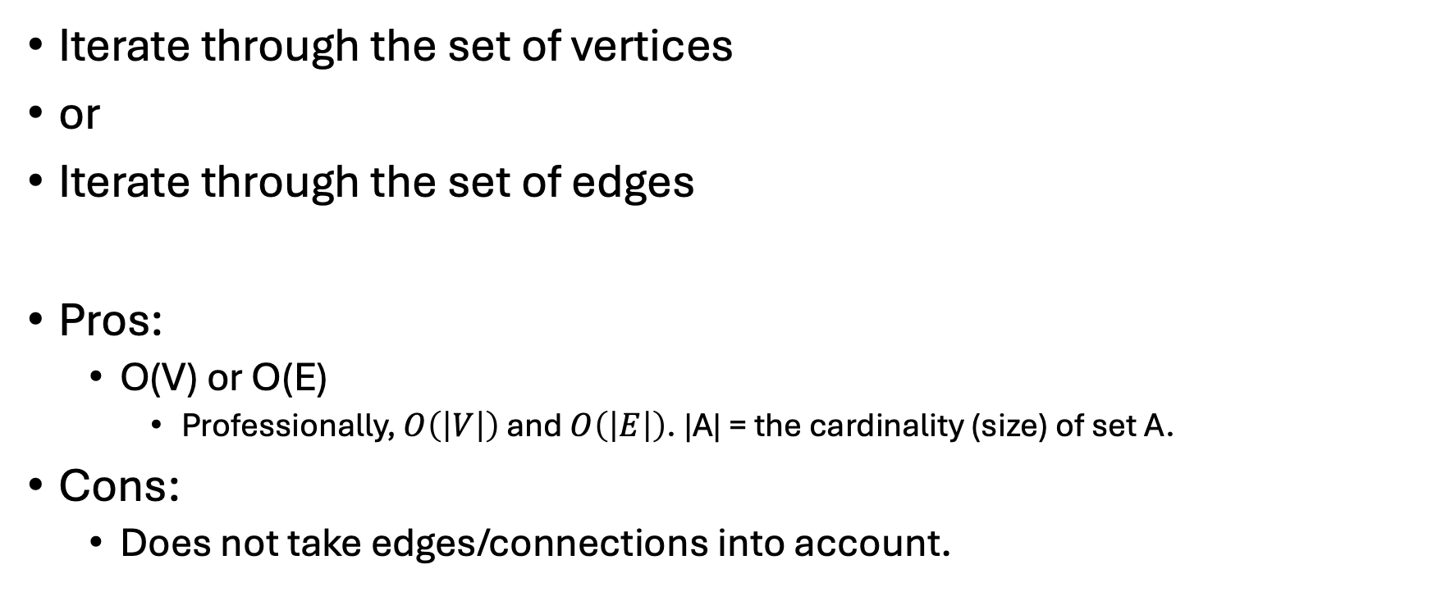
Easy way
Iterate through the set of vertices
or
Iterate through the set of edges
Pros:
O(V) or O(E)
Professionally, $O\left(\left|V\right|\right)$ and $O\left(\left|E\right|\right)$. |A| = the cardinality (size) of set A.
Cons:
Does not take edges/connections into account.

Slide 13
Less Easy Way
Devise an algorithm to iterate through the entire graph, depending on the edges present.
Two main algorithms:
BFS = Breadth-First-Search
DFS = Depth-First-Search

Slide 14
What do you get out of this?
List of nodes in some order,
Like a tree traversal: preorder, inorder, postorder, level order
A spanning tree
A subgraph that is a tree, such that every vertex of original graph is included
Which may include back edges as you go through the algorithm
The act of processing each vertex in the graph
You can attach operations to each visiting step as needed.

Slide 15
Vertex Status
Every vertex has 1 of 3 statuses:
Undiscovered / Unvisited
Discovered / Visited
Processed

Slide 16
Vertex Status
Every vertex has 1 of 3 statuses:
Undiscovered / Unvisited
Discovered / Visited
Processed
Undiscovered / Unvisited: we have not yet arrived at that vertex
Discovered / Visited: We have arrived at that vertex, but it has not yet been fully processed.
Processed: We have accomplished all we need to do at this vertex.

Slide 17
BFS

Slide 18
Main Idea
Start somewhere, add that vertex to a queue
Until the graph is entirely visited:
Dequeue it (mark processed), then enqueue all its neighbors
Complexity: O( |V| + |E| )

Slide 19
BFS Algorithm v.1

Slide 20
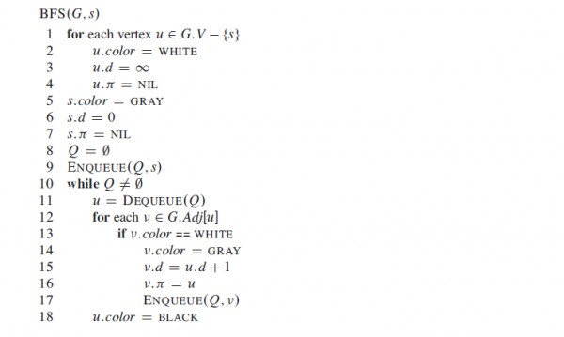
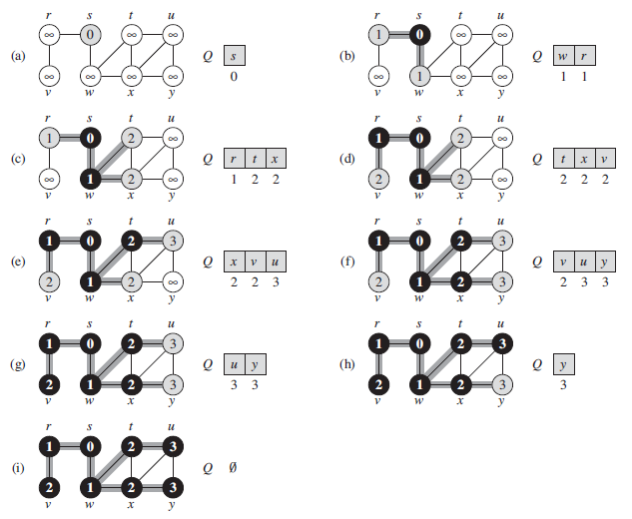

Slide 21
Insights
This is pseudocode – a sketch of code that won't actually run
But it describes pretty much everything we'd need.
Input is a graph G and a start vertex, s.
Lots of symbols, ???
There's a while loop and a queue in there??
Let's go through it step by step.

Slide 22
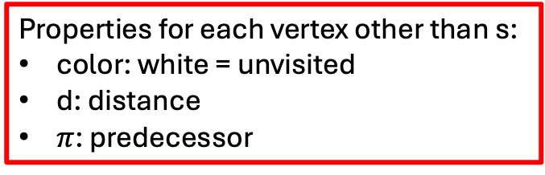
Input: G and starting point s.
Properties for each vertex other than s:
color: white = unvisited
d: distance
$π$: predecessor
Let's get started. s gets gray color = visited. Distance from s is 0 (we're there). Predecessor is nothing (we start at s).
Q is a (regular) queue, which starts empty. Add s to the queue.
While our queue is not empty, dequeue the latest vertex, u. Look at its adjacent vertices. For each adjacent vertex v:
If the color is white (unvisited), set it to gray (visited).
Update its distance +1
Set its predecessor as u.
Add v to the queue to be processed.
When we have gone through each adjacent vertex, we are done with u. Mark its color as black (processed)

Slide 23
What do the gray edges mean?

Slide 24
Warm Up: 3/10
Write a description of BFS in words on the board.
Input =
Output =
Describe how to set up the algorithm, and how to proceed through the entire graph.

Slide 25
BFS Algorithm v.2

Slide 26
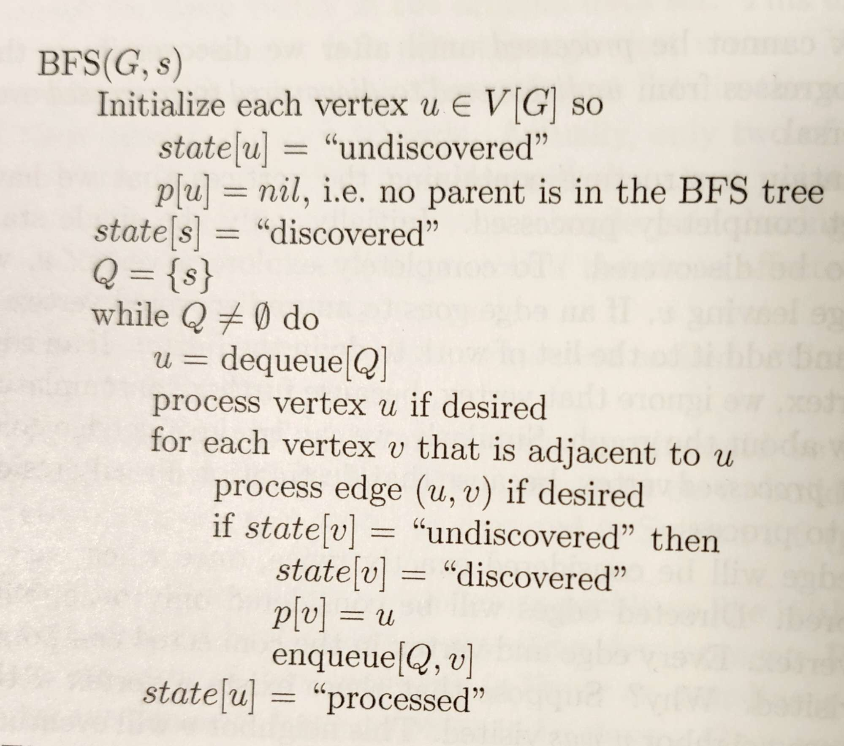
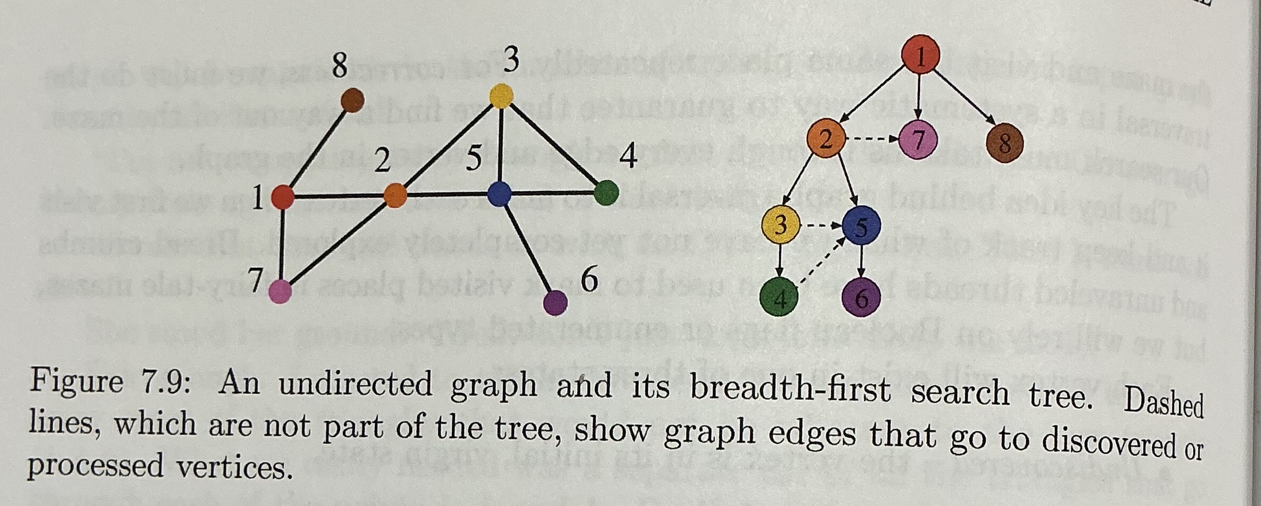

Slide 28
Turn and talk
What is the difference between the two algorithms?
In terms of…
Notation?
The algorithmic process?
Intermediate data structures/variables?
Result?

Slide 30
Do Examples
Choose a starting node
Run through the algorithm
Draw on the board
Pass out papers

Slide 31
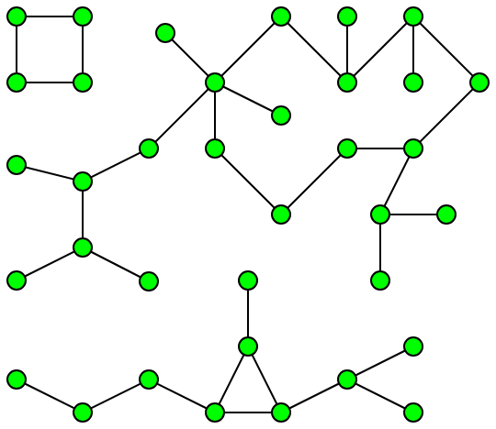
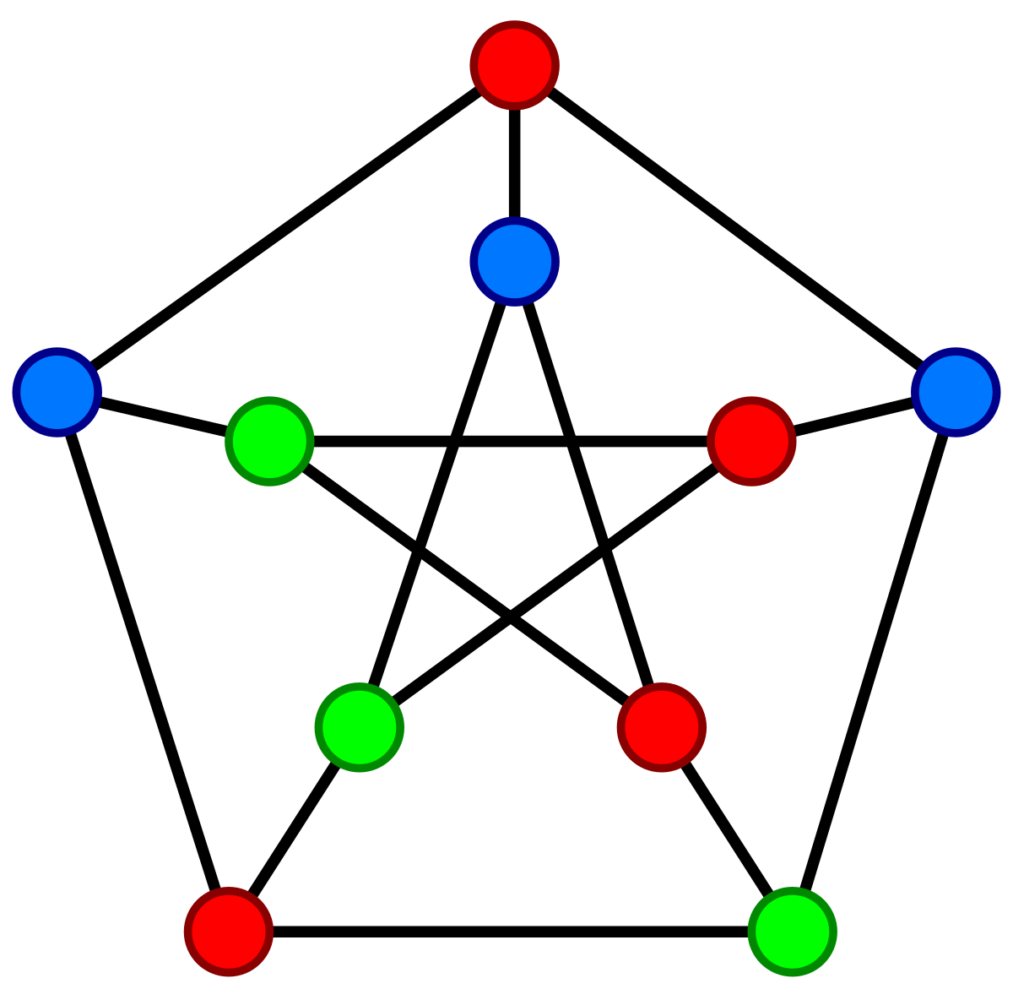
Benefits of BFS
Helps find connected components
Connected parts of the graph
Adaptations can help with coloring
Used in scheduling,
Register allocation in compilers,
Solving sudoku puzzles

Slide 32
DFS

Slide 33
Main Idea
Start somewhere, add vertex to a stack.
Until the graph is entirely visited:
Pop from the stack, and push all of that node's children (who have not been visited)
Focus on children before neighbors: Depth before breadth
Complexity: O( |V| + |E| )

Slide 34
DFS Algorithm v.1

Slide 35
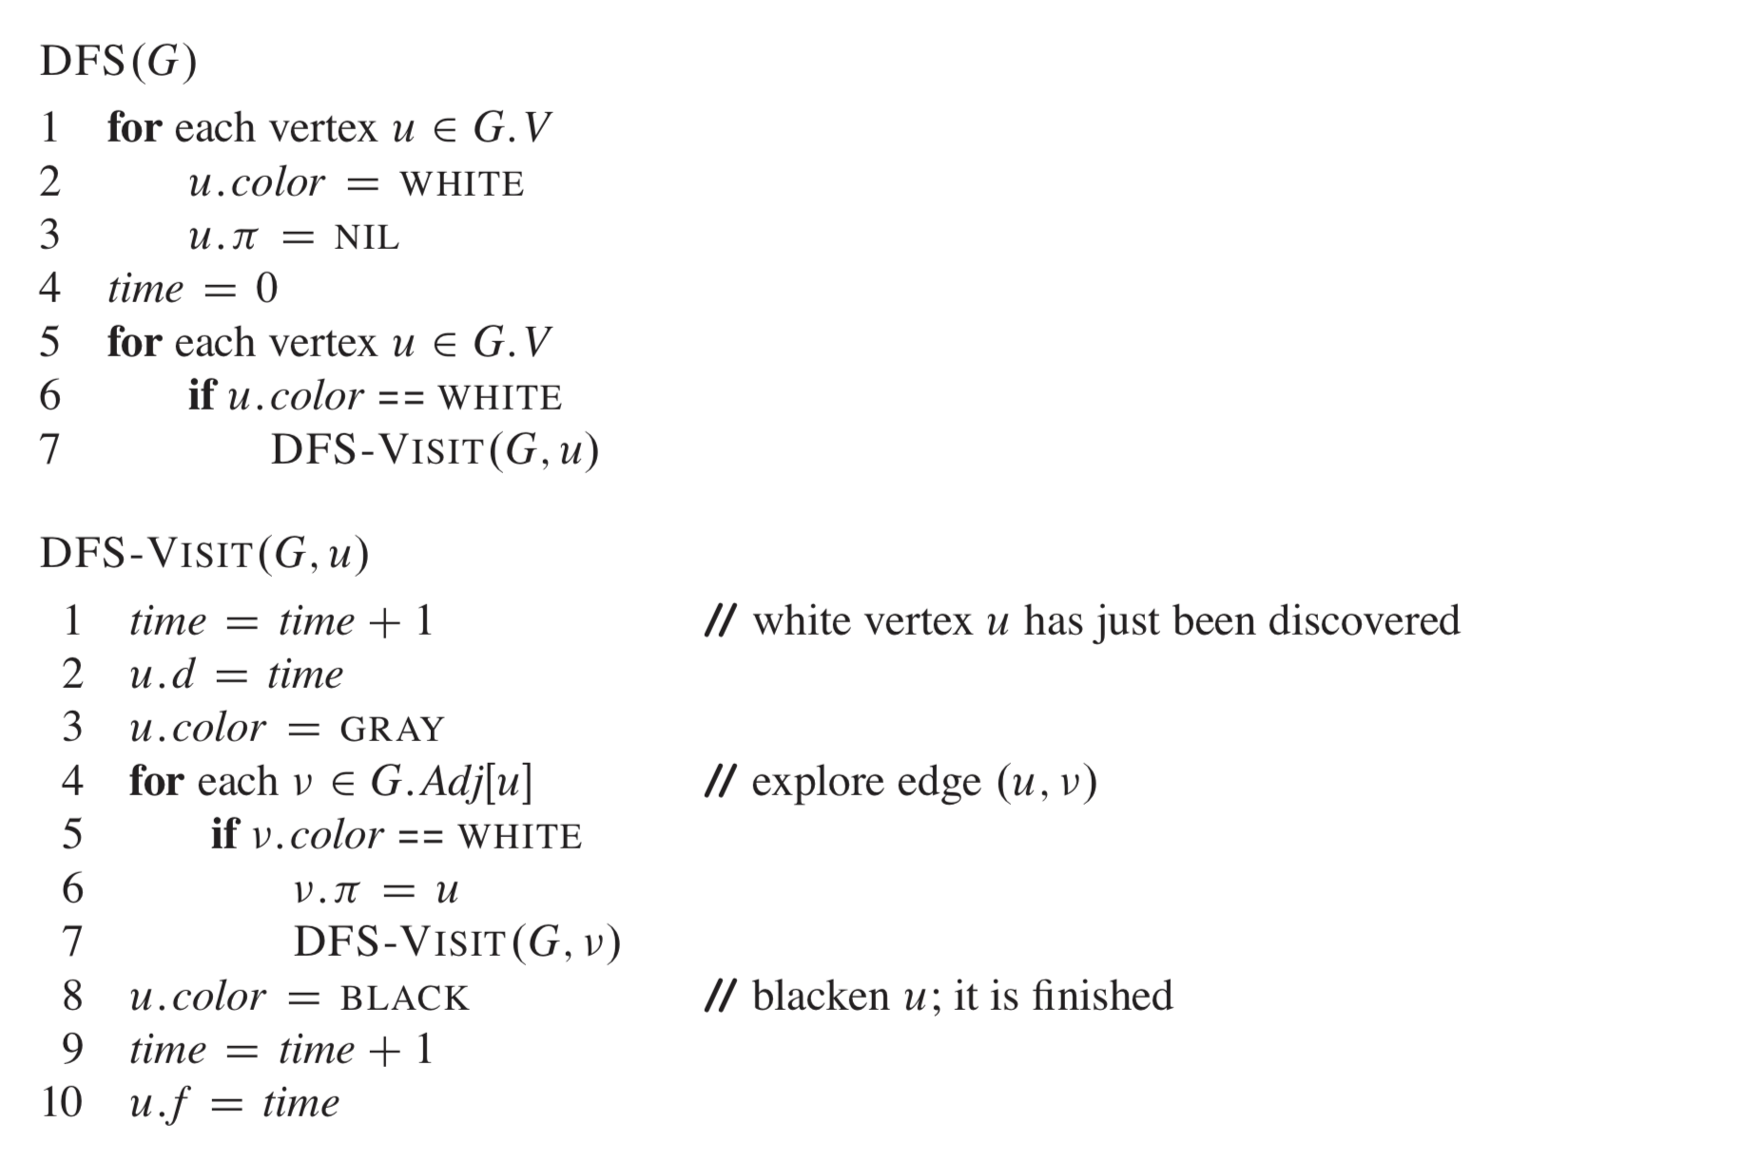

Slide 36
Insights
Two algorithms this time instead of one.
One is recursive.
Similar colors/predecessor notation as previously.
But there's other information too. f, time. ????
Let's go through it step by step.

Slide 37
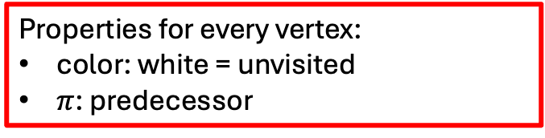
Input: G in general.
Properties for every vertex:
color: white = unvisited
$π$: predecessor
Start the "timer" (# steps/distance from starting point) at 0.
For each vertex, if it is white (unvisited), run DFS-VISIT() on it.
We discovered u, so add 1 to time, update u's distance, mark as gray (visited)
Look at each vertex adjacent to u. Visit it recursively.
We're done with u ! Mark it processed.

Slide 38
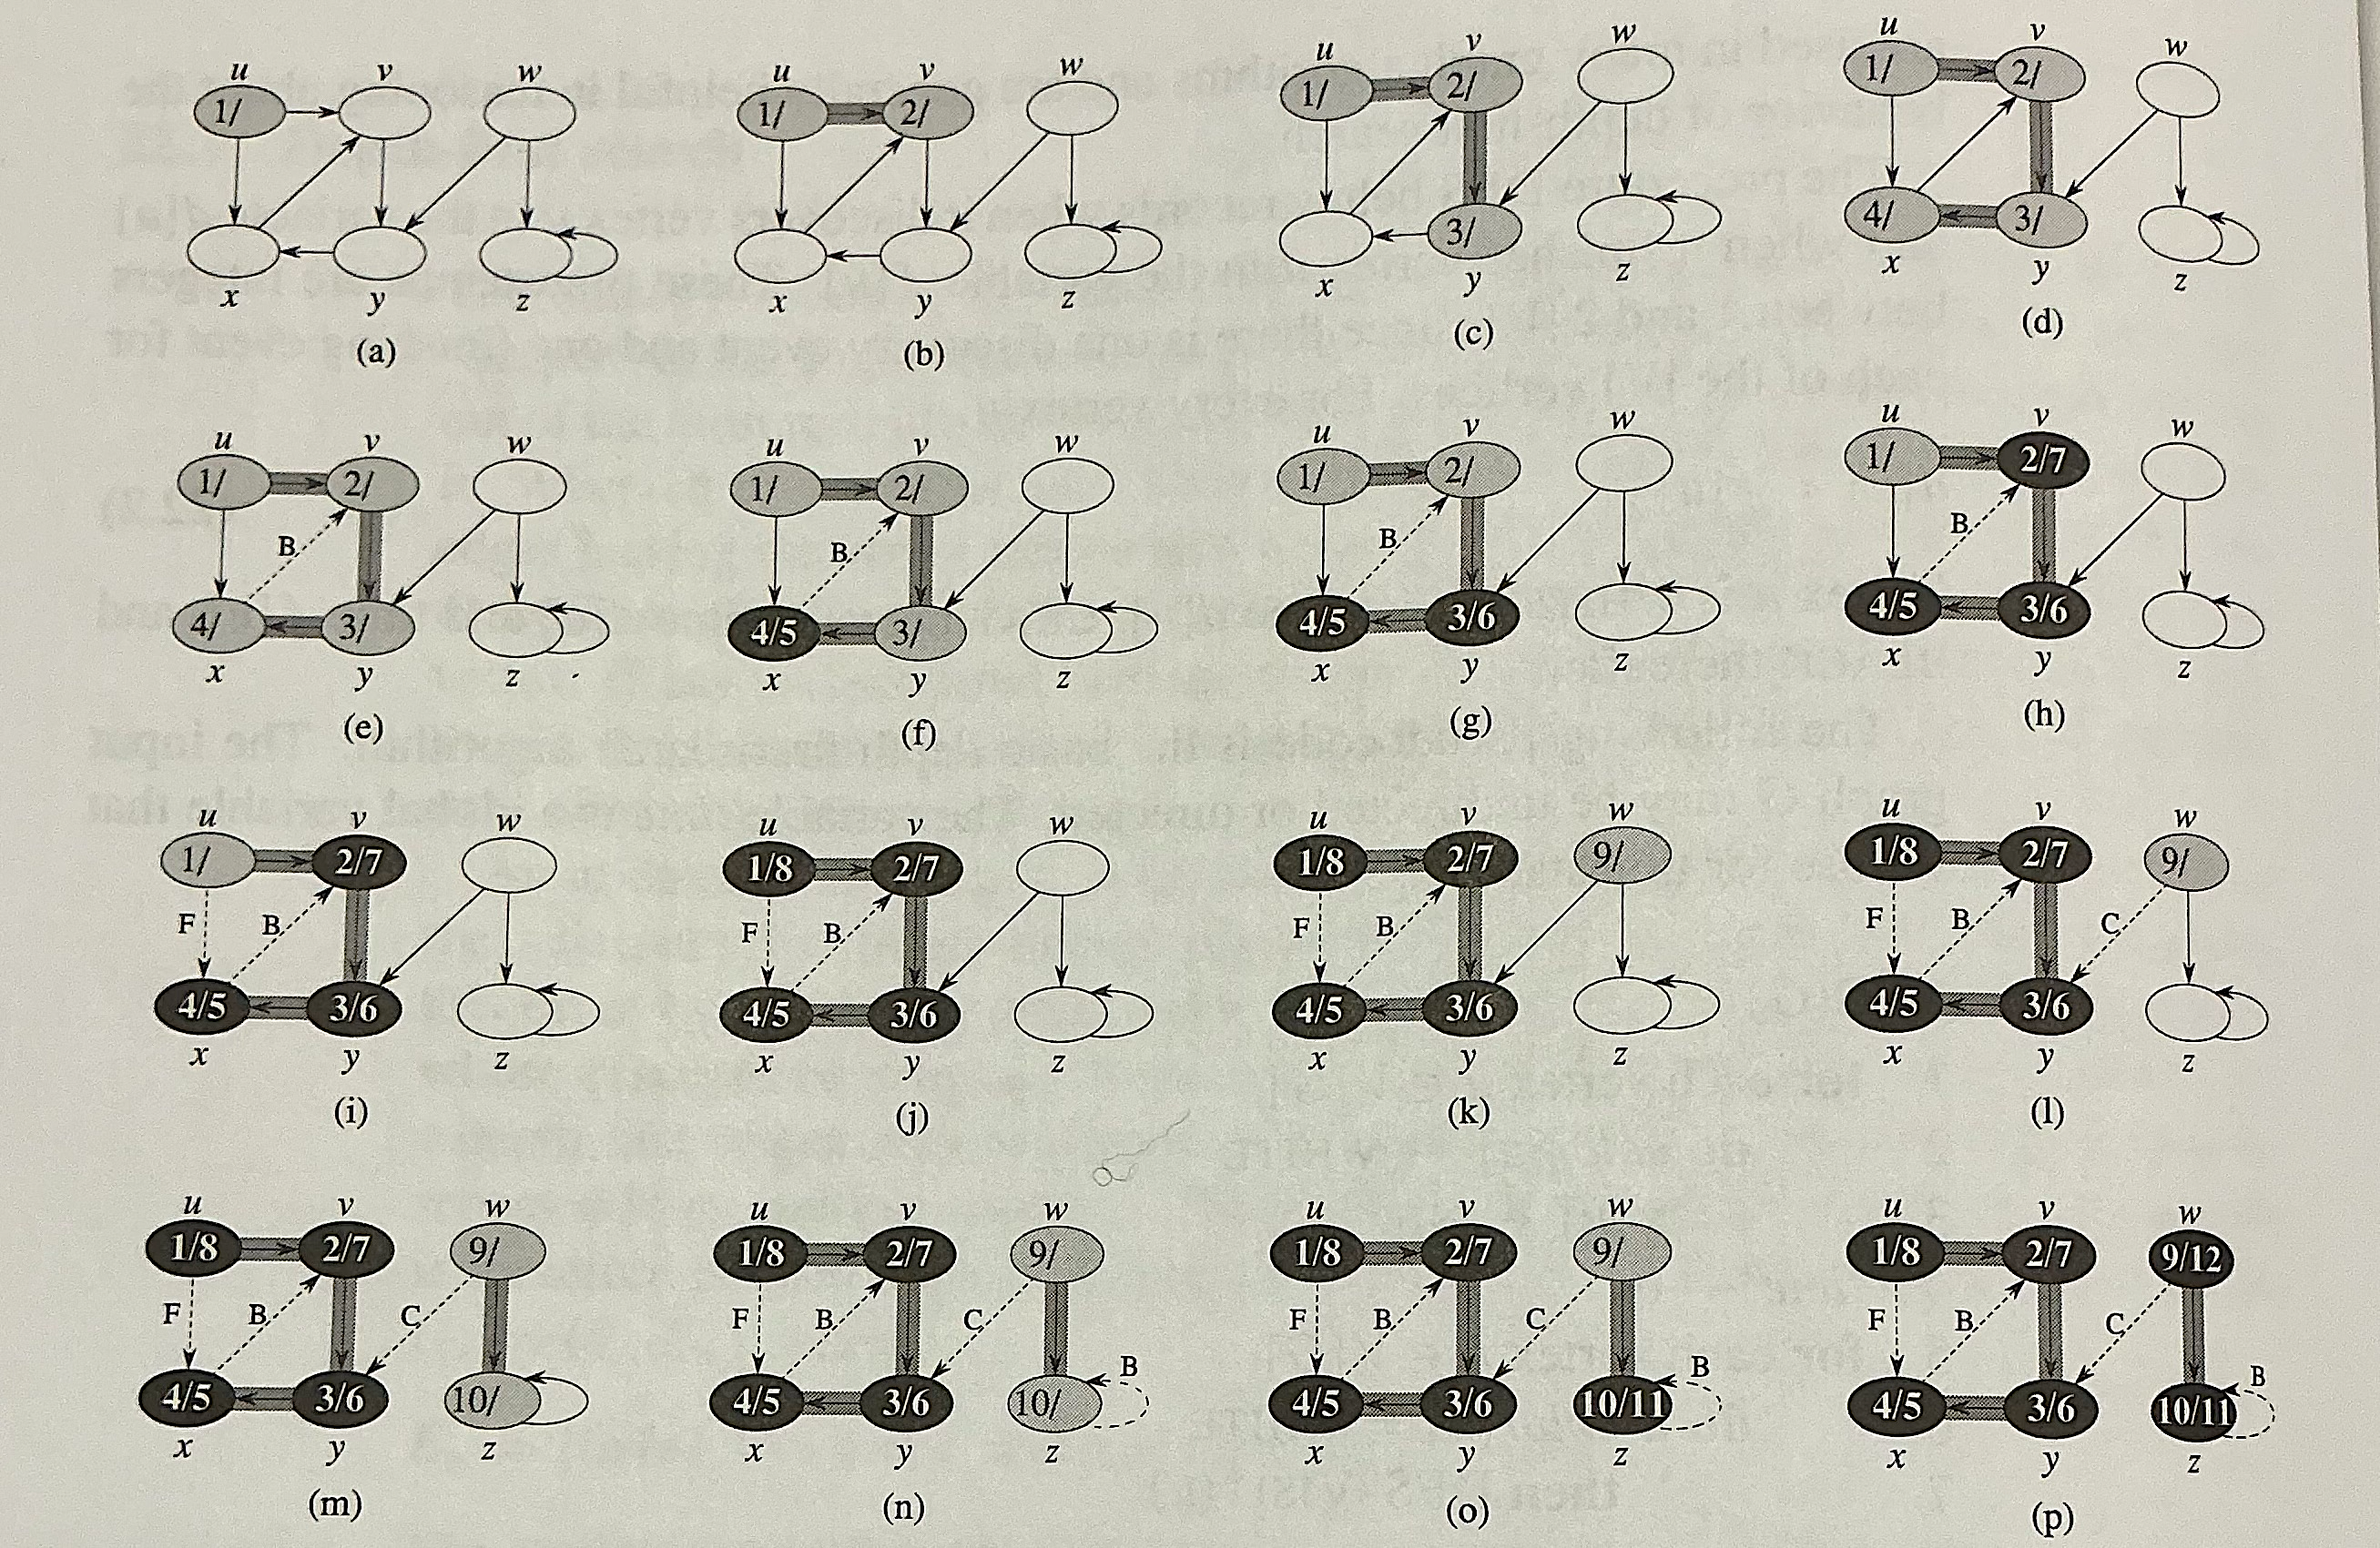
Could we run this algorithm on an undirected graph?

Slide 39
Types of edges
Tree edges
(u,v) is a tree edge if v was first discovered by exploring edge (u,v)
F = Forward edges
We could have gone "forward" in the algorithm to this node, but we've already processed it
Nontree edges (u,v) connecting u to a descendant v in a depth-first tree.
B = Back edges
Edges (u,v) connecting a vertex u to an ancestor v in a depth-first tree
Self-loops are considered back edges.
C = Cross edges
All other non-included edges.

Slide 40
DFS Algorithm v.2

Slide 41
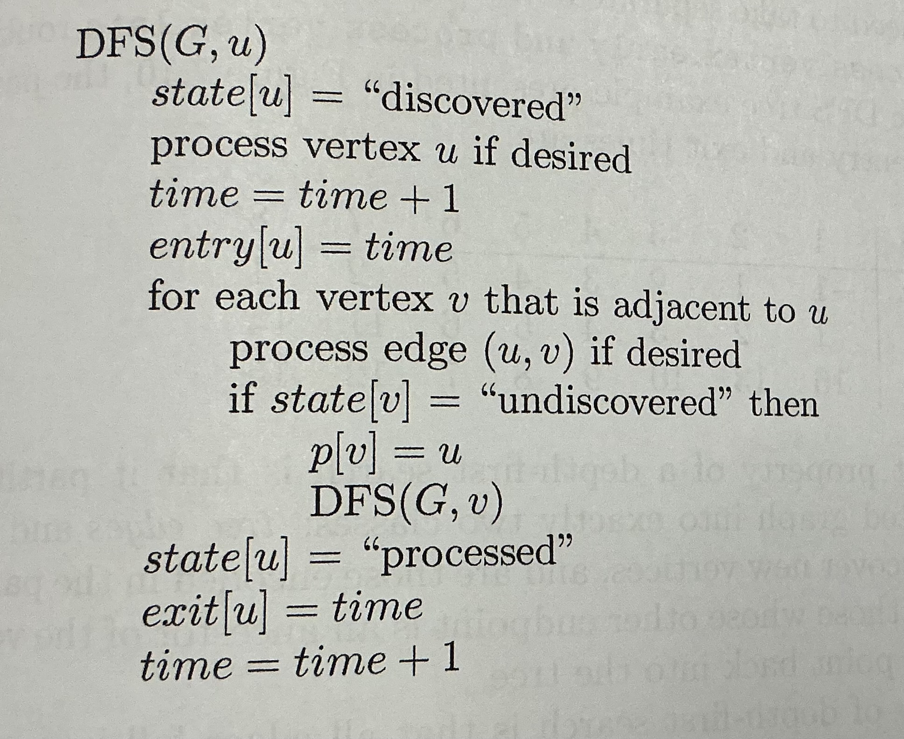
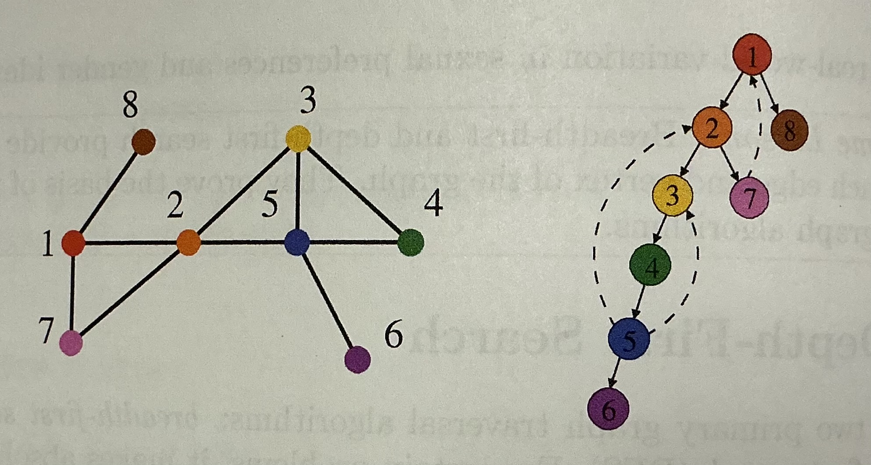

Slide 42
Dashed lines, which are not part of the tree, indicate back edges.

Slide 43
Turn and talk
What is the difference between the two DFS algorithms?
In terms of…
Notation?
The algorithmic process?
Intermediate data structures/variables?
Result?
BFS and DFS are similar algorithms. What distinguishes BFS from DFS?

Slide 45
Do Examples
Choose a starting node
Run through the algorithm
Draw on the board

Slide 46
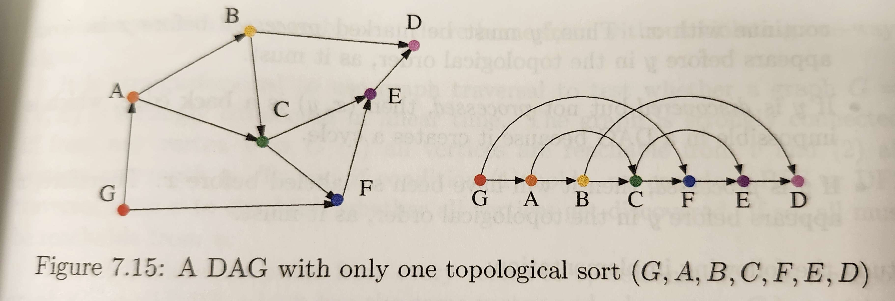
Benefits of DFS
Helps find cycles (back-edges)
Testing connectivity
Topological sorting (on directed, acyclic graphs)

Slide 47
Discuss
What did you learn from comparing different formulations of the same algorithm? (e.g. BFS – BFS; DFS – DFS)
What questions do you still have about how BFS and/or DFS work?

Slide 48
Graph Coloring

Slide 49
Why color?
Helps divide vertices into mutually exclusive groups
If chemicals x, y, and z cannot be stored together, how many different shelves are needed?
If variables are accessed in various lines of a program, how many registers are needed to store all variables?

Slide 50
How to color?
Adapt BFS or DFS.
Modify it, so that each time we process, we add a color to the vertex
Color = red/orange/yellow/etc
Color = assigned number
Such that no color can be assigned to two adjacent vertices.

Slide 51
Cool-Down: Coloring
A public aquarium has ten species of aquatic life that it wishes to feature in large tanks. However, because some of the species prey on others, they cannot all live in the same tank. We label the species A-J and show each one's "enemy" species that cannot be placed in the same tank. What is the minimum number of tanks the aquarium needs to accommodate all 10 species?
Species | Enemies | Species | Enemies
A | B,E,H,J | F | E,I
B | A, C, G, I | G | B, D, J
C | B, D | H | A, E
D | C, E, G, J | I | B, F
E | A, D, F, H, J | J | A, D, E, G

Slide 52
Cool-Down
Describe a modification to the data structure or algorithm that answers the question:
How can you use Union-Find to compute the number of connected components?
How can you use BFS to compute the number of connected components?
How can you use DFS to compute the number of connected components?

