Slide 1
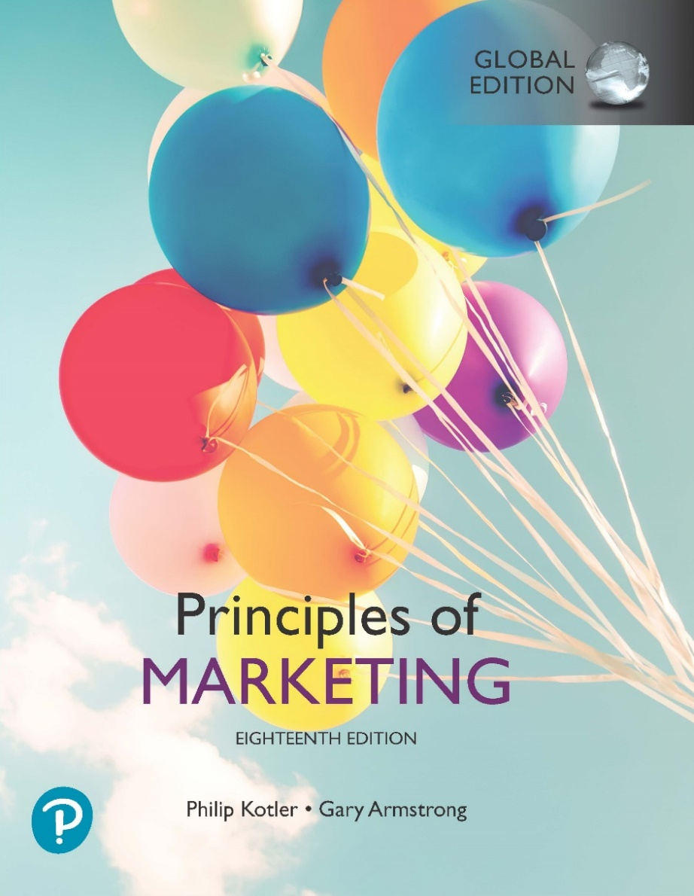
Principles of Marketing
Eighteenth Edition, Global Edition
Chapter 1
Marketing: Creating Customer Value and Engagement
Copyright © 2021 Pearson Education Ltd.
Notes:
If this PowerPoint presentation contains mathematical equations, you may need to check that your computer has the following installed:
1) Math Type Plugin
2) Math Player (free versions available)
3) NVDA Reader (free versions available)

Slide 2
Learning Objectives
1.1 Define marketing and outline the steps in the marketing process.
1.2 Explain the importance of understanding the marketplace and customers and identify the five core marketplace concepts.
1.3 Identify the key elements of a customer value-driven marketing strategy and discuss the marketing management orientations that guide marketing strategy.
1.4 Discuss customer relationship management and identify strategies for creating value for customers and capturing value from customers in return.
1.5 Describe the major trends and forces that are changing the marketing landscape in this age of relationships.

Slide 3
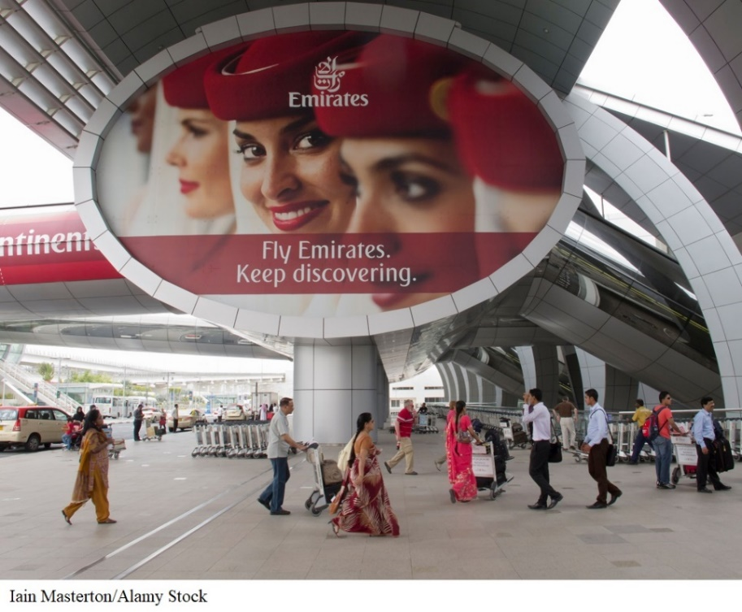
Emirates’ Customer Value–Driven Marketing: Engaging Customers and Building a Brand Community
Emirates is not just offering a way to connect people from Point A to Point B but aims to be the catalyst to connect people’s dreams, hopes, and aspirations.
Notes:
Founded in 1985, the Emirates Group operates across six continents and 144 cities. It is the largest international airline in the world.
Emirates set out to be an innovative, modern, and customer-oriented provider of high-quality air travel services.
Through the years, it has successfully and continuously created a customer-focused value proposition by offering a combination of products, services, information, and experiences customized for its market demographics for each of its destinations.
Beyond the functional benefit of air travel, Emirates marketed its services as “The Emirates Experience,” a genuine passion for comfort and attention to detail.
The company’s “Hello Tomorrow” campaign, launched in 2012 in over 80 markets, presented Emirates’ new mindset, which celebrates global travel, conveying its commitment to connect with people and help them realize their potential through travel.

Slide 4
Learning Objective 1
Define marketing and outline the steps in the marketing process.

Slide 5
What Is Marketing? (1 of 2)
Marketing is a process by which companies create value for customers and build strong customer relationships in order to capture value from customers in return.
Notes:
^{Discussion Question}
Ask students for examples of either national or local companies that are excellent at marketing and ask how they reflect the definition given in this slide.
Perhaps the simplest definition of marketing is engaging customers and managing profitable customer relationships.
The twofold goal of marketing is to:
attract new customers by promising superior value
grow current customers by delivering satisfaction
Sound marketing is critical to the success of every organization:
^{large for-profit firms}
^{not-for-profit organizations}
You already know a lot about marketing—it’s all around you:
products at your nearby shopping mall
ads that fill your TV screen and magazines, or stuff your mailbox
imaginative websites and mobile phone apps
blogs, online videos, and social media
Today’s marketers reach you directly, personally, and interactively. They want to become a part of your life and enrich your experiences with their brands—to help you live their brands.

Slide 6

What Is Marketing? (2 of 2)
Marketing is all around you, in good old traditional forms and in a host of new forms, from websites and mobile apps to online videos and social media.

Slide 7
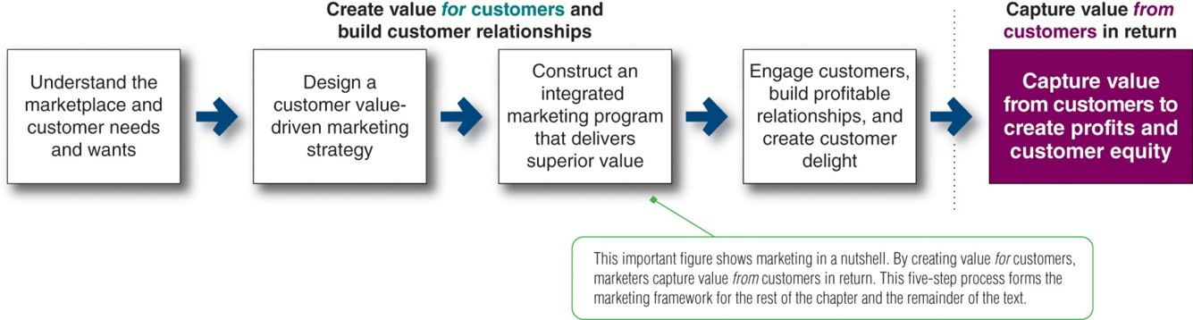
Figure 1.1 The Marketing Process: Creating and Capturing Customer Value
Notes:
This important figure shows marketing in a nutshell. By creating value for customers, marketers capture value from customers in return. This five-step process forms the marketing framework for the rest of the chapter and the remainder of the text.
This figure presents a simple, five-step model of the marketing process for creating and capturing customer value. In the first four steps, companies work to understand consumers, create customer value, and build strong customer relationships. In the final step, companies reap the rewards of creating superior customer value. The rewards are in the form of sales, profits, and long-term customer equity.
Long Description:
The heading above the chart reads: Create value for customers and build customer relationships.
The stages of the flow chart are in sequence with arrows pointing from one to the next from the left to the right as follows:
Understand the marketplace and customer needs and wants
Design a customer value-driven marketing strategy
Construct an integrated marketing program that delivers superior value
Engage customers, build profitable relationships, and create customer delight
Capture value from customers in return: capture value from customers to create profits and customer equity
A note corresponding to the flowchart reads "This important figure shows marketing in a nutshell. By creating value for customers, marketers capture value from customers in return. This five-step process forms the marketing framework for the rest of the chapter and the remainder of the text."

Slide 8
Learning Objective 2
Explain the importance of understanding the marketplace and customers and identify the five core marketplace concepts.

Slide 9

Understanding the Marketplace and Customer Needs (1 of 5)
Needs are states of felt deprivation.
Wants are the form human needs take as they are shaped by culture and individual personality.
Demands are human wants that are backed by buying power.
Staying close to customers: Airbnb’s CEO Brian Chesky and co-founder Joe Gebbia regularly stay at the company’s host locations, helping them shape new customer solutions based on real user experiences.
Notes:
Human needs include: basic physical needs for food, clothing, warmth, and safety; social needs for belonging and affection; and individual needs for knowledge and self-expression.
Wants are the form human needs take as they are shaped by one’s society and are described in terms of objects that will satisfy those needs.
When backed by buying power, wants become demands.
Outstanding marketing companies go to great lengths to learn about and understand their customers’ needs, wants, and demands.
Airbnb’s CEO Brian Chesky and co-founder Joe Gebbia regularly stay at the company’s host locations, helping them shape new customer solutions based on real user experiences.
Discussion Questions
Ask the students to
1) Give an example of a product (good or service) they purchased recently;
2) Tell how that product satisfied a need, want or demand.

Slide 10
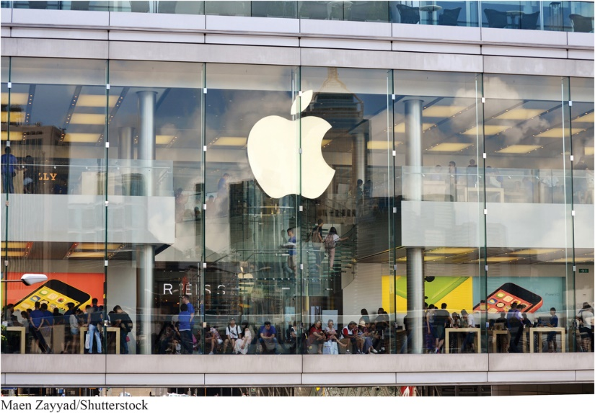
Understanding the Marketplace and Customer Needs (2 of 5)
Market offerings are some combination of products, services, information, or experiences offered to a market to satisfy a need or want.
Marketing myopia—paying more attention to the specific products than to the benefits and experiences produced
Notes:
Market offerings include other entities, such as persons, places, organizations, information, and ideas.
Many sellers suffer from marketing myopia, the mistake of paying more attention to the specific products they offer than to the benefits and experiences produced by these products. They forget that a product is only a tool to solve a consumer problem. These sellers will have trouble if a new product comes along that serves the customer’s needs better or less expensively. The customer will have the same need but will want the new product.
More than just selling products, Apple’s highly successful retail stores create engaging life-feels-good brand experiences.

Slide 11
Understanding the Marketplace and Customer Needs (3 of 5)
Customers form expectations about the value and satisfaction of market offerings.
Satisfied customers buy again
Dissatisfied customers switch to competitors
Exchange is the act of obtaining a desired object from someone by offering something in return.
Marketing actions try to create, maintain, and grow desirable exchange relationships.
Notes:
Consumers face a broad array of products and services that might satisfy a given need. Customers form expectations about the value and satisfaction that various market offerings will deliver. Satisfied customers buy again and tell others about their good experiences. Dissatisfied customers switch to competitors and criticize the product to others.
Marketers should set the right level of expectations. If they set expectations too low, they may satisfy those who buy, but fail to attract enough buyers. If they set expectations too high, buyers will be disappointed.
Customer value and customer satisfaction are key building blocks for developing and managing customer relationships.
Marketing occurs when people decide to satisfy their needs and wants through exchange relationships. Exchange is the act of obtaining a desired object from someone by offering something in return. Marketing consists of actions taken to create, maintain, and grow desirable exchange relationships with target audiences involving a product, service, idea, or other object. Companies want to build strong relationships by consistently delivering superior customer value.

Slide 12
Understanding the Marketplace and Customer Needs (4 of 5)
A market is the set of actual and potential buyers.
Consumers market when they:
search for products
interact with companies to obtain information
make purchases
Notes:
A market is the set of actual and potential buyers of a product or service. Sellers must search for buyers, identify their needs, design good market offerings, set prices for them, promote them, and store and deliver them. Although marketing was traditionally carried out by sellers, the concept now also includes consumers. Consumers engage in marketing when they search for products, interact with companies to obtain information, and make their purchases. Thus, in addition to customer relationship management, companies must also deal with customer-managed relationships as customers are empowered and marketing is made a two-way affair.

Slide 13
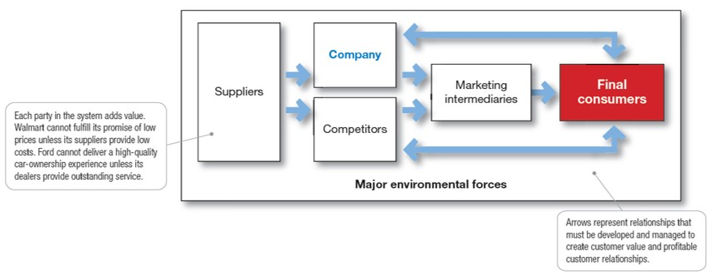
Understanding the Marketplace and Customer Needs (5 of 5)
Figure 1.2 A Modern Marketing System
Notes:
A market is the set of actual and potential buyers of a product or service. These buyers share a particular need or want that can be satisfied through exchange relationships.
Figure 1.2 shows the main elements in a marketing system.
Each party in the system adds value for the next level and is affected by major environmental forces (demographic, economic, natural, technological, political, and social/cultural).
Marketing means managing markets to bring about profitable customer relationships. Activities such as consumer research, product development, communication, distribution, pricing, and service are core marketing activities.
Buyers also carry out marketing. Thus, in addition to customer relationship management, today’s marketers must also deal effectively with customer-managed relationships.
Marketers are no longer asking only “How can we influence our customers?” but also “How can our customers influence us?” and even “How can our customers influence each other?”
Long Description:
The details of the flowchart are as follows:
Heading: Major environmental forces
Suppliers points to:
Company
Competitors
Together they lead to Marketing intermediaries which points to Final consumers.
Two bi-directional arrows connect final consumers with company as well as with competitors.
Two notes correspond to the flowchart. Note 1 reads "Arrows represent relationships that must be developed and managed to create customer value and profitable customer relationships." Note 2 reads "Each party in the system adds value. Walmart cannot fulfill its promise of low prices unless its suppliers provide low costs. Ford cannot deliver a high-quality car-ownership experience unless its dealers provide outstanding service."

Slide 14
Learning Objective 3
Identify the key elements of a customer value-driven marketing strategy and discuss the marketing management orientations that guide marketing strategy.

Slide 15
Designing a Customer Value-Driven Marketing Strategy (1 of 6)
Marketing management is the art and science of choosing target markets and building profitable relationships with them.
What customers will we serve (target market)?
How can we best serve these customers (value proposition)?
Notes:
Discussion Question
Ask students to describe a market segment they are a part of for a specific product, such as athletic or fitness equipment or clothing.
Now that the company fully understands its consumers and the marketplace, it must decide which customers it will serve and how it will bring them value.
The marketing manager’s aim is to find, attract, keep, and grow target customers by creating, delivering, and communicating superior customer value.
To design a winning marketing strategy, the marketing manager must answer two important questions:
What customers will we serve (what’s our target market)?
How can we serve these customers best (what’s our value proposition)?

Slide 16
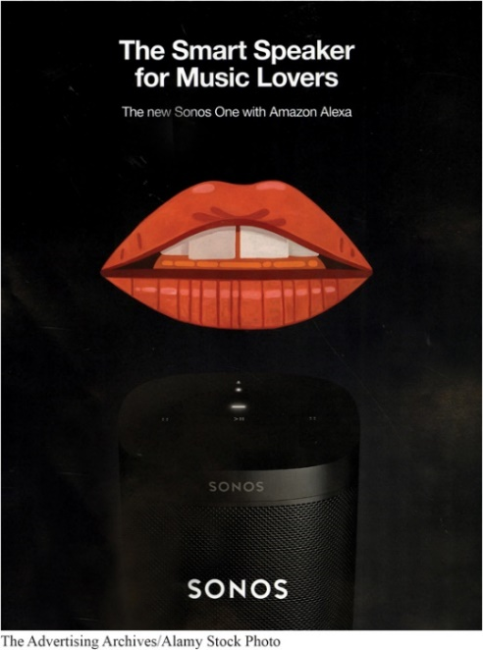
Designing a Customer Value-Driven Marketing Strategy (2 of 6)
A brand’s value proposition is the set of benefits or values it promises to deliver to customers to satisfy their needs.
Value propositions: Sonos positions its Sonos One with Amazon Alexa as “The smart speaker for music lovers.” It gives you all the advantages of Alexa but with high-quality Sonos sound.
Notes:
Value proposition: JetBlue promises to put “You Above All” by bringing “humanity back to travel.” By contrast, Spirit Airlines gives you “Bare Fare” pricing: “Less Money. More Go.” Amazon’s Echo smart speaker is “Always ready, connected, and fast. Just ask.”
Discussion Question
Have the students evaluate one of the following value propositions in terms of how well the company delivers on the proposition.
BMW promises “the ultimate driving machine.”
Nissan Leaf electric car is “100% electric. Zero gas. Zero tailpipe.”
New Balance’s Minimus shoes are “like barefoot only better.”
Vibram FiveFingers shoes: “You are the technology.”
Facebook helps you “connect and share with the people in your life.”
YouTube “provides a place for people to connect, inform, and inspire others across the globe.”
The company must decide how it will serve targeted customers—how it will differentiate and position itself in the marketplace. A brand’s value proposition is the set of benefits or values it promises to deliver to consumers to satisfy their needs.
Value propositions differentiate one brand from another. They answer the customer’s question, “Why should I buy your brand rather than a competitor’s?” Companies must design strong value propositions that give them the greatest advantage in their target markets.

Slide 17
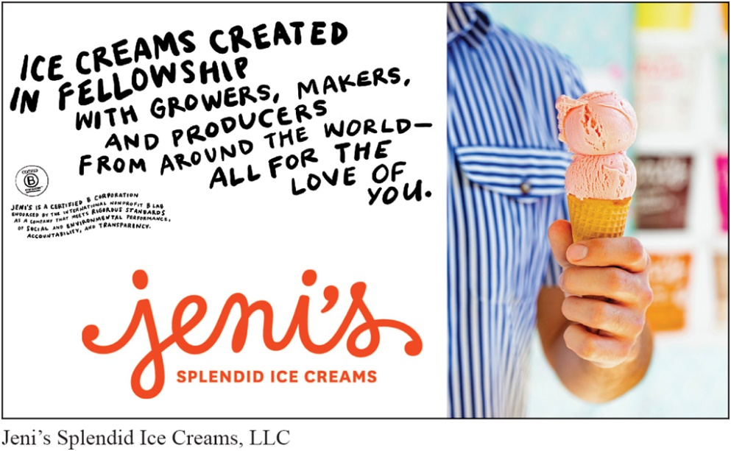
Designing a Customer Value-Driven Marketing Strategy (3 of 6)
Production concept
Product concept
Selling concept
Marketing concept
Societal Marketing concept
Notes:
There are five alternative concepts under which organizations design and carry out their marketing strategies: the production, product, selling, marketing, and societal marketing concepts.
Marketing management wants to design strategies that will build profitable relationships with target consumers.
Production concept: Consumers will favor products that are available and highly affordable.
The production concept is still a useful philosophy in some situations. For example, in the highly competitive, price-sensitive Chinese market, both personal computer maker Lenovo and home appliance maker Haier dominate through low labor costs, high production efficiency, and mass distribution.
However, although useful in some situations, the production concept can lead to marketing myopia and losing sight of the real objective—satisfying customer needs and building customer relationships.
Product concept: Consumers favor products that offer the most quality, performance, and features.
The focus is on continuous product improvements. Product quality and improvement are important parts of most marketing strategies. However, focusing only on the company’s products can also lead to marketing myopia. For example, some manufacturers believe that if they can “build a better mousetrap, the world will beat a path to their doors.”
But they are often rudely shocked. Buyers may be looking for a better solution to a mouse problem but not necessarily for a better mousetrap. The better solution might be a chemical spray, an exterminating service, a house cat, or something else that suits their needs even better than a mousetrap.
Selling concept: Consumers will not buy enough of the firm’s products unless the firm undertakes a large-scale selling and promotion effort.
The selling concept is typically practiced with unsought goods—those that buyers do not normally think of buying, such as life insurance or blood donations. These industries must be good at tracking down prospects and selling them on a product’s benefits.
Such aggressive selling, however, carries high risks. It focuses on creating sales transactions rather than on building long-term, profitable customer relationships.
Marketing concept: Know the needs and wants of the target markets and deliver the desired satisfactions better than competitors.
Under the marketing concept, customer focus and value are the paths to sales and profits.
Instead of a product-centered make-and-sell philosophy, the marketing concept is a customer-centered sense-and-respond philosophy. The job is not to find the right customers for your product but to find the right products for your customers.
For societal marketing concept, Jeni’s Splendid Ice Creams are a good example. Jeni’s Splendid Ice Cream does more than just make good ice cream. It makes “ice creams created in fellowship with growers, makers, and producers from around the world all for the love of you.”

Slide 18
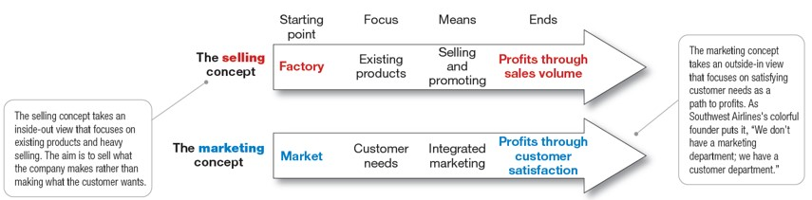
Designing a Customer Value-Driven Marketing Strategy (4 of 6)
Figure 1.3 Selling and Marketing Concepts Contrasted
Notes:
Figure 1.3 contrasts the selling concept and the marketing concept. The selling concept takes an inside-out perspective. It starts with the factory, focuses on the company’s existing products, and calls for heavy selling and promotion to obtain profitable sales. It focuses primarily on customer conquest—getting short-term sales with little concern about who buys or why.
In contrast, the marketing concept takes an outside-in perspective. As Herb Kelleher, the colorful founder of Southwest Airlines, once put it, “We don’t have a marketing department; we have a customer department.”
The marketing concept starts with a well-defined market, focuses on customer needs, and integrates all the marketing activities that affect customers. In turn, it yields profits by creating relationships with the right customers based on customer value and satisfaction.
Long Description:
The details of the figure are as follows:
The selling concept includes:
Starting point: Factory
Focus: Existing products
Means: Selling and promoting
Ends: Profits through sales volume
The marketing concept includes:
Starting point: Market
Focus: Customer needs
Means: Integrated marketing
Ends: Profits through customer satisfaction
The note corresponding to the selling concept reads "The selling concept takes an inside-outside view that focuses on existing products and heavy selling. The aim is to sell what the company makes rather than making what the customer wants."
The note corresponding to the marketing concept reads "The marketing concept takes and outside-in view that focuses on satisfying customer needs as a path to profits. As Southwest Airlines' colorful founder puts it, 'We don’t have a marketing department; we have a customer department.'"

Slide 19
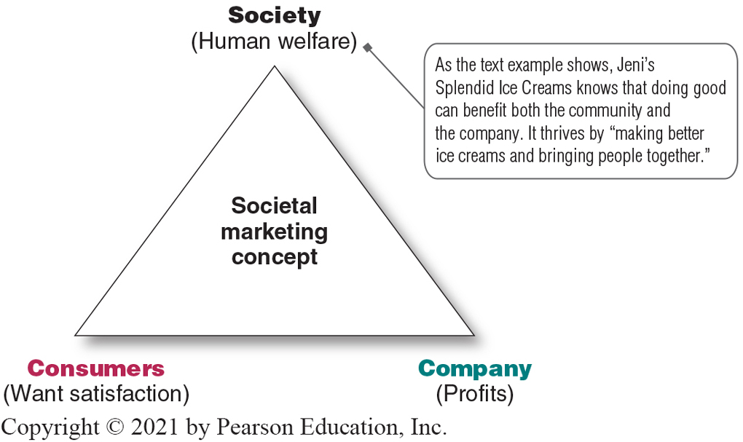
Designing a Customer Value-Driven Marketing Strategy (5 of 6)
Societal marketing:
The company’s marketing decisions should consider consumers’ wants, the company’s requirements, consumers’ long-run interests, and society’s long-run interests.
Figure 1.4 Three Considerations Underlying the Societal Marketing Concept
Notes:
The societal marketing concept questions whether the pure marketing concept overlooks possible conflicts between consumer short-run wants and consumer long-run welfare. Is a firm that satisfies the immediate needs and wants of target markets always doing what’s best for its consumers in the long run?
The societal marketing concept holds that marketing strategy should deliver value to customers in a way that maintains or improves both the consumer’s and society’s well-being. It calls for sustainable marketing, socially and environmentally responsible marketing that meets the present needs of consumers and businesses while also preserving or enhancing the ability of future generations to meet their needs.
Even more broadly, many leading business and marketing thinkers are now preaching the concept of shared value, which recognizes that societal needs, not just economic needs, define markets.
Figure 1.4 shows that companies should balance three considerations in setting their marketing strategies: company profits, consumer wants, and society’s interests.
Discussion Question
Ask students how the societal marketing concept influences their buying decisions, including brand selection and where they make purchases.
What companies can you identify with social marketing?
What do these companies do that ties to the societal marketing concept?
Long Description:
The Societal Marketing Concept is depicted as a triangle, with society (human welfare) at the apex, consumers (want satisfaction) at the left of the base, and company (profits) at the right of the base.
A note corresponding to society (human welfare) at the apex of the triangle reads "As the text example shows, Jeni's Splendid Ice Creams knows that doing good can benefit both the community and the company. It thrives by 'making better ice creams and bringing people together.'

Slide 20
Designing a Customer Value-Driven Marketing Strategy (6 of 6)
The marketing mix is comprised of a set of tools known a the four Ps:
product
price
promotion
place
Integrated marketing program—a comprehensive plan that communicates and delivers intended value
Notes:
The company’s marketing strategy outlines which customers it will serve and how it will create value for these customers. Next, the marketer develops an integrated marketing program that will actually deliver the intended value to target customers. The marketing program builds customer relationships by transforming the marketing strategy into action. It consists of the firm’s marketing mix, the set of marketing tools the firm uses to implement its marketing strategy.
The major marketing mix tools are classified into four broad groups called the four Ps of marketing: product, price, place, and promotion. To deliver on its value proposition, the firm must first create a need-satisfying market offering (product). It must then decide how much it will charge for the offering (price) and how it will make the offering available to target consumers (place). Finally, it must engage target consumers, communicate about the offering, and persuade consumers of the offer’s merits (promotion).
The firm must blend each marketing mix tool into a comprehensive integrated marketing program that communicates and delivers the intended value to chosen customers.

Slide 21
Learning Objective 4
Discuss customer relationship management and identify strategies for creating value for customers and capturing value from customers in return.

Slide 22
Managing Customer Relationships and Capturing Customer Value (1 of 9)
Customer relationship management—the overall process of building and maintaining profitable customer relationships by delivering superior customer value and satisfaction.
Notes:
The first three steps in the marketing process—understanding the marketplace and customer needs, designing a customer value-driven marketing strategy, and constructing a marketing program—all lead up to the fourth and most important step: building and managing profitable customer relationships.
We first discuss the basics of customer relationship management. Then, we examine how companies go about engaging customers on a deeper level in this age of digital and social marketing.
Customer relationship management is perhaps the most important concept of modern marketing. Some marketers define it narrowly as a customer data management activity (a practice called CRM). By this definition, it involves managing detailed information about individual customers and carefully managing customer touchpoints to maximize customer loyalty.
In the broader sense, customer relationship management is the overall process of building and maintaining profitable customer relationships by delivering superior customer value and satisfaction. It deals with all aspects of acquiring, engaging, and growing customers.

Slide 23

Managing Customer Relationships and Capturing Customer Value (2 of 9)
Relationship Building Blocks
Customer-perceived value
The difference between total customer perceived benefits and customer cost
Customer satisfaction
The extent to which perceived performance matches a buyer’s expectations
Customer satisfaction: Customer service champion L.L.Bean was founded on a philosophy of complete customer satisfaction. “If you are not 100% satisfied with one of our products, you may return it within one year of purchase for a refund.”
Notes:
The key to building lasting customer relationships is to create superior customer value and satisfaction. Satisfied customers are more likely to be loyal customers and give the company a larger share of their business.
A customer buys from the firm that offers the highest customer-perceived value—the customer’s evaluation of the difference between all the benefits and all the costs of a market offering relative to those of competing offers.
Customer satisfaction depends on the product’s perceived performance relative to a buyer’s expectations. If the product’s performance falls short of expectations, the customer is dissatisfied. If performance matches expectations, the customer is satisfied. If performance exceeds expectations, the customer is highly satisfied or delighted.
Outstanding marketing companies go out of their way to keep important customers satisfied. Most studies show that higher levels of customer satisfaction lead to greater customer loyalty, which in turn results in better company performance. Smart companies aim to delight customers by promising only what they can deliver and then delivering more than they promise.
Delighted customers not only make repeat purchases but also become willing marketing partners and “customer evangelists” who spread the word about their good experiences to others.
Long Description:
The smartphone screen shows a pair of L. L. Bean boots and the accompanying text reads "Our Guarantee: We stand behind all our products and are confident that they will perform as designed. If you are not 100 percent satisfied with one of our products, you may return it within one year of purchase for a refund. After one year, we will consider any items for return that are defective due to materials or craftsmanship."

Slide 24
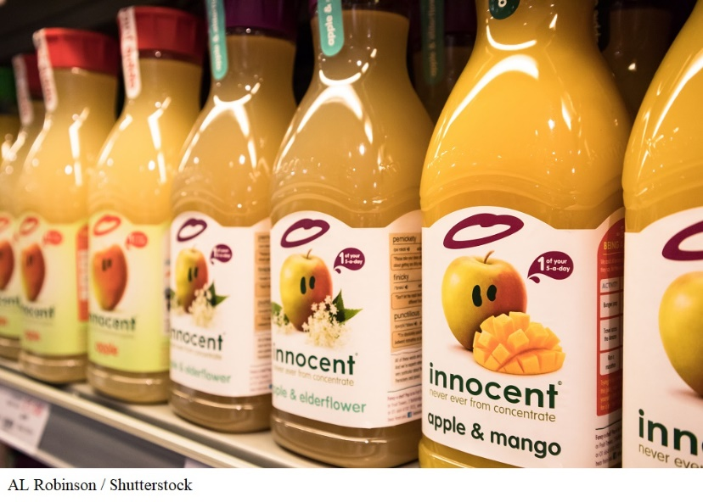
Managing Customer Relationships and Capturing Customer Value (3 of 9)
Customer-Engagement Marketing
Fosters direct and continuous customer involvement in shaping brand conversations, experiences, and community.
Engaging customers: Rather than using intrusive, hard-sell product pitches, Innocent Drinks interacts with customers in humorous ways, inspiring conversations and fostering relationships.
Notes:
Customer-engagement marketing goes beyond just selling a brand to consumers. Its goal is to make the brand a meaningful part of consumers’ conversations and lives. Today, companies are using online, mobile, and social media to refine their targeting and to engage customers more deeply and interactively. The new marketing is customer-engagement marketing.
The burgeoning internet and social media have given a huge boost to customer-engagement marketing. Today’s consumers are better informed, more connected, and more empowered than ever before.
Discussion Question
Ask students how other companies have used Facebook, Twitter, Instagram, Snapchat, or other social networks for marketing purposes.

Slide 25
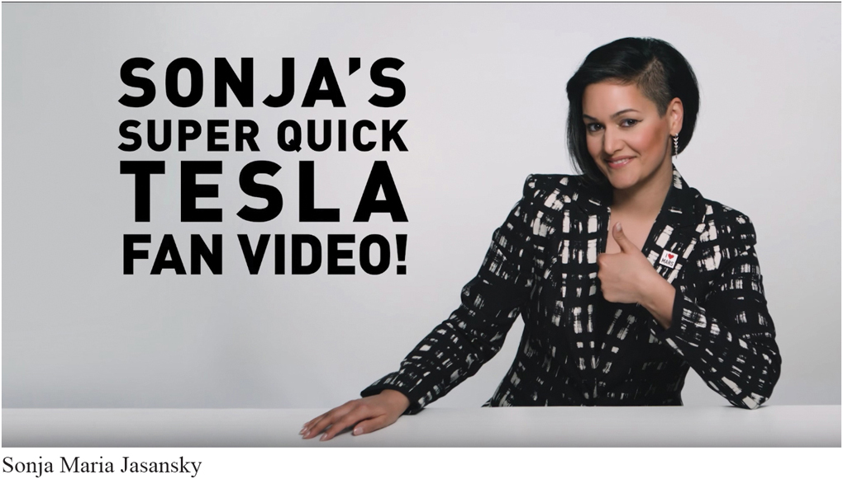
Managing Customer Relationships and Capturing Customer Value (4 of 9)
Consumer-Generated Marketing
Brand exchanges created by consumers themselves.
Consumers are playing an increasing role in shaping brand experiences.
Consumer-generated marketing: “Charmingly low-budget” fanmade Tesla ads drew millions of online views and sparked interactions among dedicated Tesla fans.
Notes:
A growing form of customer-engagement marketing is consumer-generated marketing.
This might happen through uninvited consumer-to-consumer exchanges in blogs, video-sharing sites, social media, and other digital forums. But increasingly, companies themselves are inviting consumers to play a more active role in shaping products and brand content. Some companies ask consumers for new product and service ideas.

Slide 26
Managing Customer Relationships and Capturing Customer Value (5 of 9)
Partner relationship management involves working closely with partners in other company departments and outside the company to jointly bring greater value to customers.
Notes:
In addition to being good at customer relationship management, marketers must also be good at partner relationship management—working closely with others inside and outside the company to jointly engage and bring more value to customers.
Traditionally, marketers have been charged with understanding customers and representing customer needs to different company departments. However, in today’s more connected world, every functional area in the organization can interact with customers.
Marketers must also partner with suppliers, channel partners, and others outside the company.

Slide 27
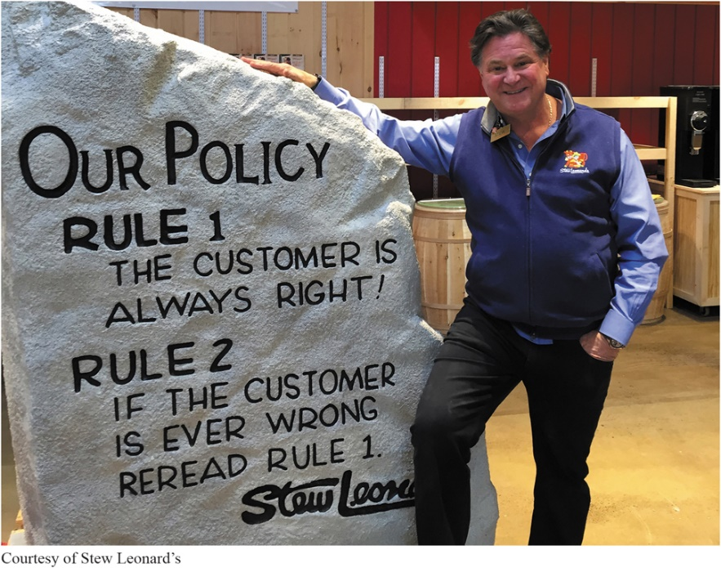
Managing Customer Relationships and Capturing Customer Value (6 of 9)
Customer lifetime value is the value of the entire stream of purchases that the customer would make over a lifetime of patronage.
Customer lifetime value: To keep customers coming back, Stew Leonard’s has created the “Disneyland of dairy stores.” Rule #1—The customer is always right. Rule #2—If the customer is ever wrong, reread Rule #1.
Notes:
At Stew Leonard’s profitable four-store supermarket, the lifetime revenue of a customer is $50,000. Because his average customer spends about $100 a week, shops 50 weeks a year, and remains in the area for about 10 years, losing one customer can be a significant loss.
Discussion Question
Ask students if they know of other retailers that build this kind of customer loyalty and retention.
Good customer relationship management creates customer satisfaction. In turn, satisfied customers remain loyal and talk favorably to others about the company and its products.
Studies show big differences in the loyalty of customers who are less satisfied, somewhat satisfied, and completely satisfied. Keeping customers loyal makes good economic sense. Loyal customers spend more and stay around longer. Research also shows that it’s five times cheaper to keep an old customer than acquire a new one. Conversely, customer defections can be costly. Losing a customer means losing more than a single sale. It means losing the entire stream of purchases that the customer would make over a lifetime of patronage.

Slide 28
Managing Customer Relationships and Capturing Customer Value (7 of 9)
Share of customer is the portion of the customer’s purchasing that a company gets in its product categories.
Notes:
Beyond simply retaining good customers to capture customer lifetime value, good customer relationship management can help marketers increase their share of customer—the share they get of the customer’s purchasing in their product categories. Thus, banks want to increase “share of wallet.” Supermarkets and restaurants want to get more “share of stomach.” Car companies want to increase “share of garage,” and airlines want greater “share of travel.”
To increase share of customer, firms can offer greater variety to current customers or they can create programs to cross-sell and up-sell to market more products and services to existing customers. For example, Amazon is highly skilled at leveraging relationships with its 237 million customers to increase its share of each customer’s spending budget.

Slide 29

Managing Customer Relationships and Capturing Customer Value (8 of 9)
Customer equity is the total combined customer lifetime values of all of the company’s customers.
Managing customer equity: To increase customer equity, Cadillac is making the classic car cool again among younger buyers. For example, says GM, “Cadillac will lead the company to an all-electric future.”
Notes:
The ultimate aim of customer relationship management is to produce high customer equity. Customer equity is the total combined customer lifetime values of all of the company’s current and potential customers. As such, it’s a measure of the future value of the company’s customer base. Clearly, the more loyal the firm’s profitable customers, the higher its customer equity. Customer equity may be a better measure of a firm’s performance than current sales or market share. Whereas sales and market share reflect the past, customer equity suggests the future.
Marketers should care not just about current sales and market share. Customer lifetime value and customer equity are the name of the game.
To increase customer equity, Cadillac is making the classic car cool again among younger buyers. For example, says GM, “Cadillac will lead the company to an all-electric future.”

Slide 30
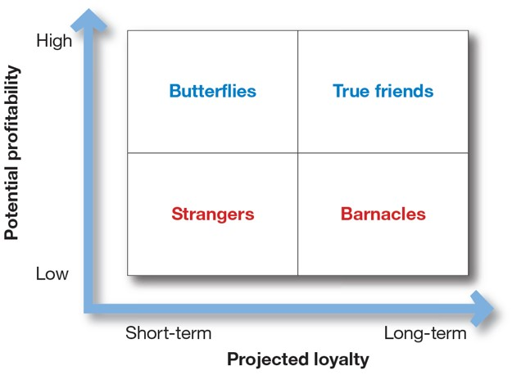
Managing Customer Relationships and Capturing Customer Value (9 of 9)
Figure 1.5 Customer Relationship Groups
Notes:
Figure 1.5 classifies customers into one of four relationship groups, according to their profitability and projected loyalty. Each group requires a different relationship management strategy.
Strangers show low potential profitability and little projected loyalty.
Butterflies are potentially profitable but not loyal.
True friends are both profitable and loyal.
Barnacles are highly loyal but not very profitable.
The point here is an important one: Different types of customers require different engagement and relationship management strategies. The goal is to build the right relationships with the right customers.
Long Description:
The horizontal axis of the diagram shows projected loyalty, moving from short-term on the left to long-term on the right.
The vertical axis shows potential of profitability, moving from low at the lower end to high at the upper end.
The details of the four quadrants are as follows:
Butterflies:
Potential of profitability: High
Projected Loyalty: Short-term
True friends:
Potential of profitability: High
Projected Loyalty: Long-term
Strangers:
Potential of profitability: Low
Projected Loyalty: Short-term
Barnacles:
Potential of profitability: Low
Projected Loyalty: long-term.

Slide 31
Learning Objective 5
Describe the major trends and forces that are changing the marketing landscape in this age of relationships.

Slide 32
The Changing Marketing Landscape (1 of 5)
Digital Age
Changing Economic Environment
Growth of Not-for-Profit Marketing
Rapid Globalization
Sustainable Marketing
Notes:
Every day, dramatic changes are occurring in the marketplace. Five major developments that are changing the marketing landscape and challenging marketing strategy include the digital age, changing economic environment, growth of not-for-profit marketing, rapid globalization, and the call for sustainable marketing practices.
We will examine these developments in more detail on the following slides.

Slide 33
The Changing Marketing Landscape (2 of 5)
We live in the age of Internet of Things, where everything is connected to everything else.
Digital and social media marketing involves using digital marketing tools such as websites, social media, mobile ads and apps, online videos, email, and blogs that engage consumers anywhere, at any time, via their digital devices.
Notes:
The explosive growth in digital technology has fundamentally changed the way we live—how we communicate, share information, access entertainment, and shop.
More than 4 billion people—55 percent of the world’s population—are now online; almost 80 percent of all American adults own smartphones. These numbers will only grow as digital technology rockets into the future.

Slide 34
The Changing Marketing Landscape (3 of 5)
Social media provide exciting opportunities to extend customer engagement and get people talking about a brand.
Mobile marketing: Using mobile channels to stimulate immediate buying, make shopping easier, and enrich the brand experience.
Big Data and AI: Brands can use big data to gain deep customer insights, personalize marketing offers, and improve customer engagements and service.
Notes:
Facebook has more than 2.3 billion active monthly users, Instagram more than 1 billion, Twitter more than 326 million, and Snapchat 186 million. Reddit, the online social news community, has 330 million users from 185 countries. But smaller, more focused social media sites are also thriving, such as CafeMom, an online community that reaches 75 million moms monthly who exchange advice, entertainment, and commiseration at the community’s online, Facebook, Twitter, Pinterest, YouTube, and mobile sites.
Mobile marketing is the fastest-growing digital marketing platform. Marketers use mobile channels to stimulate immediate buying, make shopping easier, enrich the brand experience, or all of these. For example, Starbucks customers can use their mobile devices for everything from finding the nearest Starbucks and learning about new products to placing and paying for orders.
Although online, social media, and mobile marketing offer huge potential, most marketers are still learning how to use them effectively. The key is to blend the new digital approaches with traditional marketing to create a smoothly integrated marketing strategy and mix.
Brands use big data to gain deep customer insights, personalize marketing offers, and improve customer engagements and service. To make sense of all this big data and use it to benefit their brands and customers, marketers are turning to ever-more-advanced marketing analytics.
Artificial intelligence (AI) involves machines that think and learn in a way that looks and feels human but with a lot more analytical capacity. Marketers can use AI to analyze data quickly and apply the insights to engage customers in real time and help them through the buying process.

Slide 35

The Changing Marketing Landscape (4 of 5)
Not-for-profit marketing is growing, as sound marketing can help organizations attract membership, funds, and support.
Notes:
Marketing has become a major part of the strategies of many not-for-profit organizations, such as colleges, hospitals, museums, zoos, symphony orchestras, foundations, and even churches. They face stiff competition for support and membership. Sound marketing can help them attract membership, funds, and support. For example, Alex’s Lemonade Stand Foundation is a not-for-profit organization with a special mission: “Fighting childhood cancer, one cup at a time.”
Government agencies have also shown an increased interest in marketing. For example, the U.S. military has a marketing plan to attract recruits to its different services.
Various government agencies are now designing social marketing campaigns to encourage energy conservation and concern for the environment or discourage smoking, illegal drug use, and obesity.

Slide 36
The Changing Marketing Landscape (5 of 5)
Rapid Globalization: Managers around the world are taking both local and global views of the company’s:
Industry
Competitors
Opportunities
Sustainable Marketing: Corporate ethics and social responsibility have become important for every business.
Notes:
Managers in countries around the world are increasingly taking a global, not just local, view of the company’s industry, competitors, and opportunities. They are asking: What is global marketing? How does it differ from domestic marketing? How do global competitors and forces affect our business? To what extent should we “go global”?
For example, a new internet retailer finds itself receiving orders from all over the world, while at the same time, an American consumer goods producer introduces new products into emerging markets abroad.
Marketers are reexamining their relationships with social values and responsibilities and with the very Earth that sustains us. Today’s marketers are being called on to develop sustainable marketing practices. Corporate ethics and social responsibility have gained in importance. They seek ways to profit by serving immediate needs and the best long-run interests of their customers and communities.

Slide 37
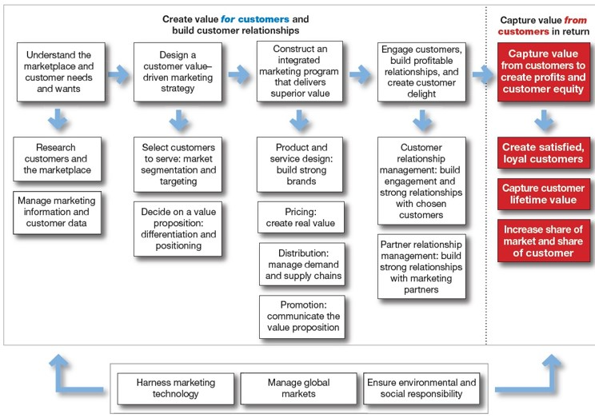
So, What Is Marketing? Pulling It All Together
Figure 1.6 An Expanded Model of the Marketing Process
Notes:
At the start of this chapter, Figure 1.1 presented a simple model of the marketing process. Now that we’ve discussed all the steps in the process, Figure 1.6 presents an expanded model that will help you pull it all together.
Long Description:
The details of the flowchart are as follows:
The heading reads "Create value for customers and build customer relationships."
It is followed by four stages leading from one to the other as follows:
Understand the marketplace and customer needs and wants
Design a customer value–driven marketing strategy
Construct an integrated marketing program that delivers superior value
Engage customers, build profitable relationships, and create customer delight
The fourth stage leads to the fifth stage under the heading "Create value from customers in return."
The fifth stage reads "Capture value from customers to create profits and customer equity."
The details of the five stages and the related points are as follows:
Understand the marketplace and customer needs and wants It leads to:
Research customers and the marketplace
Manage marketing information and customer data
Design a customer value–driven marketing strategy It leads to:
Select customers to serve: market segmentation and targeting
Decide on a value proposition: differentiation and positioning
Construct an integrated marketing program that delivers superior value It leads to:
Product and service design: build strong brands
Pricing: create real value
Distribution: manage demand and supply chains
Promotion: communicate the value proposition
Engage customers, build profitable relationships, and create customer delight It leads to:
Customer relationship management; build engagement and strong relationships with chosen customers
Partner relationship management: build strong relationships with marketing partners
Capture value from customers in return create profits and customer equity It leads to:
Create satisfied, loyal customers
Capture customer lifetime value
Increase share of market and share of customer
A bi-directional arrow at the bottom of the chart, pointing to the first stage on the left and the last stage on the right, has the following labels marked from left to right: Harness marketing technology; Manage global markets; Ensure environmental and social responsibility.
A note corresponding to the flowchart reads: "This expanded version of Figure 1.1 at the beginning of the chapter provides a good road map for the rest of the text. The underlying concept of the entire text is that marketing creates value for customers in order to capture value from customers in return."

