Slide 1
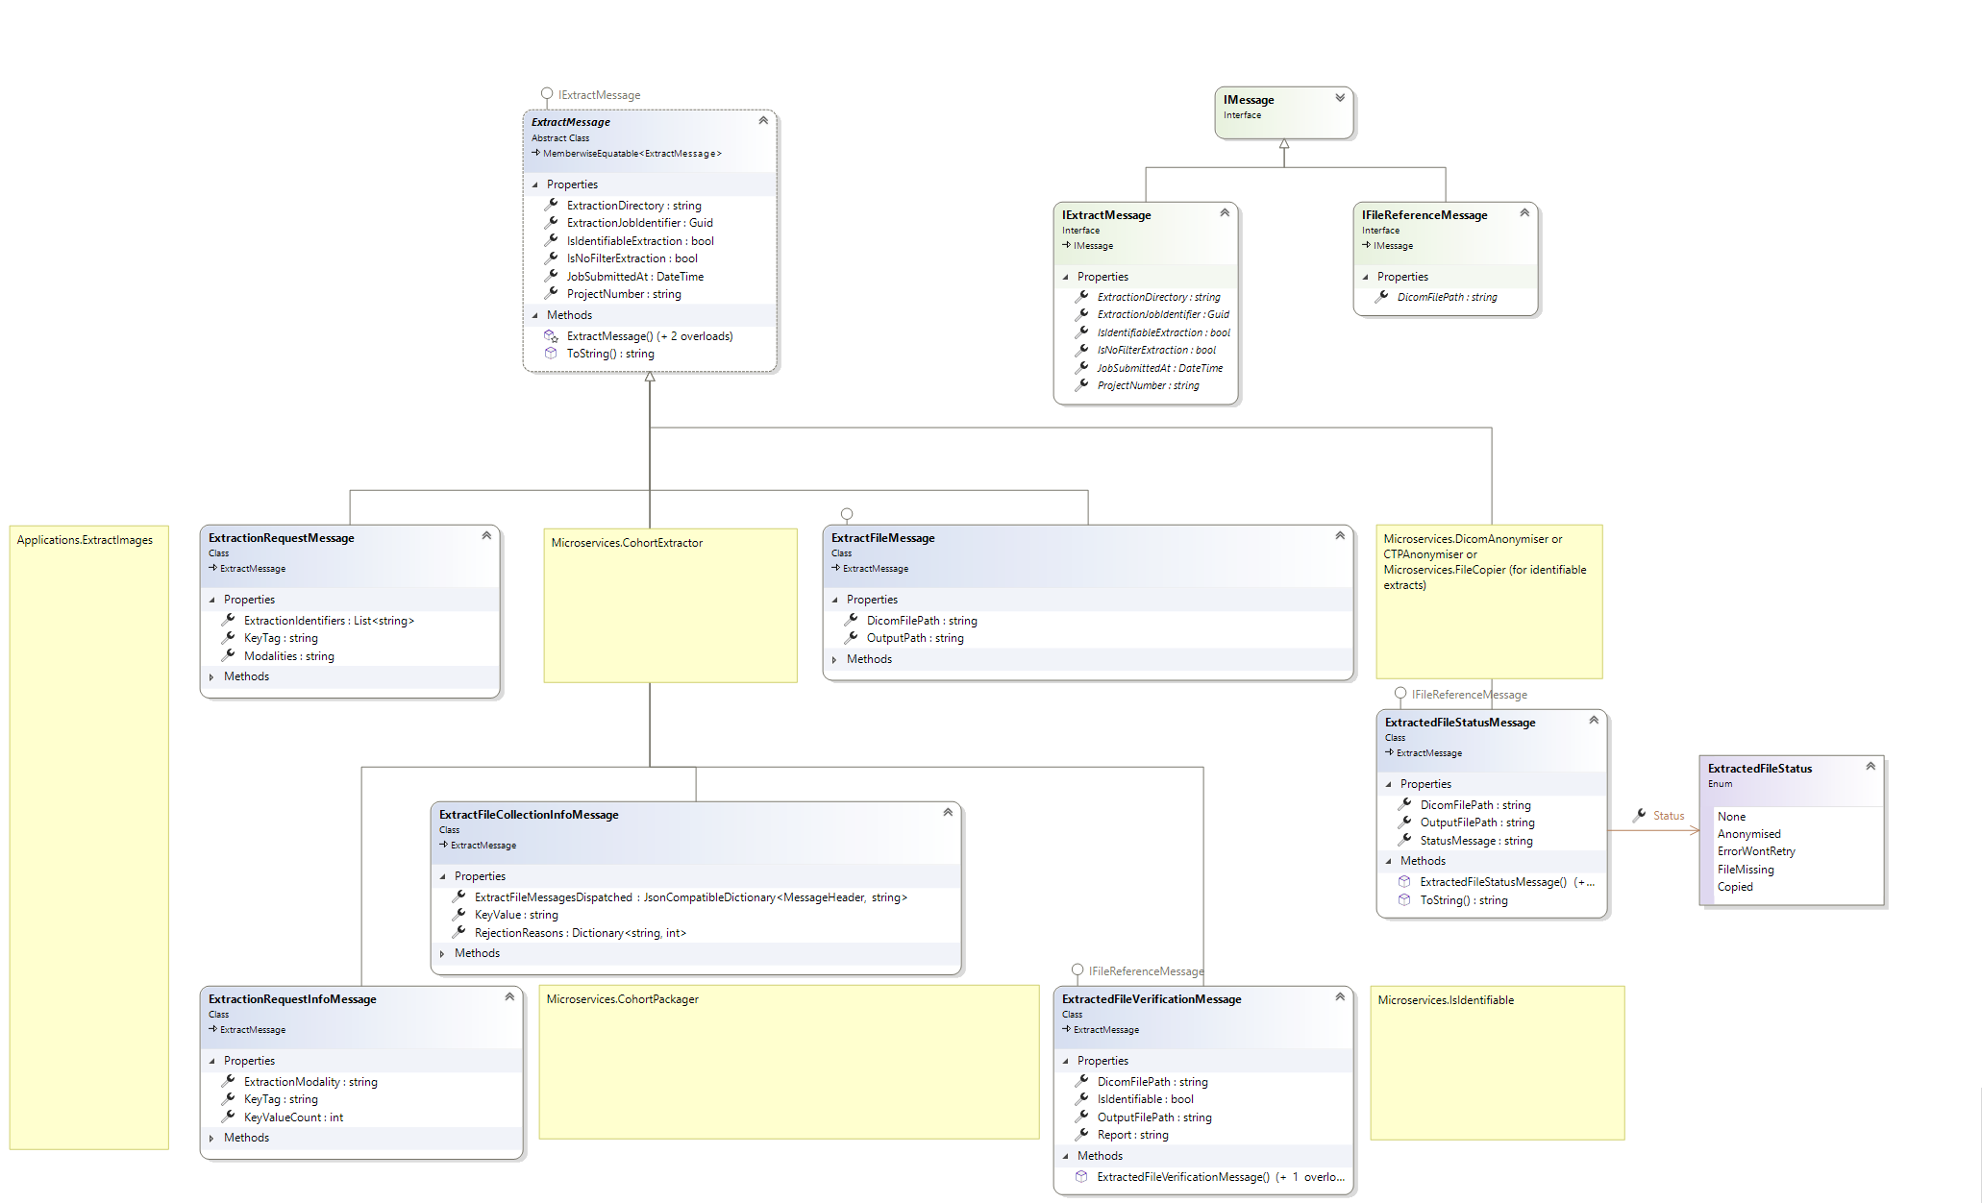
Extract the image at path x
And put it in path y
x2
I did/didn't extract an image
I was asked to process
Please extract the following
UIDs (of type KeyTag)
I ordered extraction of x files
And decided not to extract
Y because of opt out etc
I checked the anonymised
image and it does/doesn't
still contain identifiable info
I read a file of UIDs and it
had this many lines in it

