Slide 1

Disability and Health Analysis
College of Professional Studies, Northeastern University
ALY6040: DATA MINING APPLICATION
Instructor: Prof. Shahram Sattar
Presented by
Kevin Tushar Pandya, Vidhi Manojkumar Patani,
Smit Pareshbhai Ranpariya, Neha Ajinkya Nagurkar, Elvis Opoku

Slide 2
Contents
Introduction
Objectives and Techniques employed
Exploratory Data Analysis
Insights from models
Summary & Recommendations

Slide 3

Introduction
Data Source: Centers for Disease Control and Prevention
Dataset Overview:
Extensive dataset providing state-level insights into six types of functional impairments.
Focuses on overall well-being and specific needs of people with disabilities.
Machine Learning Approaches:
Utilization of multiple techniques including Decision Trees, SVM, LDA, and Logistic Regression.
Aimed at exploring disability and wellness patterns.
Assessment of each model's accuracy and effectiveness.
Data Collection and Processing:
Initial dataset comprised 644,356 items across 32 columns.
Meticulous data cleaning resulted in refinement to 17 columns.
Enhancement of quality and reliability for analysis.
Research Implications:
Analysis facilitates identification of disability patterns.
Assists in the development of improved health policies and interventions for disabled individuals.

Slide 4
Objective & Techniques employed
Research Objective and Data Preparation:
Extract insights to guide public health policies and legislative actions.
Analyze DHDS dataset to identify patterns in adult disability and health.
Initial steps involve data preprocessing, exploratory data analysis, and anomaly detection.
Advanced Analytical Models:
Use Linear Discriminating Analysis to discern differences among disability groups.
Employ Logistic Regression to predict disability status based on health and demographic data.
Data Mining Techniques:
Implement Decision Tree and Random Forest Classifiers.
Utilize Support Vector Machines to analyze disability categories.

Slide 5
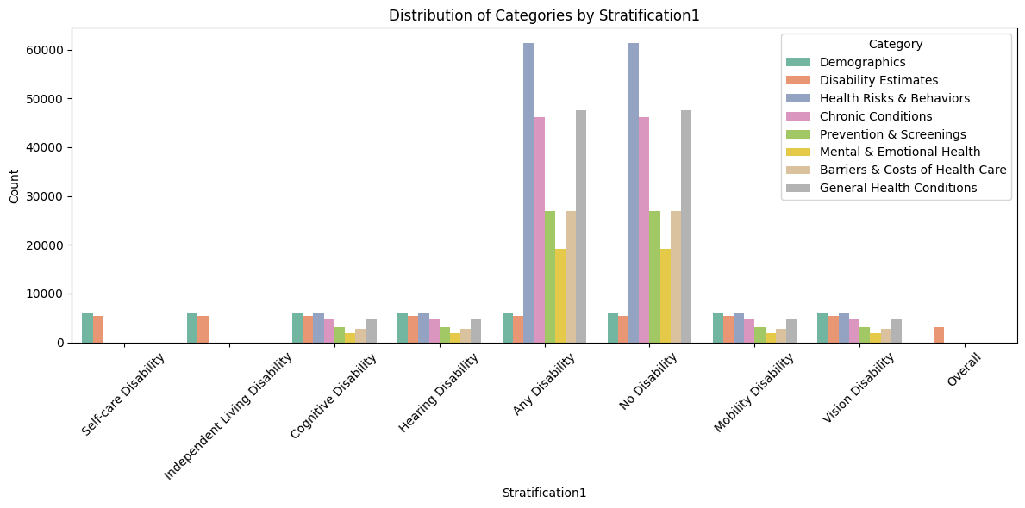
Distributions Of Target Variable
Distribution of Categories by Stratification1
Utilized a count plot to assess distribution among categories within 'Stratification1’.
Examined various demographic groupings.
Comparison of category frequencies within each demographic category.
Revealed information on relative frequency of distinct categories across different demographic groups.

Slide 6
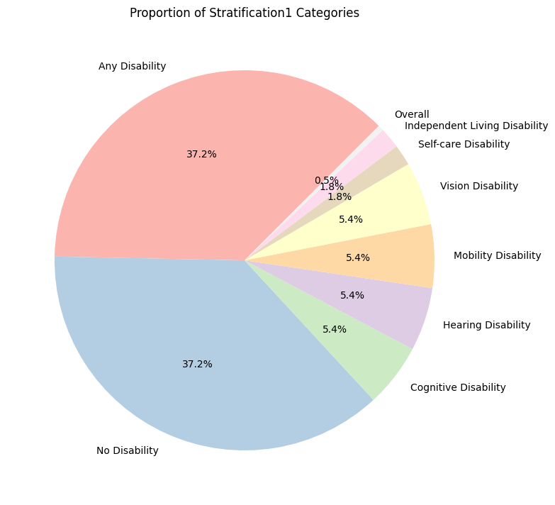
Distributions Of Target Variable
Proportion of Stratification1 Categories
Employed a pie chart to assess the fraction of 'Stratification1' groups.
Provided a comprehensive perspective of demographic makeup.
Displayed each category's proportionate contribution to the overall population.
Revealed distribution of different demographic groupings in the dataset through pie slices.

Slide 7
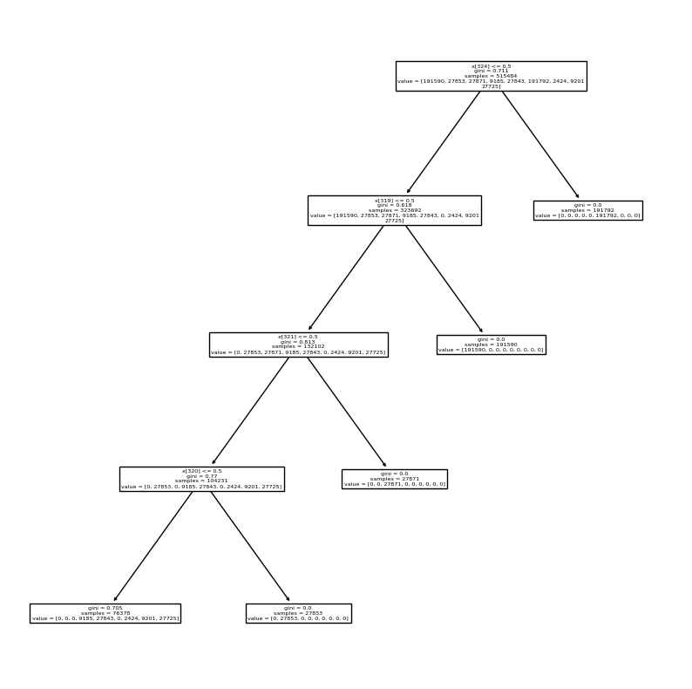
DECISION TREE CLASSIFIER
Model Creation & Analysis
Predicting handicap categories based on various dataset characteristics.
Encoded categorical parameters using one-hot encoding.
Split dataset into training and testing sets.
Decision tree depth limited to four to prevent overfitting.
Visualization of decision tree reveals hierarchical arrangement of variables aiding in prediction of handicap categories.

Slide 8
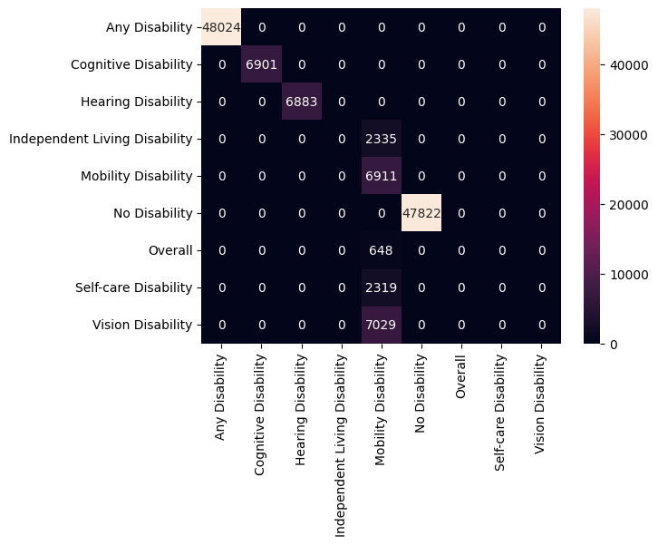
DECISION TREE CLASSIFIER INSIGHTS
Performance Metrics
Achieves a high accuracy of 90.43%, with recall, precision, and F1-score values reported for each category.
Reliable prediction of handicap kinds with excellent precision and recall in most categories.
Struggles in classifying cases of "Independent Living Disability," "Self-care Disability," & "Vision Disability" indicated by poor precision and recall scores.

Slide 9

RANDOM FOREST CLASSIFIER
Model Creation & Analysis
Enhances classification accuracy through ensemble learning by combining predictions of multiple decision trees.
Utilized to improve prediction accuracy of various handicap categories, building on decision-tree approach.
Preprocessing similar to decision-tree model, dataset divided into training and testing sets.
Random Forest set to optimal depth of four to balance complexity and performance.

Slide 10
RANDOM FOREST CLASSIFIER INSIGHTS
Performance Metrics
Achieves an accuracy of 96.98%.
Detailed metrics including precision, recall, and F1-scores for each handicap group demonstrate enhanced predictive capability.
Outperforms decision tree model in overall accuracy, recall, and precision across most handicap categories, demonstrating robustness.
Despite improvements, challenges persist in accurately predicting specific categories, notably "Hearing Disability," "Independent Living Disability," and "Self-care Disability."

Slide 11
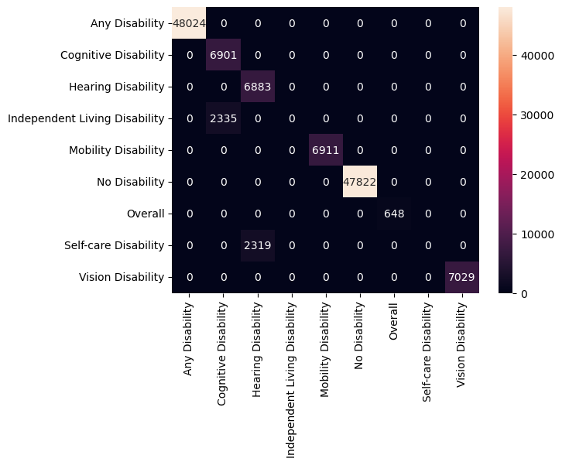
SUPPORT VECTOR MACHINE
Model Creation & Analysis
Applies advanced algorithms to categorize disability categories by maximizing margin between different classes, ensuring precise classification boundaries.
Applied to classify various handicap types in DHDS dataset. Utilizes advanced feature selection through SelectKBest with ANOVA F-value scoring to refine model inputs.
Employs radial basis function (RBF) kernel with optimized hyperparameters to handle classification task complexity effectively.

Slide 12
SUPPORT VECTOR MACHINE INSIGHTS
Performance Metrics
Achieves impressive 96.38% accuracy.
Detailed categorization report provides specific performance indicators (precision, recall) for each handicap group.
Shows strong performance with good accuracy and balanced recall and precision across various handicap categories.
Compares favorably to Decision Tree and Random Forest models.
Struggles with certain categories, particularly "Mobility Disability" and "Vision Disability," where both accuracy and recall are notably lower.

Slide 13
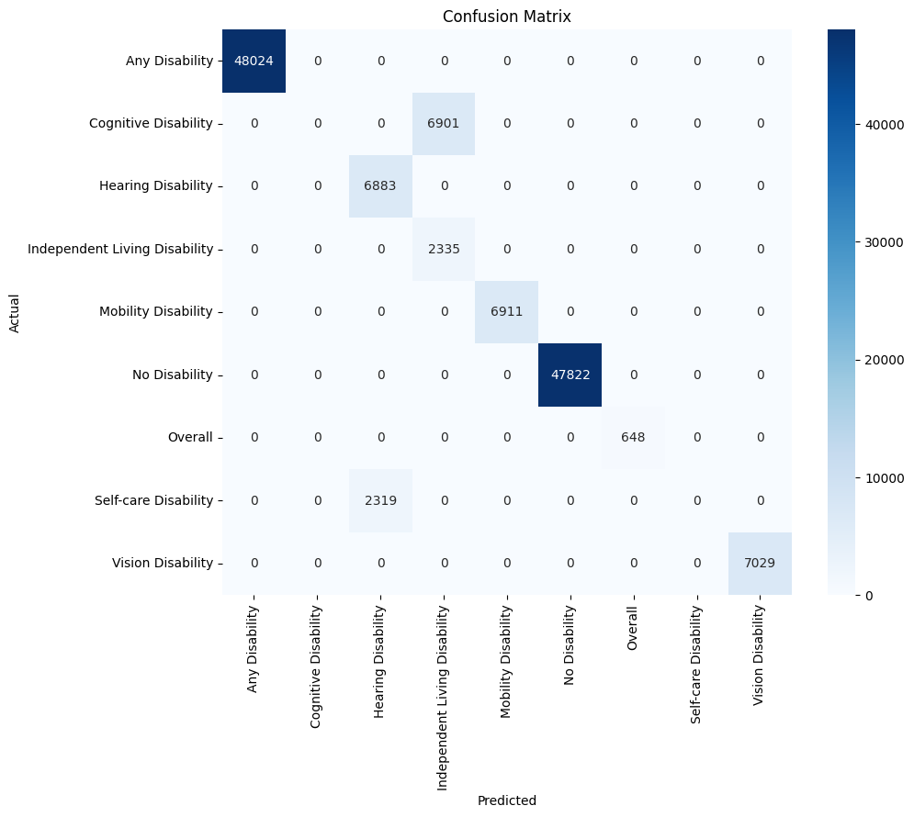
LINEAR DISCRIMINANT ANALYSIS
Model Creation & Analysis
Dimensionality Reduction Technique. LDA transforms features into a space with fewer dimensions, simplifying data while retaining necessary characteristics for accurate classification.
LDA employed to reduce dataset complexity and categorize handicap categories. Features normalized using StandardScaler for uniformity before dimensional reduction via LDA.
Identifies relevant features distinguishing between different disability groups, aiding effective dataset categorization.

Slide 14
LINEAR DISCRIMINANT ANALYSIS INSIGHTS
Performance Metrics
LDA achieves high success rate of 92.37% accuracy.
Detailed performance indicators (precision, recall, F1-scores) for each handicap category illustrate efficiency in categorization tasks.
Strong performance in classifying different handicap types. Demonstrates good accuracy, balanced precision, and recall across categories.
Model's ability to reduce dimensions enhances separation of handicap categories, leading to improved classification performance.
Struggles with certain categories, particularly “Self-care Disability" and “Cognitive Disability," where both accuracy and recall are notably lower.

Slide 15

LOGISTIC REGRESSION
Model Creation & Analysis
Employed for binary categorization of handicap categories, focusing on dichotomous outcomes to simplify analysis and enhance predictability.
Dataset undergoes comprehensive preprocessing, including imputation of missing values and one-hot encoding of categorical variables.
Confusion matrix provided to visually summarize model’s prediction performance across different categories.

Slide 16
LOGISTIC REGRESSION INSIGHTS
Performance Metrics
Logistic Regression model achieves high accuracy of 98.54% accuracy.
Excels in predicting general categories like "Any Disability" and "No Disability" with very high accuracy.
Misclassifies several specific disabilities, particularly confusing "Cognitive Disability" with "Independent Living Disability," and "Hearing Disability" with "Vision Disability."
Accurately identifies "Mobility Disability," "Self-care Disability," and "Vision Disability," showing strong performance in these specific areas.

Slide 17
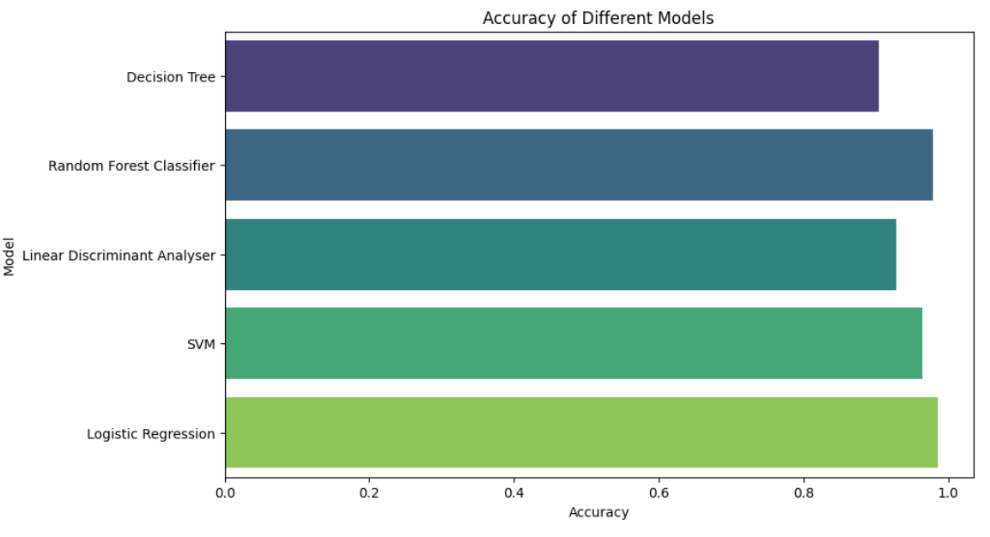
SUMMARY AND RECOMMENDATIONS
Examination of DHDS data provided insights into adult disability and health dynamics.
Models including Decision Tree, Random Forest, SVM, LDA, and Logistic Regression produced reliable predictions with accuracies ranging from 90.43% to 98.05%.. Highlighted complexities in accurately classifying certain disability types.
Further modification, including hyperparameter tuning and ensemble approaches, could enhance model performance.
Findings can shape targeted policies and initiatives to enhance well-being for persons with disabilities.

Slide 18

THANK YOU

