Slide 1
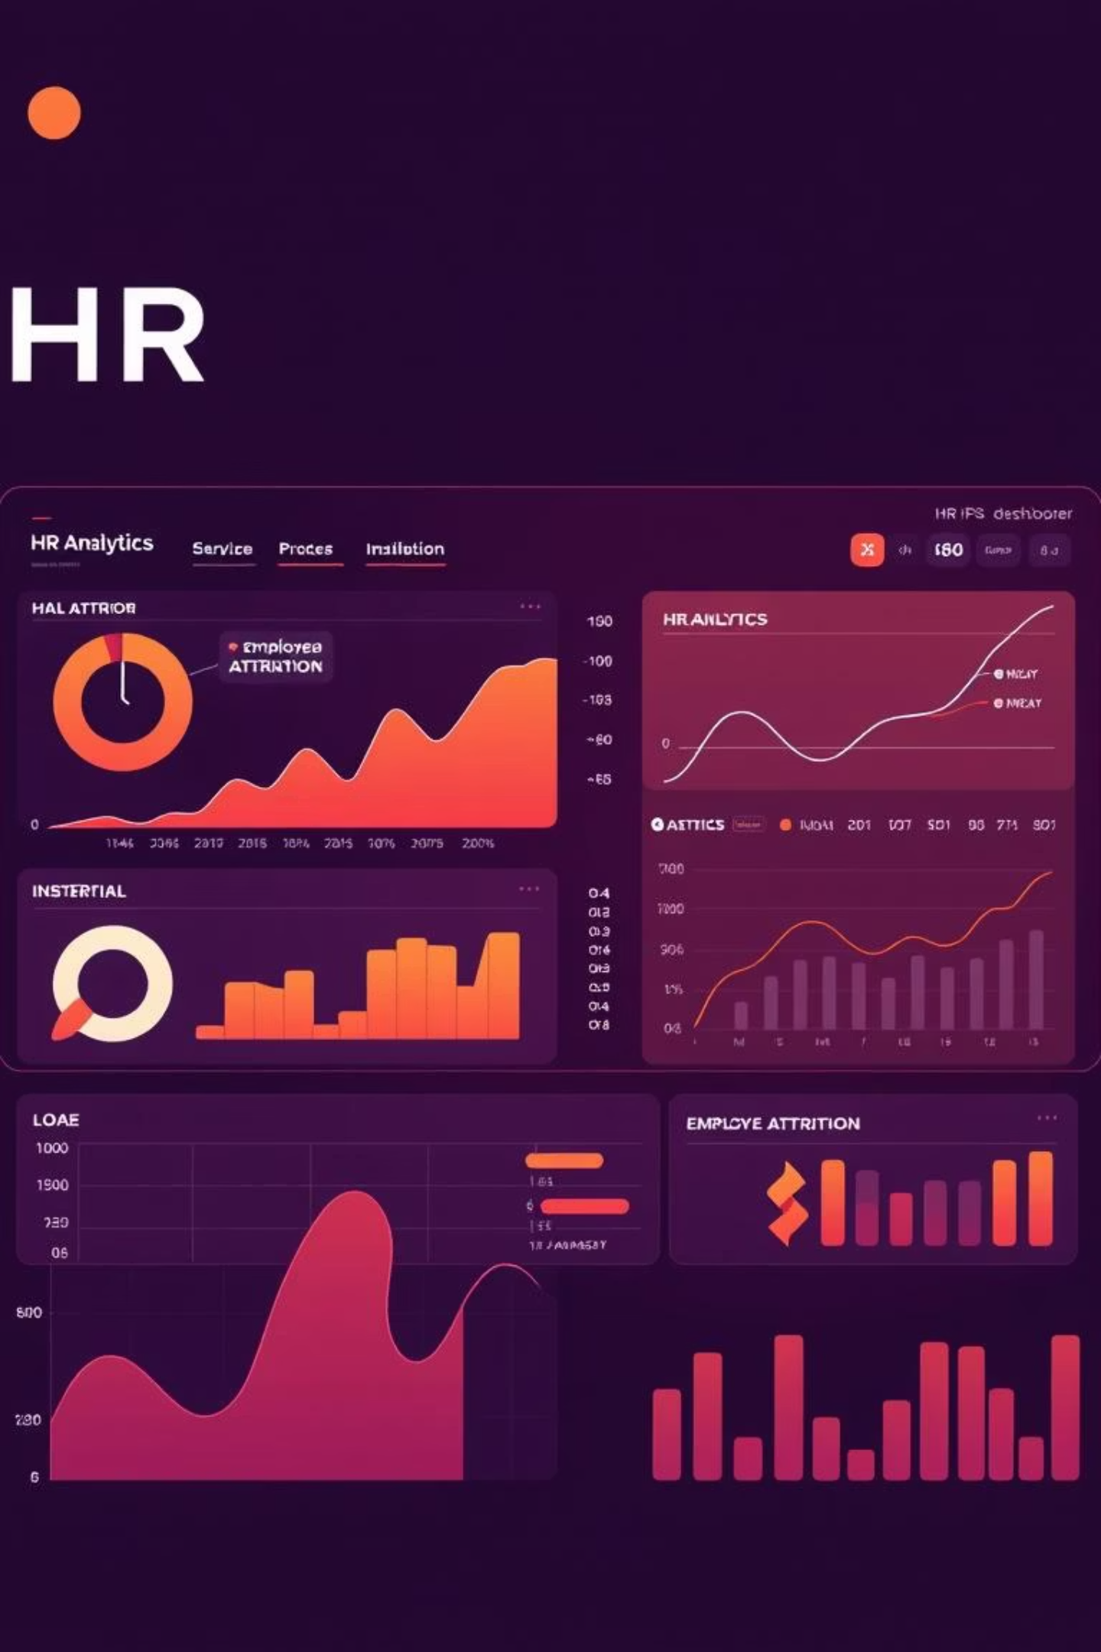
Homecrew HR Analytics: Employee Attrition Insights
Data-Driven Workforce Optimization
Presented by: Micah Chukwuemeka Okoronkwo

Slide 2
Executive Summary
This presentation delves into the critical issue of employee attrition at Homecrew Ltd., utilizing a data-driven HR analytics dashboard to uncover key trends and actionable insights. Our analysis explores attrition patterns across various demographic and organizational segments, including departments, age groups, education levels, and genders. The goal is to provide Homecrew's HR professionals and business leaders with a clear understanding of where and why talent is leaving, enabling the development of more effective retention strategies.
1500
302
41
Total Employees
Employees Attritted
Average Age
Our current workforce size.
The number of employees who have left the company.
The average age of our current employee base.
With a total of 1500 employees and 302 attritions, Homecrew faces an attrition rate of approximately 20%. This figure is a critical metric for HR planning and underscores the urgency of identifying the root causes and implementing targeted interventions to improve employee retention and foster a more stable workforce.

Slide 3
Key Metrics Overview
Understanding the foundational metrics of our workforce is essential for contextualizing attrition trends. This section provides a snapshot of Homecrew's key HR statistics, highlighting the scale of our operations and the specific challenges we face with employee turnover.
Average Monthly Income: $167,140
The current attrition rate stands at approximately 20%, which is a significant figure for HR planning and workforce stability. While our average monthly income is robust at $167.14K, the data suggests that high income alone does not guarantee low attrition. This highlights the need for deeper insights beyond compensation to understand the multifaceted drivers of employee turnover at Homecrew.
Total Employees: 1500
Departments: 6
Total Attritted: 302
Average Employee Age: 41
The presence of 6 distinct departments within the organization indicates a diverse operational structure, each potentially facing unique retention challenges. Analyzing attrition by department will be crucial for identifying specific areas requiring strategic intervention.

Slide 4
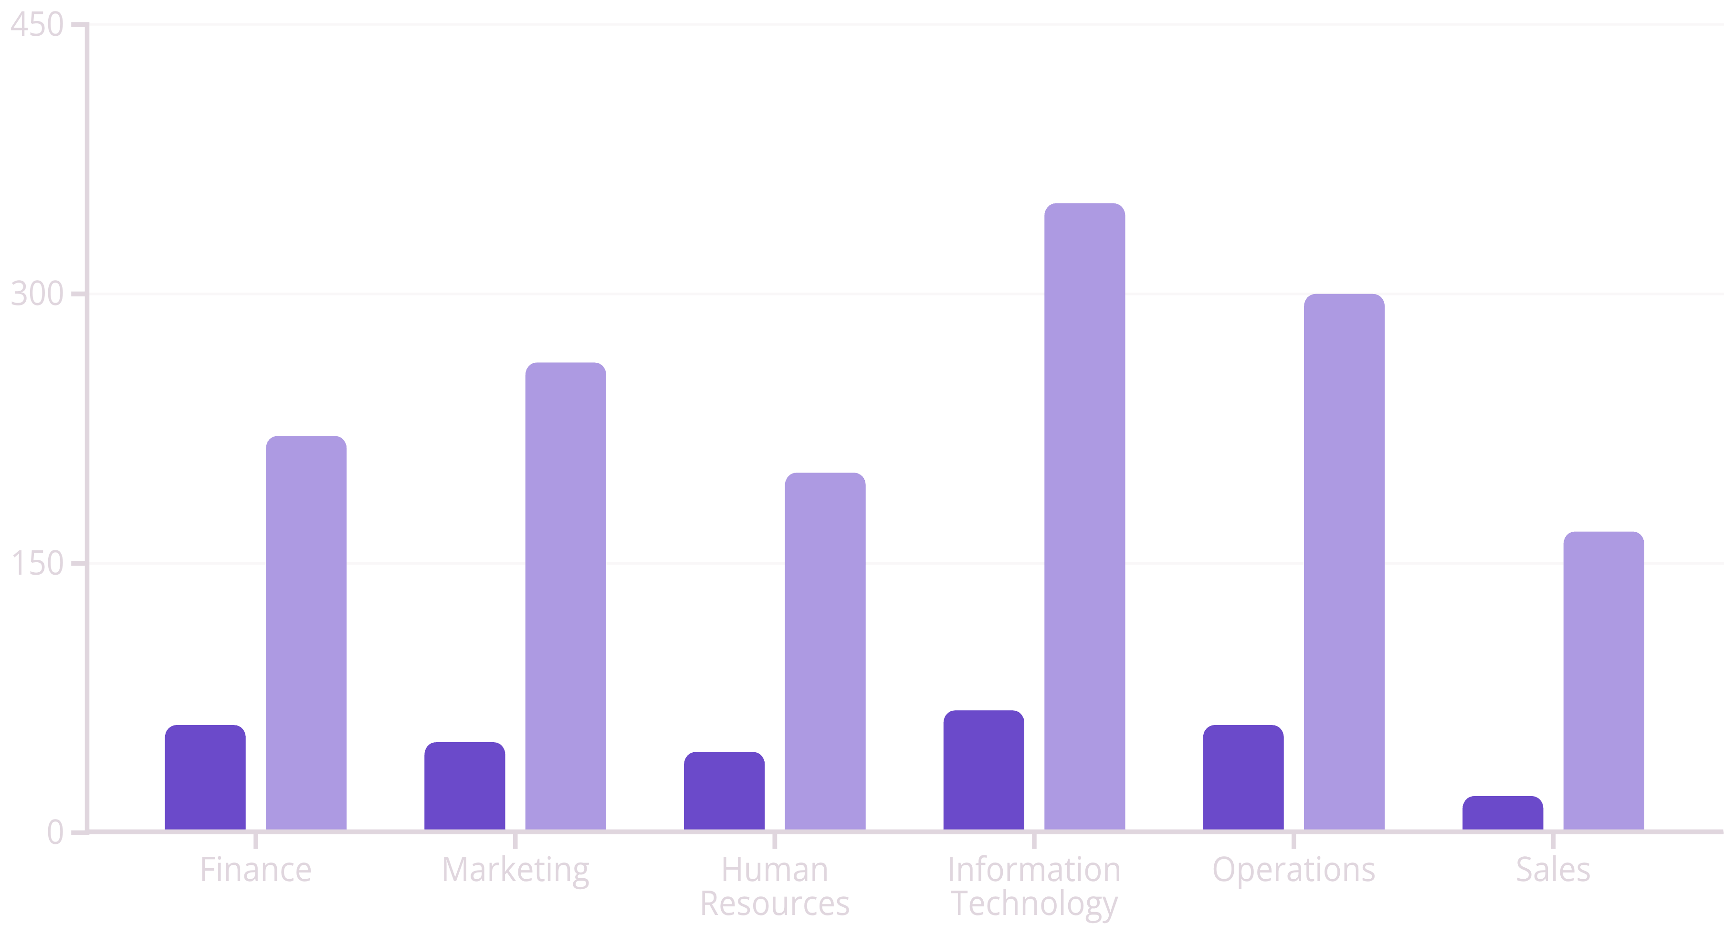
Department-Wise Attrition
Where Are We Losing Talent?
A critical step in addressing attrition is to pinpoint which departments are most affected.
This analysis reveals the departments experiencing the highest rates of employee turnover,
guiding our strategic focus for retention efforts.
Attrition Count
Total Employees
The Finance department exhibits the highest attrition count with 59 employees leaving, indicating potential underlying issues in this area. Marketing, despite having the highest employee count (262), also shows a significant attrition of 50 employees, signaling that while it's a large department, it's not immune to retention challenges. HR, IT, and Operations also demonstrate moderate losses, suggesting a widespread need for retention strategies across the organization. A strategic focus is urgently needed on these high-risk departments to stem the outflow of valuable talent.

Slide 5




Attrition by Age Group
Which Age Groups Are Most at Risk?
Understanding attrition across different age demographics is crucial for tailoring retention programs. This analysis highlights specific age groups that are more susceptible to leaving Homecrew.
Under 30
30-39
Highest attrition rate at 27.34%. This group may be seeking faster career progression, skill development, or different company cultures.
Attrition rate of 24.7%. This group often balances career growth with personal life, and competitive opportunities can be appealing.
40-49
50+
Attrition rate of 23%. Stability and recognition of experience are key for retention here.
Attrition rate of 24.95%. This group may be considering retirement or seeking roles with less pressure or more flexibility.
The data clearly indicates that employees under 30 exhibit the highest attrition rate. This suggests that younger employees may be less engaged, have lower job satisfaction, or find more appealing opportunities elsewhere early in their careers. To counteract this trend, Homecrew should consider implementing targeted early-career retention programs, such as enhanced onboarding, mentorship initiatives, clear career progression paths, and opportunities for rapid skill development, to foster greater loyalty and engagement among our younger talent.

Slide 6
Attrition by Gender and Age
Does Gender or Age Affect Attrition?
To refine our retention strategies, it's essential to understand if gender, in combination with age, plays a role in employee attrition. This analysis provides a nuanced view of turnover patterns across different demographic segments.
The analysis reveals a notable trend: female employees under 30 show the highest attrition count, with 47 individuals leaving the company. While this specific segment warrants attention, the overall attrition rates across other age groups appear to be relatively balanced between genders. This suggests that while there might be specific challenges for young female employees, Homecrew's attrition issue is primarily driven by age rather than gender across the broader workforce. Therefore, retention strategies should be primarily age-informed, focusing on the unique needs and career aspirations of younger employees, rather than being broadly gender-based, to ensure the most effective allocation of HR resources and efforts.

Slide 7
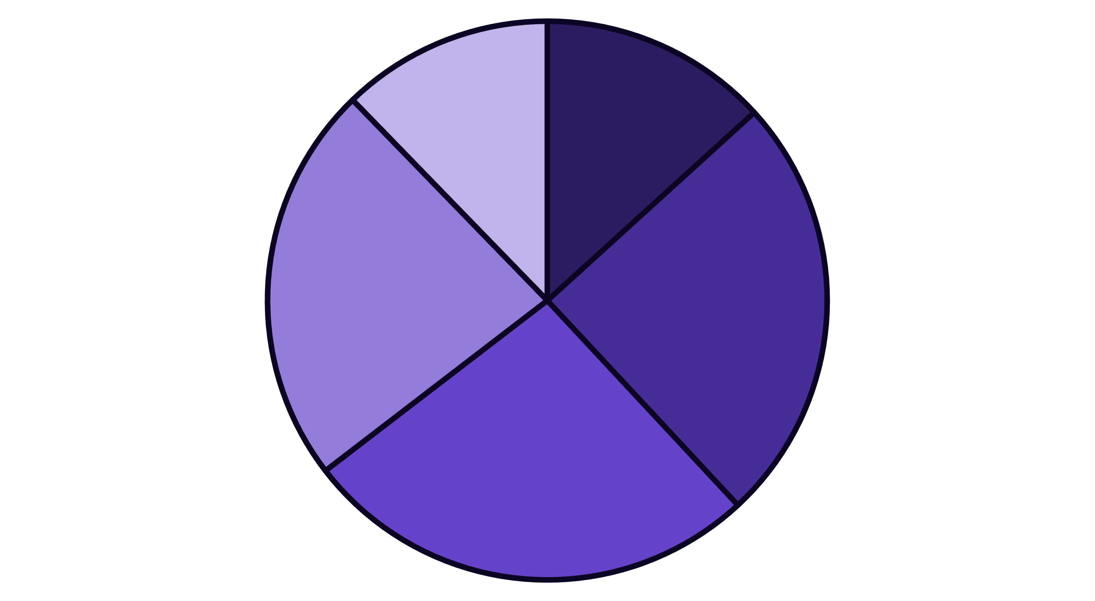
Attrition by Education Level
Does Education Influence Attrition?
Examining attrition based on education level can provide valuable insights into specific challenges faced by
different segments of our workforce and inform targeted development initiatives.
High School
Bachelor's
Master's
PhD
Associate's
Surprisingly, employees holding Master's degrees exhibit the highest attrition count with 80 individuals leaving, suggesting that this highly skilled group might be seeking advanced career opportunities or facing challenges in growth within Homecrew. In contrast, PhD holders appear to be the most stable group, with 70 attritted out of 274 total PhD employees, indicating better retention within this segment. High School and Bachelor's degree holders also show notable attrition, pointing to a broader issue across various educational backgrounds. This data suggests a need to invest more in clear career growth pathways, advanced training, and challenging opportunities specifically for employees with mid-level education (Master's and Bachelor's) to improve their retention rates.

Slide 8
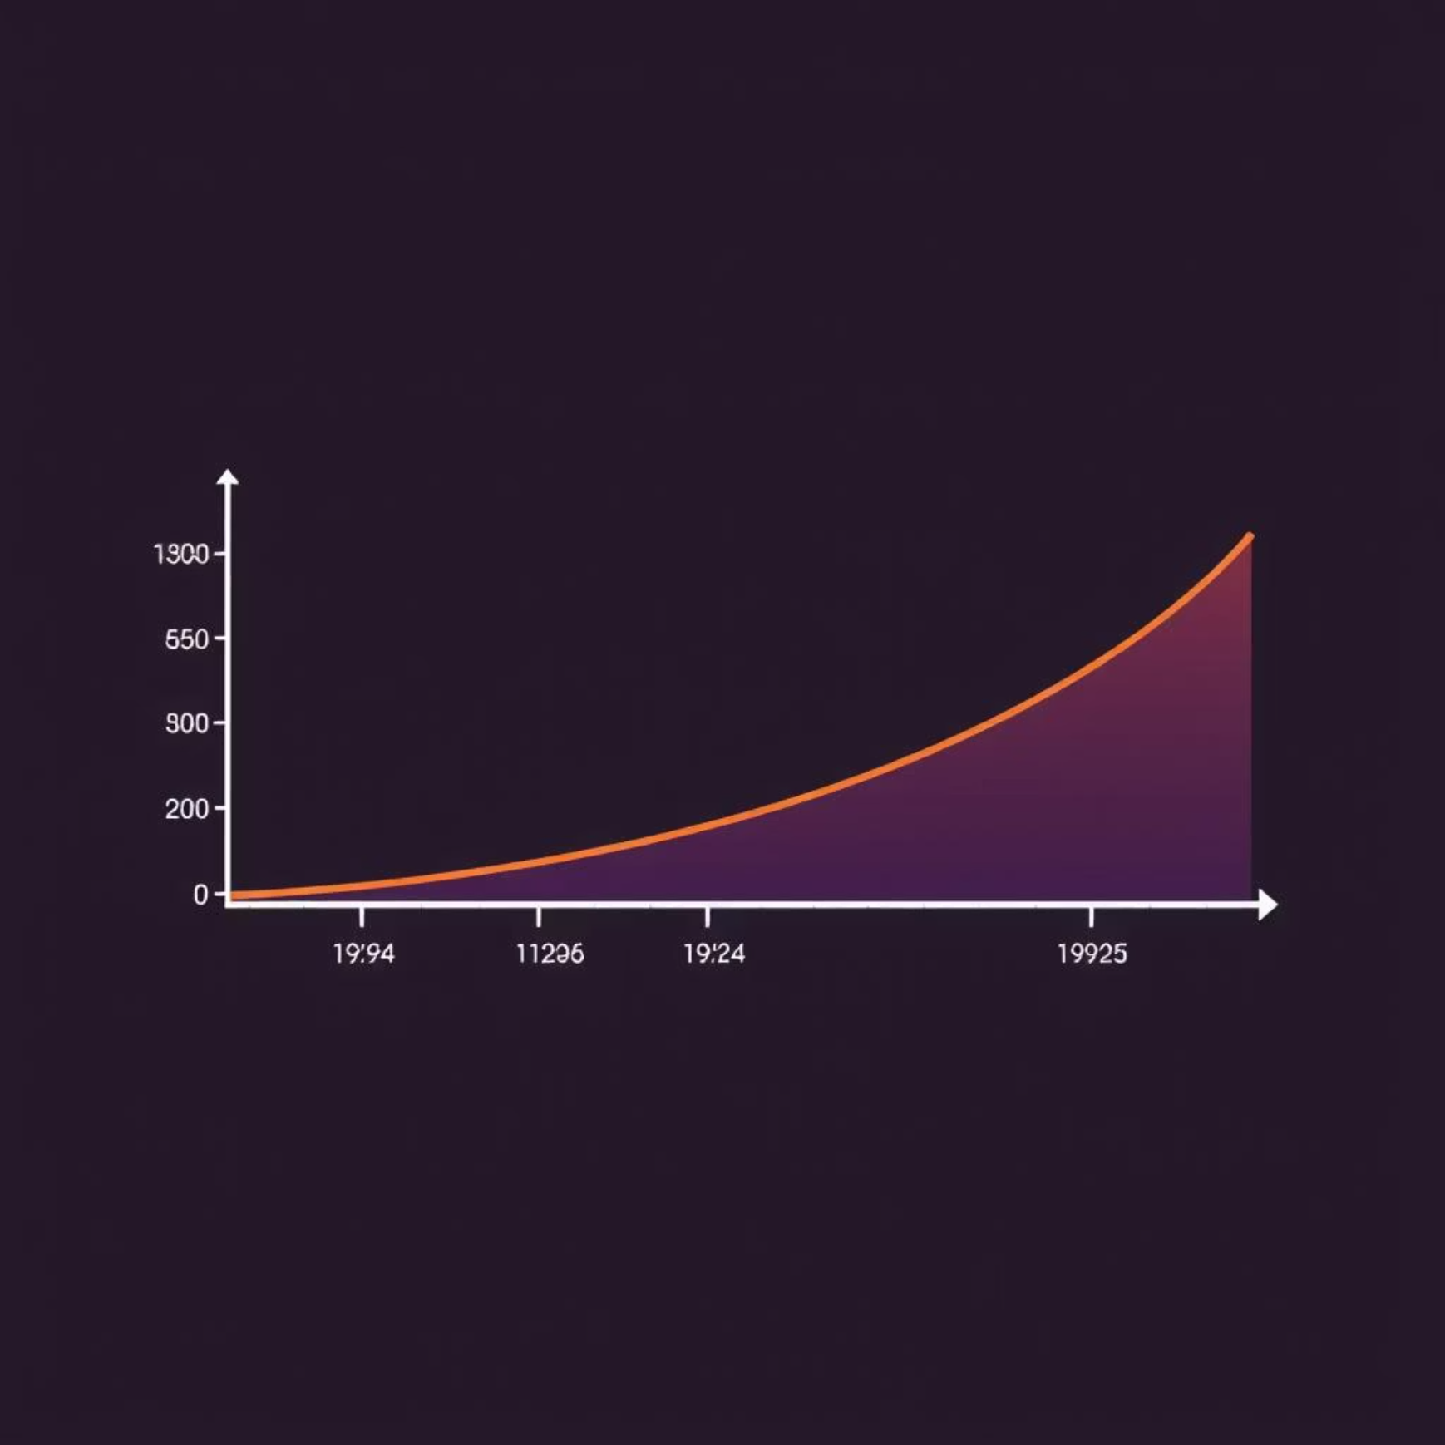
Total Employees by Attrition Rate
How Balanced Is Our Workforce?
Maintaining a stable workforce headcount of 1500 employees is crucial for Homecrew's operational continuity and strategic growth. While the overall number of employees has remained consistent, the persistent attrition rate of approximately 20% signifies a constant churn that can negatively impact productivity, institutional knowledge, and recruitment costs.
Attrition is no longer just an HR concern; it has become a critical factor directly influencing workforce planning. High turnover can lead to understaffing, increased workload for remaining employees, and a loss of specialized skills. It also incurs substantial costs related to recruitment, onboarding, and training new hires, not to mention the indirect costs associated with reduced morale and productivity.
Therefore, active tracking and the implementation of proactive prevention mechanisms are not just beneficial but absolutely necessary. This includes continuous monitoring of attrition metrics, identifying early warning signs of disengagement, and developing targeted interventions to retain valuable talent. By focusing on these mechanisms, Homecrew can move from a reactive stance to a proactive one, fostering a more stable and engaged workforce.

Slide 9

Key Influencers of Attrition
What Drives Attrition?
Beyond demographic factors, understanding the underlying drivers of attrition is paramount. This insight reveals a significant correlation between employee performance ratings and their likelihood to leave Homecrew.
Critical Insight:
Employees with Performance Rating ≤ 1 are 1.65x more likely to attrit. This finding is a strong indicator that dissatisfaction with performance, or the way performance is managed, is a major contributor to employee turnover.
This correlation highlights a crucial area for intervention within Homecrew's performance management system.
It indicates the need for:
Improved Feedback Systems
Coaching vs. Punitive Performance Management
Early Warning Systems for Disengaged Employees
Establishing clear, consistent, and constructive feedback channels can help employees understand their performance better and feel more supported in their roles. This should include regular one-on-ones, transparent performance reviews, and opportunities for 360-degree feedback.
Shifting the focus from merely identifying poor performance to actively coaching employees to improve. This involves providing resources, training, and mentorship to help individuals grow, rather than solely focusing on disciplinary actions.
Implementing mechanisms to identify employees at risk of disengagement before their performance significantly deteriorates. This could involve regular pulse surveys, manager training on identifying warning signs, and proactive HR interventions.

Slide 10
Strategic Recommendations
Based on the comprehensive analysis of Homecrew's HR analytics and attrition trends, we propose the following strategic recommendations to enhance employee retention and foster a more engaged workforce:
1
Improve Onboarding & Mentorship for Younger Staff
Given the high attrition rate among employees under 30, implement robust onboarding programs that clearly define career paths and provide dedicated mentorship. This will help integrate younger talent, foster a sense of belonging, and address their professional development needs from day one.
2
Prioritize Engagement in High-Attrition Departments
Focus targeted engagement initiatives and leadership development programs within departments showing high turnover, particularly Finance and Marketing. Conduct deep-dive surveys and focus groups to identify specific departmental pain points and co-create solutions with team leaders.
3
Introduce Career Development Programs for Masters Holders
Address the significant attrition among Masters degree holders by developing specialized career growth pathways, advanced training modules, and opportunities for leadership roles or project ownership that align with their qualifications and aspirations.
4
Link Performance Management with Growth Opportunities
Reform the performance management system to be more developmental than punitive. Ensure that feedback is continuous, constructive, and directly linked to individual growth plans, skill enhancement, and opportunities for internal mobility. Employees with lower performance ratings should be coached and supported, not just evaluated.
5
Use Age-Informed—Not Gender-Based—Retention Strategies
While young female employees show a specific attrition trend, the overall data suggests that age is a stronger determinant of attrition risk across the board. Therefore, tailor retention strategies primarily based on age-group needs and career stages, ensuring resources are effectively allocated to support employees at various points in their professional journey.

