Slide 1

Household Energy Usage Forecast

Slide 2
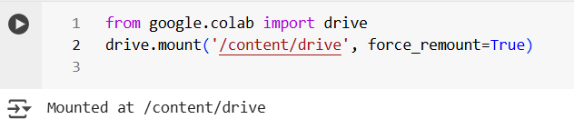
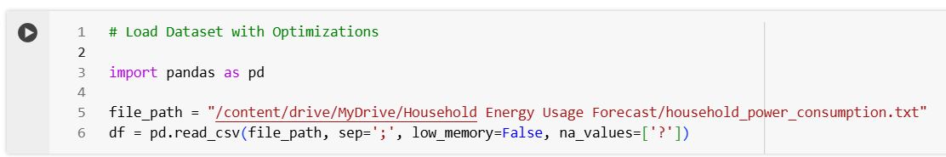
This code is used in Google Colab to mount Google Drive, allowing access to files stored in Google Drive directly from the Colab environment.
This imports the Pandas library, which is used for data manipulation and analysis in Python.
The file_path variable stores the location of the dataset file in Google Drive, allowing access to household_power_consumption.txt for analysis in Google Colab.
This loads the dataset from file_path using ; as a separator, handles missing values (? as NaN), and sets low_memory=False to optimize memory usage.

Slide 3
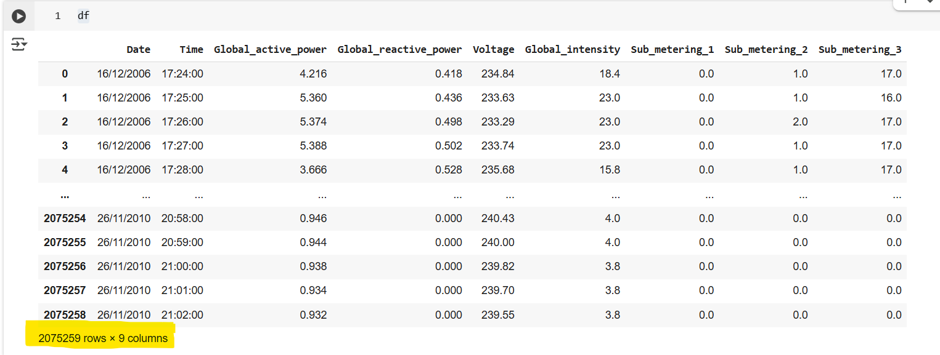
The dataset contains 20,75,259 rows and 9 columns, including Date, Time, Global Active Power, Global Reactive Power, Voltage, Global Intensity, and Sub_metering values, representing household energy consumption from 2006 to 2010.

Slide 4
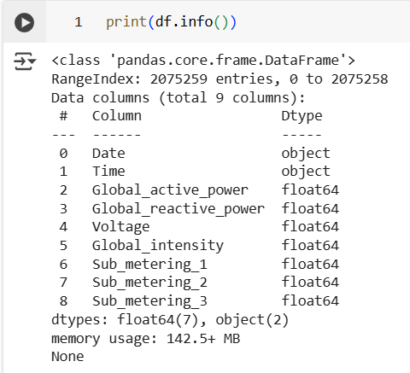
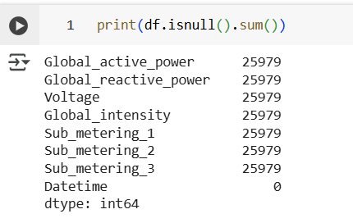
df.info() displays dataset structure, column types, and memory usage.
df.isnull().sum() shows the count of missing values in each column.

Slide 5
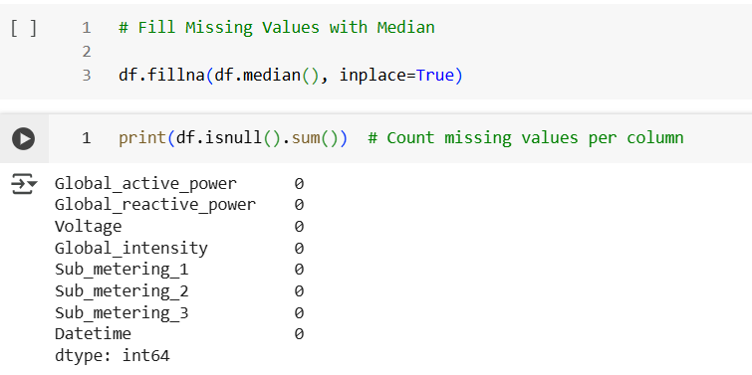
This creates a 'Datetime' column by merging 'Date' and 'Time', converts it to a DateTime format, and drops the original 'Date' and 'Time' columns.
Replaces missing values in the DataFrame with the median of each column to maintain data consistency.

Slide 6
This creates a 'Datetime' column by merging 'Date' and 'Time', converts it to a DateTime format, and drops the original 'Date' and 'Time' columns.
Replaces missing values in the DataFrame with the median of each column to maintain data consistency.

Slide 7
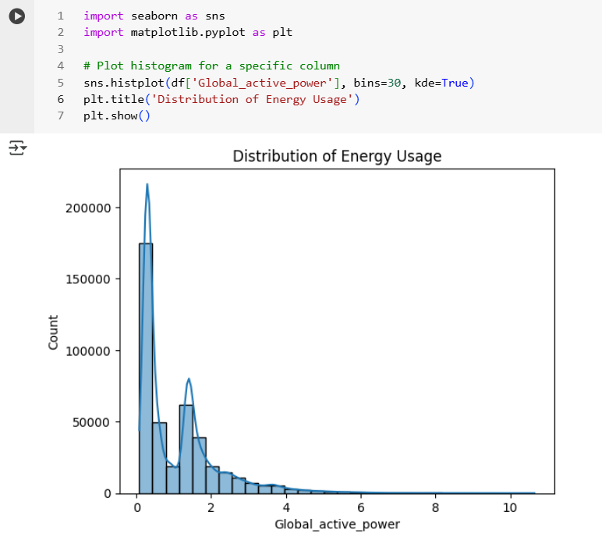
This converts specified columns to float16 data type, reducing memory usage while preserving numerical precision.
This code visualizes the distribution of 'Global_active_power' using a histogram with 30 bins and a KDE (Kernel Density Estimate) curve.
Result Explanation:
Most energy consumption values are concentrated at lower levels, with a right-skewed distribution.
The data is right-skewed, meaning most households consume low power, with fewer instances of high consumption.
KDE (blue line) helps visualize the underlying probability distribution of energy usage.

Slide 8
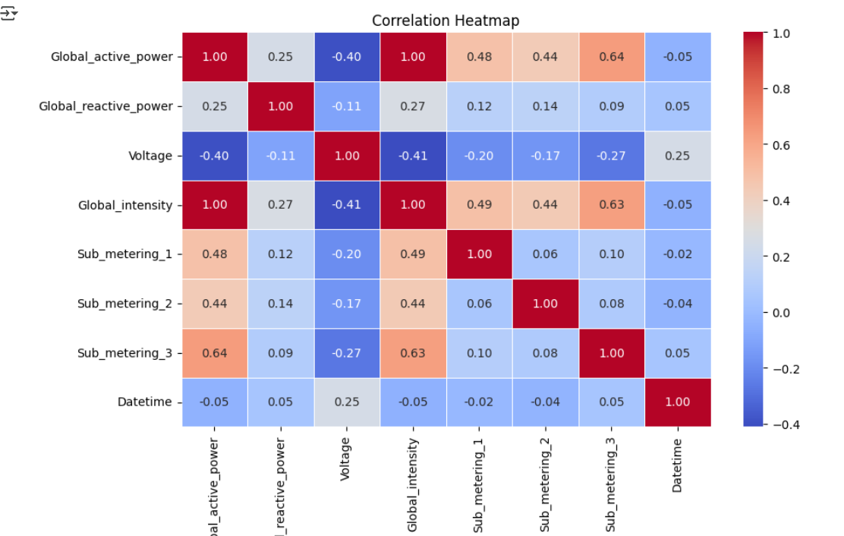
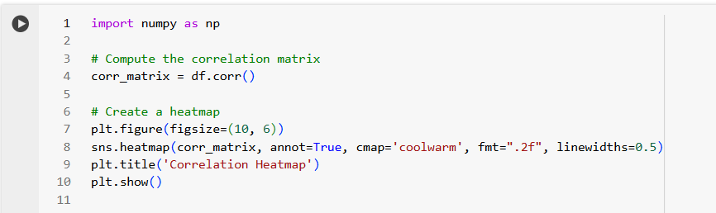
Generates a heatmap to visualize feature correlations in the dataset, highlighting relationships using color gradients.
Result Explanation:
Red/blue shades show strong/weak correlations between features.
Helps in feature selection and understanding energy usage patterns.

Slide 9
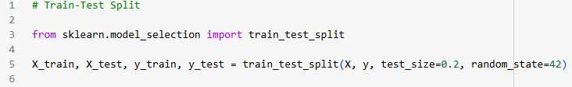
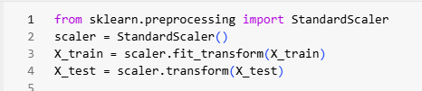
X (Features/Inputs) → Selects independent variables (predictors) from the dataset.
y (Target/Output) → Assigns 'Global_active_power' as the dependent variable to be predicted.
Splits the dataset into training (80%) and testing (20%) sets.
test_size=0.2 → 20% of the data is reserved for testing.
random_state=42 → Ensures the split is reproducible every time.
This code standardizes the features in X_train and X_test by scaling them to have zero mean and unit variance, ensuring all features are on the same scale for better model performance.

Slide 10
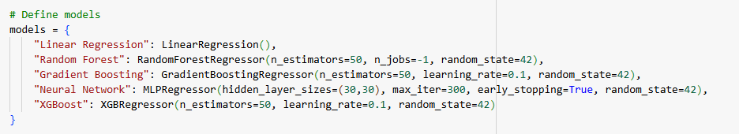

Trains five different machine learning models (Linear Regression, Random Forest, Gradient Boosting, Neural Network, and XGBoost) on the training data.
Evaluates their performance on the test set using MAE (Mean Absolute Error) , RMSE (Root Mean Squared Error), and R² (R-Squared)

Slide 11
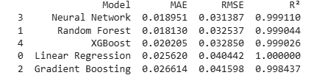
Result Explanation:
Best Model Selection Criteria
✅ MAE (Mean Absolute Error): Random Forest (0.018126) is the lowest. ✅ RMSE (Root Mean Squared Error): Random Forest (0.032539) is the lowest. ✅ R² (R-Squared Score): Linear Regression (1.000000) is the highest.
Final Decision:
Although Linear Regression has an R² of 1.000000, this could indicate overfitting, meaning the model might not generalize well to unseen data. In real-world scenarios, such a perfect R² score is rare and might suggest data leakage or a too-simple dataset.
On the other hand, Random Forest has:
✅ The lowest RMSE (0.032539) → indicating better predictive accuracy. ✅ The lowest MAE (0.018126) → meaning lower absolute errors. ✅ A very high R² (0.999044) → almost as good as Linear Regression but likely more robust.
Final Recommendation:
🚀 Random Forest is the best choice ✅ because it balances high accuracy with better error metrics, making it the most reliable model for real-world predictions.

Slide 12
Result Explanation:
Best Model Selection Criteria
✅ MAE (Mean Absolute Error): Random Forest (0.018126) is the lowest. ✅ RMSE (Root Mean Squared Error): Random Forest (0.032539) is the lowest. ✅ R² (R-Squared Score): Linear Regression (1.000000) is the highest.
Final Decision:
Although Linear Regression has an R² of 1.000000, this could indicate overfitting, meaning the model might not generalize well to unseen data. In real-world scenarios, such a perfect R² score is rare and might suggest data leakage or a too-simple dataset.
On the other hand, Random Forest has:
✅ The lowest RMSE (0.032539) → indicating better predictive accuracy. ✅ The lowest MAE (0.018126) → meaning lower absolute errors. ✅ A very high R² (0.999044) → almost as good as Linear Regression but likely more robust.
Final Recommendation:
🚀 Random Forest is the best choice ✅ because it balances high accuracy with better error metrics, making it the most reliable model for real-world predictions.

