Slide 1
Local_Dev_Example
A simple application to demonstrate deployment and program structure

Slide 2
What is this document?
To help you get started in using our tools, we created a very basic application that you can find here:
https://github.pirelli.com/DSAA/local_dev_example
The Application is running here:
http://10.130.4.101/Local_Dev_Example/
This document will explain in detail how the application works, and how it was deployed on the server.

Slide 3
Assumptions
Some assumptions:
You know what JSON is
You’ve seen Python before, you know what functions are
You’ve seen an Angular 1 Web App, using Angular Material
You don’t like Internet Explorer
Backend, Frontend, RESTApi mean something to you (or you’ve at least heard of them)
Even without all of the above, it may well make sense (unless you like Internet Explorer).

Slide 4
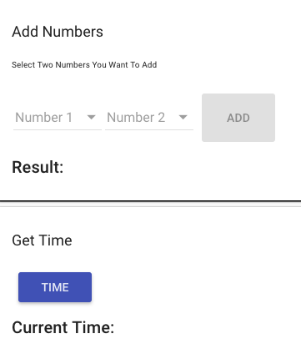
The Application
It’s a simple simple interface with two parts.
This part asks the user to choose two numbers. When two are chosen, the ADD button becomes active.
Upon Pressing ‘ADD’ the result of adding the two numbers together will be displayed.
Down here, the user can click the TIME button to get the current time (of the server running the app)

Slide 5
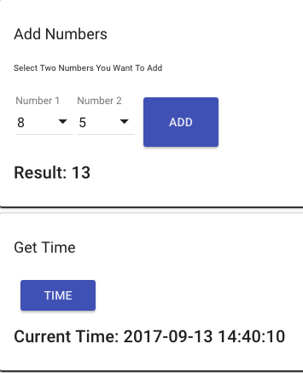
Action!
Here’s a start to finish in all its glory.

Slide 6
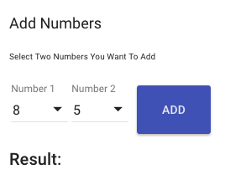
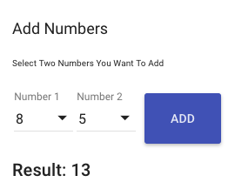
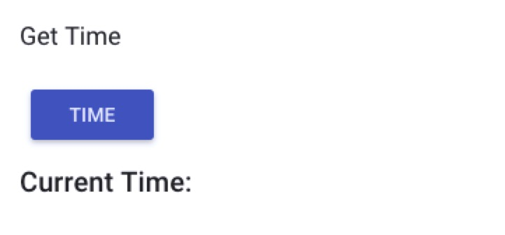
‘Under the hood’
What actually happened?
At the start the ADD button is disabled, and the number choice lists are empty.
When you select a number in BOTH lists, the ADD button is enabled
The ADD button is clicked and a request is sent to the backend
The backend code reads the request, runs the code to add the numbers and returns the result
The front end receives the answer from the back and and displays the result, in this case ‘13’
code.py
code.py
The Time button does much the same, instead asking the backend for the time

Slide 7
Concept
What was described in the previous slide is a concept seen in all our applications.
Front End
(the web pages)
Request
Back End
(the python part)
Answer

Slide 8
Concept
What was described in the previous slide is a concept seen in all our applications.
Request, please add 5 and 8
Calculate
5 + 8
code.py
code.py
code.py
code.py
Answer: 13

Slide 9
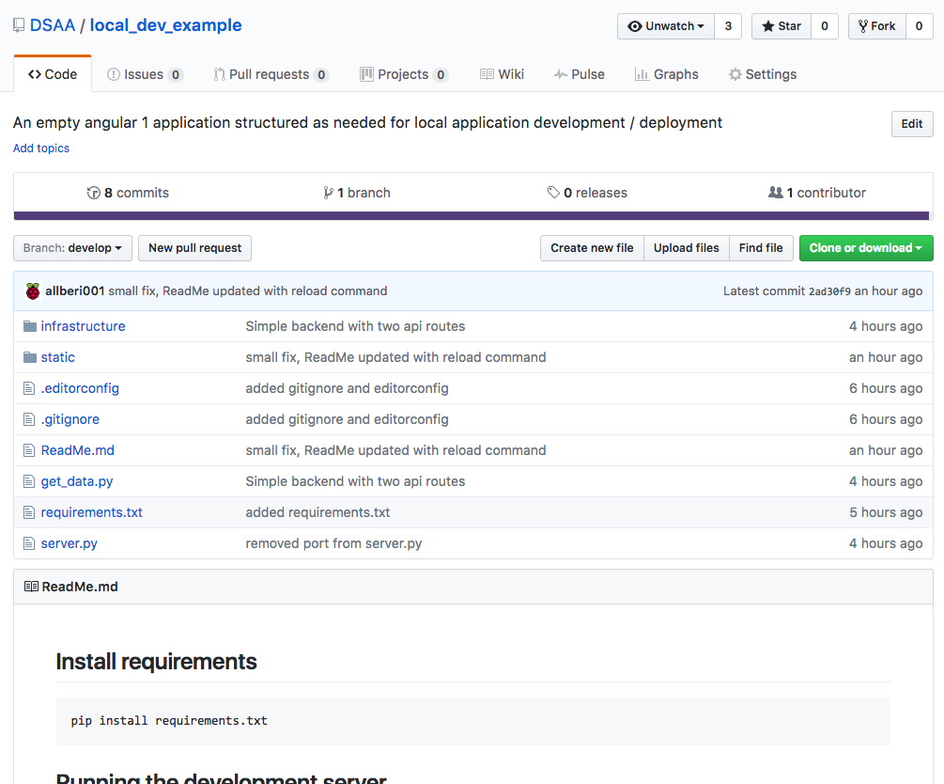
File Structure
On GITHUB, the application looks like this:
repository name for the application
settings files for deployment
front end web application
important notes for this repo
backend python files
comments written with each code commit
the ReadMe.md is automatically displayed here

Slide 10
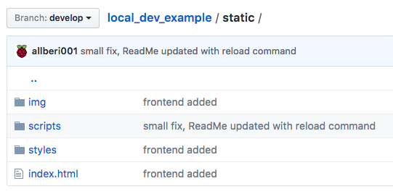
The Front End
Inside /static/
images for toolbars
javscript files
style files (css)
the web page, always called index.html
Note, here we are looking at an app with one web page file, index.html. Multiple pages are covered in other documents (or will be). The structure you see in this document is the ‘bare minimum’

