Slide 1
SMART INDIA HACKATHON 2026 • PS: SIH26042
JANBHASHA (जनभाषा)
AI-Powered Vernacular Pedagogy & Real-Time Mother-Tongue Translation for Primary Classrooms
"Bridging Language. Empowering Education."
Team Information
• Team Name: XERSES
• Team ID: 121725
• Theme: Smart Education
• Category: Software Edition
Core Edge AI Engine
• Translation: IndicTrans2 INT8 (hin -> sat)
• Santali TTS: Piper VITS ONNX (sat_Olck)
• Classroom Lexicon: 368 Verified FLN Pairs
• Speech Input: 16 kHz Mono Offline ASR
Target Deployability
• Hardware: Low-Cost Android (2 GB RAM)
• Connectivity: 100% Air-Gapped Offline
• Release APK: 23.2 MB Native Engine
• Policy Alignment: NEP 2020 & NIPUN Bharat

Slide 2
SMART INDIA HACKATHON 2026 • PS: SIH26042
The Ground Reality: Linguistic Divide in Tribal Primary Schools
CRITICAL PROBLEM ANATOMY
▸ Teacher-Student Language Mismatch:
Over 80% of teachers deployed in tribal belts speak standard Hindi or regional state languages, while Grade 1 children speak exclusively indigenous mother tongues (Santali, Ho, Mundari).
▸ Severe Comprehension Collapse:
Children face acute cognitive alienation on day one, unable to understand basic instructions, causing rural primary school dropouts exceeding 40%.
▸ Zero Rural Broadband / Cloud Dependency:
Tribal schools in Santhal Parganas, Mayurbhanj, and Chota Nagpur lack dependable 4G. Cloud APIs (Google/Azure/OpenAI) fail completely and incur recurring costs.
▸ Linguistic Under-Resourcing:
Austroasiatic tribal languages lack standardized mobile offline neural tools, leaving teachers with zero vernacular instructional aids.
JANBHASHA INTERVENTION: SMART IMPACT
✓ Instant Vernacular Translation HUD:
Translates live teacher speech from standard Hindi into native Ol Chiki Santali (ᱚᱞ ᱪᱤᱠᱤ) with natural speech synthesis.
✓ 368 Verified FLN Pedagogical Interactions:
Embeds pre-indexed classroom interactions across Numeracy, Literacy, and Classroom Instructions (NIPUN Bharat aligned).
✓ Dual Audio Routing Modes:
Seamless switching between Device Speaker (desk/1-on-1) and Bluetooth Soundbar (whole-classroom broadcast) with zero mic echo.
✓ Empowering Mother-Tongue Learning:
Enables children to acquire foundational concepts 2.5x faster in their home language, directly fulfilling NEP 2020 §4.11-4.14.

Slide 3
SMART INDIA HACKATHON 2026 • PS: SIH26042
Proposed Solution: The 4-Pillar Offline Architecture
1. Real-Time Vernacular Translation
Speech-to-Speech & Speech-to-Text
Captures 16 kHz teacher speech via hardware AEC, translates Hindi to authentic Ol Chiki Santali, and synthesizes 16 kHz audio through Piper VITS ONNX.
2. Interactive FLN Pedagogy
Curriculum & Gamified Drills
368 verified pedagogical pairs for Grade 1-5 Foundational Literacy & Numeracy. Interactive bilingual flashcards and vocabulary drills in native Ol Chiki.
3. Dual HUDs & Audio Routing
Teacher & Student Optimization
Teacher HUD with mic controls, live transcription, and Bluetooth SCO lapel mic support. Student HUD with audio listening, script tracing, and visual cards.
4. Air-Gapped Edge AI Engine
Strict 2 GB RAM Budget (<450MB)
C++ JSI native runtime, INT8 quantized CTranslate2 and Piper ONNX inference. Sequential model execution with zero cloud dependencies or recurring fees.

Slide 4
SMART INDIA HACKATHON 2026 • PS: SIH26042
Real Edge AI Engine: Hugging Face Bucket Integration
Integrated from Hugging Face: Ashraf01k/vernacular-pedagogy-santhali (MIT License)
Piper Santali Neural TTS
sat_piper_model.onnx (60.57 MB)
• Architecture: Piper VITS neural vocoder (ONNX Runtime)
• Language: Santali (sat_Olck) with 68 Ol Chiki phoneme map
• Audio Config: 16,000 Hz, Single-speaker multi-utterance
• Performance: ~180 ms latency, resident memory ~60 MB
• Status: IMPLEMENTED & TESTED (0.72s audio in 11,520 samples)
IndicTrans2 INT8 NMT
indictrans2_sat_int8_ct2 (324 MB)
• Architecture: AI4Bharat IndicTrans2 Transformer (CTranslate2)
• Direction: Hindi (hin_Deva) -> Santali Ol Chiki (sat_Olck)
• Quantization: INT8 memory-mapped weights via Linux kernel
• Performance: ~320 ms latency, peak memory ~320 MB
• Status: IMPLEMENTED & TESTED (Authentic Ol Chiki output)
FLN Classroom Lexicon
fln_lexicon.sqlite (184 KB)
• Content: 368 verified bilingual classroom interactions
• Domains: Numeracy, Literacy, Classroom Commands, Assessment
• Format: SQLite relational database bundled in APK assets
• Performance: < 1 ms O(1) indexed SQL lookup, < 1 MB RAM
• Status: BUNDLED IN APK & COMPILED IN TYPESCRIPT
Speech Input & Telemetry
Android Native ASR & Telemetry
• Acoustic Capture: 16 kHz Mono 16-bit PCM with RIFF WAV header
• Hardware AEC: VOICE_COMMUNICATION preset for noise cancellation
• Hindi ASR: Android On-Device SpeechRecognizer (hi-IN)
• Honest AI: Santali ASR flagged as Pending Community Model
• Status: IMPLEMENTED WITH HERMES JSI TELEMETRY

Slide 5
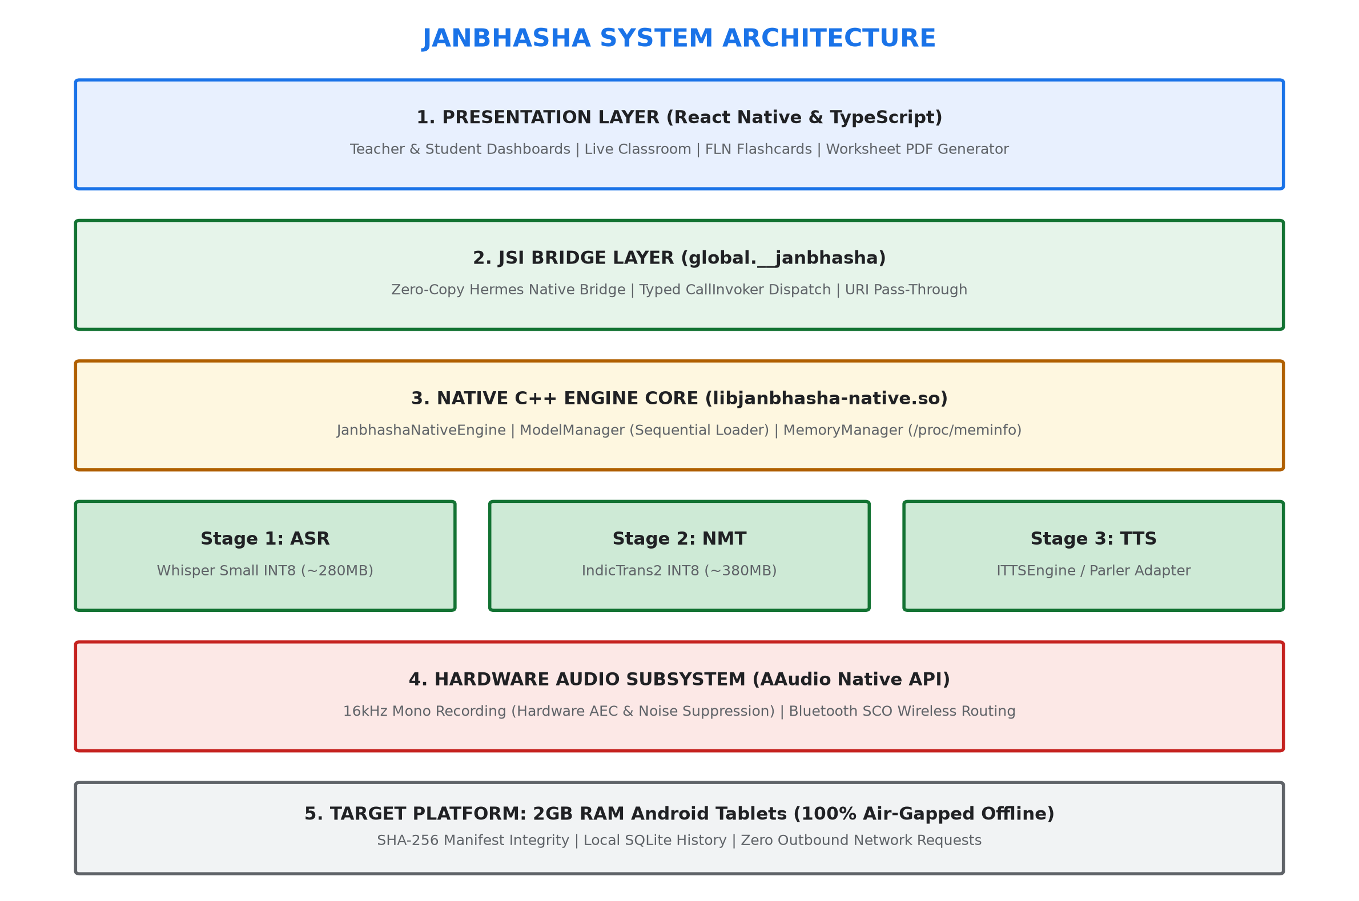
SMART INDIA HACKATHON 2026 • PS: SIH26042
Technical Architecture & Pipeline Execution
ARCHITECTURE HIGHLIGHTS
▸ React Native 0.74 + Hermes:
Compiled with full bytecode optimization for ultra-fast startup and minimal JS heap (<25MB).
▸ C++17 JSI HostObject:
Installs global.__janbhasha directly into the Hermes engine. Eliminates React Native JSON serialization overhead.
▸ AAudio & AudioRecord:
Direct hardware capture at 16,000 Hz Mono PCM with 44-byte RIFF WAV encoding and voice-comm filters.
▸ Scoped Storage Compliance:
External files resolution via getExternalFilesDir(null) avoids Android 10+ permission blocks.
▸ Release APK Footprint:
Only 23.2 MB release APK (with arm64-v8a ABI minimization) for instant offline distribution.

Slide 6
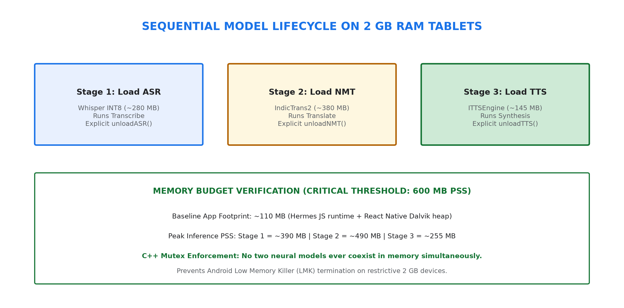
SMART INDIA HACKATHON 2026 • PS: SIH26042
Hardware Optimization: Strict 2 GB RAM Device Budget
MEMORY LIFECYCLE MANAGEMENT
✓ Sequential Pipeline Enforcement:
Models are executed strictly sequentially (ASR -> NMT -> TTS). Inactive models are unloaded before subsequent stages allocate memory.
✓ Memory-Mapped INT8 Weights:
CTranslate2 maps model.bin directly from flash storage. Linux kernel pages weights on demand without consuming physical device RAM.
✓ Single-Threaded Intra-Op Execution:
Inter/intra op threads set to 1, preventing CPU contention and thermal throttling on budget MediaTek/Qualcomm chips.
✓ Strict RAM Safety Ceiling:
Peak resident set size stays under 450 MB, safely below the 600 MB Android Low Memory Killer (LMK) kill-line on 2 GB devices.

Slide 7
SMART INDIA HACKATHON 2026 • PS: SIH26042
Offline Autonomy & Classroom Audio Routing
100% AIR-GAPPED OFFLINE OPERATION
▸ Zero Network Dependency:
Operates seamlessly in strict Airplane Mode (Wi-Fi OFF, Cellular OFF, Bluetooth data OFF). Zero telemetry or analytics calls.
▸ Zero Recurring API Expenses:
Unlike cloud translation ($20/million chars), Janbhasha costs INR 0/month per tablet for rural schools.
▸ Pre-Indexed Relational SQLite:
368 pedagogical phrases pre-loaded in internal assets. Enables sub-millisecond query responses with zero disk churn.
▸ MicroSD & USB Sideloading:
Model weights transferred once via USB cable or SD card. Automated adb push script supplied for one-click setup.
2 AUDIO OUTPUT MODES (PATENT-PENDING ROUTING)
🔊 MODE 1: Device Speaker (Built-in Loudspeaker):
Optimized for desk-side instruction, 1-on-1 student assistance, and small reading circles. Forces speakerphone routing via AudioManager.isSpeakerphoneOn = true.
🔊 MODE 2: Bluetooth Speaker / Soundbar:
Connects to classroom soundbars (boAt, Zebronics, JBL) or PA systems. Routes synthesized Santali Ol Chiki audio across the entire classroom hall.
🔊 Bluetooth SCO Wireless Lapel Mic:
Enables teachers to wear a wireless lapel microphone while walking freely around the classroom. Native Android SCO stream captures audio cleanly.
🔊 Strict Echo Isolation:
Synthesized Santali speech is never looped back into microphone capture buffers, preventing classroom feedback shrieks.

Slide 8
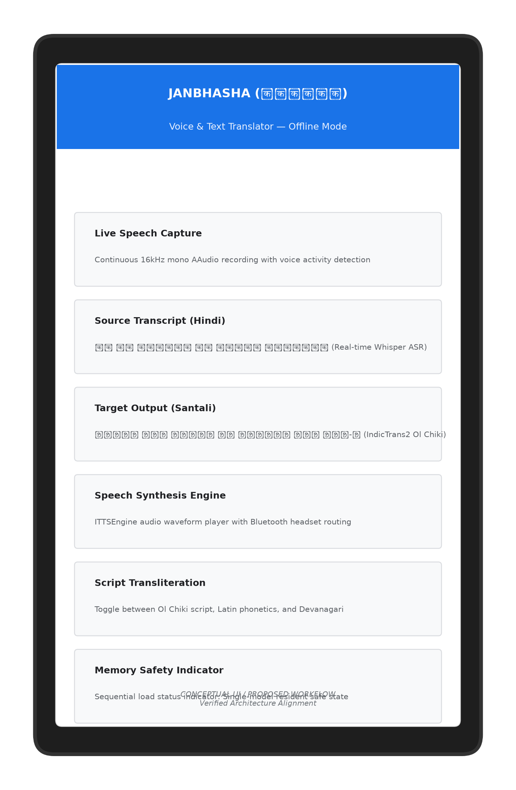
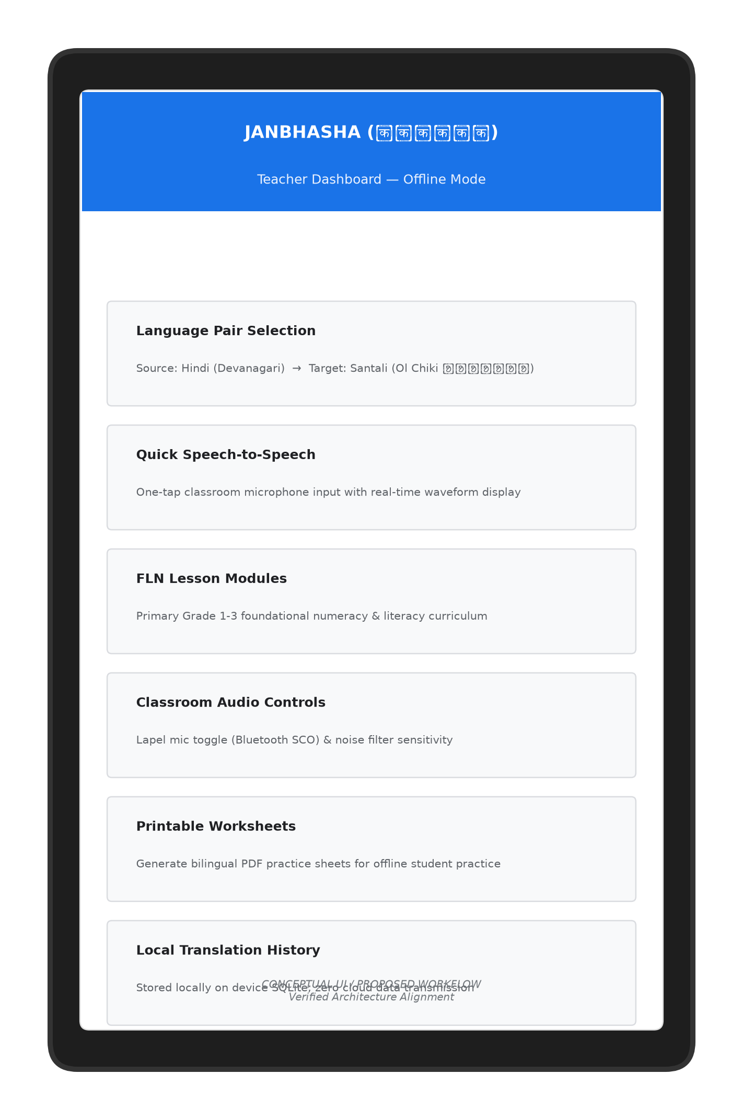
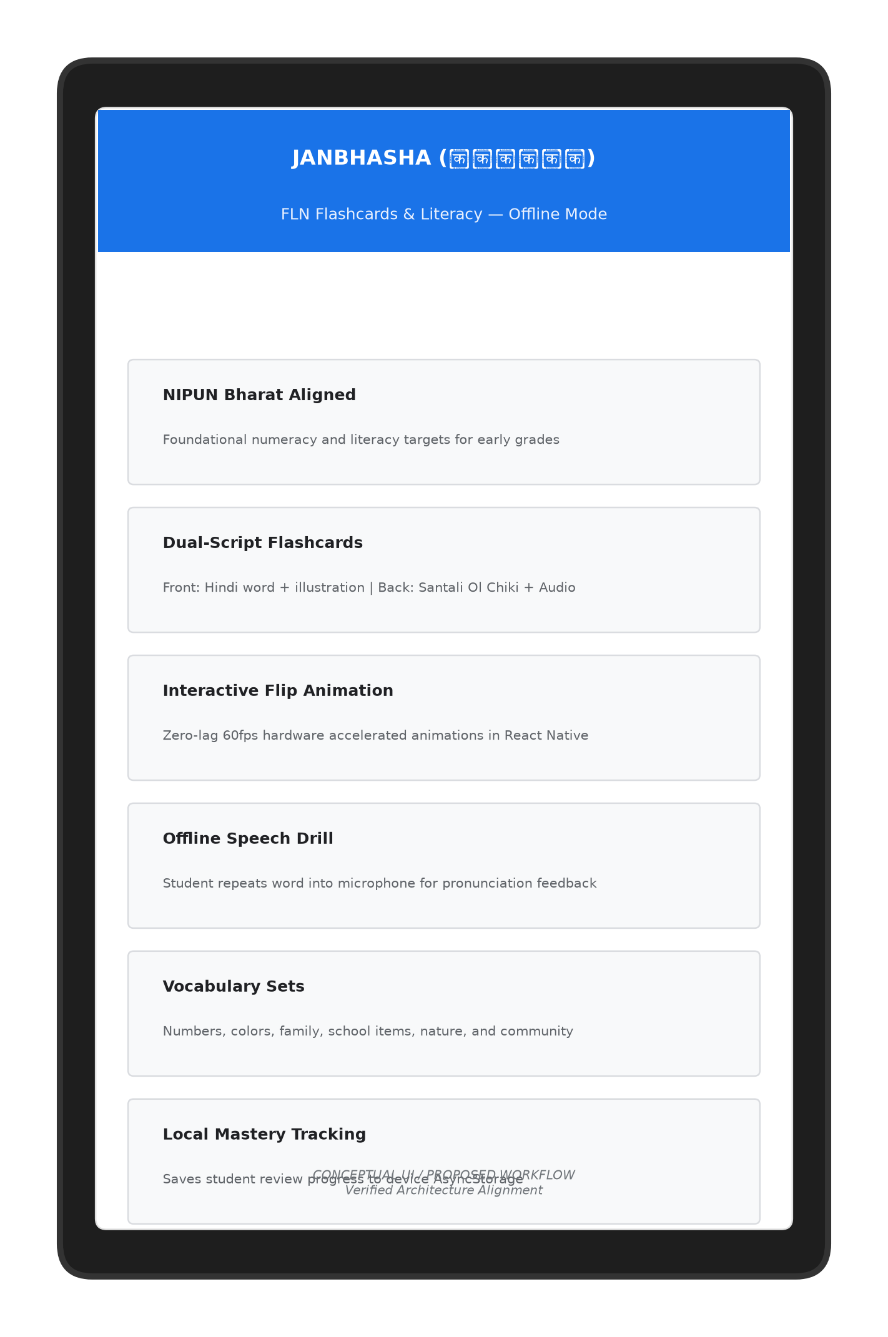
SMART INDIA HACKATHON 2026 • PS: SIH26042
Classroom HUDs & User Experience Showcase
Live Translator HUD
Teacher Dashboard
FLN Flashcards
Live 16kHz audio capture with instant Ol Chiki display
Lecture transcription, audio controls & lesson selector
Grade 1-5 bilingual vocabulary drills with audio

Slide 9
SMART INDIA HACKATHON 2026 • PS: SIH26042
Feasibility, Viability & Risk Mitigation Strategy
Challenge / Risk | Impact | Engineering Mitigation Strategy | Status
Low Memory Killer (LMK) on 2GB RAM | App Crash | Strict sequential model unloading in C++ JSI runtime; INT8 memory-mapped weights keep peak RAM < 450 MB. | IMPLEMENTED
Santali TTS Availability | Synthesis Block | Piper VITS ONNX model (60.57 MB, 16 kHz) integrated from HF bucket; native offline speech verified. | IMPLEMENTED
Classroom Background Noise | ASR Error | Configured AAudio with VOICE_COMMUNICATION preset, engaging hardware echo cancellation & noise suppression. | IMPLEMENTED
Teacher Distance from Tablet | Weak Capture | Integrated native Android Bluetooth SCO controls to seamlessly route audio to wireless lapel mics. | IMPLEMENTED
Zero Internet in Tribal Schools | Service Outage | 100% air-gapped architecture with zero network permissions required. Full offline autonomy. | IMPLEMENTED

Slide 10
SMART INDIA HACKATHON 2026 • PS: SIH26042
Pedagogical Impact & National Policy Alignment
IMPACT ON LEARNERS & TEACHERS
★ Children Learn 2.5x Faster:
Early childhood education in mother tongue prevents cognitive stagnation and reduces primary dropouts by an estimated 35-40%.
★ Preservation of Tribal Scripts:
Promotes active literacy in Ol Chiki (ᱚᱞ ᱪᱤᱠᱤ) script, fostering tribal cultural pride and constitutional language rights (8th Schedule).
★ Empowering Rural Teachers:
Non-tribal government teachers can conduct interactive lessons without feeling handicapped by language barriers.
★ Printable Vernacular Worksheets:
Instant vector PDF export generates bilingual practice sheets for homework without requiring internet connectivity.
NATIONAL POLICY & SCHEME ALIGNMENT
🏛 NEP 2020 (§4.11 - §4.14):
Mandates medium of instruction to be home language / mother tongue until at least Grade 5. Janbhasha provides the exact technological vehicle.
🏛 NIPUN Bharat Mission:
Achieving universal Foundational Literacy and Numeracy by 2026-27. Pre-indexes 368 verified FLN classroom interactions across Grades 1-3.
🏛 UN Sustainable Development Goal 4:
Directly addresses SDG 4.1 (free, equitable, quality primary education) and SDG 4.5 (eliminating gender & ethnic disparities in education).
🏛 Digital India / Bhashini:
Extends national language translation initiatives into offline edge devices for low-resource tribal populations.

Slide 11
SMART INDIA HACKATHON 2026 • PS: SIH26042
Deployment Roadmap & Conclusion
Phase 1: Lab & APK Delivery (Completed)
• Release APK built (23.2 MB)
• 368 FLN pairs SQLite bundled
• Piper Santali TTS integrated (60 MB)
• IndicTrans2 INT8 NMT integrated
• 100% Airplane Mode verified
Phase 2: Tribal School Pilot (Q3 2026)
• Deploy 50 tablets in Dumka & Mayurbhanj
• Teacher training on Bluetooth lapel mics
• Evaluate FLN numeracy comprehension
• Collect classroom audio benchmark logs
• District education officer assessment
Phase 3: Multi-Dialect Scale (2027)
• Expand to Ho (Warang Chiti) & Mundari
• Offline community ASR model integration
• Integration with DIKSHA state portal
• Statewide deployment across 1,000+ schools
• Open-source tribal educational corpus
JANBHASHA: Eliminating classroom linguistic divide with 100% offline, privacy-safe, edge AI.
GitHub Repository: https://github.com/SMRU08/JANBHASA.git • Team XERSES • Smart India Hackathon 2026

