Slide 1




BPUT HACKATHON 2026
SAFESYNC
Industrial AI Safety & Hazard Monitoring System
    Problem Statement: PS06
    Problem Statement Title: AI-Powered Real-Time Industrial Workplace Safety Monitoring, 4-Point PPE Compliance, and Optical Fire/Smoke Detection
    Theme: Smart Automation
    PS Category: Software
    Team ID: BH26PS06T049
    Team Name: XERSES

Slide 2
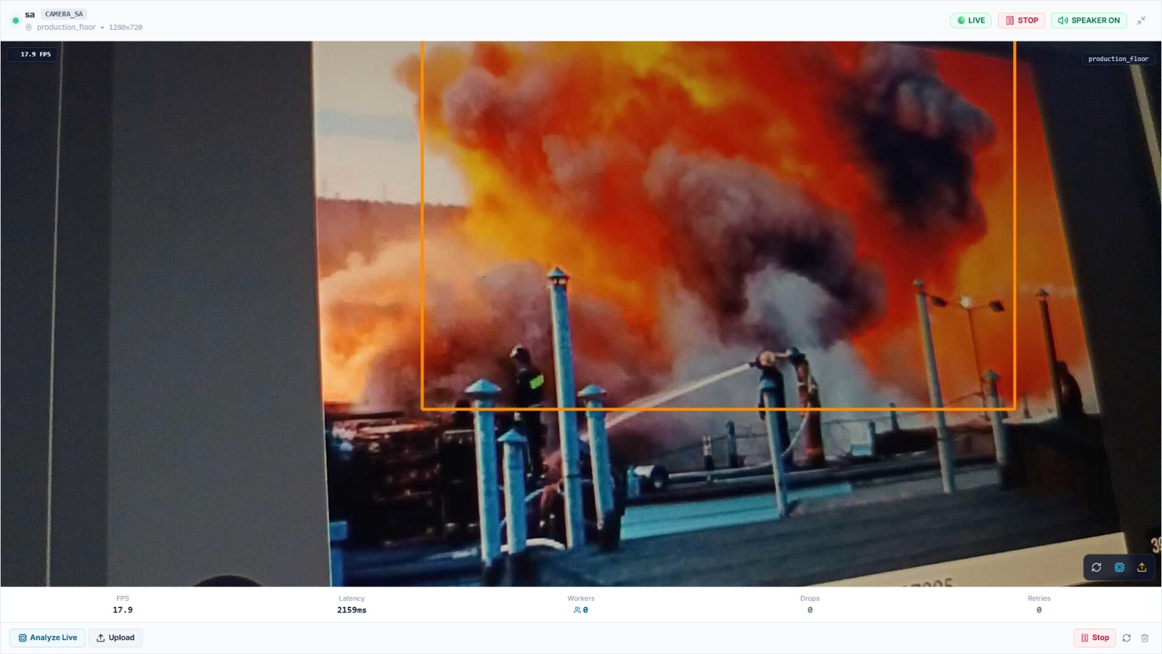
SAFESYNC
PROPOSED SOLUTION :
    Detailed explanation of the proposed solution
SafeSync is an AI vision platform that analyses existing CCTV and video streams to check 4-point PPE compliance (helmet, high-vis vest, gloves, safety footwear) and to detect fire and smoke in real time. It runs locally on a standard CPU.
How it addresses the problem
Replaces periodic manual inspection with continuous monitoring. A confirmed violation or fire/smoke event becomes an incident with an alarm, saved evidence image and a live dashboard entry.
Innovation and uniqueness of the solution
▪ Worker-level PPE association: gear is matched to each tracked worker, not just counted in the frame.
▪ UNKNOWN state: only confirmed missing PPE raises a violation, so unclear frames never trigger false alarms.
▪ Temporal validation: events need 3 (PPE) or 5 (fire, smoke) consecutive confirmed frames.
▪ Fire/smoke state machine with P0–P3 priorities and a deterministic 0–100 risk score.
▪ Incident lifecycle, evidence capture and system health monitoring.
Live prototype: fire/smoke detection on a test feed (demonstration evidence only)
56.4 ms
≈17.7 FPS
7
309 / 309
Mean YOLOv8n inference (CPU)
Processing rate, Intel i5-13420H
Detection classes
Unit, integration & E2E tests passed
2
“Smart Vision. Safe Workers. Faster Response.”

Slide 3
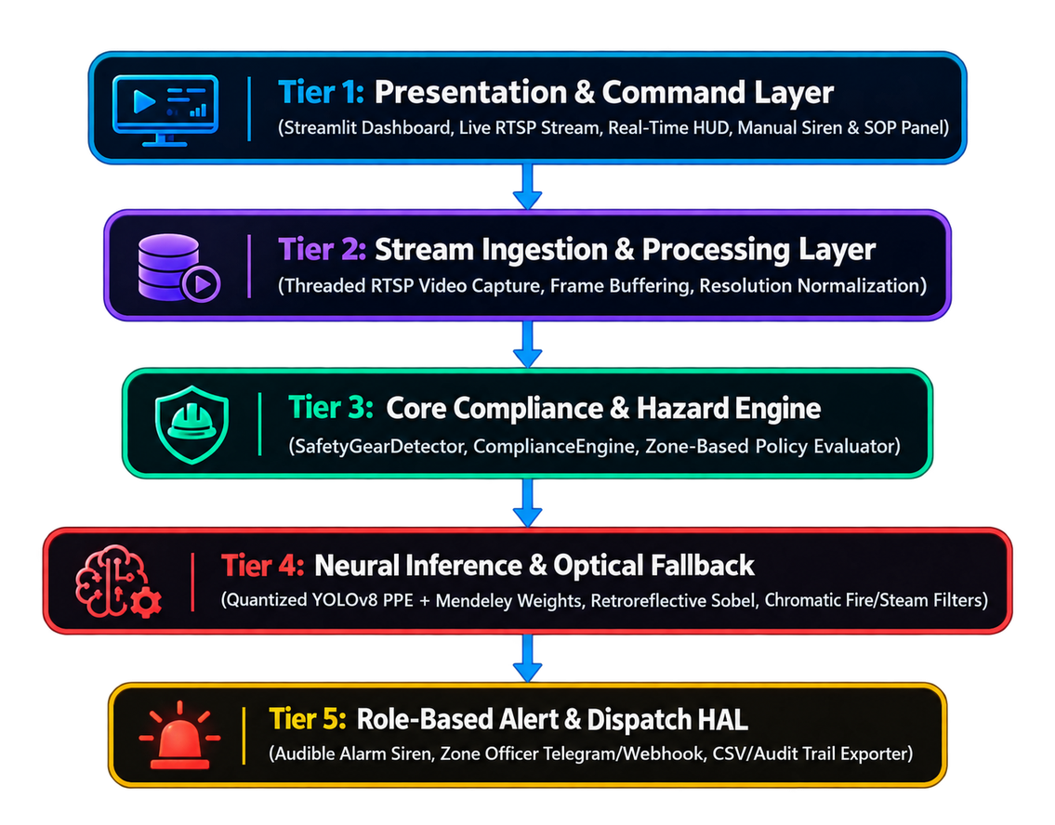
TECHNICAL APPROACH
Technologies used
▪ Languages: Python 3.13, TypeScript, SQL
▪ Backend / APIs: FastAPI, async REST, WebSockets, Prometheus metrics
▪ Frontend: React 18, Vite 6, Tailwind CSS
▪ AI / CV: PyTorch (CPU), YOLOv8n at 384×384, OpenCV, ByteTrack
▪ Database: SQLite (WAL mode)
▪ Sources / hardware: USB and IP cameras, video files, RTSP (partial); Intel Core i5-13420H, 16 GB RAM, CPU only
Methodology and process for implementation
▪ 1 Ingest: thread-isolated capture, queue depth 1 (latest frame wins)
▪ 2 Detect: single-pass YOLOv8n, 7 classes (person, helmet, vest, gloves, footwear, fire, smoke)
▪ 3 Track: ByteTrack gives each worker a persistent ID
▪ 4 Associate: PPE mapped to each worker’s head, torso, hands and feet
▪ 5 Validate: 3 confirmed frames (PPE) or 5 (fire, smoke) before an event fires
▪ 6 Alert: 0–100 risk score, incident created, alert pushed via WebSocket
Measured on CPU (Intel i5-13420H)
56.4 ms mean inference (≈17.7 FPS). 250 unit, 39 integration and 20 E2E recovery tests pass.
Tier 1: Presentation Layer
React dashboard, live video, incident log, WebSocket alerts
Tier 2: Stream Ingestion
Threaded capture (USB / IP / RTSP / file), queue depth 1
Tier 3: Compliance & Hazard Engine
Worker tracking, PPE association, temporal validation, risk and incident engines
Tier 4: AI Inference
YOLOv8n (7 classes) + ByteTrack, fire/smoke state machine
Tier 5: Alerts, Evidence & Storage
Alarm, evidence capture, SQLite (WAL), Prometheus health metrics
3
“See in Real-Time. Act in Seconds. Prevent the Hazard.”

Slide 4
FEASIBILITY AND VIABILITY
ANALYSIS OF FEASIBILITY
POTENTIAL CHALLENGES & RISKS
STRATEGIES TO OVERCOME
▪ Runs on existing hardware: CPU-only prototype, 56 ms YOLOv8n inference (≈17.7 FPS) on an Intel i5-13420H.
▪ Low integration cost: uses existing USB, IP and RTSP cameras; no new sensors.
▪ Proven datasets: Pictor PPE, Hard Hat Workers, Construction Site Safety and D-Fire.
▪ Verified: 250 unit, 39 integration and 20 E2E recovery tests pass.
▪ Modular design: multi-camera-ready backend, WebSocket dashboard, SQLite WAL.
▪ Steam, sparks and dust can cause fire/smoke false alarms.
▪ Plain orange or yellow clothing can be mistaken for high-vis vests.
▪ Occlusion and posture: kneeling, bending or machinery can hide boots and gloves.
▪ Missed detections can turn into false violations.
▪ Video latency and CPU limits on multiple or high-resolution feeds.
▪ Camera dropouts and unstable streams.
▪ Temporal validation plus a fire/smoke state machine and hard-negative validation.
▪ Worker-level spatial association maps gear to head, torso, hands and feet.
▪ UNKNOWN state: unclear frames are never treated as violations.
▪ Latest-frame-wins with a bounded queue and a lightweight 384×384 model.
▪ Camera health monitoring with automatic reconnect.
▪ Planned: INT8/FP16 quantization and NVIDIA Jetson + TensorRT edge acceleration.
4
“No New Sensors. No Cloud Dependency. Just Smarter Cameras.”

Slide 5


IMPACT AND BENEFITS
Worker Safety
Safety Teams & Supervisors
Compliance & Audit
▪ Flags confirmed missing PPE (helmet, vest, gloves, footwear) per worker
▪ Detects fire and smoke early and raises a P0 emergency
▪ Alerts the site team faster than manual observation
▪ Continuous monitoring replaces reliance on manual patrols
▪ Live dashboard with incident log and system health
▪ Location-specific alerts with incident context
▪ Evidence image saved with every incident
▪ Timestamped incident records ready for safety audits
▪ P0–P3 priorities and a 0–100 risk score explain every alert
Cost & Deployment
Operations
People & Environment
▪ Works with existing CCTV and video files; no new sensors
▪ Runs on a standard CPU; no GPU required
▪ Modular software that grows camera by camera
▪ Fewer false alarms through UNKNOWN state and temporal validation
▪ Camera and system faults flagged by health monitoring
▪ Prometheus metrics for monitoring and integration
▪ Supports a proactive, safety-first culture on the floor
▪ Early smoke and fire detection helps limit harm to people and plant
▪ Supports safety teams; it does not by itself guarantee accident prevention
FUTURE SCOPE: Jetson + TensorRT edge acceleration • Modbus / OPC-UA / MQTT • Zone geofencing and violation heatmaps • Historical analytics • Model improvements
5
“Because Every Worker Deserves to Return Home Safe.”

Slide 6


RESEARCH AND REFERENCES
RESEARCH PAPERS / JOURNALS
DATASETS (ACTUALLY USED & REFERENCED)
FRAMEWORKS, OFFICIAL DOCUMENTATION, GITHUB & SAFETY STANDARDS
Ultralytics YOLOv8 (2023)
Anchor-free real-time object detector used for all 7 classes.
github.com/ultralytics/ultralytics
ByteTrack (ECCV 2022)
Multi-object tracking that keeps worker IDs through occlusion.
arxiv.org/abs/2110.06864
CPPE-5 (arXiv 2021)
Medical PPE dataset paper; referenced for multi-class PPE evaluation.
arxiv.org/abs/2112.09569
D-Fire dataset and paper (2022)
Flame and smoke detection benchmark; Neural Computing & Applications.
github.com/gaia-solutions-on-demand/DFireDataset
Pictor PPE [USED]
1,487 images of construction workers, helmets and vests.
github.com/carlosh93/pictor-ppe
Hard Hat Workers [USED]
7,035 images of worker headwear and safety vests.
public.roboflow.com/object-detection/hard-hat-workers
Construction Site Safety [USED]
9,451 images: helmets, vests, gloves and boots.
universe.roboflow.com/roboflow-universe-projects/construction-site-safety
D-Fire [USED]
4,480 images of flames and smoke plumes.
github.com/gaia-solutions-on-demand/DFireDataset
SH17 and Ultralytics PPE [REFERENCED]
Evaluated for class alignment and training settings.
FastAPI and Uvicorn
Async Python API and WebSocket backend.
fastapi.tiangolo.com
React 18 and Vite
Component-based dashboard frontend.
react.dev
SQLite WAL
ACID persistence with write-ahead logging.
sqlite.org/wal.html
SafeSync repository
Codebase, models and test suites.
github.com/SMRU08/SafeSync
OSHA 29 CFR 1926.100 and 1926.95
Head protection and personal protective equipment.
osha.gov
ISO 45001:2018
Occupational health and safety management systems.
iso.org

