Slide 1
BPUT HACKATHON 2026 | TITLE PAGE
Organized by Software Technology Parks of India (STPI) & EmTek
SafeSync
Autonomous AI Vision Platform for Industrial Safety Gear Compliance & Hazard Governance
PROBLEM STATEMENT SPECIFICATION
TEAM & INSTITUTIONAL METADATA
Problem Statement ID: PS06
Problem Statement Title: Build a prototype AI system that detects safety gear compliance
Theme: Artificial Intelligence & Computer Vision / Workplace Safety
Category: Software (Edge AI & Full-Stack Web Application)
Verification Status: Verified Prototype (250/250 Unit Tests • 39/39 Integration Scenarios)
Team ID: BPUT-PS06-XERSES (To Be Assigned)
Team Name: XERSES
College / Institution: Biju Patnaik University of Technology (BPUT) Affiliated Institute
Department: Computer Science & Engineering (To Be Updated)
Project Lead: Smruti Ranjan Nayak (@SMRU08)
GitHub Repository: https://github.com/SMRU08/SafeSync.git

Slide 2
BPUT HACKATHON 2026 | PROBLEM STATEMENT PS06 | SLIDE 2 OF 6
IDEA TITLE
SafeSync — Autonomous Industrial Safety Gear Compliance & Hazard Governance
PROPOSED SOLUTION & HOW IT ADDRESSES PS06
INNOVATION / UNIQUENESS
PROPOSED SOLUTION:
SafeSync is an edge-compatible, multi-camera AI computer vision system designed to automate workplace safety monitoring. It continuously inspects live video streams, localizes workers, tracks movement paths, and evaluates Personal Protective Equipment (PPE) compliance while monitoring early flame and smoke hazards before escalation.
HOW IT ADDRESSES THE PROBLEM (PS06):
• Replaces intermittent manual walkthroughs with continuous 24/7 video surveillance.
• Eliminates human monitor vigilance decay (which drops after 20–30 mins).
• Delivers sub-second alerts with cryptographically signed photographic snapshots.
• Positive Detection + Derived Absence: Avoids training noisy negative classes (e.g. no_helmet). Positively detects items and verifies anatomical overlap with tracked worker bodies.
• Strict Ambiguity Invariant (UNKNOWN != VIOLATION): Partial machine occlusions or boundary clipping yield an UNKNOWN state; UNKNOWN strictly never triggers false violation alarms.
• Zero-Biometric Privacy Architecture: Employs anonymous ByteTrack integer track IDs (Track #101); zero facial recognition, zero facial vector storage, and zero PII collected.
KEY FEATURES (VERIFIED IMPLEMENTED FEATURES)
• Real-Time PPE Compliance: 4-zone anatomical association (Head, Torso, Hands, Feet) • Temporal Validation: N_confirm = 3 consecutive frames eliminates 1-frame false alarms
• Worker-Level PPE Association: Nearest-centroid IoU mapping eliminates double-counting • Location-Specific Policy: Declarative YAML zone rules (e.g. mandatory boots in Loading Dock)
• Helmet & Safety Vest Detection: High-confidence cranial and thoracic coverage validation • Multi-Camera Monitoring: Thread-isolated RTSP, USB Webcam, HTTP MJPEG, and file inputs
• Protective Gloves & Footwear: Distal limb detection with far-field UNKNOWN suppression • Real-Time Dashboard: React 18 SOC interface with live video HUD & WebSocket streaming
• Fire and Smoke Detection: Dual-channel 7-stage state machine (N_confirm = 5 frames) • Incident & Evidence Tracking: SHA-256 hashed photographic snapshots & 60s alert cooldown

Slide 3
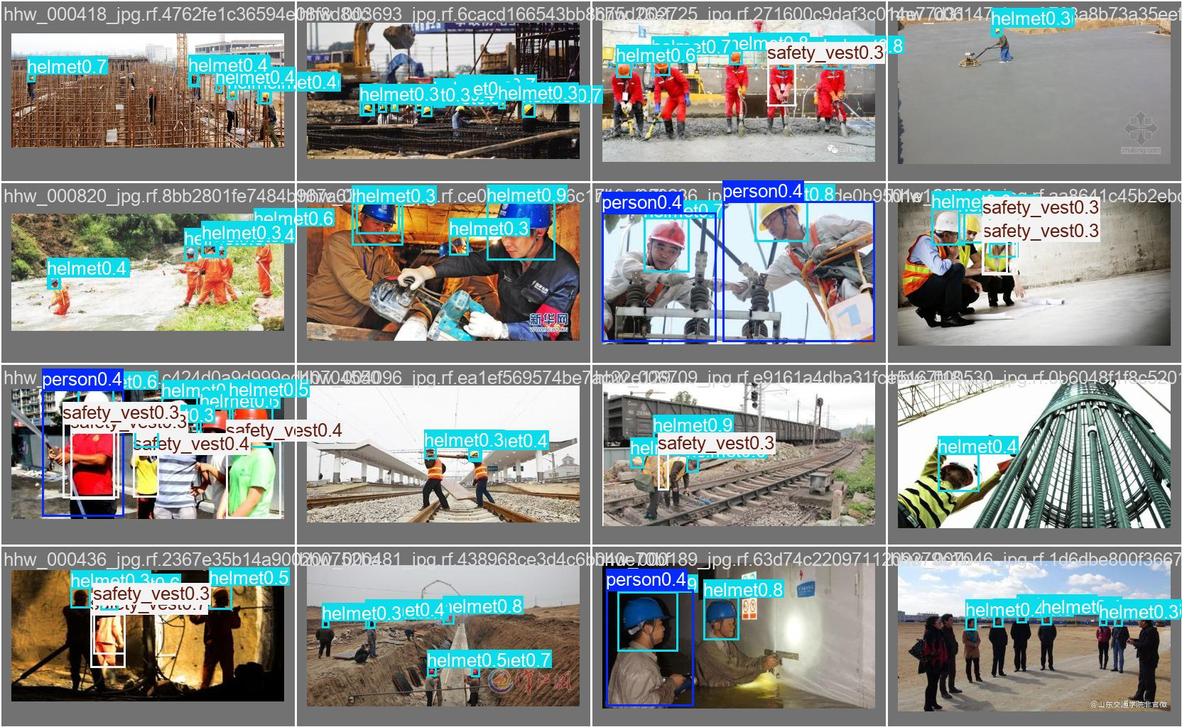
BPUT HACKATHON 2026 | PROBLEM STATEMENT PS06 | SLIDE 3 OF 6
TECHNICAL APPROACH
Production-Grade AI Pipeline, Decoupled Architecture & Real Prototype Evidence
TECHNOLOGIES USED
METHODOLOGY & SYSTEM ARCHITECTURE
WORKING PROTOTYPE / DEMO
Programming Languages:
Python 3.13, TypeScript, SQL
Frameworks:
FastAPI, React 18, Vite 6, Tailwind CSS, PyTorch 2.14.0+cpu, OpenCV
AI/ML Models:
Ultralytics YOLOv8n (384x384), ByteTrack 8-State Kalman Filter
Database:
SQLite (WAL Mode, PRAGMA synchronous=NORMAL, 5000ms busy timeout)
APIs:
Async REST APIs, WebSockets (/ws/events, /ws/alerts), Prometheus /metrics
Hardware / Sensors:
13th Gen Intel Core i5 CPU, USB Webcams, IP Cameras, RTSP Feeds
Step-by-Step Methodology:
1. Ingestion: Thread-isolated worker buffers frame (Queue depth = 1).
2. AI Detection: Single-pass YOLOv8n outputs 7 canonical classes.
3. Tracking: ByteTrack links worker Kalman trajectories anonymously.
4. Spatial Zoning: Maps PPE to Head (25%), Torso (20-70%), Hands, Feet.
5. Debouncing: Requires N_confirm = 3 frames (PPE) or N=5 (Hazard).
6. Risk & Push: Calculates 0-100 risk score; dispatches via WebSockets.
System Architecture / Flow:
Camera / CCTV / Video Feed
↓
Frame Capture (Queue Depth = 1)
↓
AI Detection (Ultralytics YOLOv8n)
↓
Person + PPE + Hazard Detection
↓
Worker Tracking (ByteTrack)
↓
PPE Association (4-Zone Geometry)
↓
Temporal Validation (N_confirm = 3)
↓
Safety / Risk Engine (0-100 Score)
↓
Incident & Alert Engine (60s Cooldown)
↓
Database (WAL) + WebSocket Gateway
↓
SafeSync React 18 Dashboard
Live Implementation Evidence:
• Unit Test Suite: 250 / 250 Passing (100% Pass Rate)
• Integration Suite: 39 / 39 Real-World Scenarios Passing
• End-to-End Recovery: 20 / 20 Matrix Tests Verified
• Measured Latency: 56.45 ms/frame (~18 FPS on CPU)
• Optical Challenge: 0 / 13 False Positives (100% Rejection)

Slide 4
BPUT HACKATHON 2026 | PROBLEM STATEMENT PS06 | SLIDE 4 OF 6
FEASIBILITY AND VIABILITY
Technical Feasibility, Financial Viability, Operational Workflow & Mitigations
TECHNICAL & FINANCIAL FEASIBILITY
OPERATIONAL FEASIBILITY
TECHNICAL FEASIBILITY (VERIFIED ON REAL HARDWARE)
• AI Model: YOLOv8n (3.2M params) operates at 384x384 input resolution with SHA-256 integrity check.
• Hardware Requirements: Validated on commodity 13th Gen Intel Core i5 CPU without requiring discrete GPUs.
• Camera/Video Compatibility: Ingests standard USB Webcams, HTTP MJPEG, RTSP feeds, and video files.
• Real-Time Capability: Sustains ~56.45 ms latency (17.7 FPS) on CPU with bounded queue depth 1.
FINANCIAL FEASIBILITY
• Eliminates Dedicated AI Server Hardware: Runs directly on existing edge or plant PCs.
• Zero Licensing Costs: 100% open-source software stack (Python, FastAPI, React, SQLite, PyTorch).
• Retrofit Compatibility: Connects with existing plant CCTV infrastructure without camera re-cabling.
REAL-WORLD INDUSTRIAL CONTROL-ROOM WORKFLOW
• CCTV / Video Monitoring: Continuous automated surveillance operates 24/7 without vigilance fatigue.
• Live Operator Dashboard: Real-time multi-camera grid with per-worker Checklist HUD badges.
• Color-Coded Alert HUD: Green (PRESENT), Red (ABSENT violation), and Gray (UNKNOWN non-alerting).
• Human-in-the-Loop Actions: Control room operators can Acknowledge, Resolve, or Dismiss alerts.
• Multi-Camera Thread Isolation: Ingestion failures on one camera thread never crash neighboring feeds.
CHALLENGES / RISKS & VERIFIED MITIGATIONS
SCALABILITY / FUTURE SCOPE
• Challenge: False PPE Absences on Occlusion
→ Solution: Strict UNKNOWN != VIOLATION policy suppresses alerts during boundary clipping or machine obstruction.
• Challenge: Hair or Clothing Confusion
→ Solution: Multi-frame debouncing (N_confirm = 3 consecutive frames) filters transient 1-frame misclassifications.
• Challenge: Steam, Dust & Welding Glare
→ Solution: Dual-channel 7-stage state machine (N=5) and negative training data; verified 0/13 false positives.
• Challenge: Limited Edge CPU Resources
→ Solution: Thread-isolated latest-frame-wins ingestion (Queue depth = 1) avoids buffer growth and memory bloat.
• Challenge: Camera or Network Disconnections
→ Solution: Bounded exponential backoff reconnection loop automatically re-establishes dropped video feeds.
Planned Engineering Roadmap:
• [FUTURE] INT8 TensorRT & ONNX Runtime: Quantization for low-power NVIDIA Jetson Orin edge nodes (>60 FPS).
• [FUTURE] Physical Factory CCTV Pilot: On-site multi-week trial deployment under continuous 72-hour load.
• [FUTURE] Automated PLC Interlocks: Integration with Modbus TCP & MQTT to automatically halt dangerous machinery.
• [FUTURE] Expanded Safety Gear: High-angle safety harnesses, welding face-shields, and hearing protection.

Slide 5
BPUT HACKATHON 2026 | PROBLEM STATEMENT PS06 | SLIDE 5 OF 6
IMPACT AND BENEFITS
Value Proposition, Multi-Sector Real-World Applications & Realistic Impact
TARGET USERS & EXPECTED IMPACT
MULTIDIMENSIONAL BENEFITS
TARGET OPERATIONAL PERSONAS
• Industrial Safety Officers & EHS Managers: Centralized real-time compliance oversight.
• Control-Room Operators: Prioritized visual incident alerts and checklist HUDs.
• Plant Operations Directors: Tamper-evident visual audit trails for regulatory defense.
• Industrial Enterprises: Facility-wide monitoring without hiring dedicated surveillance staff.
EXPECTED OPERATIONAL IMPACT
Automated visual safety monitoring eliminates human observer fatigue and spot-check blind spots. By alerting safety teams within seconds of sustained gear removal and detecting incipient flames before physical smoke alarms trigger, SafeSync actively mitigates severe workplace casualties.
• Social Benefits: Protects human life and worker physical integrity; upholds worker dignity through zero-biometric anonymous tracking.
• Economic Benefits: Reduces catastrophic equipment downtime, lowers workers' compensation liabilities, and prevents regulatory fines.
• Technological Benefits: Delivers production-grade edge AI execution on commodity CPU hardware with explainable risk scoring.
• Environmental Benefits: Rapid flame and smoke plume detection prevents uncontrolled industrial fires and toxic atmospheric emissions.
REAL-WORLD APPLICATIONS & LONG-TERM SCALABILITY
HIGH-HAZARD INDUSTRIAL SECTORS
• Heavy Manufacturing & Fabrication: Active overhead crane zones, press bays, and CNC machining lines requiring helmets, vests, and fire vigilance.
• Construction & Infrastructure Sites: High-traffic perimeter gates, scaffold zones, and heavy earth-moving equipment pathways.
• Chemical Processing & Storage Hubs: Volatile liquid storage, hazardous warehousing, and battery charging bays requiring rapid smoke warning.
• Metal Smelting & Power Plants: Turbine floors, boiler halls, and electrical sub-stations requiring high-temperature flame monitoring.
LONG-TERM SCALABILITY & EVOLUTION
SafeSync is built as a modular edge safety platform. By keeping vision inference decoupled from administrative policy, individual plants can scale from a single standalone camera to enterprise-wide distributed networks with centralized cloud reporting and localized edge autonomy.

Slide 6
BPUT HACKATHON 2026 | PROBLEM STATEMENT PS06 | SLIDE 6 OF 6
RESEARCH AND REFERENCES
Foundational Research, Verified Datasets, Frameworks & Regulatory Compliance Standards
RESEARCH PAPERS / JOURNALS
DATASETS (ACTUALLY USED & REFERENCED)
• Ultralytics YOLOv8 (2023): Anchor-free neural architecture providing efficient real-time multi-task object detection at the edge.
https://github.com/ultralytics/ultralytics
• ByteTrack Multi-Object Tracking (ECCV 2022): Associates both high- and low-confidence detection boxes to maintain robust worker trajectories through occlusions.
https://arxiv.org/abs/2110.06864
• CPPE-5 Benchmark (CVPR Workshop 2021): Challenging Personal Protective Equipment Dataset establishing visual multi-class safety evaluation criteria.
https://arxiv.org/abs/2112.07253
• D-Fire Combustion Dataset (IEEE Access 2022): Benchmark research for optical flame and smoke detection and boundary localization.
https://github.com/gaia-solutions-on-demand/DFireDataset
• Pictor Construction Safety [ACTUALLY USED]: 1,487 images of real construction personnel, helmets, and vests.
https://github.com/carlosh93/pictor-ppe
• Hard Hat Workers [ACTUALLY USED]: 7,035 images covering multi-angle worker headwear and safety vests.
https://public.roboflow.com/object-detection/hard-hat-workers
• Construction Site Safety [ACTUALLY USED]: 9,451 images covering helmets, vests, gloves, and protective boots.
https://universe.roboflow.com/roboflow-universe-projects/construction-site-safety
• D-Fire Combustion Dataset [ACTUALLY USED]: 4,480 images of active flames and industrial smoke plumes.
https://github.com/gaia-solutions-on-demand/DFireDataset
• SH17 & Ultralytics PPE [REFERENCED / EVALUATED]: Evaluated for benchmark ontology alignment and training hyperparameters.
FRAMEWORKS, OFFICIAL DOCUMENTATION, GITHUB & SAFETY STANDARDS
• FastAPI & Uvicorn: High-concurrency asynchronous Python ASGI web framework and WebSockets. https://fastapi.tiangolo.com
• React 18 & Vite: Declarative component-driven frontend architecture with sub-millisecond DOM updates. https://react.dev
• SQLite WAL Engine: ACID-compliant relational persistence operating under Write-Ahead Logging. https://sqlite.org/wal.html
• Official GitHub Repository: https://github.com/SMRU08/SafeSync.git (Live codebase, models & test suites)
• OSHA Standards: 29 CFR 1926.100 (Head Protection) & 1926.95 (Personal Protective Equipment). https://www.osha.gov
• ISO 45001:2018: Occupational Health and Safety Management Systems Standard requirements. https://www.iso.org

