Slide 1
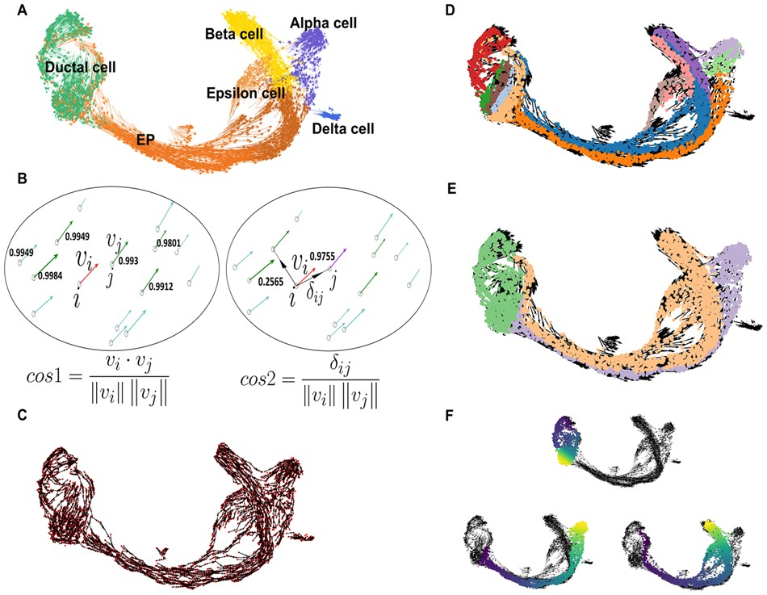

Fig. 1. VeTra reconstructs single-cell trajectories for multiple cell lineages. (A) A 2D embedding plot using the ...
Notes:
Fig. 1. VeTra reconstructs single-cell trajectories for multiple cell lineages. (A) A 2D embedding plot using the scRNAseq for pancreatic development. (B) Cosine similarity to search for the neighboring cells with similar direction. cos1 finds the vectors with similar direction and cos2 identifies the cell to transit from a cell. (C) The directed graph obtained by applying cosine similarity. (D) The WCCs obtained using all possible paths. (E) The grouped WCCs using a hierarchical clustering algorithm. (F) The pseudo-time for each lineage identified by VeTra
Unless provided in the caption above, the following copyright applies to the content of this slide: © The Author(s) 2021. Published by Oxford University Press.This is an Open Access article distributed under the terms of the Creative Commons Attribution Non-Commercial License (https://creativecommons.org/licenses/by-nc/4.0/), which permits non-commercial re-use, distribution, and reproduction in any medium, provided the original work is properly cited. For commercial re-use, please contact journals.permissions@oup.com

