Slide 1
Sequence Pattern Search
國立陽明大學 生物資訊所
鐘翊方(I-Fang Chung)
ifchung@ym.edu.tw
2006/10/19
Parts of Slides from C. H. Chang
J. J. Tsay in CCU …

Slide 2
Outline
Pattern, Profile
1. Motif, Consensus Sequences
2. Regular Expression Models, Sequence Logos
3. PSSM, PSI-BLAST, PHI-BLAST
Hidden Markov Models
1. Markov Models, Hidden Markov Models
2. Forward, Backward, and Viterbi Algorithm
3. Applications in Bioinformatics

Slide 3
Mutiple Sequence Alignment
Questions:
1. How to generate the multiple alignment
2. By what computational model to describe the alignment
3. How to assess the matches of query sequences to the model
Possible computational models:
1. Consensus sequence
2. Regular expression
3. Position specific scoring matrices (PSSMs) or weight matrices (WMs)
4. Profiles / Hidden Markov Models (HMMs)
5. Neural Networks

Slide 4
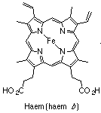
Motif
A subsequence (substring) that occurs in multiple sequences with a biological importance. The “biological object” that is approximated by a pattern or profile.
Enzyme catalytic sites
Prosthetic group attachment sites (e.g. haem, pyridoxal phosphate, biotin, etc.)
Ion binding residues
Cysteines involved in disulfide bonds
Small molecule or protein binding regions

Slide 5
Sequence Features
Features following an exact pattern
e.g. restriction enzyme recognition sites
Features with approximate patterns
Promotors
Ribosome binding sites

Slide 6
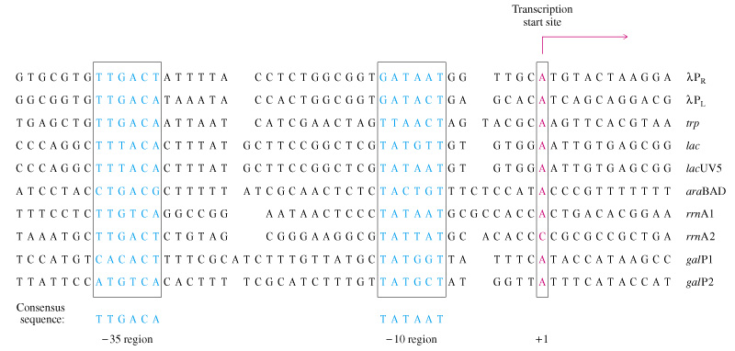
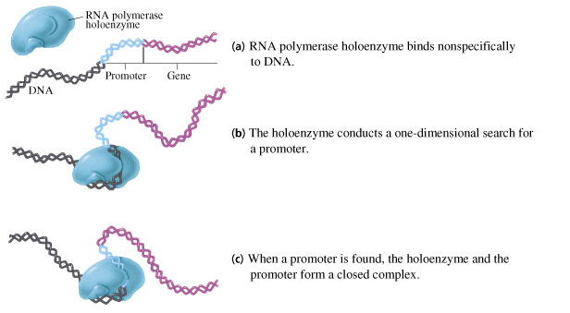
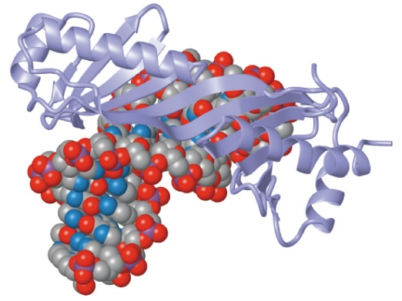
Prokaryotic Promotor Regions
Source: http://cwx.prenhall.com/horton/medialib/media_portfolio/

Slide 7
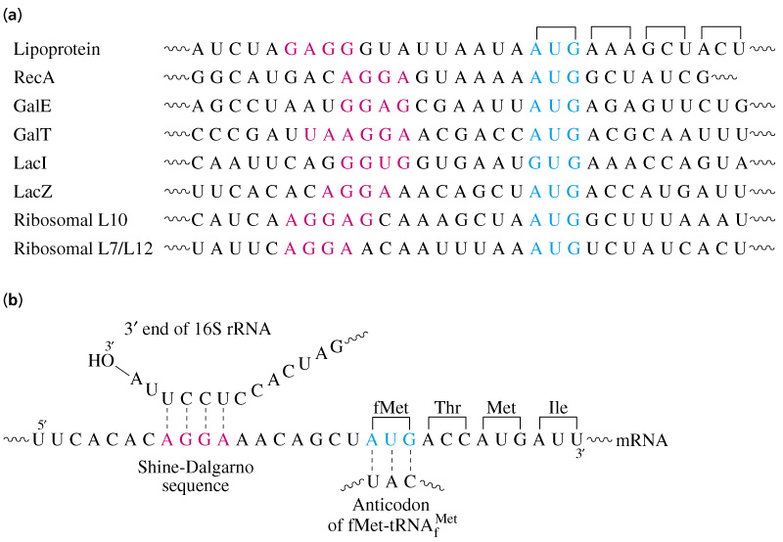
Shine-Dalgarno (SD) Sequence
The 16S rRNA binding site

Slide 8
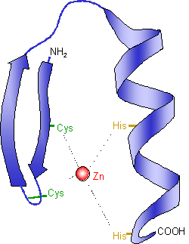
Zinc Finger
Zinc finger is part of a protein that can bind to DNA.
Zinc finger domains typically consist of two antiparallel β sheets, each carrying a cysteine residue, and an α helix carrying two histidine residues.
The cysteine and histidine residues bind a zinc atom.
Many transcription factors (such as TFIIIA), regulatory proteins, and other proteins that interact with DNA, all contain zinc fingers.
Source: http://en.wikipedia.org/wiki/Zinc_finger

Slide 9
Any known sequences with this pattern (C₂H₂)?
MSA of 9 sequences
1 YICSFADCGAAYNKNWKLQ*AHLC*KH 37
2 TGEK*PFPCKEEGCEKGFTSLHHLT*RHSL*TH 67
3 TGEK*NFTCDSDGCDLRFTTKANMK*KHFNRFH 98
4 NIKICVYVCHFENCGKAFKKHNQLK*VHQF*SH 129
5 TQQL*PYECPHEGCDKRFSLPSRLK*RHEK*VH 159
6 AG--*-YPCKKDDSCSFVGKTWTLYLKHVAECH 188
7 QD--*LAVC--DVCNRKFRHKDYLR*DHQK*TH 214
8 EKERTVYLCPRDGCDRSYTTAFNLR*SHIQSFH 246
9 EEQR*PFVCEHAGCGKCFAMKKSLE*RHSV*VH 276
TGEK*PYVC..DGCDKRFTKK..LK*RH..*.H
Consensus sequence
TFIIIA: Pattern of consensus sequence: CX{2,5}CX{12,12}HX{2,3}H

Slide 10
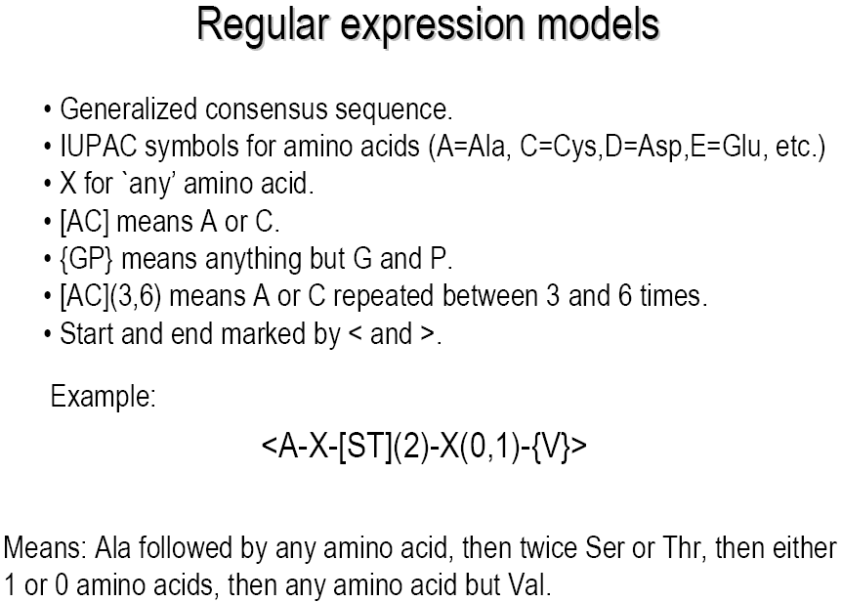
Regular Expression Models

Slide 11
Regular Expression Models (cont’d)
A regular expression represents a generalization about the range of variability that occurs in corresponding positions across a family of protein sequences.
Meaning, it represents variability by specifying a group of amino acids permitted in that position.
A C G T A C G T
A A G T A G G T
A T T T A A C T
A C G T A C G T
A T G C
T A
A-X-[G,T]-T-A-X-[G,C]-T
Sequence patterns using regular expressions (such as PROSITE) have a problem with large multiple alignments of divergent families: As more sequences are added, the probability that there will be even a few constant or even strongly conserved sites will diminish. There will always be an exception to the rule.

Slide 12
Regular Expression Models (cont’d)
Consensus sequence:
reductionistic representation of a motif
Most frequent instance is used as a representative
Loss of information
Regular expression:
More complex representation allowing motif degeneracy

Slide 13
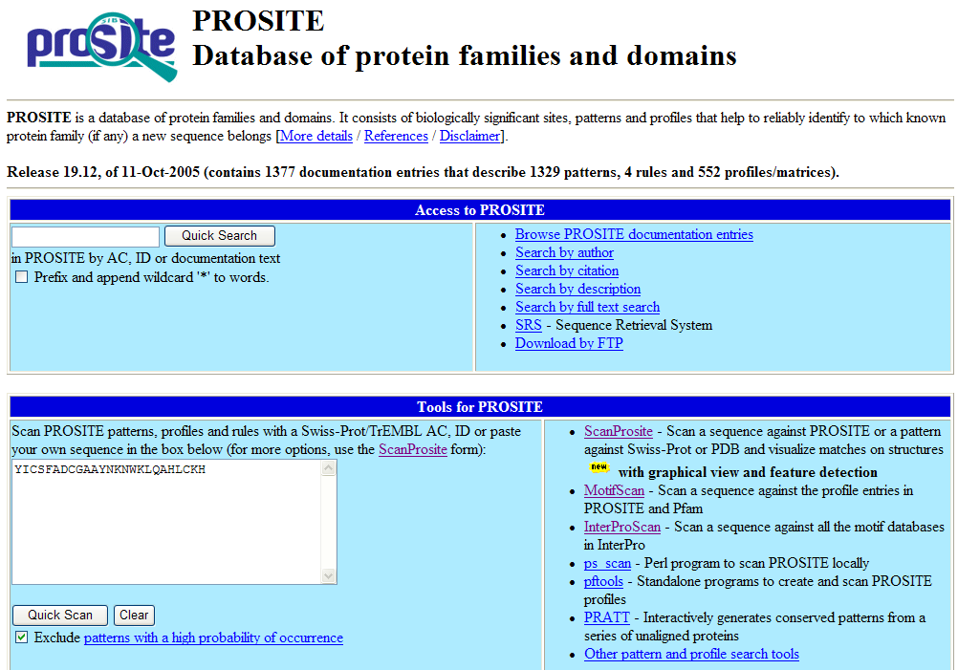
PROSITE (http://www.expasy.org/prosite/)
Regular expressions are used by the Prosite database.

Slide 14
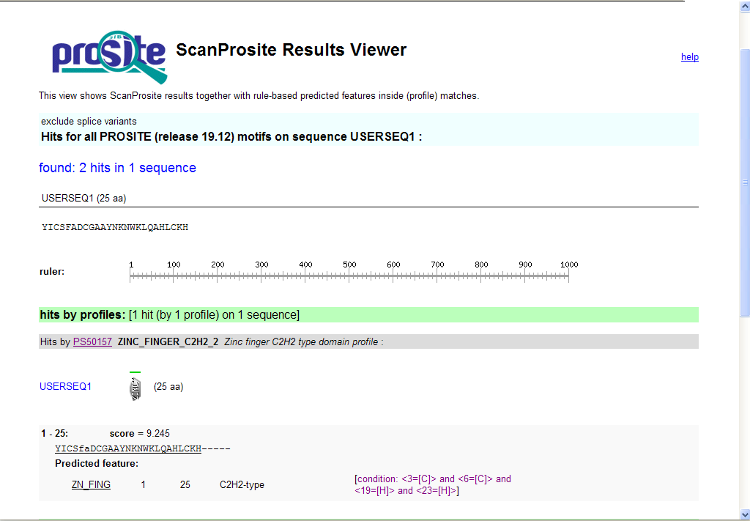
PROSITE (Cont’d)

Slide 15
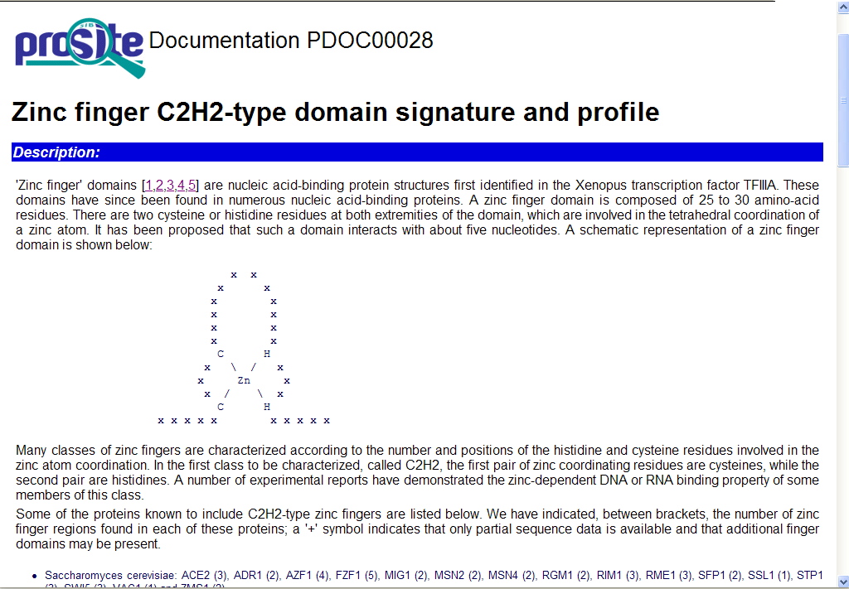
PROSITE (Cont’d)

Slide 16
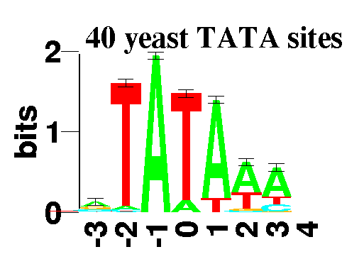
Sequence Logos
Sequence logos provide a graphical representation of a position specific weight matrix.
Logos are defined as follows for each position of a motif:
Letters representing the four nucleotides or twenty amino acids are stacked on top of each other.
Letters are sorted according to their frequencies and the height of each letter is proportional to its frequency.
Source: http://www-lmmb.ncifcrf.gov/~toms/sequencelogo.html

Slide 17

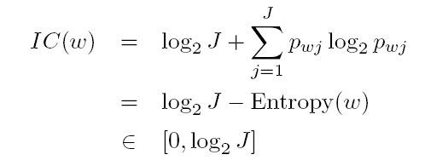
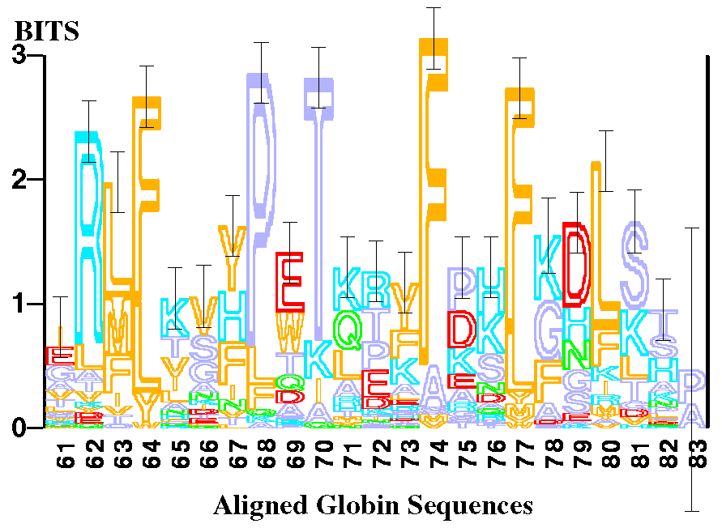
Sequence Logos (cont’d)
Logos are defined as follows for each position of a motif: (cont’d)
The height of the entire stack is proportional to the information content (IC) at that position. The vertical scale is in bits,
Height of letter j at position w where p_{wj} denotes the frequency of letter j at position w.
For a J letter alphabet (J = 4 nucleic acids; J = 20 proteins),
Source: http://www-lmmb.ncifcrf.gov/~toms/sequencelogo.html

Slide 18
Pattern
A qualitative description of a motif
May be generated manually or automatically
A regular expression is used to define the motif
PROSITE is a pattern database

Slide 19
Profile
A quantitative description of a motif
Matrix of probabilities for the occurrence of a particular amino acid at each position
Profiles can be used to describe very divergent protein motifs
Profiles contain more information than patterns and are more sensitive for database searching
BLOCKS is a profile database
A profile is a table of position-specific amino acid weights and gap costs.

Slide 20
Various Types of Profiles
PSSM (Position Specific Scoring Matrix)
used in the BLOCKS database
Gribskov alignment profile
Scores for matches, substitutions, insertions
used for PROSITE profiles
Gribskov et al. (Proc. Natl. Acad. Sci. USA 84; 4355-4358 (1987))
Gribskov, et al. (CABIOS 4; 61-66 (1988))
Hidden Markov Model (HMM)
Bayesian statistical approach
used for Pfam

Slide 21
Concept of Profile
Common ancestor (Homology)
Structure conservation
Position dependent sequence conservation
Position specific scoring matrix (PSSM)
A profile conserves all of the information in the alignment, whereas a consensus sequence removes this information.

Slide 22
Profile (cont’d)
Profiles are generated from multiple sequence alignments. The information in the alignment is represented quantitatively as a table of position-specific values and gap penalties. This table is called a profile.
A profile is a table where we find for each amino acid position the frequency of each of the 20 amino acids (Profile = position-specific scoring table) - i.e., a position-dependent scoring matrix that has N rows and 20+ columns. N is the length of the profile.
The first 20 columns of each row specify the probability for finding, at that position in the target sequence, each of the 20 amino acid residues.
The >20 column(s) contain(s) a penalty (penalties) for insertions/deletions (for opening and extending gaps) at that position.

Slide 23
Profile (cont’d)
In order to avoid missing a known member of a family, the regular expression has to be made more general, but then the danger of including garbage increases. This is the typical sensitivity-specificity problem.
Sequence profiles are essentially patterns where each position in the sequence of the segment (or motif) has been assigned a probability value for each possible amino-acid residue type.
Instead of requiring a yes/no response to the question "does the amino acid in the sequence fit the pattern?", we now get a response "it fits at a level of 0.9", or "it fits at level of 0.1". The idea is to make the process softer. Add together the soft responses to an overall sum and then make a decision. Don't make the decision at each comparison step.

Slide 24
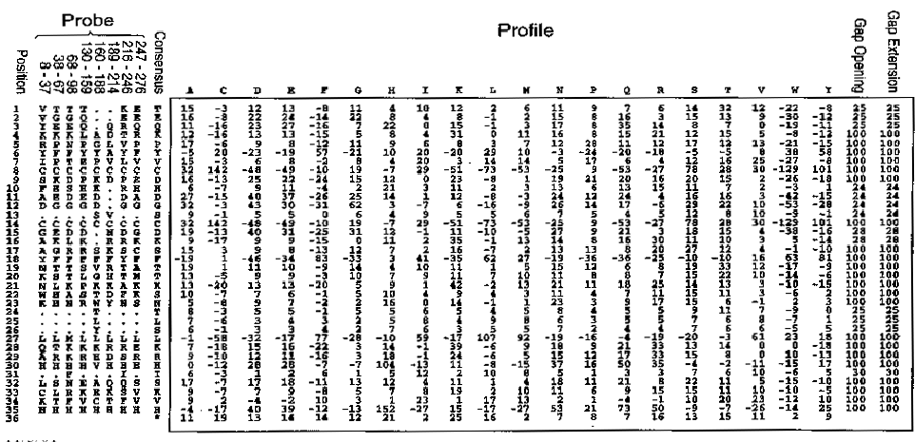
Profile of a Zinc Finger
Profile is composed of:
Columns: one for each residue; columns for insertions and deletions as well
Rows: one for each position in the conserved region or motif

Slide 25
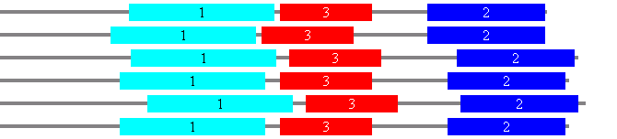
Representing Conserved (Motif) Regions with Profiles
Once the conserved (motif) regions have been identified, a profile can be created and used to search other protein sequences for it.
This is a very common sequence annotation strategy!
Profile 1
Profile 3
Profile 2

Slide 26
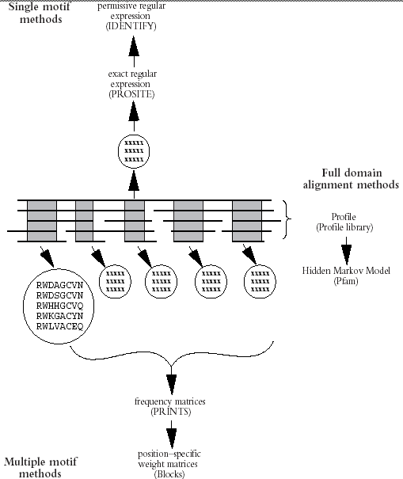
Methods for Building Pattern Databases
(BRIEFINGS IN BIOINFORMATICS. VOL 1. NO 1. 45-59. FEBRUARY 2000)
①
Alignment profile
③
HMM
PSSM
②

Slide 27
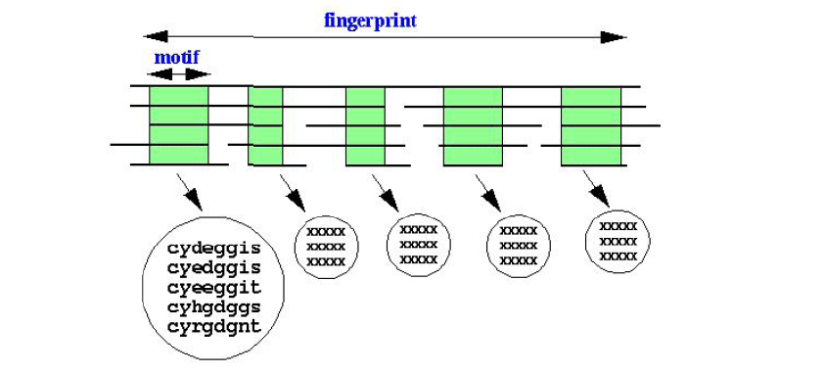
Fingerprints: Combinations of Weight Matrices
Protein families can in a reasonable number of cases be described
by a ‘fingerprint’ of a particular combination of weight matrices. The PRINTS database uses such fingerprints.

Slide 28
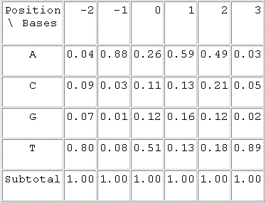
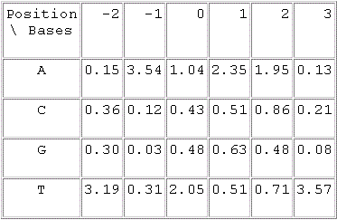
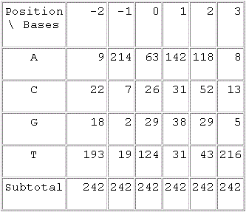
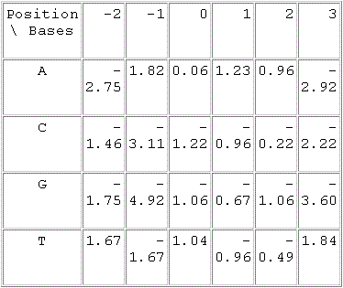
Profile (Weight Matrix): Make Model
242 species sequences
Make odds
MSA
Consensus sequence
(length=6bp)
Log(odds)
normalization
statistics

Slide 29
Compute Frequency from Counts
F(S_{i})/N
The counts were obtained from the alignment result of 242 sequences.
Simply divide the counts of each nucleotide at a given position by total
sequence number. You will get the frequency of each nucleotide at
each position.

Slide 30
Compute Odds from Frequency
P(S_{i})/0.25
Assume the composition of each nucleotide is 25% here.
Divide frequency by the composition will give you the
odds of finding each nucleotide at a given position.

Slide 31
Convert to log(odds)
log2(odds)
When scoring a segment of nucleic acids, we can get the score by using addition instead of multiplication.

Slide 32
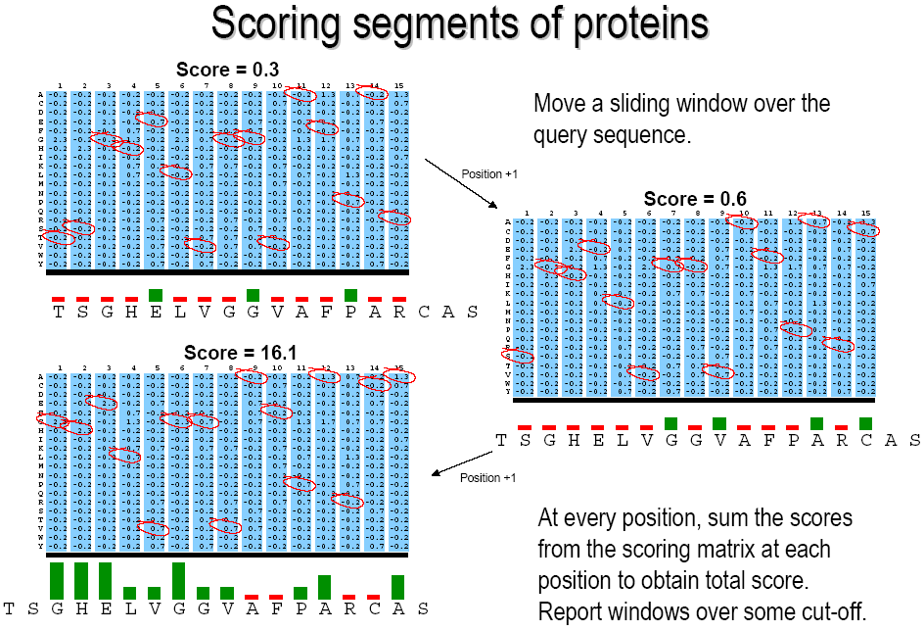
Scoring Segments of Proteins

Slide 33
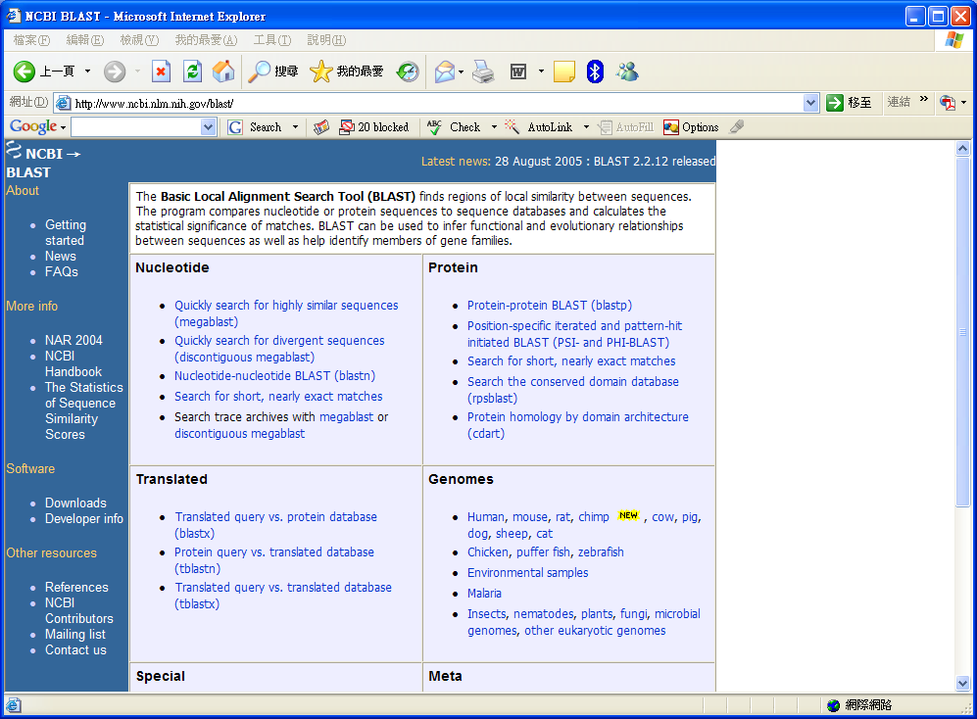
Iterative Database Search Using PSSM (http://www.ncbi.nlm.nih.gov/blast/)

Slide 34
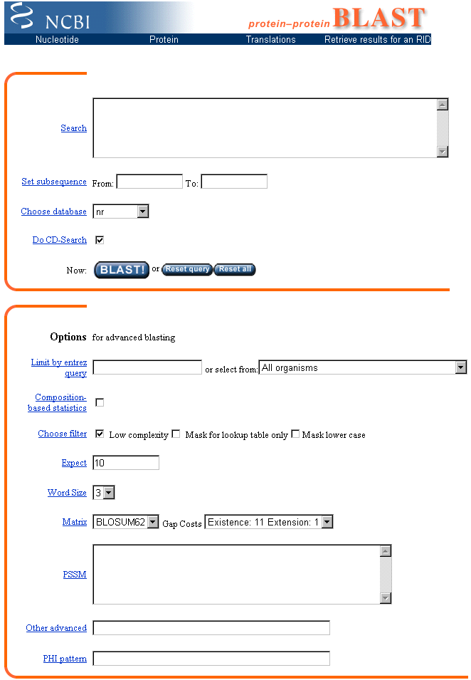
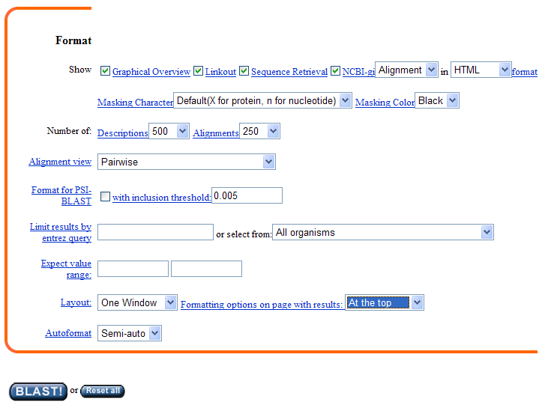
Iterative Database Search Using PSSM (Cont’d)
PSI- BLAST (position specific iterated)
& PHI-BLAST (pattern hit initiated)

Slide 35
PSI-BLAST
Position-specific iterated
Runs one round of gapped-BLAST, and then builds a PSSM
The PSSM is used as the input for the following rounds of BLAST - a new BLAST search is performed using this matrix instead of BLOSUM62
Reference: Altschul et al (1997) Nucleic Acids Research 25(17):3389-3402.

Slide 36
Steps in PSI-BLAST
Query sequence
Use profile as query to collect more significant hits
Gapped blast
Convergence?
(No new significant
hits anymore)
No
MSA of significant hits
Make profile from alignment result
Yes
stop

Slide 37
PSI-BLAST E-values
Two different E value settings need to be specified in the PSI-BLAST program.
The first of these (upper) sets the threshold for the initial BLAST search. The default value is 10 as in the standard BLAST program.
The second E value (lower) is the threshold value for inclusion in the position specific matrix used for PSI-BLAST iterations. The default setting is 0.005.
The E values specified allow the user to see (and selectively, based on prior knowledge, include) all of the BLAST hits up to E=10; but to automatically include only those hits exceeding a relatively rigorous E value threshold of 0.005.

Slide 38
Iteration
PSI-BLAST continues until no new proteins with E-value of less than 0.005 are found
Adds the new sequences in each round to the PSSM
User has the choice to manually edit (force sequences in or out) the input to the alignment

Slide 39
Why (not) PSI-BLAST?
If the sequences used to construct the Position Specific Scoring Matrices (PSSMs) are all homologous, the sensitivity at a given specificity improves significantly.
However, if non-homologous sequences are included in the PSSMs, they are “corrupted.” Then they pull in more non-homologous sequences, and become worse than generic

Slide 40
How to Use PSI-BLAST
Set initial thresholds high. Inspect each iteration's result for suspicious sequences.
Do several iterations (~5), or until no new sequences are found
Even if only looking for a small set of sequences, make the initial search very broad
First, use NR with up to 5 iterations to set PSSM
Then use that PSSM to search in restricted domain

Slide 41
PSI-BLAST Caveats
Increased ability to find distant homologues
Cost of additional required care to prevent non-homologous sequences from being included in the PSSM calculation.
When in doubt, leave it out!
Examine sequences with moderate similarity carefully.
Be particularly cautious about matches to sequences with highly biased amino acid content

Slide 42
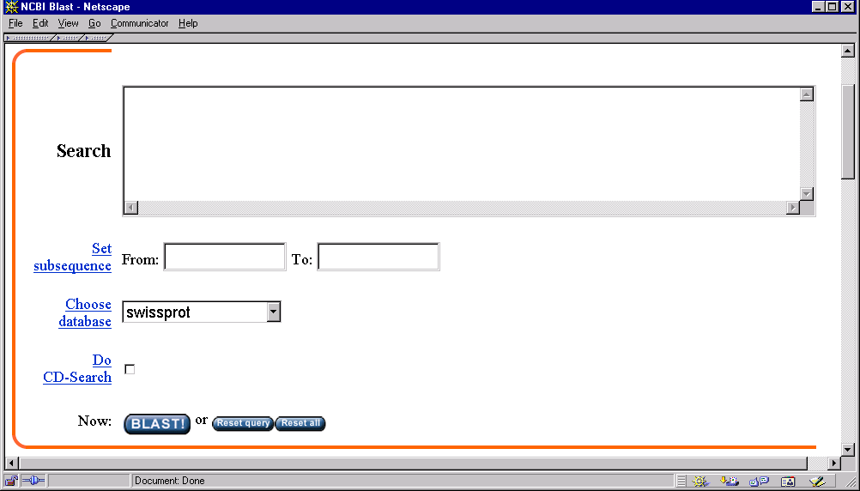
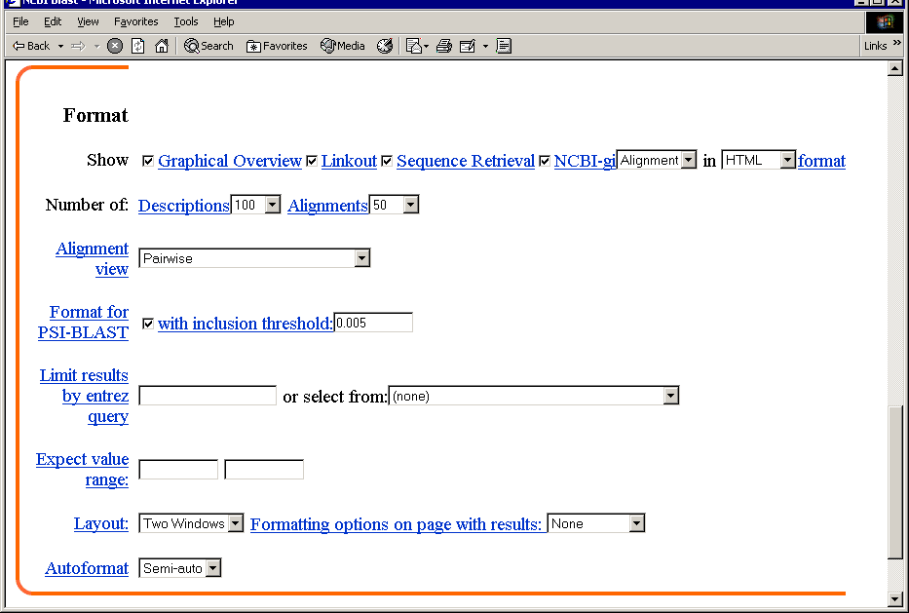
Example for PSI-BLAST
>gi|113340|sp|P03958|ADA_MOUSE ADENOSINE DEAMINASE (ADENOSINE
MAQTPAFNKPKVELHVHLDGAIKPETILYFGKKRGIALPADTVEELRNIIGMDKPLSLPGF
VIAGCREAIKRIAYEFVEMKAKEGVVYVEVRYSPHLLANSKVDPMPWNQTEGDVTPDDVVD
EQAFGIKVRSILCCMRHQPSWSLEVLELCKKYNQKTVVAMDLAGDETIEGSSLFPGHVEAY
RTVHAGEVGSPEVVREAVDILKTERVGHGYHTIEDEALYNRLLKENMHFEVCPWSSYLTGA
VRFKNDKANYSLNTDDPLIFKSTLDTDYQMTKKDMGFTEEEFKRLNINAAKSSFLPEEEKK
Formatting Options
Can be set after the search
All web BLAST searches
are PSI-BLAST
e value cutoff for PSSM

Slide 43
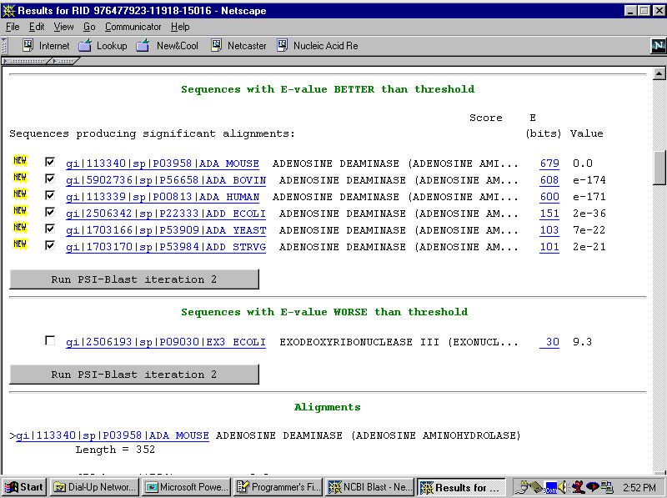
PSI Results: Initial BLAST Run
Same results as protein-protein BLAST

Slide 44
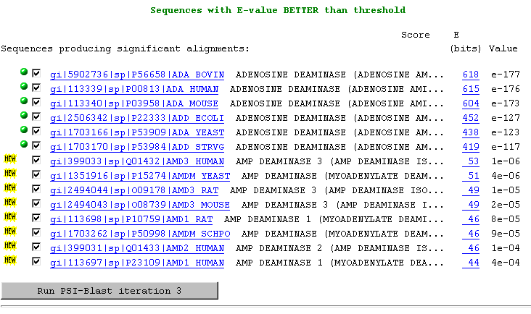
PSI Results: First PSSM Search
Other purine nucleotide metabolizing enzymes not found by ordinary BLAST

Slide 45
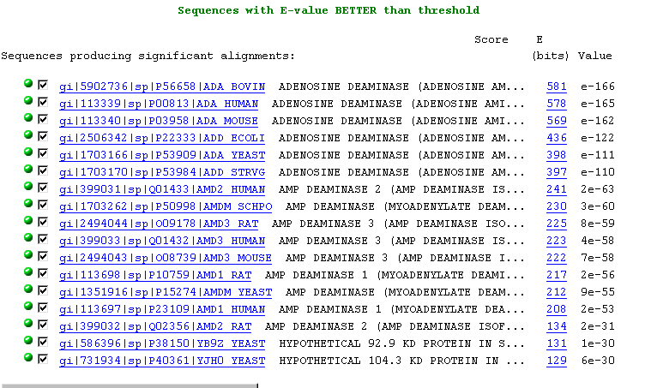
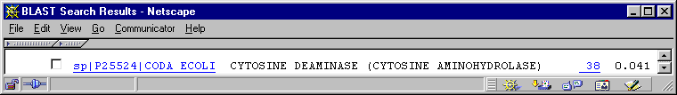
Third PSSM Search: Convergence
Just below threshold, another
nucleotide metabolism enzyme
Check to modify PSSM

Slide 46

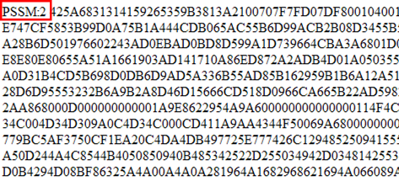
The PSSM Text File
A PSSM matrix, that has been constructed from the search just done,
will be displayed. This should be saved as a text file (can be done as a "save as" from browser function).
-> Simply cutting and pasting the file contents from the browser window will not work – the file must be saved as text.
This text file can be pasted into the PSSM box. If the same database is searched, the results will be the same as the original iteration. If the database is different, a new list of results will be displayed.
- This strategy is especially useful when one database (e.g. an organism-specific database) has known close matches and a second database, (e.g.Swissprot) may hold unknowns.
- The building of the PSSM with known matches increases the sensitivity of the search in the new database.
When using the PSSM box nothing needs to be added to the BLAST search box. The identity of the sequence is included in the PSSM text file.

Slide 47
Other Advanced Power Searching
Other advanced gives command search options for changing the search parameters of BLAST.
Spacing is important here. The spacing should be -Command [Space] Value [Space].
Though the Gap and Gap Extension parameters can be changed, not all combinations of values for these are supported (as we saw in the pull-down menus for these options).
A list of supported values for Gap Opening and Gap Extension penalties can be found at:
http://www.ncbi.nlm.nih.gov/Class/NAWBIS/Modules/Similarity/simsrch47b.html

Slide 48
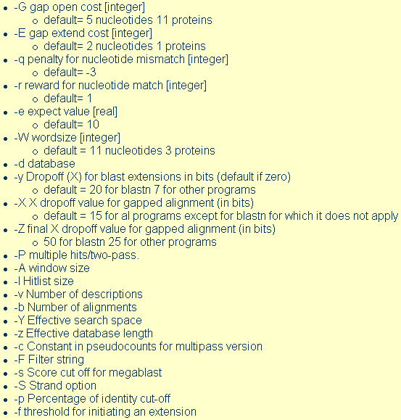
Power Searching Commands
Options and Defaults for Other Advanced

Slide 49
PHI-BLAST
PHI-BLAST means Pattern-Hit Initiated BLAST
PHI-BLAST expects as input a protein query sequence and a pattern contained in that sequence.
PHI-BLAST searches the specified database for other protein sequences that also contain the input pattern and have significant similarity to the query sequence in the vicinity of the pattern occurrences.
Statistical significance is reported using E-values as for other forms of BLAST, but the statistical method for computing the E-values is different.
PHI-BLAST is integrated with Position-Specific Iterated BLAST (PSI-BLAST), so that the results of a PHI-BLAST query can be used to initiate one or more rounds of PSI-BLAST searching.

Slide 50
Steps in PHI-BLAST
Query pattern
Query sequence
Use profile as query to collect more significant hits
(filter)
Gapped blast
Convergence?
(No new significant
hits anymore)
No
MSA of significant hits
Make profile from alignment result
Yes
stop

Slide 51
PHI-BLAST: How It Works
find sequences with
good flanking
alignment
find from database
all sequences containing
given pattern

Slide 52
Consensus, Regular Expressions, & Weight Matrices
Consensus & regular expressions: - Easy to construct from alignment & databases can be searched very efficiently. - Easy to understand & are handy for summarizing patterns. - Too simplistic for representing any but the simplest of patterns in protein sequences.
Weight matrices: - Are general enough to capture more realistic & complex patterns. - Computationally almost as efficient as consensus and regular expressions. - Scores have clear probabilistic interpretation.
Main problem: -None of these methods can deal flexibly with insertions and deletions in the domains. i.e. weight matrices demand all examples of the domain have precisely the same length.
Answer: Profile/Hidden Markov Models

Slide 53
Outline
Pattern, Profile
1. Motif, Consensus Sequences
2. Regular Expression Models, Sequence Logos
3. PSSM, PSI-BLAST, PHI-BLAST
Hidden Markov Models
1. Markov Models, Hidden Markov Models
2. Forward, Backward, and Viterbi Algorithm
3. Applications in Bioinformatics

Slide 54
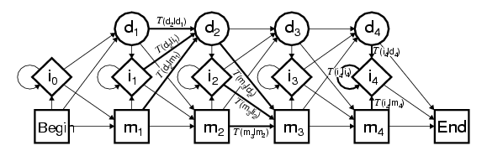
HMM for DNA Sequence

Slide 55
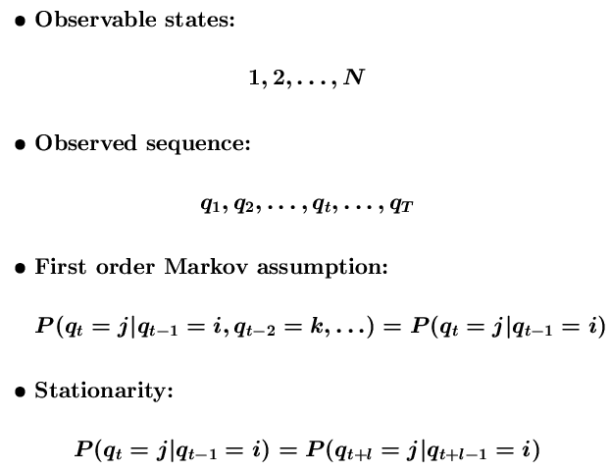
Markov Models
States are observable

Slide 56
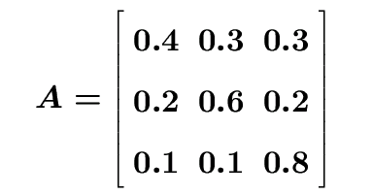
Weather Model
States
R: Rainy, C: Cloudy, S: Sunny
State Transition Probability Matrix
What is the probability of observing O=SSRRSCS given that today is S?

Slide 57

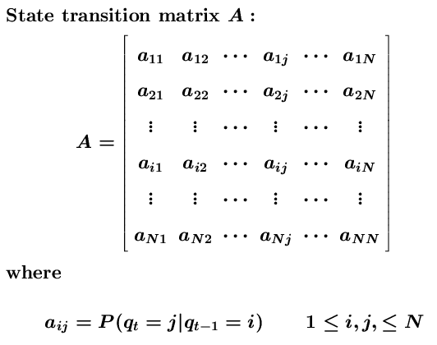
Markov Models (cont’d)

Slide 58
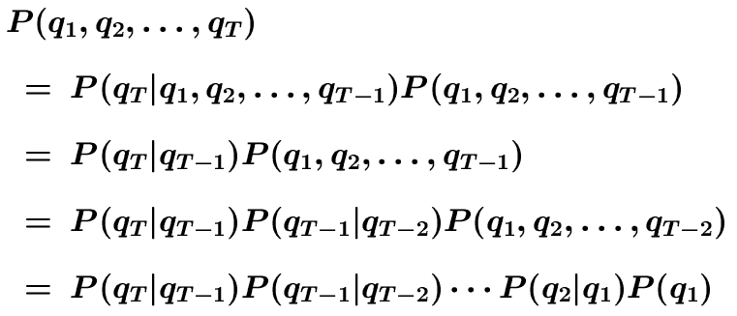
Weather Model (cont’d)
Basic Rule: P(A, B) = P(A|B)P(B)
Markov chain rule:

Slide 59
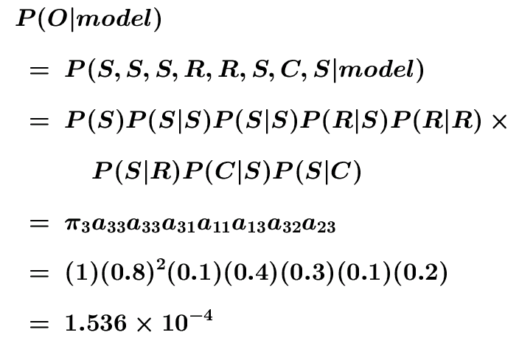
Weather Model (cont’d)
Observation Sequence O:
O = (S, S, S, R, R, S, C, S)
By Chain Rule
initial probability
π_{i} = P(q₁=i)

Slide 60
Hidden Markov Models
States are not observable
Observations are probabilistic functions of states
State transitions are still probabilistic
Hidden variables
H₁
H₂
H_{i}
H_{L-1}
H_{L}
X₁
X₂
X_{i}
X_{L-1}
X_{L}
Observed data

Slide 61
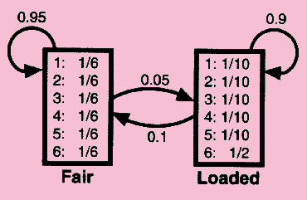
Dishonest Casino
Actually, what is hidden in this model?

Slide 62
Coin-Tossing
Start
tail
1/2
1/2
1/2
tail
0.1
1/4
Fair
loaded
0.9
0.1
0.9
1/2
3/4
head
head
Fair/Loaded
L tosses
H₁
H₂
H_{i}
H_{L-1}
H_{L}
X₁
X₂
X_{i}
X_{L-1}
X_{L}
Head/Tail
Q: What is the probability of the sequence of observed outcome (e.g. HHHTHTTHHT), given the model?

Slide 63
CpG Islands
In human genome, CG dinucleotides are relatively rare
CG pairs undergo a process called methylation that modifies the C nucleotide
A methylated C mutate (with relatively high chance) to a T
Promotor regions are CG rich
These regions are not methylated, and thus mutate less often
These are called CpG islands

Slide 64
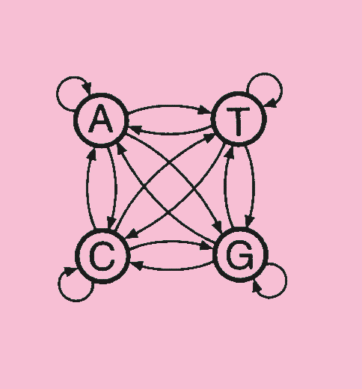
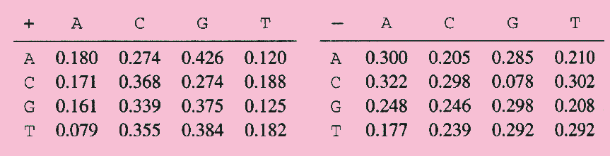
CpG Islands by Markov Models
We can construct Markov chain for CpG rich and poor regions
Using maximum likelihood estimates from 60K nucleotide, we get two models

Slide 65
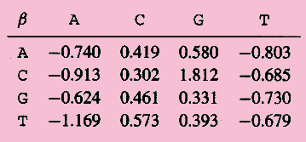
Ratio Test for CpC Islands
Given a sequence X1,…,Xn we compute the likelihood ratio

Slide 66
Finding CpG Islands
Simple Minded approach:
Pick a window of size N (N = 100, for example)
Compute log-ratio for the sequence in the window, and classify based on that
Problems:
How do we select N?
What do we do when the window intersects the boundary of a CpG island?

Slide 67
CpG Islands by HMM
q/4
A
G
q/4
P
q
Regular
DNA
P
change
q
P
P
q
q
C
q/4
T
q/4
p/6
p/3
(1-P)/4
A
G
(1-q)/6
(1-q)/3
P/6
p/3
C-G island?
T
C
C-G island
H₁
H₂
H_{i}
H_{L-1}
H_{L}
X₁
X₂
X_{i}
X_{L-1}
X_{L}
A/C/G/T

Slide 68
Elements of a HMM
Q={1,2,…,N} : set of hidden states
V={1,2,…,M} : set of observation symbols
A: state transition probability matrix
a_{ij} = P(q_{t+1}=j|q_{t}=i)
B: observation symbol probability (Emission Probabilities)
b_{j}(k) = P(o_{t}=k|q_{t}=j)
π: initial state distribution
π_{i} = P(q₁=i)
λ: the entire model λ=(A,B,π)

Slide 69
Sequence Generator
generate a sequence of T observations O=(o₁,o₂,…,o_{T})
Choose an initial state q₁ = S_{i} according to state distribution, and set t = 1
Choose O_{t}=v_{k} according to the symbol probability distribution in state S_{i}, i.e. b_{i}(k)
Transit to a new state q_{t+1}=S_{j} according to the state transition probability distribution for state S_{i}, i.e. a_{ij}
Set t = t+1; go to step 3 if t < T; otherwise terminate the procedure

Slide 70
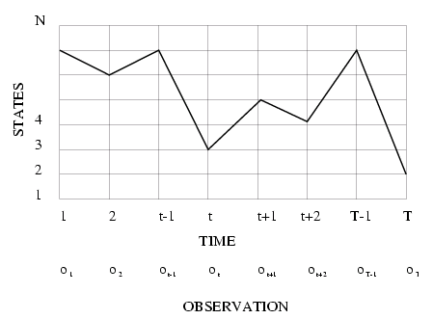
Execution of HMM
State sequence corresponds to a path in the grids

Slide 71
Three Basic Problems
compute the probability that the model generates the observation sequence
classification
find the optimal state sequence that generates the observation sequence
hidden state discovery (tagging, alignment, promoter, gene, intron, exon, …)
learn a HMM that best fits the observation sequences

Slide 72
Basic Problem 1 (Evaluation)
Given observation O=(o₁,o₂,…,o_{T}) and model λ=(A,B,π), efficiently compute P(O|λ)
P(O|λ) is the probability that O is produced by λ
Hidden states complicates the probability evaluation
Given two models λ₁ and λ₂, the probability (score) can be used to choose the better one
λ_{i} models some protein family
O denotes a protein
find the most probable protein family for O

Slide 73
Basic Problem 2 (Decoding)
Given observation O=(o₁,o₂,…,o_{T}) and model λ=(A,B,π), find the optimal state sequence q=(q₁,q₂,…,q_{T})
to uncover the hidden part of the model
Optimality criterion has to be decided (e.g. maximum likelihood)
find “explanation” for the data
O is the header of some scientific paper
find title, author, publication date, … of the paper
a fundamental problem in citation index generation
word-sense disambiguation, promoter identification, gene finding

Slide 74
Basic Problem 3 (Learning)
Given observation O=(o₁,o₂,…,o_{T}), estimate model parameters λ=(A,B,π) that maximizes P(O|λ)
to train the model
find the best topology
find the best parameters

Slide 75
Solution to Problem 1
Problem: compute P(o₁,o₂,…,o_{T}|λ)
Consider state sequence q=(q₁,q₂,…,q_{T})
Assume observations are independent
P(O|q,λ) = Π_{i=1,…,T}(o_{t}|q_{t},λ)
= b_{q1}(o₁) b_{q2}(o₂)… b_{qT}(o_{T})
P(q|λ) = π_{q1}a_{q1q2}a_{q2q3}… a_{qT-1qT}
P(O|λ) = Σ_{q} P(O|q,λ)P(q|λ)
N^{T} state sequences each with O(T) time
Complexity O(TN^{T})
For N=5, T=100, TN^{T}=100x5¹⁰⁰ ~ 10⁷²

Slide 76
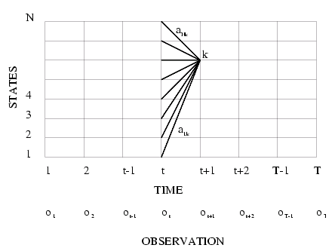
Forward Algorithm: Intuition
α_{t}(i) = P(o₁,o₂,…,o_{t},q_{t}=i|λ)
the probability of observing the partial sequence (o₁,o₂,…,o_{t}) such that state q_{t} is i

Slide 77
Forward Algorithm
forward variable α_{t}(i) = P(o₁,o₂,…,o_{t},q_{t}=i|λ)
α_{t}(i) is the probability of observing the partial sequence (o₁,o₂,…,o_{t}) such that state q_{t} is S_{i}
Initialization: α₁(i) = π_{i}b_{i}(o₁)
Induction:
Termination:
Complexity: O(N²T)

Slide 78
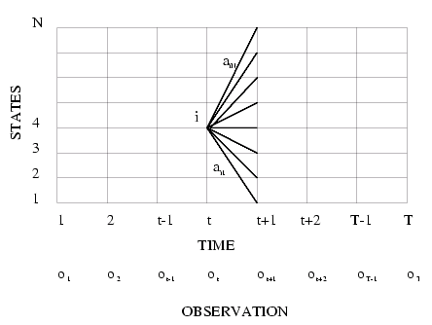
Backward Algorithm: Intuition
β_{t}(i) = P(o_{t+1},o_{t+2},…,o_{T}|q_{t}=i,λ)
The probability of observing the partial sequence (o_{t+1},o_{t+2},…,o_{T}) such that state q_{t} is i

Slide 79
Backward Algorithm
backward variable
β_{t}(i) = P(o_{t+1},o_{t+2},…,o_{T}|q_{t}=i,λ)
β_{t}(i) is the probability of observing the partial sequence (o_{t+1},o_{t+2},…,o_{T}) such that state q_{t} is i
Initialization: β_{T}(i) = 1
Induction:
Termination:
Complexity: O(N²T)

Slide 80
Solution to Problem 2
Find the most likely path (assume state sequence Q=q₁…q_{T})
Find the path that maximizes likelihood:
P(q₁,q₂,…,q_{T}|O, λ) which is equivalent to maximize P(q₁,q₂,…,q_{T}, O|λ)
define
δ_{t}(i) is the highest prob. path ending at state i
by induction,

Slide 81
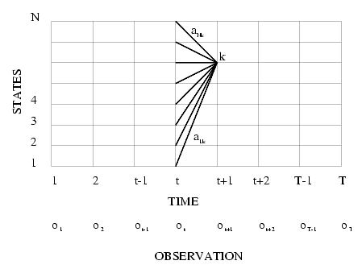
Viterbi Algorithm

Slide 82



Viterbi Algorithm
Initialization:
Recursion:
Termination:
Path (state sequence) backtracking:

Slide 83
Solution to Problem 3
estimate λ=(A,B,π) to maximize P(O|λ)
no analytic method because of complexity – iterative method
is the probability of being in state i at time t, and in state j at time t+1

Slide 84
Parameter Re-estimation
Use the forward-backward (or Baum-Welch) algorithm, which is a hill-climbing algorithm
Using an initial parameter instantiation, the forward-backward algorithm iteratively re-estimates the parameters and improves the probability that given observation are generated by the new parameters
Three parameters need to be re-estimated:
Initial state distribution:
Transition probabilities: a_{i,j}
Emission probabilities: b_{i}(o_{t})

Slide 85
Expectation Maximization
= (expected number of times in state i at time 1)
a’_{ij} = (expected number of transitions from state i to state j) / (expected number of transitions from state i)
b’_{j}(k) = (expected number of times in state j and observing symbol k) / (expected number of times in state j)
P(O|λ’)>P(O|λ)

Slide 86
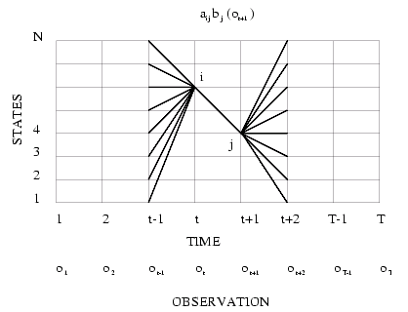
Re-estimating Transition Probabilities

Slide 87
Re-estimating Emission Probabilities
State probability:
The probability of being in state s_{i}, given the complete observation o₁,…,o_{T}
Formally:
Where
Note that here is the Kronecker delta function and is not related to the in the discussion of the Viterbi algorithm!!

Slide 88
Re-estimating Initial State Probabilities
Initial state distribution: is the probability that s_{i} is a start state
Re-estimation is easy:
Formally:

Slide 89
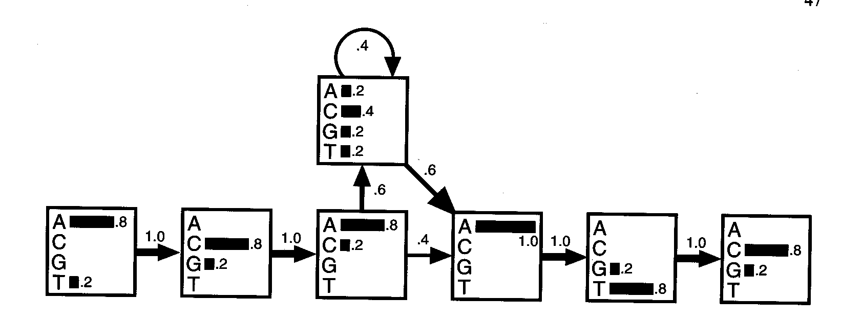
Building HMM – from an Existing Alignment
ACA - - - ATG
TCA ACT ATC
ACA C - - AGC
AGA - - - ATC
ACC G - - ATC
insertion
Transition probabilities
Emission Probabilities
A HMM model for a DNA motif alignments, The transitions are shown with arrows whose thickness indicate their probability. In each state, the histogram shows the probabilities of the four bases.

Slide 90
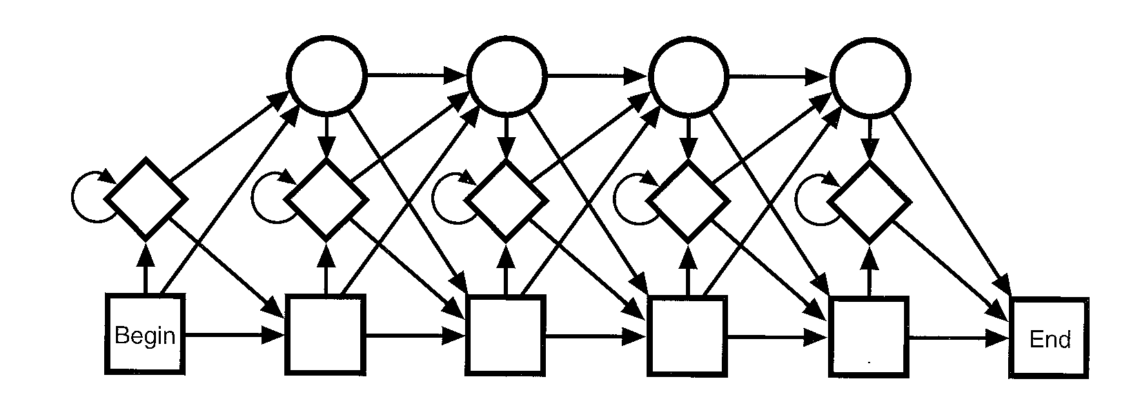
Building HMM – Final Topology
Matching states
Deletion states
Insertion states
No. of matching states = average sequence length in the family
PFAM Database - of Protein families
(http://pfam.wustl.edu)

Slide 91

Example for Insertion States & Deletion States

Slide 92
Query a New Sequence
Suppose I have a query protein sequence, and I am interested in which family it belongs to? There can be many paths leading to the generation of this sequence. Need to find all these paths and sum the probabilities.
Consensus sequence:
P (ACACATC) = 0.8x1 x 0.8x1 x 0.8x0.6 x 0.4x0.6 x 1x1 x
0.8x1 x 0.8 = 4.7 x 10 ⁻²
ACAC - - ATC

Slide 93


Query a New Sequence (cont’d)
Pseudocounts: P(CCACATC)= 0*1.0*0.8…= 0
Observed counts of C in column 1
Pseudocounts of C in column 1
Observed counts over all nucleotides in column 1
Pseudocounts over all nucleotides in column 1

Slide 94
Multiple Alignments
Try every possible path through the model that would produce the target sequences
Keep the best one and its probability.
Output : Sequence of match, insert and delete states
Viterbi alg. Dynamic Programming

Slide 95
Building HMM – Unaligned Sequences
Baum-Welch Expectation-maximization method
Start with a model whose length matches the average length of the sequences and with random emission and transition probabilities.
Align all the sequences to the model.
Use the alignment to alter the emission and transition probabilities
Repeat. Continue until the model stops changing
By-product: It produced a multiple alignment

Slide 96

Order State of HMMs
Markov Models take into account additional information
about neighboring residues.

Slide 97

HMMs for Gene Finding
A HMM for unspliced genes
Four models are combined together using Viterbi algorithm to find the most probable pathway

Slide 98
Overview Applications HMMs in Bioinformatics
Pairwise alignment of sequences.
Multiple alignments of sequences.
Finding genes in DNA sequences.
Representing proteins families and recognizing new members from sequence.
Representing protein domains and recognizing domains in sequence.
Representing and finding signals in protein sequences.
Representing transcription factor binding sites and finding them in sequence.
RNA-folding and prediction of RNA genes.

Slide 99
Examples of HMM Analysis
BMERC PSA protein structure prediction:
http://bmerc-www.bu.edu/psa/
PFAM (protein family identification and prediction)
http://pfam.wustl.edu/
Gene prediction
Genscan (http://genes.mit.edu/GENSCAN.html)
HMMGene (http://www.cbs.dtu.dk/services/HMMgene/)
GeneMark.hmm (http://opal.biology.gatech.edu/GeneMark/)
General software
HMMer (http://hmmer.wustl.edu)
SAM (http://www.cse.ucsc.edu/research/compbio/sam.html)

Slide 100


Hw1
Shown below is a matrix of log odds column scores made from an alignment of a set of sequences.
(A) Calculate the alignment score for each of the four possible positions in the new sequence shown.
(B) What is the sequence with the highest score?

Slide 101
Hw2: CpG Islands by HMM
Please explain how to know the probabilities for the following figure and what the assumptions are presumed.
q/4
A
G
q/4
P
q
Regular
DNA
P
change
q
P
P
q
q
C
q/4
T
q/4
p/6
p/3
A
G
(1-P)/4
(1-q)/6
P/6
p/3
T
C
(1-q)/3
C-G island

Slide 102

Hw3
Giving an alignment of 30 short amino acid sequences (SH3):

Slide 103

Hw3 (cont’d)
A profile HMM made from the alignment shown in last slide.
Transition lines with no arrow head are transitions from left to right.
Transitions with probability zero are not shown, and those with very small probability are shown as dashed lines.
Transitions from an insert state to itself is not shown; instead the probability times 100 is shown in the diamond.
The numbers in the circular delete states are just position numbers.
Q: Please indicate how to obtain the value of 85?

Slide 104
Bibliography
Rabiner L.R., “A Tutorial on Hidden Markov Models and Selected Applications in Speech Recognition,” Proceedings of the IEEE, Vol. 77, No. 2, pp. 257-286, 1989.
Durbin R., Eddy S., Krogh A., and Mitchison G., Biological Sequence Analysis, 1998.
Krogh A., “An Introduction to Hidden Markov Models for Biological Sequences,” in ch4 of Computational Methods in Molecular Biology, pp. 45-63, 1998.

