Slide 1

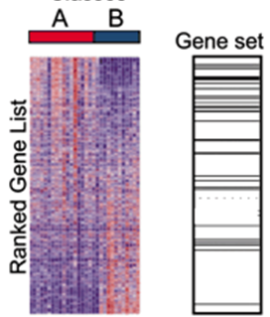
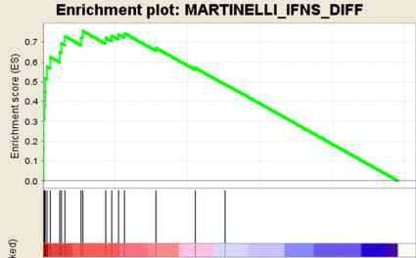

Locations of genes in 1 gene set
Understanding the Broad Institute’s GSEA and hands-on training with the software
Presented by Alan E. Berger, Ph.D.
Lowe Family Genomics Core, School of Medicine, Johns Hopkins University
September 30, 2014 NIH Building 10 FAES Classroom 1
Using gene sets, e.g., pathways, GO categories, to interpret microarray (and other) biology data
Using a measure of differential expression for all the genes, rather than a list of distinguished genes
The general approach of the Broad Institute’s GSEA software // comparison with DAVID (NIAID)
The statistics behind GSEA // The data files and formats required to use GSEA
Hands on running the GSEA software (using output data from Partek runs)
Understanding the output files produced by GSEA

Slide 2
The content of this set of slides is derived from several NIH-CIT tutorials on GSEA given by Aiguo Li, Ph.D., NIH-NCI and Alan Berger, Ph.D., in 2007 & 2008, and from slides prepared by Alan Berger and Maggie Cam, Ph.D., NIH-NCI for April and December 2013 NCI-BTEP classes on GSEA
my contact information:
Alan E. Berger
aberger9@jhmi.edu
410-550-5089

Slide 3
Outline
Functional Analysis of Microarray or RNA-seq Data – Analysis of Differential Expression Between 2 groups at the Level of Gene Sets
Enrichment of gene sets in a list of “distinguished” genes (e.g., DAVID)
Gene set methods using all the available expression data
Broad Institute’s Gene Set Enrichment Analysis (GSEA)
How GSEA measures differential expression for each set of genes
Controlling effects of multiple comparisons in GSEA (False Discovery Rate (FDR))
The Broad Institute library of groups of gene sets (MSigDB)
What files are needed for GSEA and their required formats
User options and installing and running GSEA
Hands-on running GSEA
Loading the required GSEA data files for an example cancer dataset
Using the GSEA GUI interface: Parameter selection
Rank-based analysis (submitting a measure of differential expression for each gene)
Understanding the GSEA outputs: judging statistical and biological significance

Slide 4
Background
Genome-wide expression profiling with microarrays or RNA-sequencing has become an effective frequently used technique in molecular biology
Interpreting the results to gain insights into biological mechanisms remains a major challenge
For a typical two group comparison, e.g., tumor vs. normal, treated vs. control, a standard approach has been to produce a list of differentially expressed genes (DEGs)
One also might obtain a list of “Distinguished Genes” from examining correlation of gene expression with a pertinent clinical variable, or from differences in methylation

Slide 5
Criteria for Differential Expression of a Gene
Statistically significant differential expression
by t-test, multi-way ANOVA, etc.
P-value cut-off: require, e.g., p ≤ 0.01, but see FDR (which will impose more stringent requirement for p-values)
Satisfactory false discovery rate (FDR)
What fraction of the DEG list is false positives?
Benjamini-Hochberg procedure for estimating the FDR is a common choice (e.g., require FDR ≤ 0.1 or 0.2).
Sufficient level of fold change (FC)
require |FC| ≥ 1.5 or 2 (common convention: groups A, B, gene g with average expression levels μ_{A}, μ_{B}; FC ≡ μ_{A} /μ_{B} when μ_{A} ≥ μ_{B} ; FC ≡ -μ_{B} /μ_{A} when μ_{B} ≥ μ_{A} )

Slide 6
DEG lists II
Large fraction of “Present” (above background) calls for the expression values in the group with the higher average expression level for that probe
80% but require 3 out of 3 when group size = 3
If this is not satisfied for a given probe, do not do any statistical testing on it.
This avoids false positives based on noise, and also reduces the number of comparisons N used in calculating the FDR.
Can see very high correlations with a clinical variable with 0 Present calls
Specific criteria and cutoffs depend on the platform, user preference and the biological situation (e.g., would like “reasonable amount” of mRNA and |FC| ≥ 2 for qRT-PCR verification)

Slide 7
Challenges in Interpreting Gene Microarray Data
Even with DEG lists of upregulated and of down-regulated genes, still need to accurately extract valid biological inferences. Cutoff for inclusion in DEG lists is somewhat arbitrary.
May obtain a long list of statistically significant genes without any obvious unifying biological theme
May have few individual genes meeting the threshold for statistical significance

Slide 8
Enrichment of Gene Sets in a List of “Distinguished” Genes
Test* if members of a list of “distinguished” genes are significantly overrepresented in given pathways and other predefined gene sets
Many tools have been developed along this line including: DAVID http://david.abcc.ncifcrf.gov/ whose use is described in considerable detail in an Appendix file available on the course web site or by request (aberger9@jhmi.edu); GoMinor, GenMAPP, Onto-Express, Gostat, GATHER.
Submit upregulated and downregulated (or positively correlated and negatively correlated) gene lists separately (often see significant results only in 1 direction)
But note that Gene Set methods can only report enrichment for gene sets that are already in the library of gene sets being examined.
genes passing the criteria for significant upregulation in group A vs. group B
genes with a high positive <negative> correlation with a clinical variable
genes with a high fold change in group A vs. group B
*Fisher’s exact test based on the hypergeometric distribution along with FDR estimation

Slide 9
Example: gene list enriched in a gene set S
10,000 distinct genes in microarray platform
200 genes in the pathway S (2% of the genome).
50 genes in the “distinguished” list
6 genes of the distinguished gene list actually were in S
One would expect on average to have 1 gene of a random list of 50 genes being in the pathway S.
Here have 6 genes from the distinguished list in S. The hypergeometric distribution provides the p-value for this event (the probability that by chance one would have this many (6) or more genes of a randomly chosen list of 50 genes being in the pathway S). p = 0.00045

Slide 10
Gene Set Enrichment Methods
These methods formulate a statistic for the ensemble of genes in each gene set using a selected metric for each gene. Increases statistical power.
The expression data for all the genes in the dataset is used
Can be applied to many types of gene sets
But note: results depend on the collection of gene sets examined, and still must address multiple testing error control (though much less severe than for all probes on a large array). Run different types of gene set collections separately.
T-score for group A vs. group B comparison
Fold Change for group A vs. group B
Pearson correlation of gene expression with a pertinent clinical variable
pathways from BioCarta & KEGG
genes changed in response to some disease or experimental condition
GO categories
genes co-located in cytobands
genes having common transcription factor motifs

Slide 11
Some References for Gene Set Methods
Gene Set Enrichment Analysis (GSEA): Subramanian et al., A knowledge-based approach for interpreting genome-wide expression profiles, PNAS 2005, 102:15545; note Lamb et al., The Connectivity Map…, Science 2006, 313:1929. (see Broad Institute web page for this and other software)
PAGE: Parametric Analysis of Gene-Set Enrichment: Kim and Volsky, BMC Bioinformatics 2005, 6:144 (uses the average of the measure of differential expression (DE) of genes in a gene set, and values of DE over the chip to get a gene set z-score).
Systematic consideration of the issues in formulating and evaluating gene set methods: Ackermann and Strimmer, A general modular framework for gene set enrichment analysis, BMC Bioinformatics 2009, 10:47
Systematic consideration of the issues in formulating and evaluating gene set methods: Varemo, Nielsen and Nookaew, Enriching the gene set analysis of genome-wide data by incorporating directionality of gene expression and combining statistical hypotheses and methods, Nucleic Acids Research 2013 Mar 22 [Epub ahead of print]

Slide 12
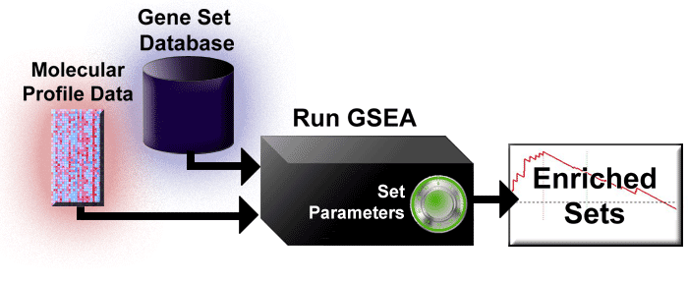
GSEA Overview -- Workflow
GSEA is a computational method that determines whether an a priori
defined set of genes shows statistically significant, concordant
differences between two biological states (e.g. phenotypes).
text and figure from the Broad Institute web pages for GSEA : http://www.broad.mit.edu/gsea/index.html the current version of the figure at the Broad site is slightly different from the one above
Notes:
GSEA algorithm allows a user to determine whether a known gene set shows concordant differences between two biological states.

Slide 13
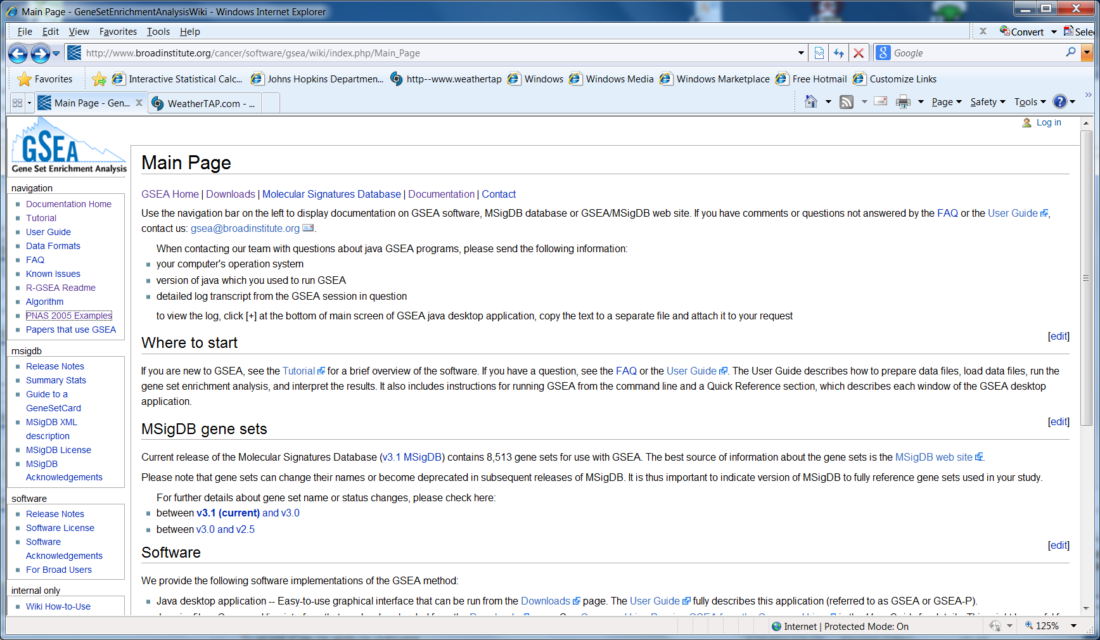
The Broad Institute GSEA Documentation Main Page
The Broad GSEA web site has extensive information

Slide 14
Three Main Components in GSEA
Algorithm
Software implementation (Broad Institute)
Database of gene sets:
Molecular signature database (MSigDB at the Broad Institute) containing collections of gene sets of interest
Utilities mapping chip features to genes (e.g., Illumina or Affymetrix probe set IDs to HUGO gene symbols)

Slide 15
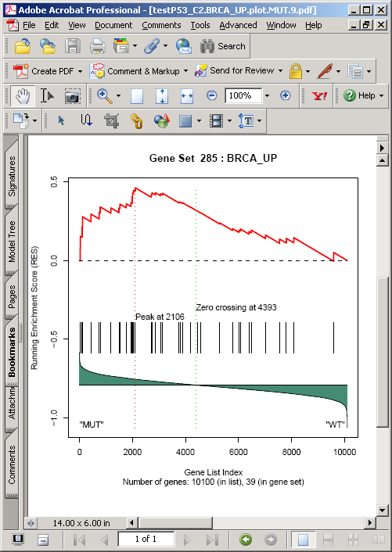
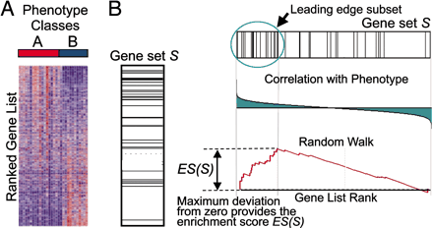
GSEA: Gene Set Enrichment Analysis
Get ranked
list L of all the
genes on the
chip based
on a chosen
measure, e.g., FC or Tscore,
of the difference of
their expression
levels between the
phenotypes A & B
under study, e.g.,
tumor vs. normal
For each
gene set S:
find the
location of
each gene s
in S within L
Generate enrichment
score ES for S based
on running-sum statistic:
“reward” presence of s
toward top or bottom of L
running sum
L
Analyze significance of
this Kolmogorov-Smirnov
type statistic by
permutation testing
+FC
ES>0
L
-FC
ES<0
Multiple hypothesis testing (MHT)
error control for multiple S’s using
the estimated false discovery rate (FDR)
bands are locations in L of genes from S
Notes:
A given functional gene set representing a biological pathway or signatures is compared to the ordered list to determine if the distribution of hits in the entire list is random or biased toward the top or bottom of the list. Many methods have been developed and the pioneer initiative along this line is the innovative development of gene set enrichment analysis (GSEA) software by (see refs) GSEA is a parametric method in which a weighted Kolmogorov-Smirnov method is used to determine the significance of the hit distribution (members of S) in the whole list. Sig pathway use Wilcoxon test and is a non-parametric method. Designating one of the 2 phenotypes as “A”,
and doing the ranked list L from most upreg in A at top to most downreg in A at bottom, is genes in S are concentrated at top, ES(S) will be > 0, if conc. at bottom of L, ES(S) will be <0. For GSEA, the phenotype of the first
chip (first column at left of expression data) is A).

Slide 16
Enrichment Score (ES) Calculation
Start with ranked list (L) of genes that are in (Hit) or not in (Miss) a gene set (S), using fold change (FC) as example metric
Ranked List
(L)
FC
 |  |  | Contribution to running sum for ES | Hits +|FC| / Σ | Misses -1/(N-N_{H}) | Running sum for ES
15
12
10
9
8
6
Hit +0.15 +0.15 0.15
Hit +0.12 +0.12 0.27
Miss -0.001 -0.001 0.269
Hit +0.09 +0.09 0.359
Hit +0.08 +0.08 0.439
Miss -0.001 -0.001 0.438
…
…
…
…
Hits: Genes ∈ S +|FC| / Σ
Misses: Genes ∉ S -1/(N-N_{H})
= sum of fold changes for genes in gene set (S) (e.g., 100)
N = no. of genes in the array (e.g., 1020)
N_{H} = no. of genes in the gene set (S) (e.g., 20)
running sum
L
ES(S) ≡ value of maximum deviation from 0 of the running sum

Slide 17
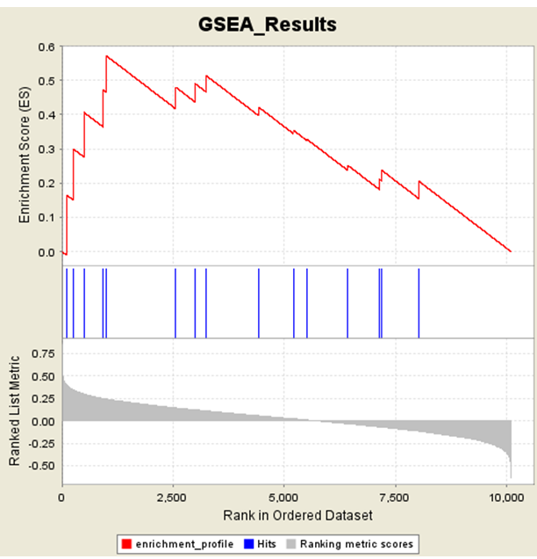
The running enrichment score for a positive ES gene set from the P53 GSEA example data set
running enrichment score
ES(S)
locations of genes in S
+
p53 WT
-
p53 MUT
Zero crossing of ranking metric values
underlying running enrichment score figure copied from http://www.broadinstitute.org/gsea/datasets.jsp
p53 dataset (gene set is lairPathway)

Slide 18
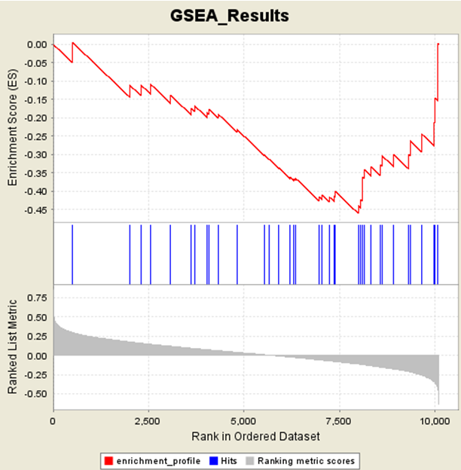
The running enrichment score for a negative ES gene set from the P53 GSEA example data set
running enrichment score
ES(S)
locations of genes in S
+
p53 WT
-
p53 MUT
Zero crossing of ranking metric values
running enrichment score figure copied from http://www.broadinstitute.org/gsea/datasets.jsp
p53 dataset (gene set is BRCA_UP)

Slide 19
GSEA Algorithm: Definition of Enrichment Scores the equations
W_{j} = measure of differential expression of gene j between group A and group B
1. Order the genes in a ranked list L so W_{j} decreases from the top (j=1) to the bottom (j=N) of the list
2. Account for the locations of the genes in S (‘‘hits’’) weighted by W_{j} and the locations of genes not in S (‘‘misses’’) from the top of the list down to a given position i in L
where
for GSEA the default is t = 1, for Kolmogorov-Smirnov t = 0
= # genes in S
= # genes in platform
Calculate maximum deviation from zero of K_{hit} - K_{miss} over 1 ≤ i ≤ N:
ES(S,i) = K_{hit}(S,i) – K_{miss}(S,i) Note K_{hit}(S,N) = K_{miss}(S,N) = 1 so ES(S,N) = 0
ES(S) = max deviation{ES(S,i)} (greatest excursion of the ES(S,i) from 0)
Notes:
For
extr(a set of numbers) = “extreme value of”
= sign * max(magnitudes of the numbers) where
sign is 1 if number with max magnitude is > 0,
sign is -1 if number with max magnitude is < 0

Slide 20
If have at least 7 samples in each of the 2 groups, do sample label permutations to get statistics; otherwise do gene set “permutations”
Gene Set Permutation
For a given gene set S (count of genes in S = s), each permutation π is the random selection of s genes from all genes in the genome which have a probe on the platform, forming a random gene set S_{π}
The corresponding enrichment score ES(S, π) = ES(S_{π}) is calculated from the original expression matrix using S_{π}
If ES(S) > 0, the resulting empirical p-value for S is the fraction of the ES(S, π) values that equal or exceed the actual enrichment score ES(S). The p-value is the fraction of time one would get an enrichment score ≥ ES(S)) just by random chance (estimated using the randomly sampled sets S_{π}) (and similarly for ES(S) < 0)

Slide 21
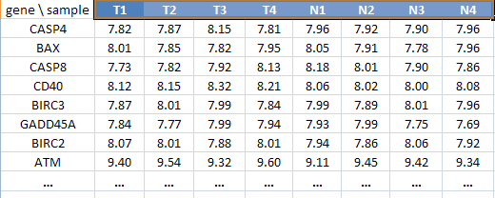
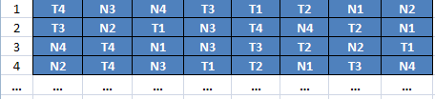
Testing the Significance of ES using Sample Label Permutations:
gene expression matrix, sample labels indicate phenotype group
compute the differential expression value for each gene (DE(g)), and then the ES(S) values for all the gene sets
do ≈ 1000 sample label permutations π * - for each permutation π_{i} randomly shuffle the labels of which sample is in which group while leaving the rest of the expression matrix fixed, and recalculate {DE(g)} and then the enrichment score for each S
permutation number
{ES(S,π₁)}
{ES(S,π₂)}
{ES(S,π₃)}
{ES(S,π₄)}
*actually want at least 7 samples in each group for sample label permutation, else do gene permutation

Slide 22
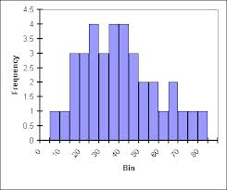
Testing the Significance of ES
Significance of the observed ES(S) is compared with the set of empirical null distribution scores ES(S,π) computed with the randomly assigned phenotypes or random gene sets.
ES_{NULL}(S):null distribution for ES(S)
G | T1 | T2 | T3 | T4 | N1 | N2 | N3 | N4
ES(S)
Histogram of 1000 ES(S,π) Scores
ES(S,π₁)
ES(S)
G | T4 | N3 | N4 | T3 | T1 | T2 | N1 | N2
ES(S,π₂)
G | T3 | N2 | T1 | N3 | T4 | N4 | T2 | N1
G | N4 | T4 | N1 | N3 | T3 | T4 | N2 | T1
ES(S,π₃)
:
ES(S,π₁₀₀₀)
:
1000 x
The empirical, nominal p-value for each ES(S) is then calculated relative to the null distribution for ES(S): p = fraction of ES(S,π) values ≥ ES(S)
Notes:
Mathematically GSEA does three things.
Construct a ranked list L of all the genes in the chip using a measure of expression difference of each gene between the two phenotypes under study (e.g., by T-score). Then GSEA calculates an enrichment score by walking down the ranked list L, increasing a running-sum statistic when we encounter a gene in S and decreasing it when we encounter genes not in S. The magnitude of the increment depends on the rank of the gene in the list. The enrichment score is the maximum deviation from zero encountered in the walk.
Secondly, it estimates the significance level of ES by using an empirical phenotype-based permutation test procedure, i.e. permute the phenotype labels and recompute the ES , which generates a null distribution for the ES. The nominal p-value of the observed ES is then calculated using this null distribution.
Adjustment for multiple hypothesis testing. They first normalized the ES using the null distribution for ES -→ normalized enrichment scores (NES) and an empirical distribution for NES. Then they calculated FDRs by comparing the tails of the observed and null distributions for the NES.

Slide 23
How normalized enrichment scores (NES) are calculated from ES (using the NES helps normalize out effect of different gene set sizes)
Histogram of the ES(S,π) values for a given S from the permutations
ES(S)
original ES(S)
NES(S) ≡
mean_{π}{ES(S, π) values with the same sign as ES(S)}
ES(S,π)
For each permutation π and gene set S, compute NES(S, π) to use in computing the FDR:
ES(S,π₁)
ES(S,π₂)
ES(S, π_{k})
ES(S,π₃)
NES(S, π_{k}) ≡
mean_{π}{ES(S, π) values with the same sign as ES(S, π_{k})}
ES(S,π)

Slide 24
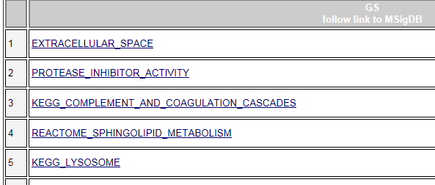
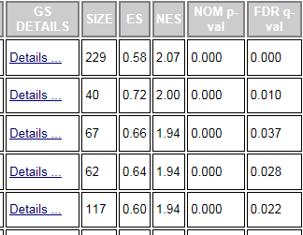
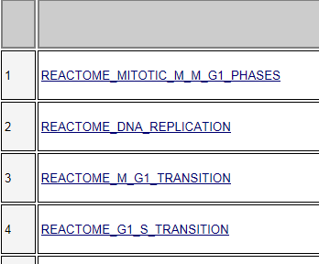
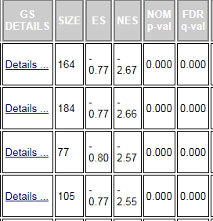
GSEA returns two lists of gene sets: {S with NES > 0} and {S with NES < 0} (each sorted by NES value)
NES > 0, descending order
NES < 0, ascending order

Slide 25
If one has a list of the form A = {all gene sets S with NES(S) ≥ NES*}# with NES* a chosen value, one would like to estimate what fraction of the gene sets in A are false positives. This is called the False Discovery Rate (FDR) for A.
GSEA uses the collection {NES(S, π_{k})} of NES values from the permutations as an empirical null distribution to estimate the FDR.
The {NES(S, π_{k})} values estimate the pattern of NES values one would see if there was no difference between the 2 groups being examined.
Actual NES(S) values that “stand out” (are far enough out on a tail of the histogram of the {NES(S, π_{k})} values) are considered to be true positives.
# and similarly for the case of all gene sets S with NES(S) ≤ NES* for some fixed value NES*

Slide 26
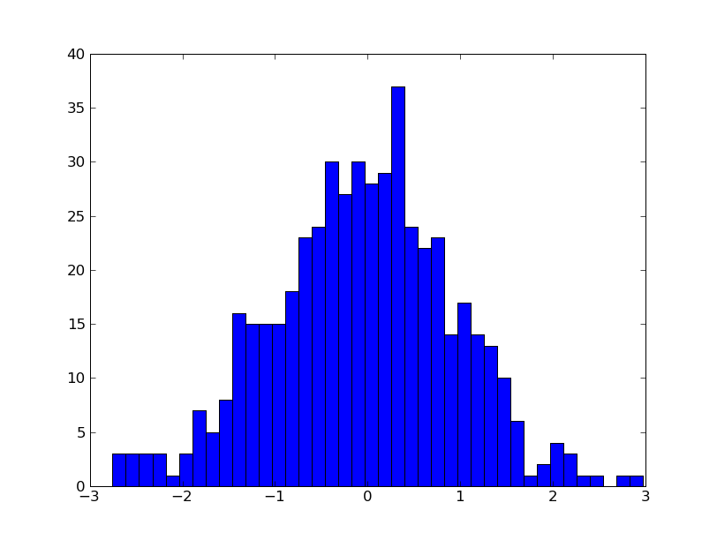
Histogram of NES(S, π) Scores
NES*
NES(S,π)
NES(S,π) ≥ NES*

Slide 27
False Discovery Rate (FDR) q value for each gene set S
Create a histogram of all NES(S, π), over all S and π.
Use this null distribution to compute an FDR q value for each NES(S) > 0* . Denote NES(S) by NES*
FDR q value for S: D(S) = {gene sets with NES ≥ NES* }
estimate of # of false positives in D(S)
size of D(S) = # of S with NES(S) ≥ NES*
= F N_{S}⁺
q ≡
*
Histogram of NES(S, π) Scores
Histogram of NES(S) Scores
NES*
NES*
NES(S,π)
NES(S)
NES(S) ≥ NES*
NES(S,π) ≥ NES*
F ≡ fraction of the positive NES(S,π) ≥ NES*
N_{S}⁺ ≡ # of gene sets with NES(S) > 0
*similarly for NES(S) < 0

Slide 28
Example GSEA output
Dataset:
Wegener’s granulomatosis (WG)* vs. normal controls (C)
41 patients, 23 controls
expression data in PBMCs
* (now officially: granulomatosis with polyangiitis)

Slide 29
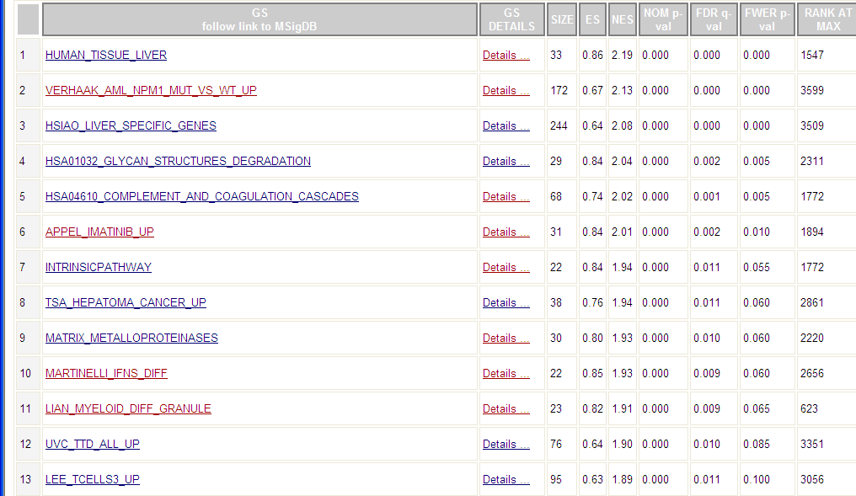
GSEA output: gene sets upregulated in WG

Slide 30
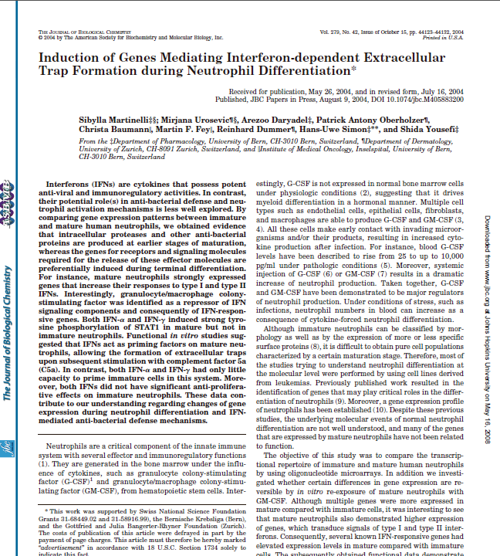
Gene set associated with immature neutrophils
note the WG dataset was from PBMCs

Slide 31
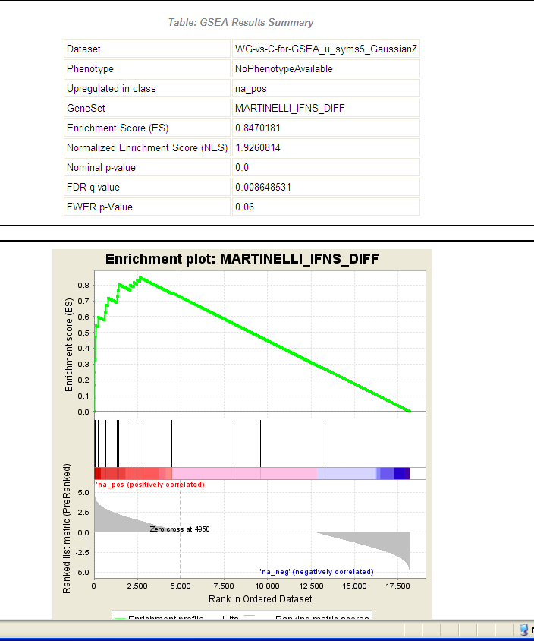

Slide 32
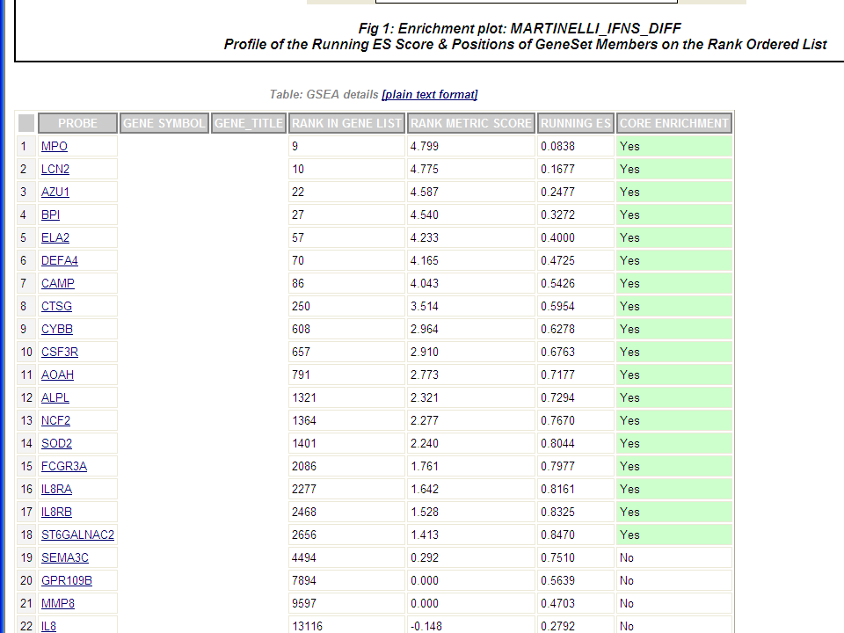
Note large number of genes in the gene set at the top of the complete ranked list (relative to gene set size)

Slide 33
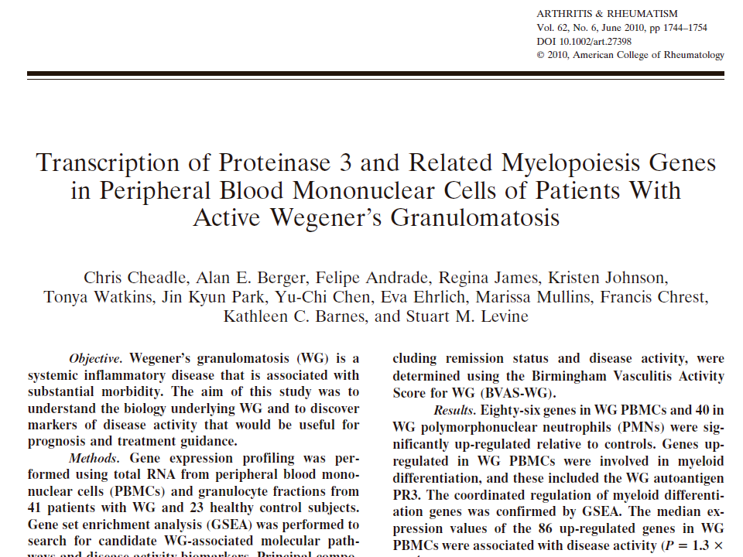

Slide 34
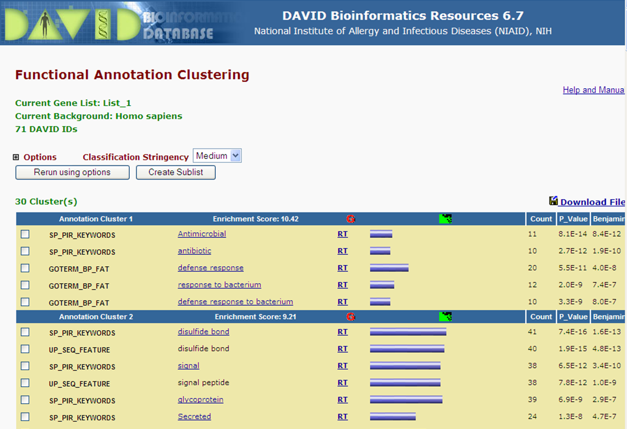
DAVID output for WG dataset The collection of gene sets used in the run really matters

