Slide 1
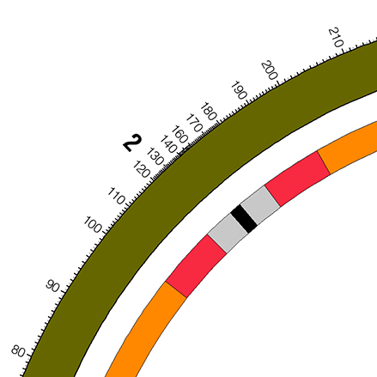
ticks.conf
ideogram.conf
circos.conf
+ ticks.conf controls of the loci display on the ideogram
+ ideogram.conf controls the display of the first ring
+ circos.conf is the main configure file, all of the circles’s
layout and genome description was define in this file.

