Slide 1
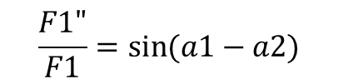
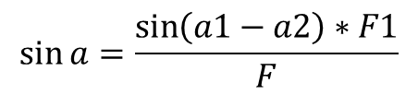
Parallelogram Law
$$F={F1}^{2}+{F2}^{2}+2F1F2\cos\left(a1−a2\right)$$
F1
F1’
$$\frac{F1"}{F1}=\sin{(a1−a2)}$$
a
a1-a2
F2
$$\sin{a}=\frac{\sin\left(a1−a2\right)∗F1}{F}$$

Slide 2
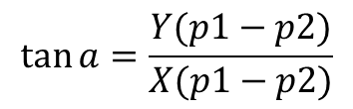

Coulombs Law
p1-p2
$$F=k\frac{q1q2}{r^{2}}$$
a
$$\tan{a}=\frac{Y(p1−p2)}{X(p1−p2)}$$

Slide 3
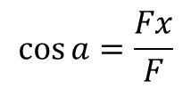

Resolution of Forces
$$\sin{a}=\frac{Fy}{F}$$
a
$$\cos{a}=\frac{Fx}{F}$$

