Slide 1
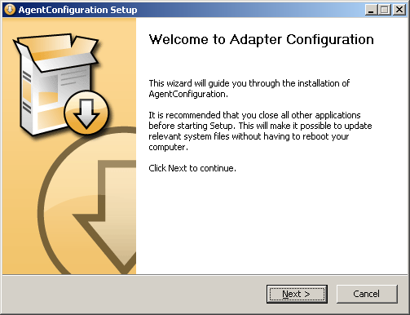
NSIS Welcome
Adapter configuration is a NSIS install program that DOES NO INSTALLING. Instead, it prompts the users to specify the set of Adatpers that provide SHDR input to the Agent, and then creates a Devices.xml file and the Adapter configuration part of the Agent.cfg file.
The Install files is divided into Sheets, with each Sheets either prompting the user for intput, or being informative, or both.

Slide 2
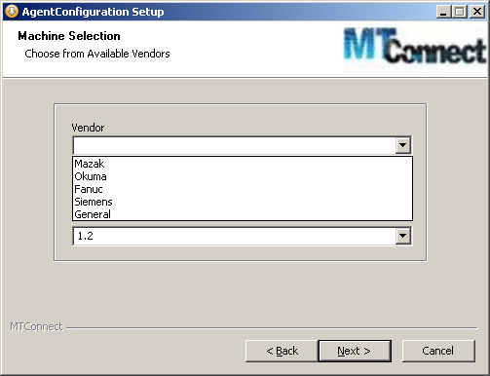
Selecting Vendor
The first sheet asks the user to select a vendor, machine type and version.
You must select an MTConnect to match your machine tool vendor CNC, and for which MTConnect templates are available.

Slide 3
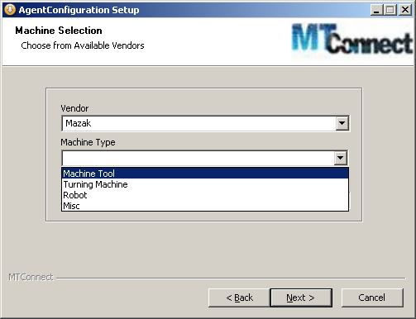
Selecting Machine Type
A placeholder for now is defining a Machine Type. Machine tool vendors can have hundreds of configurations, so narrowing the list by machine type should help users in finding the correct match.

Slide 4
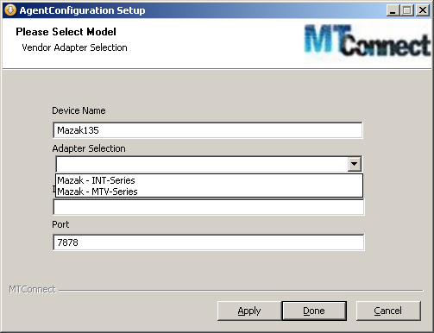
Configuring Adapter
The necessary information is input to configure an Adapter. Device Name, Type, IP and Port.

Slide 5
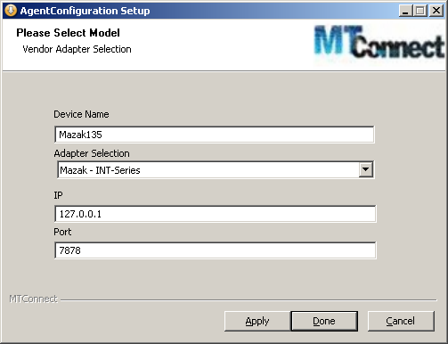
Applying Adapter
When you click Apply, an adapter.cfg entry and the devices.xml piece are saved in the NSISlist structure, for later file writing.
Apply takes you back a slide to append a new adapter to your configuration.

Slide 6
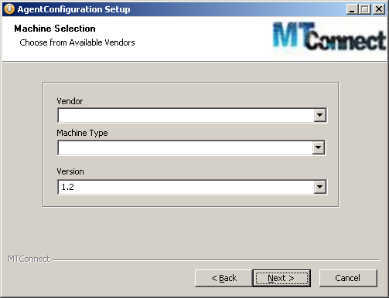

Slide 7
Agent.cfg after generation of Adapters
After all the adapters have been configured, the AdapterConfiguration install script builds a portion of the Agent.cfg file that will be extended by the Agent configuration to fill out the parameterization.

Slide 8
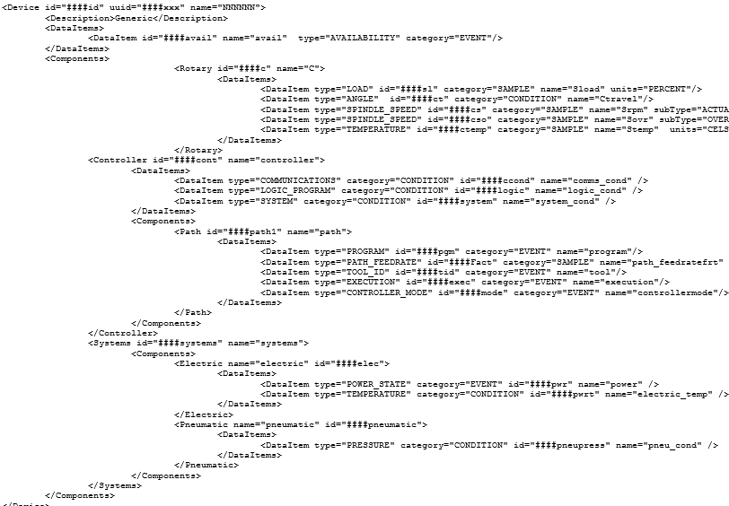
Template driven Devices.xml
Devices.xml specifies the machine configuration as well as the data items available to users of MTConnect Agent.
A simple template format is used, with every XML id appended by ### as well as the <Device specific information. Thus, when a user specifies an Device name is given, it is used to replace all occurance of #### in the template.
Know problems: device names must be unique – and this is not handled. Similar model names can have varied axes configuration, again not handled.

