Slide 1
MTConnect Agent Installation

Slide 2
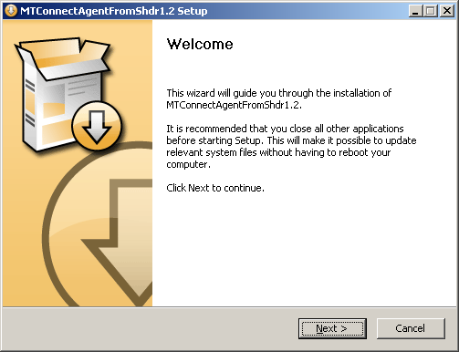
Welcome
NSIS is Nullsoft Scriptable Install System (NSIS) is a script-driven installation system for Microsoft Windows with minimal overhead backed by Nullsoft, the creators of Winamp.
NSIS is free software released under a combination of free software licenses, primarily the zlib license.
NSIS is a script driven . It has some quirks, and many user interfaces, e.g., modern, modern 2, etc. But it has been around about 20 years.

Slide 3
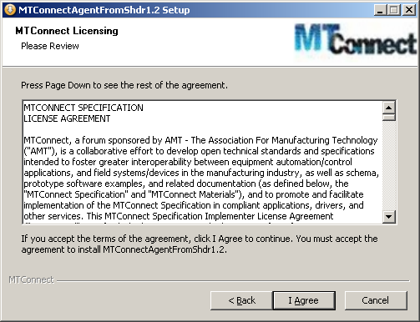
License Agreement
Very old. Not sure its relevant.

Slide 4
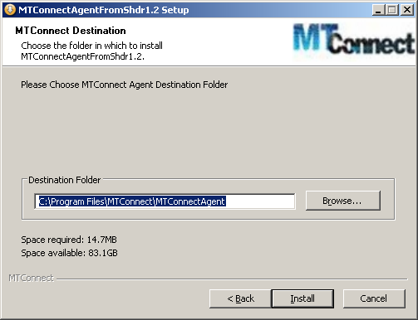
Install Directory
User selects a drirectory to install agent.
This is nice in case you need 2 agents, the can coexist with this installation mechanism, whereas Microsoft prefers either overwriting older versions or wont install the software with the same GUID.

Slide 5
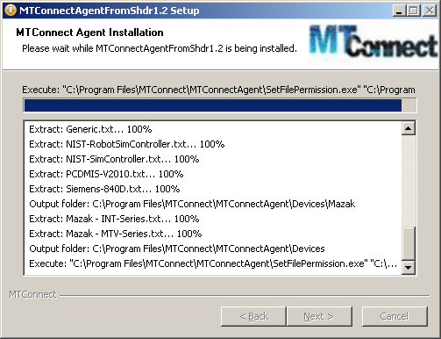
Installing
It copies the files over to the user specified folder.

Slide 6
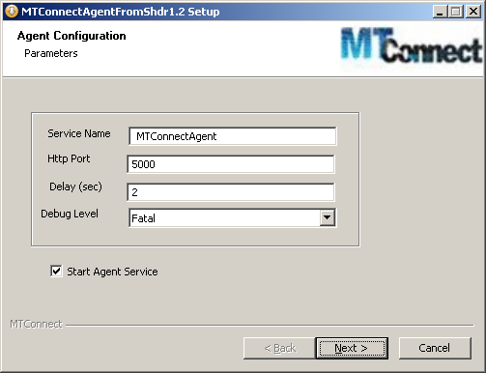
Agent Configuration
User specifies service name, http port, and other agent specific parameters.
The adapter configuration installation will then be executed to configure the remaining portions of agent.cfg and devices.xml.
You have the option of starting the agent.

Slide 7
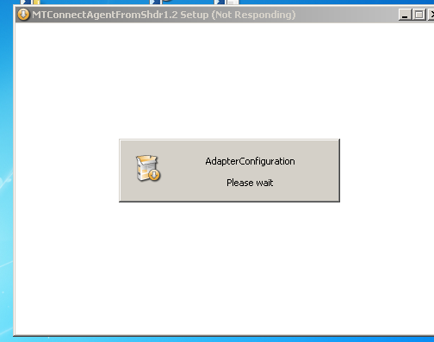
Flash screen popup
A flash scrren alerts the user that the Adapter Wizard is going to run.

Slide 8
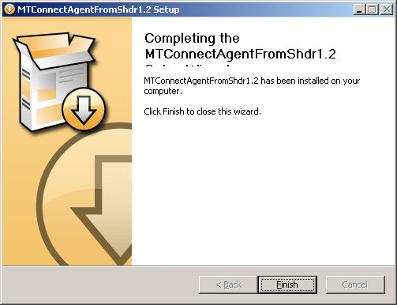
Finish Page
All done!

