Slide 1
Prediction of Lysine Glycation PTM site in Protein using Peptide Sequence Evolution based Features
Presented by
S.M. Shovan
Dept. of CSE, RUET
Date: 17/11/2018
Supervisor
Dr. Md. Al mehedi hasan
Associate Professor
Dept. of cse, ruet

Slide 2
Contents
What is PTM?
Effects of PTM
Problem Statement
Necessity of Computational Tool
Background
Objective
Dataset Selection
Methodologies
Model Selection
Results
Conclusion and Future Work
References

Slide 3
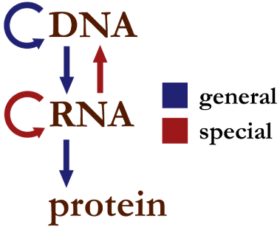
1. What is PTM?
Central dogma: Formation of protein from DNA [1]

Slide 4
1. What is PTM? (cont’d)
PTM stands for Post Translational Modification
It is enzymatic modification of proteins following protein biosynthesis.
PTM occurs on the amino acid side chains or on the c- or N- terminal.
There are 20 standard amino acids
A, C, D, E, F, G, H, I, K, L, M, N, P, Q, R, S, T, V, W, Y
Example, K = Lysine, P = Proline, R=Arginine, T= Threonine.

Slide 5
2. Effects of PTM
The structural and functional diversities[2].
Responsible for expanding the genetic code[3-4].
Responsible various types of diseases.
Lysine glycation causes diabetes [5], Parkinson’s disease and Alzheimer’s disease [6], renal failure [7].

Slide 6
3. Problem Statement
What should we do?
Identify PTMs (Lysine glycation)
But how?
There are two ways,
Laboratory.
Computational tool for prediction.

Slide 7
4. Necessity of Computational Tool
Know about the functionality of protein.
Drug development.
To save time.
To save money.

Slide 8
5. Background
Y. Xu, L. Li, J. Ding, L. Wu, G. Mai and F. Zhou, "Gly-PseAAC: Identifying protein lysine glycation through sequences", Gene, vol. 602, pp. 1-7, 2017. [8]
Feature extraction
Position Specific Amino Acid Propensity (PSAAP)
Classifier
Support vector machine

Slide 9
5. Background (continued)
Z. Ju, J. Sun, Y. Li and L. Wang, "Predicting lysine glycation sites using bi-profile bayes feature extraction", Computational Biology and Chemistry, vol. 71, pp. 98-103, 2017. [9]
Feature extraction
Bi-profile bayes
Classifier
Support vector machine.

Slide 10
6. Objective
To design a more efficient
predictor for lysine glycation PTM.

Slide 11
7. Dataset Selection
Lysine glycation
Table 1: A portion of positive dataset for lysine glycation[10].
Table 2: A portion of negative dataset for lysine glycation[10].
ID | Site | Sequence
P00325 | 11 | AGKVIKCKAAVLWEV
P00325 | 40 | KAYEVRIKMVAVGIC
ID | Site | Sequence
P10591 | 98 | KLIDVDGKPQIQVEF
P10636 | 557 | PKSPSSAKSRLQTAP

Slide 12
7. Dataset Selection (cont’d)
Source
http://123.206.31.171/BPB_GlySite/data.html
Contains
Positives (glycated) sites: 223
Negative (non-glycated) sites: 446
Total sites: 696

Slide 13
8. Methodologies
Steps
Figure 2: Flow chart representing each step for development of predictor.
Dataset selection
Feature extraction
Data Balancing
Classification
Data validation
Measuring matrices
Prediction tools

Slide 14
8.1 Feature Extraction
Feature extraction: Representation of dataset in numeric.
Technique
Peptide Sequence Evolution based Features
Based on sequential evolutionary feature extraction technique

Slide 15
8.1 Feature Extraction (cont’d)
Figure 3: Typical sequential evolutionary feature extraction technique [11].
Premade Protein
Database
PSI-BLAST
(iter,e-val)
PSSM matrix
Feature vector
Query Sequence

Slide 16
8.1 Feature Extraction (cont’d)
Figure 4: Peptide Sequence Evolution based Features.
Custom Peptide
Database
PSI-BLAST
(iter,e-val)
PSSM matrix
Feature vector
Query Sequence

Slide 17
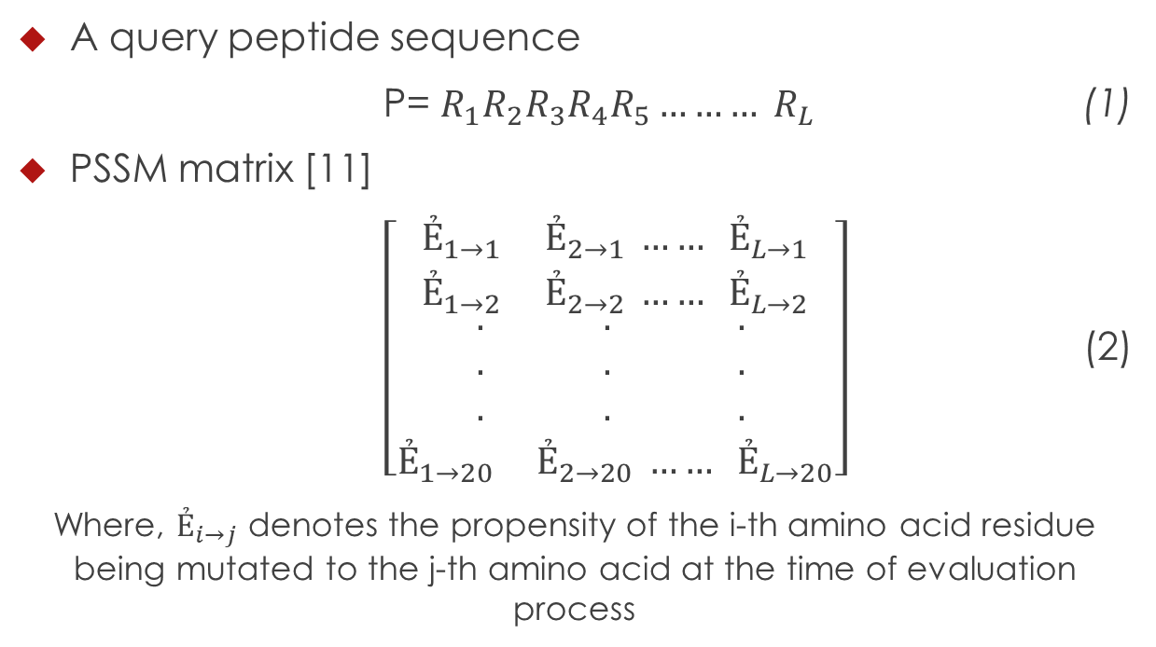
8.1 Feature Extraction (cont’d)
A query peptide sequence
P= $R_{1}R_{2}R_{3}R_{4}R_{5}……… R_{L}$ (1)
PSSM matrix [11]
$\left[\begin{aligned}\begin{aligned}Ẻ_{1→1} Ẻ_{2→1} …… Ẻ_{L→1} \\ Ẻ_{1→2} Ẻ_{2→2} …… Ẻ_{L→2} \\ {\begin{aligned}. \\ . \\ .\end{aligned}}_{ } {\begin{aligned}. \\ . \\ .\end{aligned}}_{ } {\begin{aligned}. \\ . \\ .\end{aligned}}_{ }\end{aligned} \\ Ẻ_{1→20} Ẻ_{2→20} …… Ẻ_{L→20}\end{aligned}\right]$ (2)
Where, $Ẻ_{i→j}$ denotes the propensity of the i-th amino acid residue being mutated to the j-th amino acid at the time of evaluation process

Slide 18
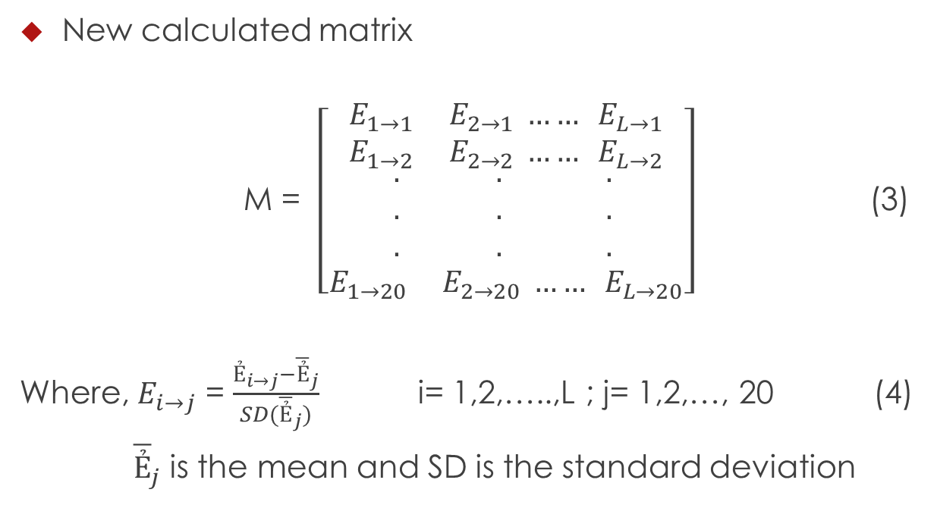
8.1 Feature Extraction (cont’d)
New calculated matrix
M = $\left[\begin{aligned}\begin{aligned}E_{1→1} E_{2→1} …… E_{L→1} \\ E_{1→2} E_{2→2} …… E_{L→2} \\ {\begin{aligned}. \\ . \\ .\end{aligned}}_{ } {\begin{aligned}. \\ . \\ .\end{aligned}}_{ } {\begin{aligned}. \\ . \\ .\end{aligned}}_{ }\end{aligned} \\ E_{1→20} E_{2→20} …… E_{L→20}\end{aligned}\right]$ (3)
Where, $E_{i→j}$ = $\frac{Ẻ_{i→j}−{\overline{Ẻ}}_{j}}{SD({\overline{Ẻ}}_{j})}$ i= 1,2,…..,L ; j= 1,2,…, 20 (4)
${\overline{Ẻ}}_{j}$ is the mean and SD is the standard deviation

Slide 19
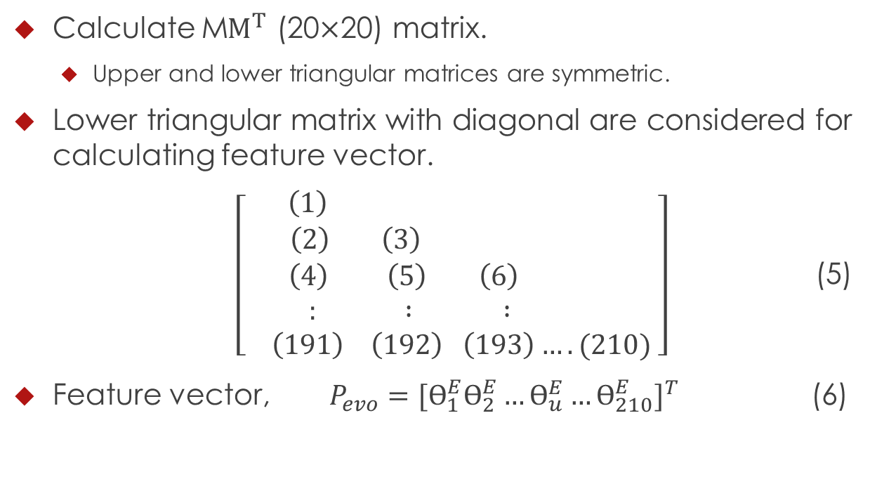
8.1 Feature Extraction (cont’d)
Calculate M$M^{T}$ (20$×$20) matrix.
Upper and lower triangular matrices are symmetric.
Lower triangular matrix with diagonal are considered for calculating feature vector.
$\left[\begin{aligned}\left(1\right) \\ \left(2\right) \left(3\right) \\ \left(4\right) \left(5\right) \left(6\right) \\ : : : \\ \left(191\right) \left(192\right) \left(193\right)….(210) \end{aligned}\right]$ (5)
Feature vector, $P_{evo}={[Ө_{1}^{E}Ө_{2}^{E}…Ө_{u}^{E}…Ө_{210}^{E}]}^{T}$ (6)

Slide 20
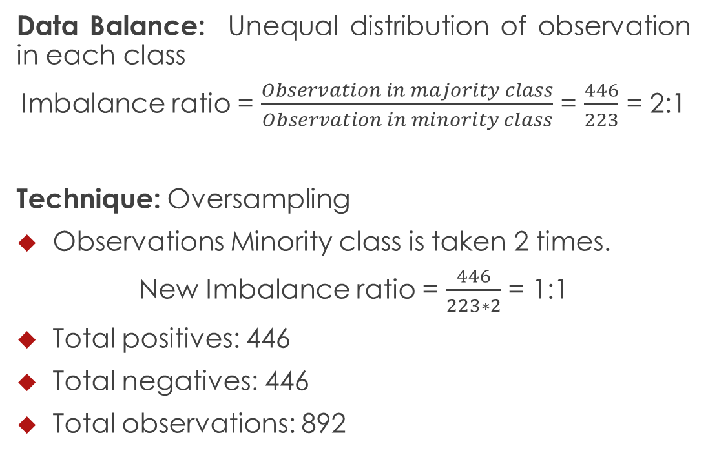
8.2 Handling Data Imbalance
Data Balance: Unequal distribution of observation in each class
Imbalance ratio = $\frac{Observation in majority class}{Observation in minority class}$ = $\frac{446}{223}$ = 2:1
Technique: Oversampling
Observations Minority class is taken 2 times.
New Imbalance ratio = $\frac{446}{223∗2}$ = 1:1
Total positives: 446
Total negatives: 446
Total observations: 892

Slide 21
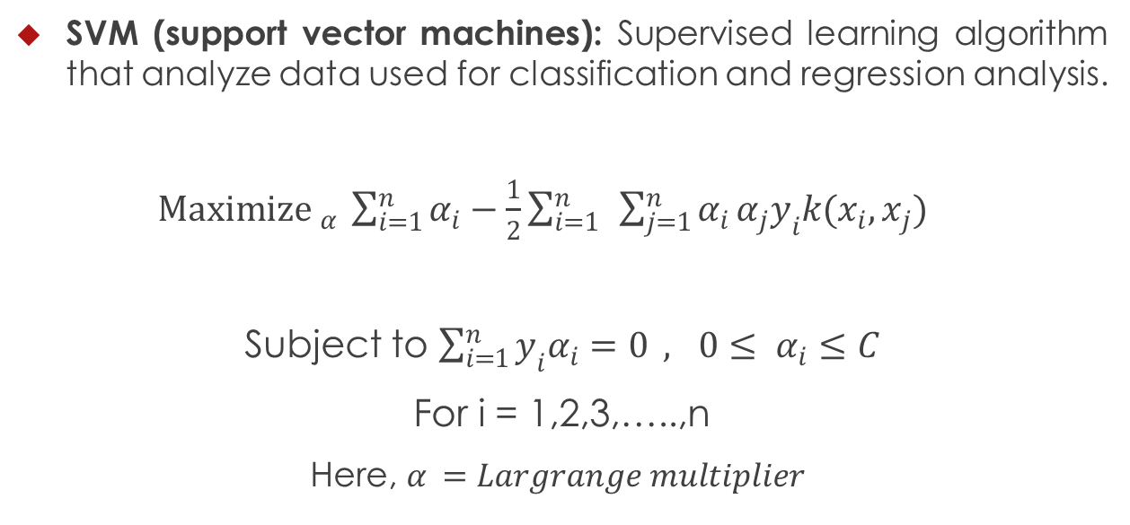
8.3 Classifier(SVM)
SVM (support vector machines): Supervised learning algorithm that analyze data used for classification and regression analysis.
${Maximize }_{α} \sum_{i=1}^{n}{α_{i}}−\frac{1}{2}\sum_{i=1}^{n}{ }\sum_{j=1}^{n}{α_{i}}α_{j}y_{i}k(x_{i},x_{j})$
Subject to $\sum_{i=1}^{n}{y_{i}α_{i}=0 }, 0≤ α_{i}≤C$
For i = 1,2,3,…..,n
Here, $α_{ }=Largrange multiplier$
(7)

Slide 22
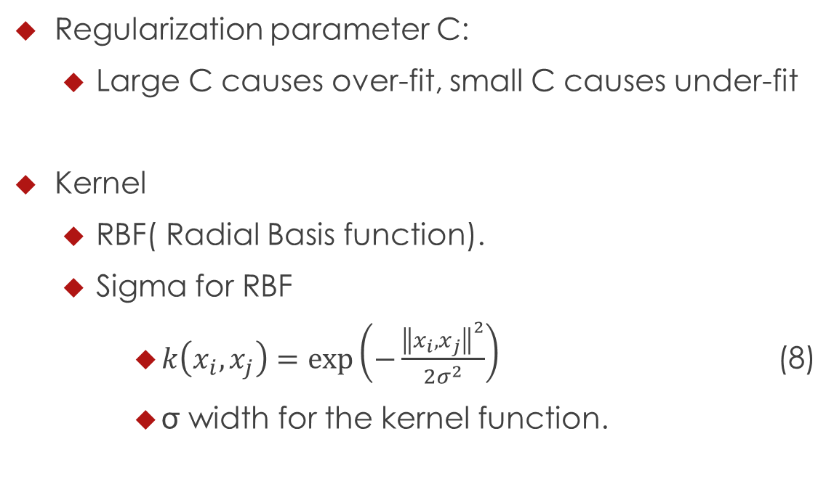
8.3 Classifier(SVM) (cont’d)
Regularization parameter C:
Large C causes over-fit, small C causes under-fit
Kernel
RBF( Radial Basis function).
Sigma for RBF
$k\left(x_{i},x_{j}\right)=exp\left(−\frac{{\left\|x_{i},x_{j}\right\|}^{2}}{2σ^{2}}\right)$ (8)
σ width for the kernel function.

Slide 23
8.4 Model Validation
Cross validation
10-fold cross validation [13]
Example 1: 10-fold cross validation
D1 D2 D3 D4 D5 D6 D7 D8 D9 | D10

Slide 24

8.6 Measuring Matrices
Measuring matrices
Accuracy = $\frac{TP+TN}{TP+TN+FP+FN}$ (9)
Sensitivity = $\frac{TP}{TP+FN}$ (10)
Specificity = $\frac{TN}{TN+FP}$ (11)

Slide 25
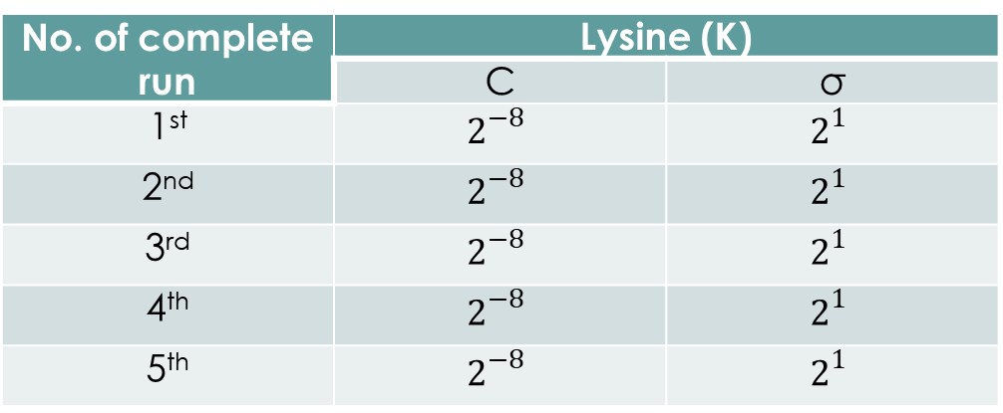
9. Model Selection
Table 3: Implementation specification
Table 4: Parameters to PSI-BLAST
No. of complete run | Lysine (K)
 | C | σ
1st | $$2^{−8}$$ | $$2^{1}$$
2nd | $$2^{−8}$$ | $$2^{1}$$
3rd | $$2^{−8}$$ | $$2^{1}$$
4th | $$2^{−8}$$ | $$2^{1}$$
5th | $$2^{−8}$$ | $$2^{1}$$
No. of iteration | E-value cutoff
2 | 0.001

Slide 26
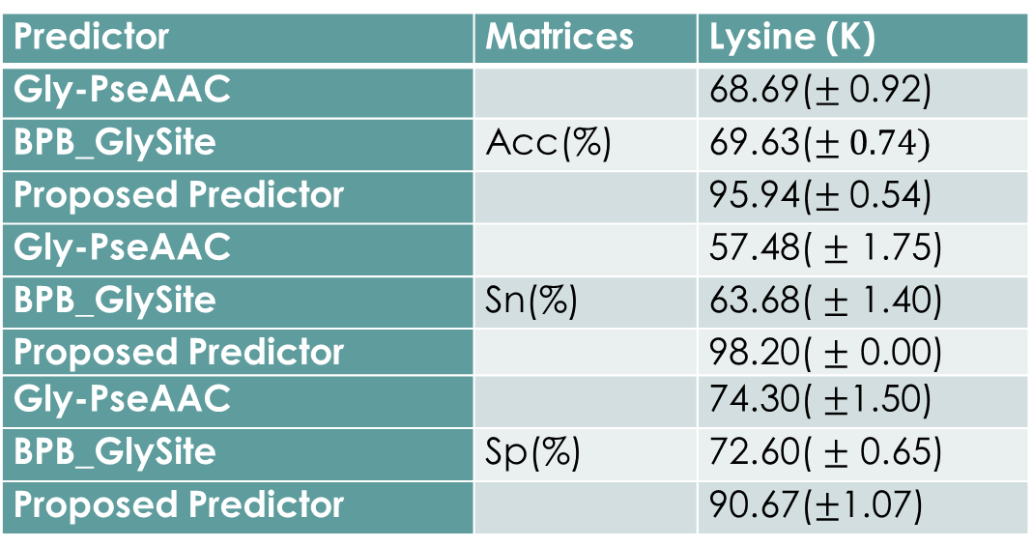
10. Results
Table 5: Comparison Among Gly-PseAAC, BPB_Glysite & Our proposed Model
Predictor | Matrices | Lysine (K)
Gly-PseAAC |  | 68.69($±$ 0.92)
BPB_GlySite | Acc(%) | 69.63($± 0.74)$
Proposed Predictor |  | 95.94($±$ 0.54)
Gly-PseAAC |  | 57.48( $±$ 1.75)
BPB_GlySite | Sn(%) | 63.68( $±$ 1.40)
Proposed Predictor |  | 98.20( $±$ 0.00)
Gly-PseAAC |  | 74.30( $±$1.50)
BPB_GlySite | Sp(%) | 72.60( $±$ 0.65)
Proposed Predictor |  | 90.67($±$1.07)

Slide 27
Background
10. Results (cont’d)

Slide 28
11. Conclusion and Future Work
Peptide Sequence Evolution based Features outperforms.
Implementation on different datasets.
Comparison with typical sequenctial evolutionary technique.

Slide 29
12. References
[1] F. CRICK, "Central Dogma of Molecular Biology", Nature, vol. 227, no. 5258, pp. 561-563, 1970.
[2] Y. Xu, J. Ding, L. Wu and K. Chou, "iSNO-PseAAC: Predict Cysteine S- Nitrosylation Sites in Proteins by Incorporating Position Specific Amino Acid Propensity into Pseudo Amino Acid Composition", PLoS ONE, vol. 8, no. 2, p. e55844, 2013.
[3] C. Walsh, S. Garneau-Tsodikova and G. Gatto, "Protein Posttranslational Modifications: The Chemistry of Proteome Diversifications", Angewandte Chemie International Edition, vol. 44, no. 45, pp. 7342-7372, 2005.
[4] E. Witze, W. Old, K. Resing and N. Ahn, "Mapping protein post- translational modifications with mass spectrometry", Nature Methods, vol. 4, no. 10, pp. 798- 806, 2007.
[5] N. Ahmed, R. Babaei-Jadidi, S. Howell, P. Beisswenger and P. Thornalley, "Degradation products of proteins damaged by glycation, oxidation and nitration in clinical type 1 diabetes", Diabetologia, vol. 48, no. 8, pp. 1590-1603, 2005.

Slide 30
12. References (Cont’d)
[6] e. Ling X, "Immunohistochemical distribution and subcellular localization of three distinct specific molecular structures of advanced glycation end products - PubMed - NCBI", Ncbi.nlm.nih.gov, 2018.
[7] S. Agalou, "Profound Mishandling of Protein Glycation Degradation Products in Uremia and Dialysis", Journal of the American Society of Nephrology, vol. 16, no. 5, pp. 1471-1485, 2005.
[8] Y. Xu, L. Li, J. Ding, L. Wu, G. Mai and F. Zhou, "Gly-PseAAC: Identifying protein lysine glycation through sequences", Gene, vol. 602, pp. 1- 7, 2017.
[9] Z. Ju, J. Sun, Y. Li and L. Wang, "Predicting lysine glycation sites using bi-profile bayes feature extraction", Computational Biology and Chemistry, vol. 71, pp. 98-103, 2017.
[10] http://123.206.31.171/BPB_GlySite/data.html
.

Slide 31
12. References (Cont’d)
[11] A. Schaffer, "Improving the accuracy of PSI-BLAST protein database searches with composition-based statistics and other refinements", Nucleic Acids Research, vol. 29, no. 14, pp. 2994- 3005, 2001.
[12] Y. Li, C. Lin and W. Zhang, "Improved sparse least-squares s upport vector machine classifiers", Neurocomputing, vol. 69, no. 13-15, pp. 1655-1658, 2006.
[13] P. Burman, "A Comparative Study of Ordinary Cross-Validation, v- Fold Cross-Validation and the Repeated Learning-Testing Methods", Biometrika, vol. 76, no. 3, p. 503, 1989.

Slide 32
Thank you
Any Question?

