Slide 1
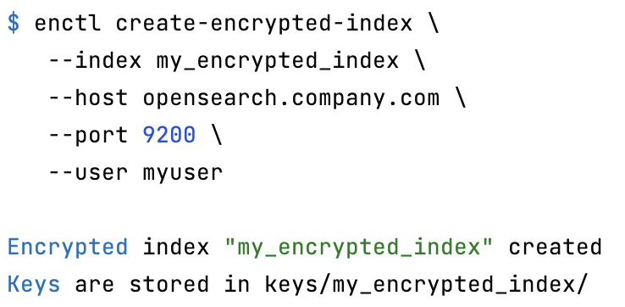
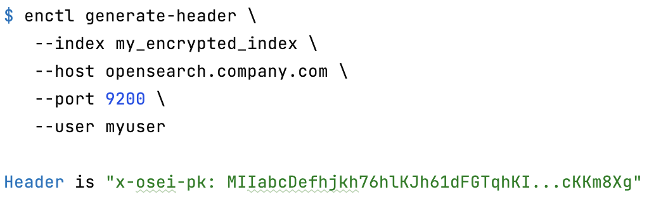
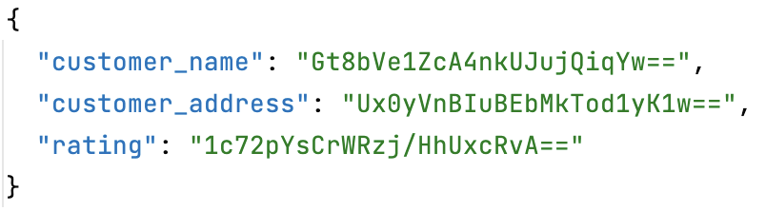
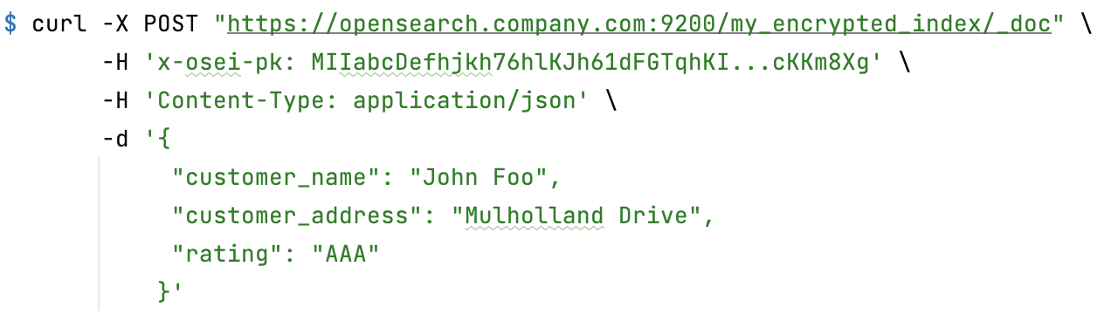
1. Create encrypted index
2. Generate header
OpenSearch Node
Index „my_encrypted_index“
Encrypt
3. Index encrypted data

Slide 2
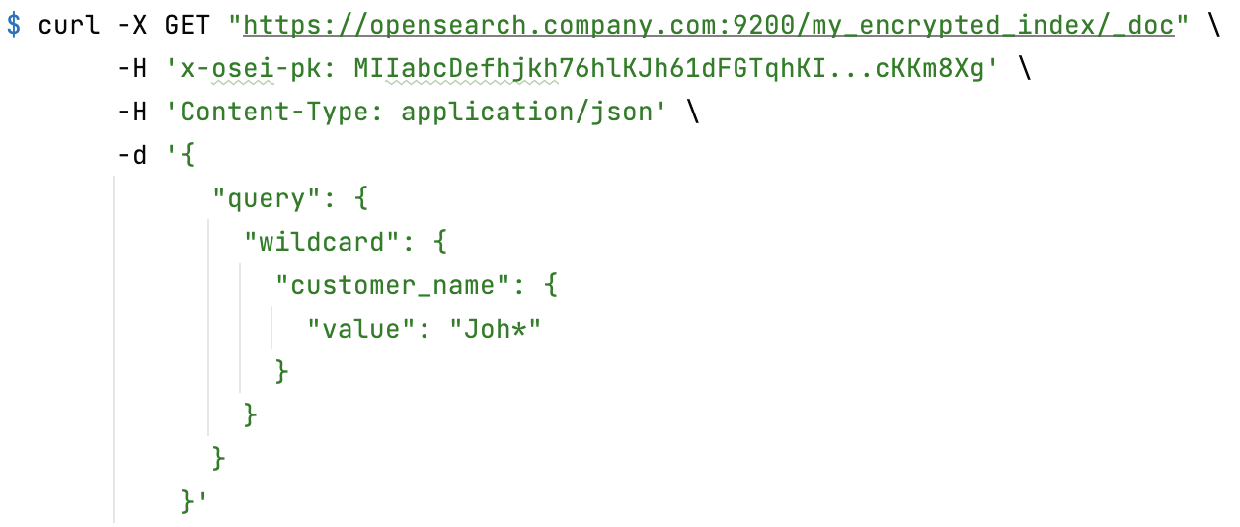
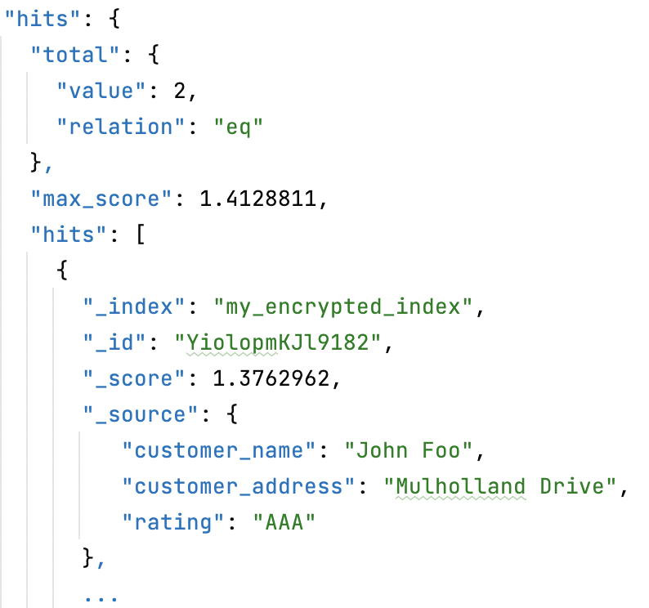
OpenSearch Node
4. Search encrypted data
Encrypt search terms
Search
Index „my_encrypted_index“
Decrypt

Slide 3

OpenSearch Node
Inverted index
Term | Docs
CAB58C3259DC4719685FD0E66760C133 | 1,2
844B392E287C6085B038DCCF37E5E135 | 2
00E6A5B4AC8A8471C2E4B4FDEEBE3D16 | 1
22F9328770DEFB7E8CADC1F0A0D56AA2 | 1,4
Index „my_encrypted_index“
Stored fields
Doc values
Doc ID | Value
1 | 00E6A5B4AC8A8471C2E4B4FDEEBE3D16
2
3 | B685958247896DC8FFEC27AB39AB0199
4
Translog

