Slide 1
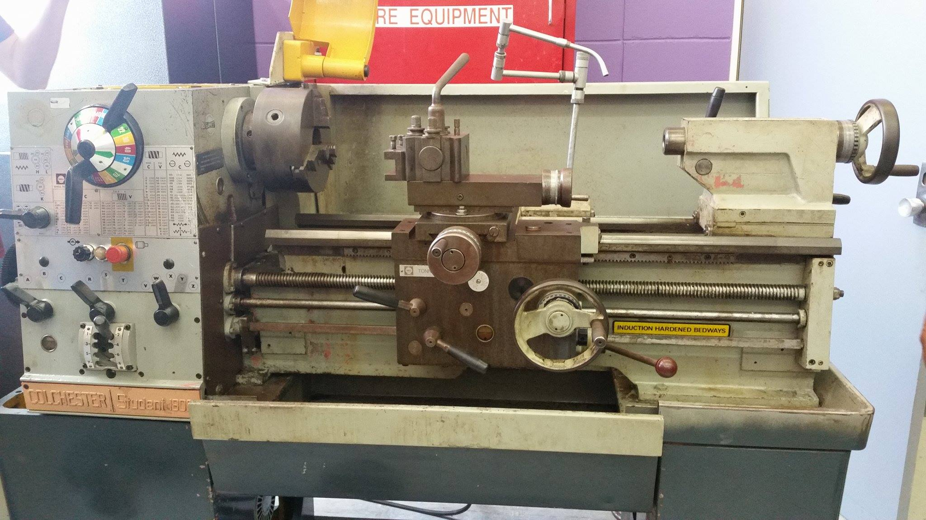
Tool post
Spindle (with chuck)
Carriage
Ways
Tailstock quill
Spindle speed selector
Tail stock
Hand wheel
Headstock assembly
Bed
Feed selector
Apron
Longitudinal & transverse feed control
Lead screw
Feed rod

Slide 2

Machining specifications
Travel distance (max distance between centres): 550 mm
Swing over carriage (max diameter): 105.70 mm
Swing over bed: 161.10 mm
Swing over the ways: 150.02 mm

Slide 3
Mechanical perspective
Motor specifications: Max speed: 1420 rpm, power: 2.2 kW.
Forces involved to cut mild steel:
Energy to cut mild still under the max load
Speed rates of machining
Torque
Cutting tools

Slide 4
In milling, cutting forces are exerted in three planes to deform and shear away material in the form of a chip. Tangential cutting forces overcome the resistance to rotation and account for 70 perent of the total force. Feed forces account for 20 percent of the total force. Radial forces tend to push away the tool and account for 10 percent of the cutting forces.
A milling cutter's performance is limited by its maximum chip load. Since commonly used speed and feed calculators show only feed per tooth, expressed as fz, the terms "chip load" and "fz" tend to be used interchangeably. This common misconception can lead to significant error.

Slide 5
Tool Cutting Edge Angle
Different angles at the cutting edge generate different-thickness chips. For example, a 45-degree cutter has equal radial and axial forces, making it less demanding on spindle bearings and enabling higher feed rates. This is usually a good choice for face milling as it provides a smooth entrance and exit to the cut while offering high surface finish quality.
The greater the lead angle, the lower the chip-thinning effect. A 90-degree cutter, therefore, will have high insert loads because chip thickness is at maximum for a given feed.

Slide 6
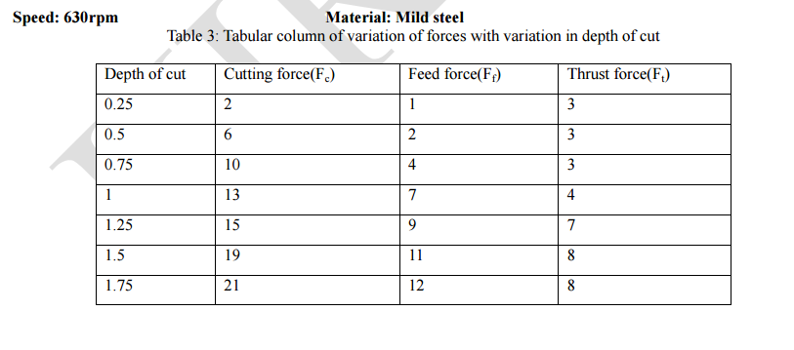
Retrieved: https://www.ijirset.com/upload/2014/october/65_Finding.pdf 28/Feb/2017

Slide 7
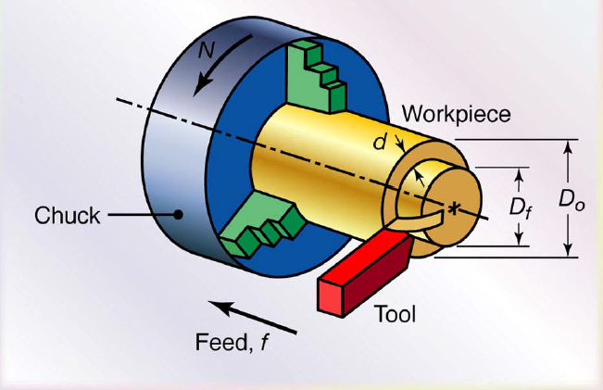
Cutting force calculation
Ft: Tangential cutting force (N)
Ks: specific cutting force (N/mm^2)
a: depth of cut (mm)
s: feed (mm/r)
A: chip area (mm^2) depends on the cutting tool
Ks= Ft/ A
Ft= ks x a x s (see calculation in Excel)
Power requirements (see calculation in Excel)

