Slide 1
P14 · IT SERVICES / CUSTOMER SUPPORT · TEAM 12
Deskline
Customer Support Helpdesk & Ticketing System
“One case number. One thread. One deadline.”
TEAM MEMBERS
PROGRAMME
S M Tejashree Kashyap (2460440)
Sharilyn Fiona Dsilva (2460449)
Sarvani Panthangi (2460447)
Samvrith Singh V (2460441)
5 BTCS A · 5th Semester
GITHUB REPOSITORY
github.com/SMTejashreeKashyap/HelpLine-Desks
L&T EduTech · CIA-3 Backend Development Project Report

Slide 2
PROJECT OVERVIEW
A backend-driven helpdesk platform
Deskline models the full lifecycle of a support ticket — from customer submission through agent resolution to manager oversight — the way enterprise tools like Zendesk or Freshdesk do, at a smaller scale. Built on Node.js, Express, and MongoDB with a self-built JWT authentication flow, every protected route enforces role-based access across the three actors in the system.
13
Functional modules
3
User roles
The application follows an MVC-style folder structure and implements a five-stage ticket workflow with priority-based SLA deadlines, automatic breach flagging, threaded conversations, agent-only internal notes, escalation, and manager-facing reporting on volume, compliance, and agent workload.
5
MongoDB collections
5-stage
Ticket lifecycle
DESKLINE · P14 CUSTOMER SUPPORT HELPDESK & TICKETING SYSTEM
2

Slide 3
PROJECT OBJECTIVES
Six goals driving the build
1
Data Modelling
2
Ticket Lifecycle
Model tickets, agents, and SLA rules cleanly — deciding deliberately between referencing and embedding.
Implement priority-based SLA deadlines rather than a flat status field.
3
Assignment & Escalation
4
Reporting
Support ticket assignment, escalation, and comment threads distinct from internal notes.
Provide manager-facing reporting on resolution time, SLA compliance, and agent workload.
5
Access Control
6
Documentation
Enforce role-based access for Customer, Agent, and Manager/Admin on every protected route.
Ship a GitHub-hosted, README-documented codebase a new developer can run in minutes.
DESKLINE · P14 CUSTOMER SUPPORT HELPDESK & TICKETING SYSTEM
3

Slide 4
ACTORS / USER ROLES
Three roles, one shared ticket record
Customer
Support Agent
Manager / Admin
C
A
M
Raises tickets, tracks live status, and replies in the thread.
Resolves assigned tickets, updates status, and adds internal notes.
Assigns and escalates tickets, configures SLA rules, monitors compliance.
DEMO ACCOUNT
DEMO ACCOUNT
DEMO ACCOUNT
customer@helpdesk.io
agent@helpdesk.io
manager@helpdesk.io
DESKLINE · P14 CUSTOMER SUPPORT HELPDESK & TICKETING SYSTEM
4

Slide 5
SCOPE OF THE PROJECT
What's in, what's assumed
The scope covers a complete backend helpdesk platform with a demonstration frontend, focused on MongoDB schema design, RESTful API correctness, and workflow / business-rule logic rather than visual polish.
In Scope
Assumptions & Boundaries
All 13 mandatory P14 modules, implemented and demonstrable
Self-built JWT auth flow with bcrypt password hashing
MVC folder structure: routes / controllers / models / middleware
Lightweight HTML/CSS/JS frontend for live demos across all 3 roles
Third-party integrations (SMS/email/payments) may be mocked
Social login (Google/Facebook) is not required
Single currency, locale, and time zone assumed
Postman-only demonstration is an acceptable fallback
DESKLINE · P14 CUSTOMER SUPPORT HELPDESK & TICKETING SYSTEM
5

Slide 6
TOOLS & TECHNOLOGIES
Recommended stack, fully adopted
N
E
M
M
Node.js
Express.js
MongoDB
Mongoose
Server-side JS runtime
REST routing & middleware
Document database
Schema & validation (ODM)
J
b
P
H
JWT
bcrypt
Postman
HTML/CSS/JS
Stateless authentication
One-way password hashing
API testing & docs
Demo frontend (Bootstrap-style)
DESKLINE · P14 CUSTOMER SUPPORT HELPDESK & TICKETING SYSTEM
6

Slide 7
DATABASE DESIGN
MongoDB collections, modelled around reads
Frequently-growing, independently-queried data (comments, ratings) is referenced by ticketId rather than embedded; SLA rules live in their own collection so managers can edit category/priority mappings without touching ticket documents.
Collection | Key Fields | Purpose
users | name, email, passwordHash, role | Stores Customer, Agent & Manager/Admin accounts
tickets | customerId, category, priority, status, assignedAgentId, slaDueAt, createdAt | Core ticket record and its lifecycle state
comments | ticketId, authorId, message, isInternal, createdAt | Threaded replies and agent-only internal notes
slaRules | category, priority, resolutionHours | Configurable SLA resolution windows
ratings | ticketId, customerId, score, comment | Post-resolution customer satisfaction rating
DESKLINE · P14 CUSTOMER SUPPORT HELPDESK & TICKETING SYSTEM
7

Slide 8
TICKET STATUS WORKFLOW
A real lifecycle, not a flat CRUD field
Open
In Progress
On Hold
Resolved
Closed
SLA Deadline Calculation
SLA Breach Flagging
Status History Log
Due-by time computed from each ticket's category + priority against configured SLA rules.
Tickets crossing their SLA deadline before resolution are visibly flagged “Breached” across lists and reports.
Every transition between stages is captured and shown in the ticket detail view.
DESKLINE · P14 CUSTOMER SUPPORT HELPDESK & TICKETING SYSTEM
8

Slide 9
FUNCTIONAL MODULES
All 13 mandatory modules, implemented
User Registration & Authentication
Ticket Creation Module
Ticket Assignment Engine
1
2
3
Ticket Status Workflow
SLA Deadline Calculation
SLA Breach Flagging
4
5
6
Comment / Reply Thread
Internal Notes Module
Escalation Workflow
7
8
9
Category & Priority Management
Customer Satisfaction Rating
Agent Workload Dashboard
10
11
12
Manager Reports & Analytics
13
DESKLINE · P14 CUSTOMER SUPPORT HELPDESK & TICKETING SYSTEM
9

Slide 10
API ENDPOINT REFERENCE
Core REST routes exposed by the backend
Method | Endpoint | Description
POST | /api/auth/register | Register a customer or agent account
POST | /api/auth/login | Authenticate and issue a JWT
POST | /api/tickets | Customer creates a new ticket
PUT | /api/tickets/:id/assign | Manager assigns a ticket to an agent
PUT | /api/tickets/:id/status | Agent / Manager updates ticket status
POST | /api/tickets/:id/comments | Add a customer reply or internal note
PUT | /api/tickets/:id/escalate | Escalate a ticket with a reason
POST | /api/tickets/:id/rating | Customer rates a resolved ticket
GET | /api/manager/reports/sla | SLA compliance rate & category breakdown
DESKLINE · P14 CUSTOMER SUPPORT HELPDESK & TICKETING SYSTEM
10

Slide 11
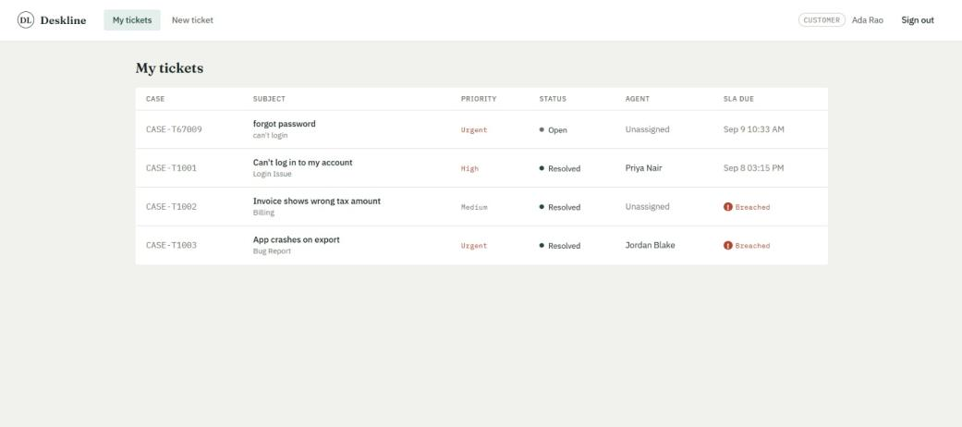
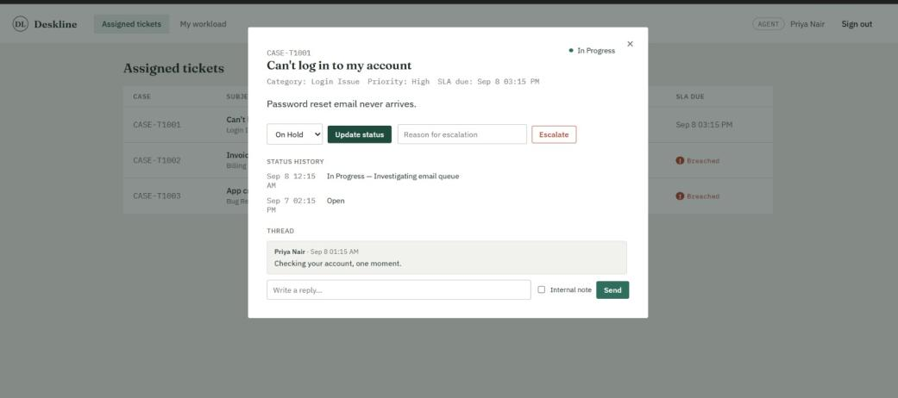
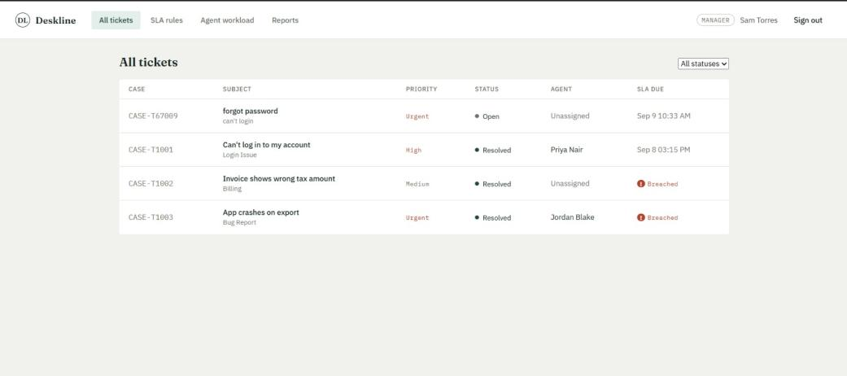
LIVE DEMO SCREENS
One workflow, three role-scoped views
Customer Portal
Agent Workspace
Manager Console
Raises tickets & tracks “My tickets” with live SLA due times.
Updates status, escalates, and replies or adds internal notes.
Views every ticket, assigns agents, filters by status.
DESKLINE · P14 CUSTOMER SUPPORT HELPDESK & TICKETING SYSTEM
11

Slide 12
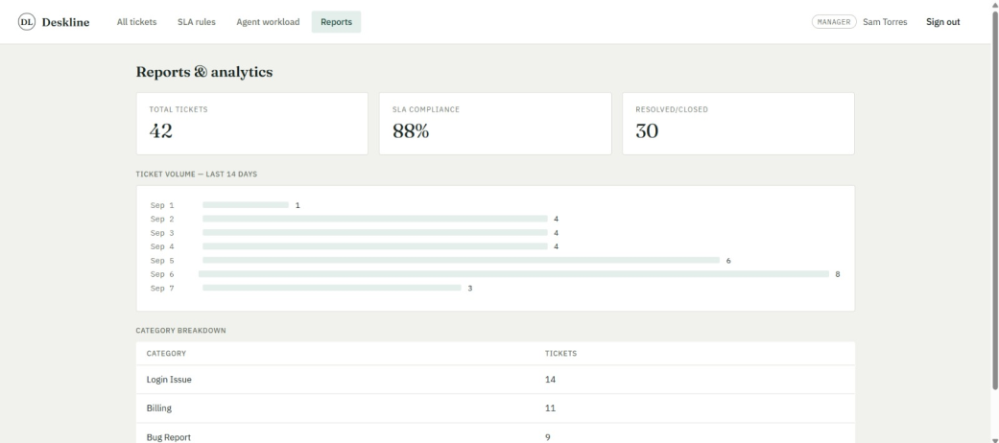
MANAGER REPORTS & ANALYTICS
SLA compliance, volume, and category breakdown
42
Total tickets
88%
SLA compliance
30
Resolved / closed
The Agent Workload screen aggregates open tickets, total assigned, and average resolution time per agent. The Reports screen rolls this up into SLA compliance rate, a 14-day ticket volume trend, and a category-wise breakdown.
DESKLINE · P14 CUSTOMER SUPPORT HELPDESK & TICKETING SYSTEM
12

Slide 13
IMPLEMENTATION SAFEGUARDS
Common pitfalls, deliberately avoided
✓
Secrets & hashing
✓
Server-side validation
Passwords are bcrypt-hashed; JWT secrets and the MongoDB URI are read from environment variables, never committed to source.
All request bodies are validated server-side, so the API is safe to call directly from Postman.
✓
Role & ownership checks
✓
Centralized error handling
Every protected route checks the caller's role and, where relevant, ownership before allowing an update.
A single Express middleware returns consistent 4xx/5xx JSON instead of crashing on an unhandled rejection.
✓
Read-pattern schema design
✓
Status history logging
MongoDB collections are designed around how data is actually read, not relational joins.
Every workflow transition is logged, evidencing real business logic — not plain CRUD.
DESKLINE · P14 CUSTOMER SUPPORT HELPDESK & TICKETING SYSTEM
13

Slide 14
OUTCOME
A working, end-to-end helpdesk backend
Complete ticket lifecycle with priority-driven SLA deadlines & automatic breach flagging
Role-scoped views for Customer, Agent, and Manager/Admin, each backed by protected API routes
Working escalation path with customer-visible replies separated from agent-only internal notes
Manager-facing SLA configuration, agent workload dashboard, and compliance reporting
CONCLUSION
Deskline demonstrates a secure, role-based backend built on Node.js, Express, and MongoDB — covering the full support-ticket lifecycle from creation to resolution and rating.
Deliberate schema choices, consistent role/ownership enforcement, and centralized validation and error handling together show that workflow logic — not plain CRUD — was the focus of this implementation.
FUTURE ENHANCEMENTS
Email / SMS notifications on assignment & SLA breach
Auto-routing to least-loaded available agent
Real-time updates via WebSockets
File / attachment support on ticket replies
Thank you — Team 12

