Slide 1
COMPUTER NETWORKS · UNIT V
Firewalls, Trusted Systems
& Common Criteria for
IT Security Evaluation
A study of network perimeter defense, trust models,
and international standards for security evaluation.
BY:
S M Tejashree Kashyap - 2460440
Anurag Etta – 2460335
UNIT V

Slide 2
CHAPTER 1
Introduction to Firewalls
Modern networks constantly face hostile or unwanted access attempts, whether from outside intruders or misused internal privileges. A firewall acts as a controlled choke point between a trusted internal network and an untrusted external network, enforcing a defined security policy on every packet that tries to cross the boundary.
Choke Point Control
01
Interconnects networks with differing trust and imposes restrictions on services
02
Traffic Filtering
Only authorized traffic, matching defined rules, is allowed to pass through
03
Auditing & Alarms
Logs activity and can raise alarms for abnormal or suspicious behaviour
04
NAT & VPN Support
Provides usage monitoring, address translation, and secure VPNs via IPSec
COMPUTER NETWORKS – UNIT V
2

Slide 3
CHAPTER 2
What is a Firewall?
A firewall is a system, or group of systems, that enforces an access-control policy between an internal trusted network and an external untrusted network such as the Internet. It forms a single choke point through which all traffic must pass, where security and auditing can be imposed and monitored.
CRITICAL PROPERTY
Immune to
Penetration
Choke Point
Core capabilities of a firewall:
All traffic between the two networks is forced through one controlled point
• Interconnects networks with differing levels of trust
• Imposes restrictions — only authorized traffic is allowed
Policy Enforcement
• Provides auditing and controlling of network access
• Can implement alarms for abnormal behaviour
Only traffic that matches the defined security policy is permitted to pass
• Provides NAT and usage monitoring
• Implements VPNs using IPSec
Trusted Perimeter
Separates trusted internal hosts from untrusted external networks
COMPUTER NETWORKS – UNIT V
3

Slide 4
CHAPTER 2
Firewall Limitations
B
I
M
Bypass Routes
Insider Threats
Malware Transfer
Cannot protect against attacks that bypass it entirely — sneaker-net transfers, dial-up modems, or trusted external services such as SSL/SSH tunnels.
Cannot protect against internal threats, such as a disgruntled or colluding employee misusing legitimate access rights.
Cannot fully protect against transfer of virus-infected programs or files, given the huge range of operating systems and file types.
COMPUTER NETWORKS – UNIT V
4

Slide 5
CHAPTER 3
Types of Firewalls
PF
SI
AG
CG
Packet-Filtering Router
Stateful Inspection
Application-Level Gateway
Circuit-Level Gateway
Examines each IP packet in isolation (no context) and permits or denies it based on static address/port rules.
Tracks client–server sessions in context, validating that each packet genuinely belongs to an established connection.
A proxy with full understanding of the application protocol; validates requests before relaying them onward.
Relays two TCP connections after validating the session, without inspecting the application content.
COMPUTER NETWORKS – UNIT V
5

Slide 6
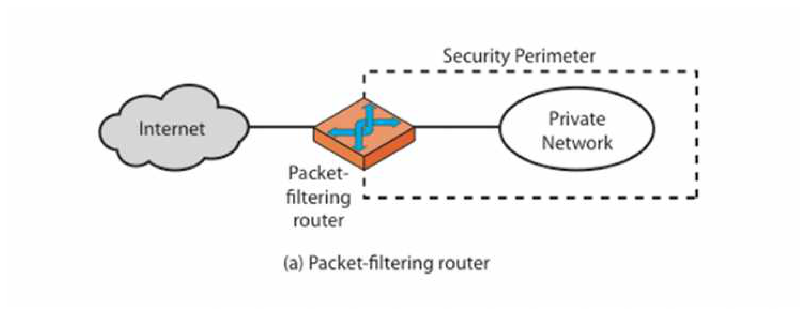
CHAPTER 3
Packet-Filtering Firewalls
The simplest, fastest firewall component:
Foundation of any firewall system
Examines each IP packet in isolation (no context) and permits or denies it according to defined rules
Restricts access to services by filtering on ports
Default policy: deny unless expressly permitted, or permit unless expressly prohibited
COMPUTER NETWORKS – UNIT V
6

Slide 7
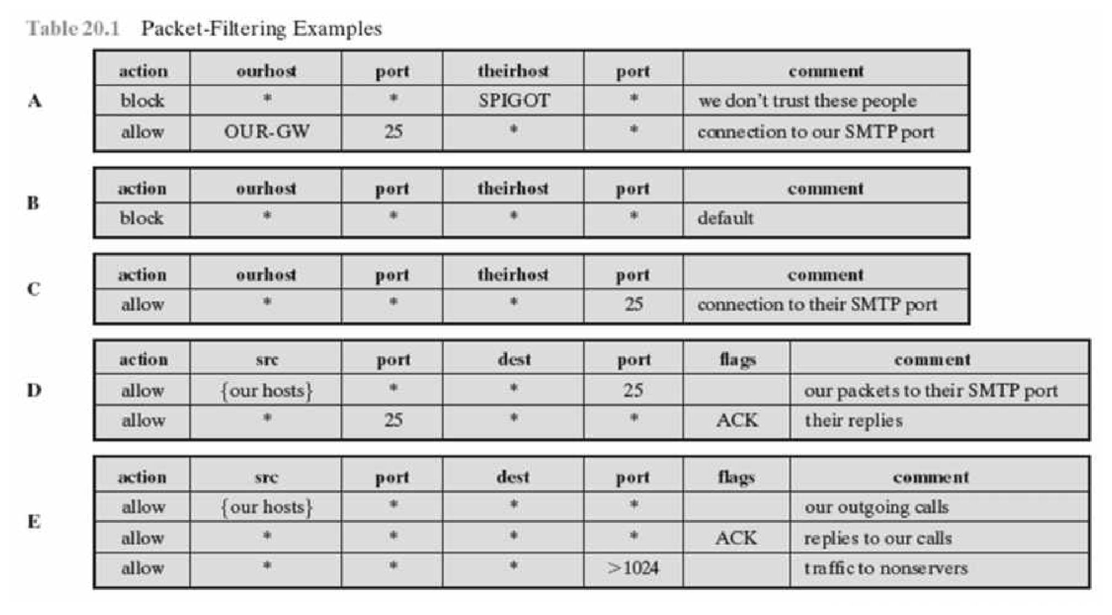
CHAPTER 3
Packet-Filter Rule Examples
Rules are checked in order for every packet; the first matching rule decides whether it is allowed or blocked.
COMPUTER NETWORKS – UNIT V
7

Slide 8
CHAPTER 3
Attacks on Packet Filters
IP Address Spoofing — the attacker fakes the source address to appear as a trusted host. Countered by adding filters on the router to block external packets claiming to be from an internal address.
1
Source Routing Attacks — the attacker specifies the route a packet should take, bypassing normal security checks. Countered by blocking all source-routed packets outright.
2
Tiny Fragment Attacks — header information is split across several very small packets to slip past filters. Countered by discarding tiny fragments or reassembling packets before inspection.
3
COMPUTER NETWORKS – UNIT V
8

Slide 9
CHAPTER 3
Stateful Packet Filters
Traditional packet filters examine each IP packet in isolation and cannot match a returning packet with the outgoing flow that triggered it. Stateful packet filters close this gap by tracking the state of every connection, and are far better able to detect bogus packets that fall outside any known context.
KEY IDEA
Context-Aware
Filtering
Session Tracking
How stateful filtering works:
Maintains state for every active client–server session, not just individual packets
• Examines each packet within the context of a connection
• Keeps track of client-server sessions as they are established
Context Validation
• Confirms every packet belongs to a session already in progress
• Maintains a dynamic state table of active connections
Confirms each packet validly belongs to a session already in progress
• Detects and drops packets that fall outside any known session
• Matches reply traffic automatically to its originating request
Return-Path Matching
Automatically matches reply packets to the outbound request that caused them
COMPUTER NETWORKS – UNIT V
9

Slide 10
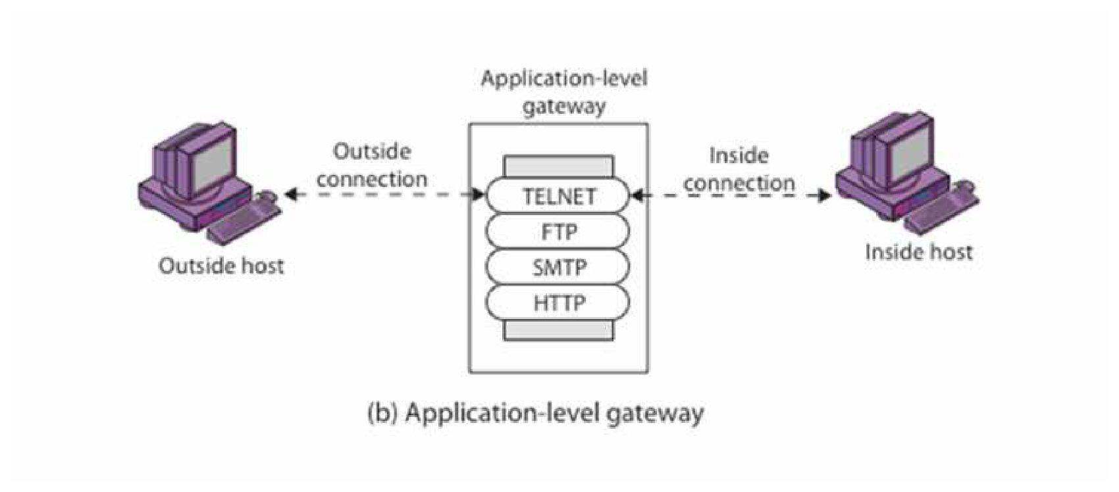
CHAPTER 3
Application-Level Gateway (Proxy)
A proxy with full protocol awareness:
User requests a service from the proxy; the proxy validates the request as legal
Only then does it action the request and return the result to the user
Can log and audit traffic at the application level
Needs a separate proxy for each service — some support this naturally, others are harder
COMPUTER NETWORKS – UNIT V
10

Slide 11
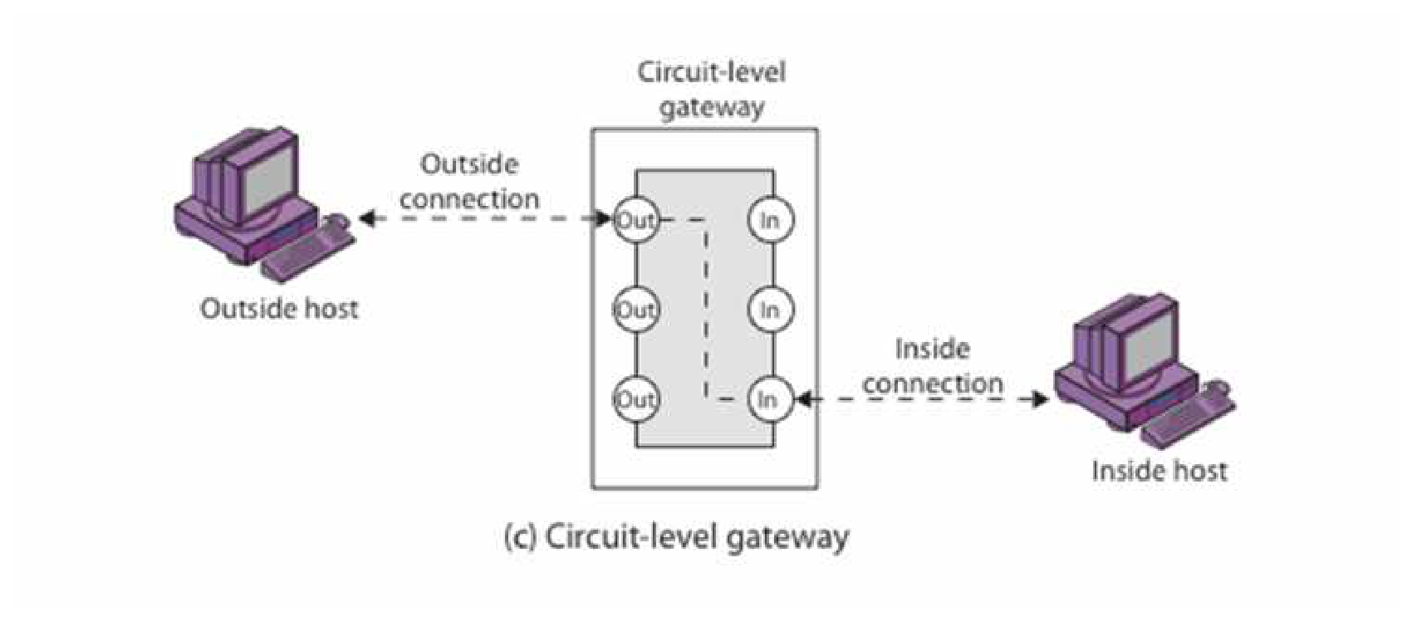
CHAPTER 3
Circuit-Level Gateway
Relays connections without inspecting content:
Relays two TCP connections end to end
Imposes security by limiting which such connections are allowed
Once created, usually relays traffic without examining its contents
Typically used to trust internal users with general outbound access
SOCKS is a commonly used circuit-level protocol
COMPUTER NETWORKS – UNIT V
11

Slide 12
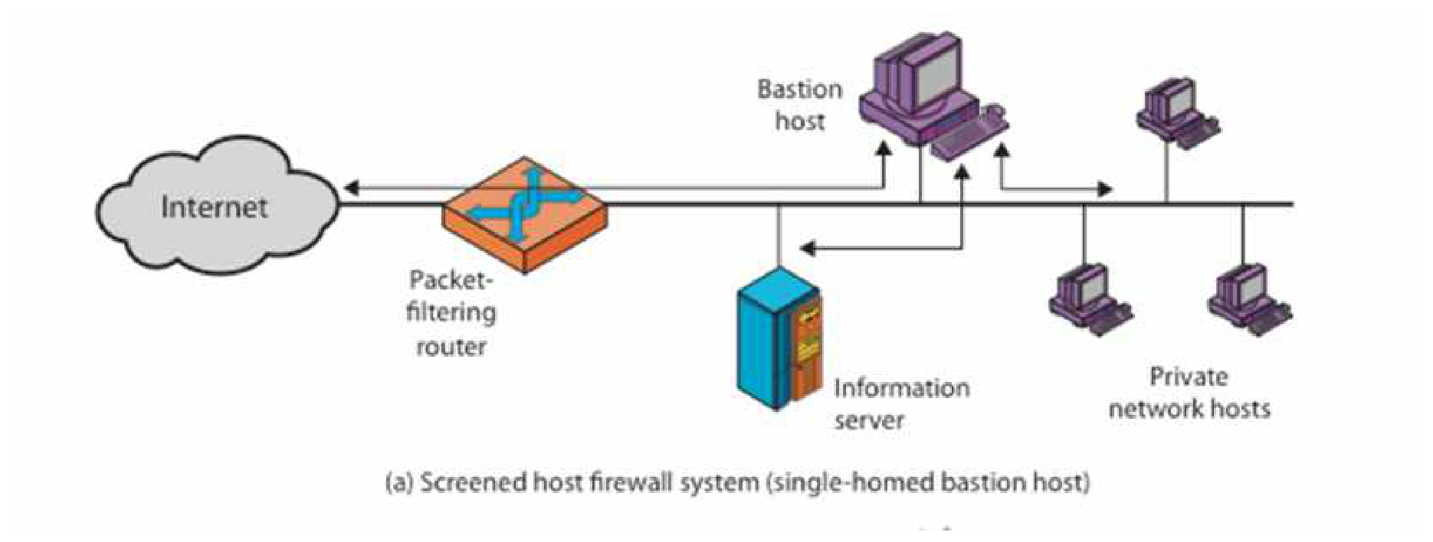
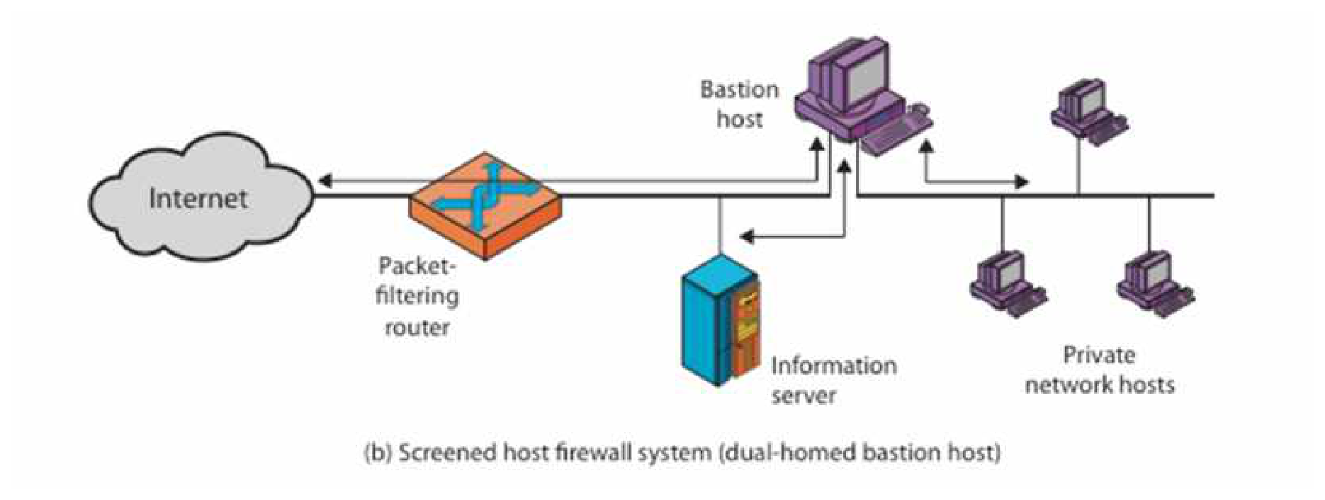
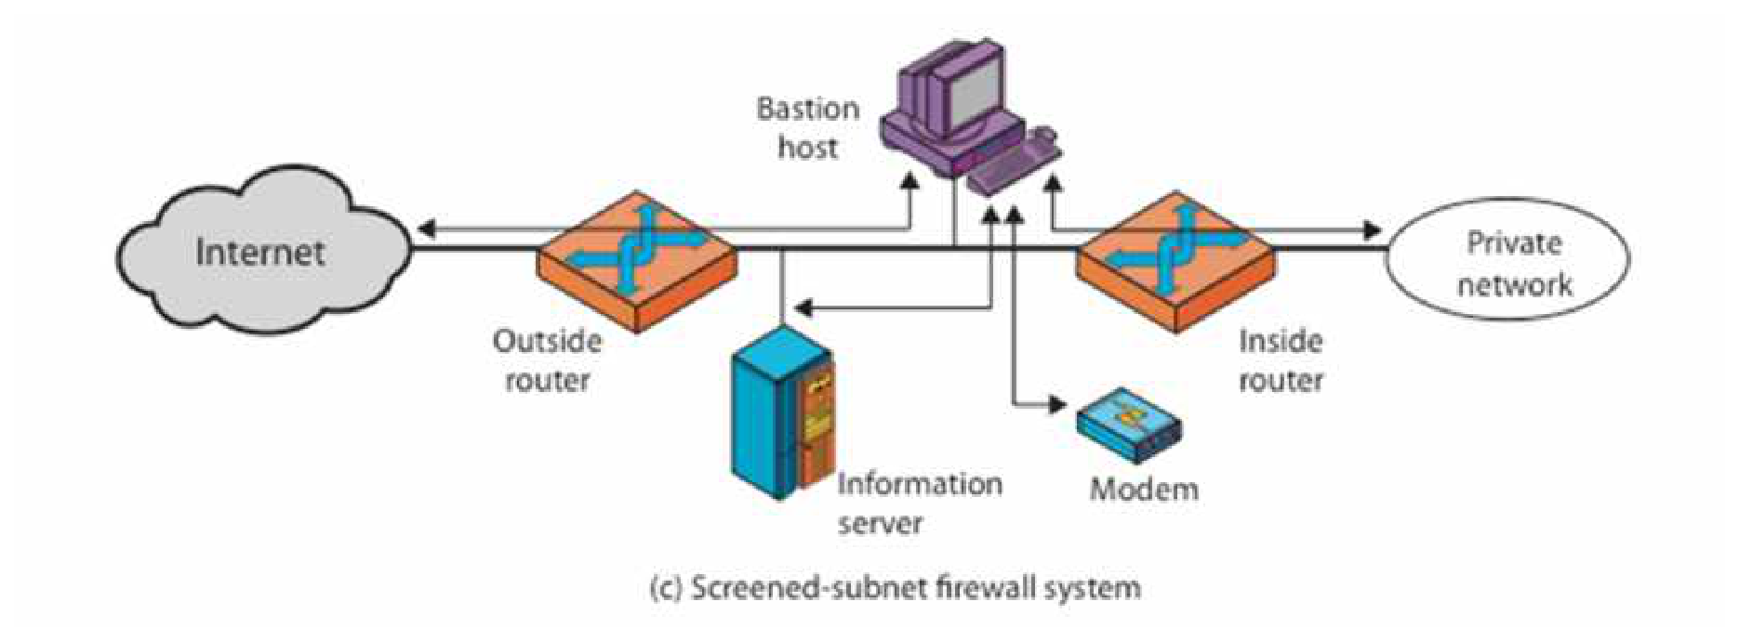
CHAPTER 4
Bastion Host & Firewall Configurations
A bastion host is a highly secure system that runs the circuit- or application-level gateways and is hardened to withstand direct exposure to untrusted networks. It anchors each of the configurations below.
Screened Host — Single-Homed Bastion
Screened Host — Dual-Homed Bastion
Screened-Subnet Firewall System
COMPUTER NETWORKS – UNIT V
12

Slide 13
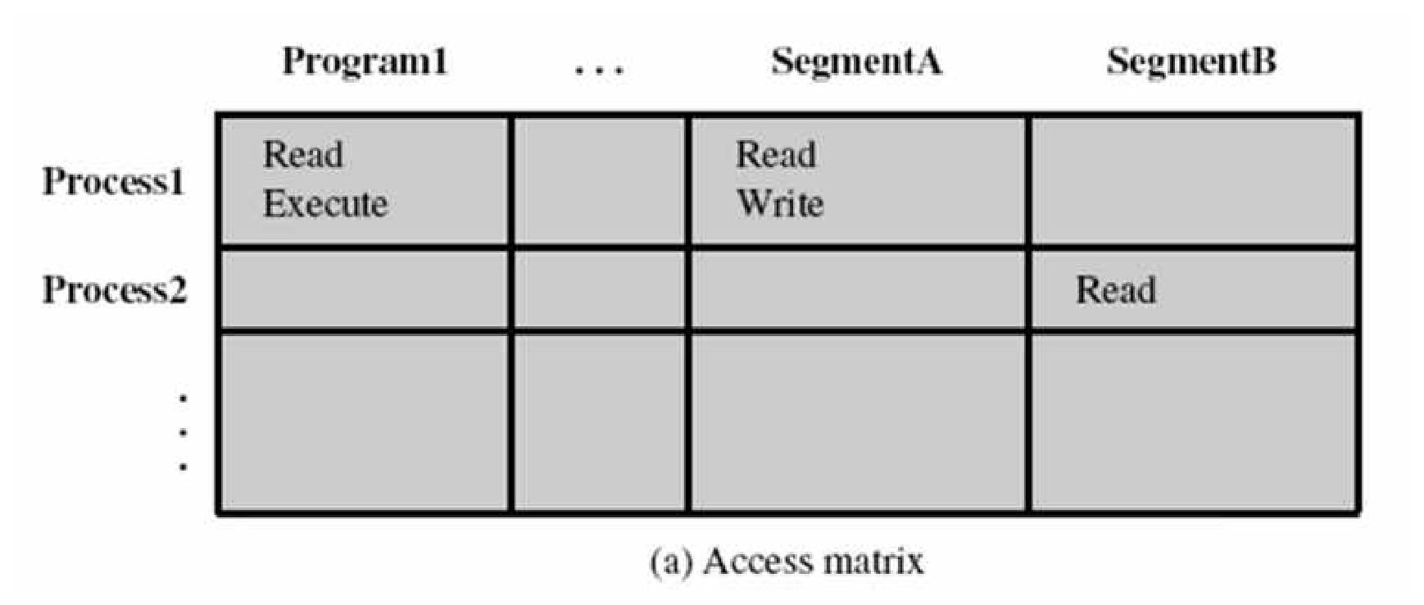
CHAPTER 5
Access Control & Trusted Systems
Controlling what an identified user can reach:
Once a system identifies a user, it must determine what resources they can access
Modelled as an access matrix of subjects (users/processes) and objects (files/resources)
Columns of the matrix form access control lists; rows form capability tickets
Trusted systems assign subjects and objects varying security levels — multilevel security
COMPUTER NETWORKS – UNIT V
13

Slide 14
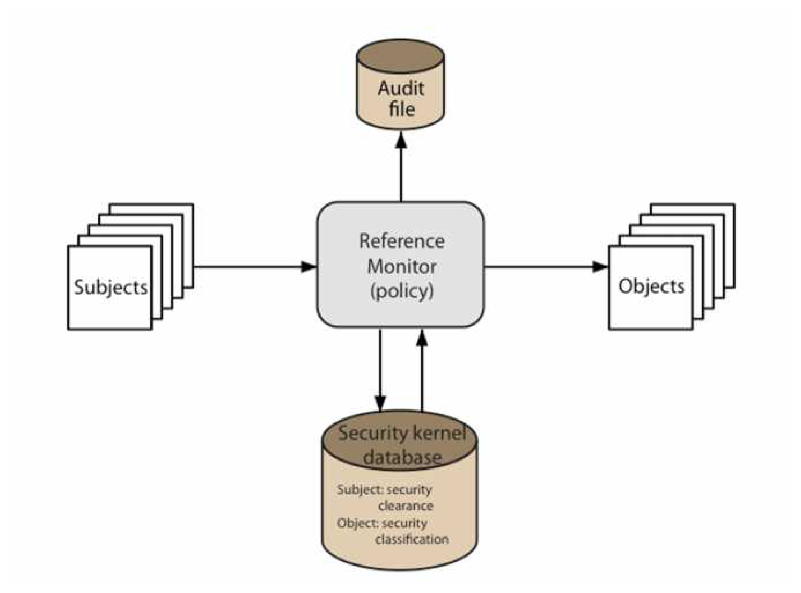
CHAPTER 5
Bell-LaPadula Model & Reference Monitor
Two mandatory policies enforce multilevel security:
No Read Up (simple security property): a subject may read an object only if its security level dominates the object's classification
No Write Down (*-property): a subject may write to an object only if its level is dominated by the object's classification
A reference monitor mediates every access, checking subject and object security attributes against a security kernel database and logging to an audit file
COMPUTER NETWORKS – UNIT V
14

Slide 15
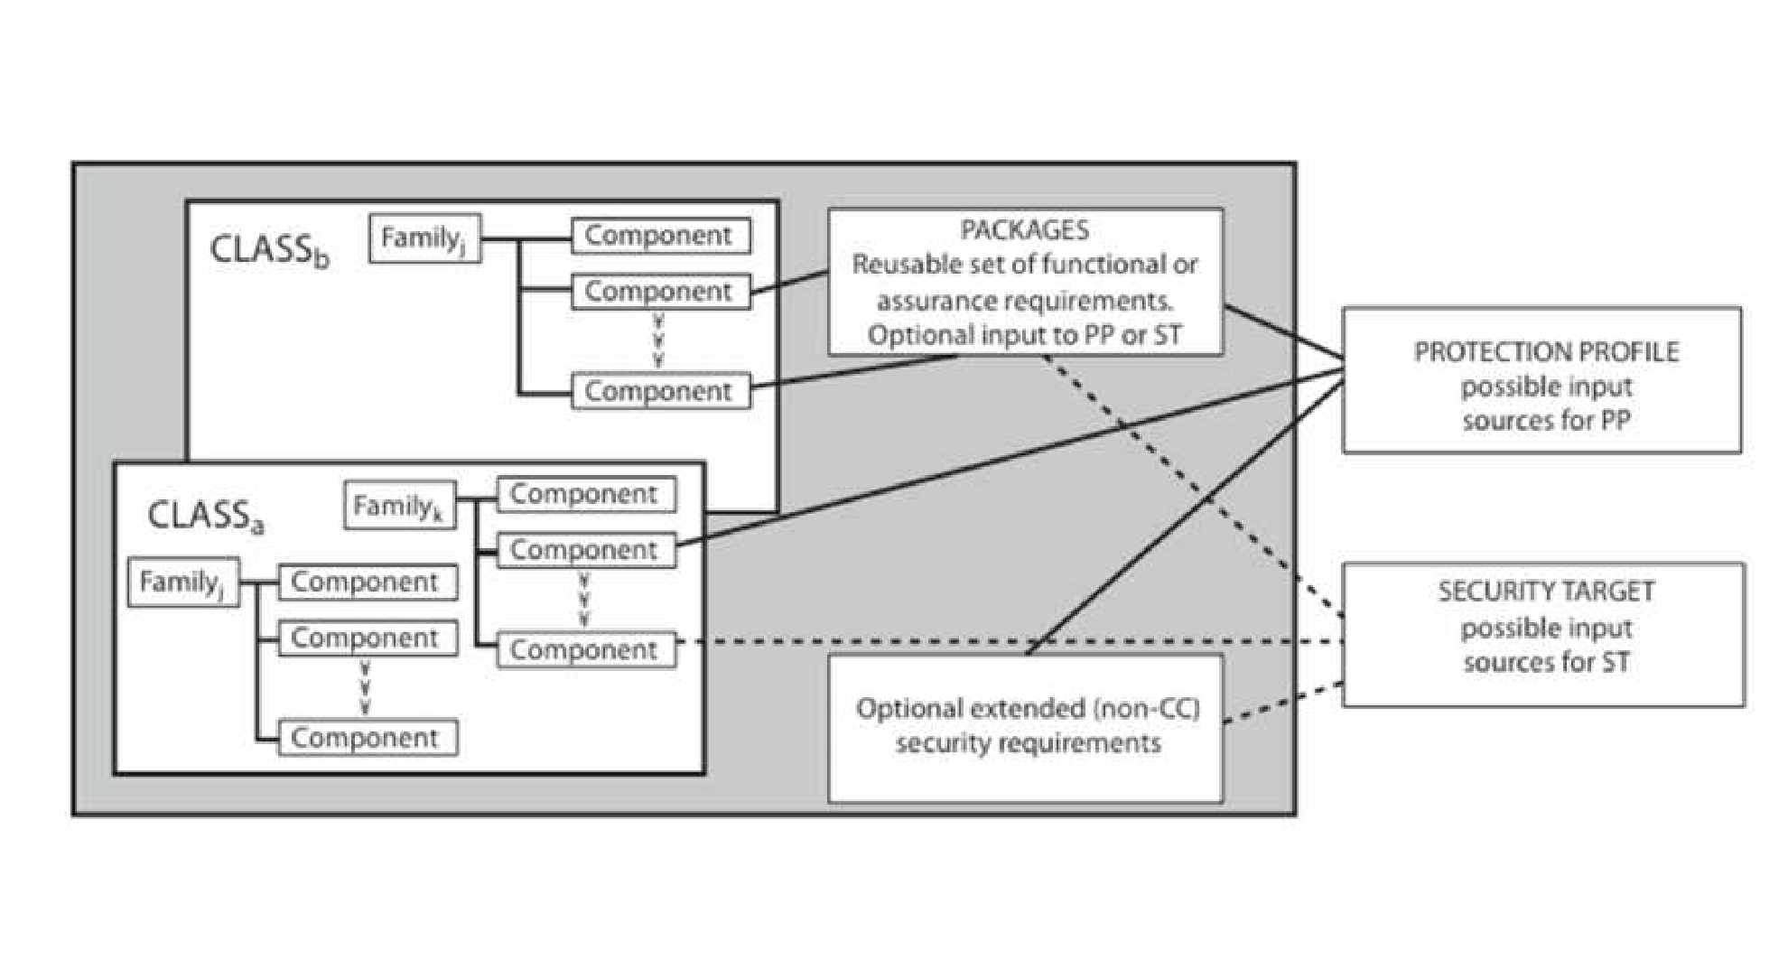
CHAPTER 6
Common Criteria — Overview
An international standard for security evaluation:
Specifies security requirements and defines criteria for evaluating IT products
Incorporates earlier standards — TCSEC, ITSEC, and the Canadian CTCPEC
Defines a Target of Evaluation (TOE) against which requirements are assessed
Covers evaluation criteria, methodology, and administrative certification procedures
Requirements are grouped into reusable Packages feeding Protection Profiles and Security Targets
COMPUTER NETWORKS – UNIT V
15

Slide 16
CHAPTER 6
Common Criteria – Requirement Categories
1
2
3
Security Audit
Cryptographic Support
User Data Protection
Functional — recording and reviewing security-relevant events
Functional — managing keys and cryptographic operations
Functional — enforcing access-control on user data & privacy
4
5
6
Configuration Management
Testing & Vulnerability Assessment
Guidance & Life-Cycle Support
Assurance — controlling change through the development lifecycle
Assurance — verifying functionality and searching for weaknesses
Assurance — proper documentation, delivery, operation & upkeep
COMPUTER NETWORKS – UNIT V
16

Slide 17
CONCLUSION
A layered defense that turns policy
into a controlled point of trust.
Firewalls remain the foundation of network perimeter defense — from simple packet filters to stateful inspection, application gateways and circuit-level proxies. Bastion hosts and screened-subnet configurations harden that perimeter further, while trusted-system models such as Bell-LaPadula and the reference monitor govern access once traffic is inside. Together with internationally recognised Common Criteria evaluation, they form a layered, auditable approach to information security that no single control can achieve alone.
Packet Filtering
Stateful Inspection
Trusted Systems
Common Criteria
COMPUTER NETWORKS – UNIT V
17

