Slide 1

TITLE
Birthday
Congrats
Mother Days

Slide 2
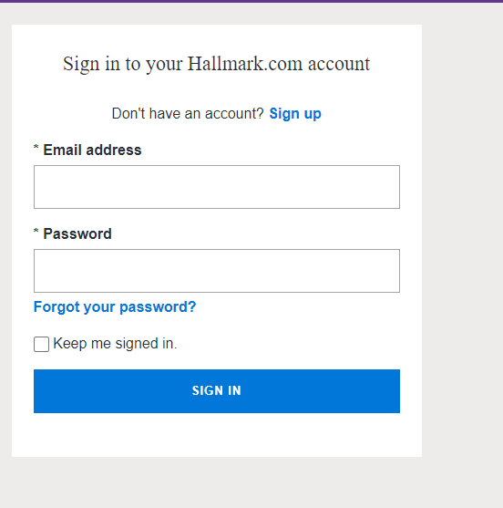
Login Page
Username Field
Password Field
Login Button
New User Register

Slide 3
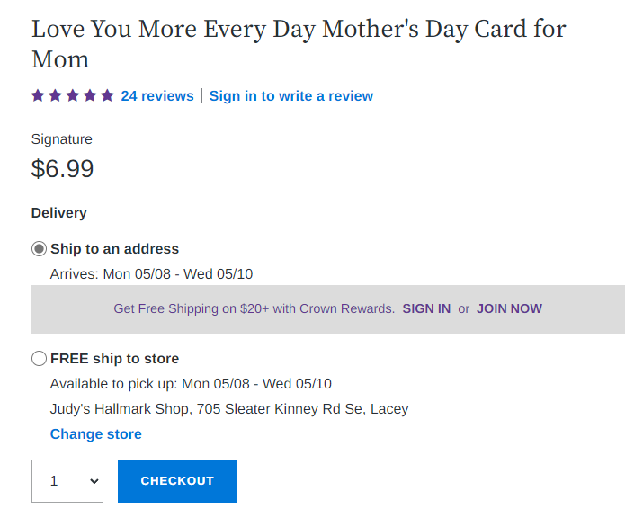
Checkout option

Slide 4
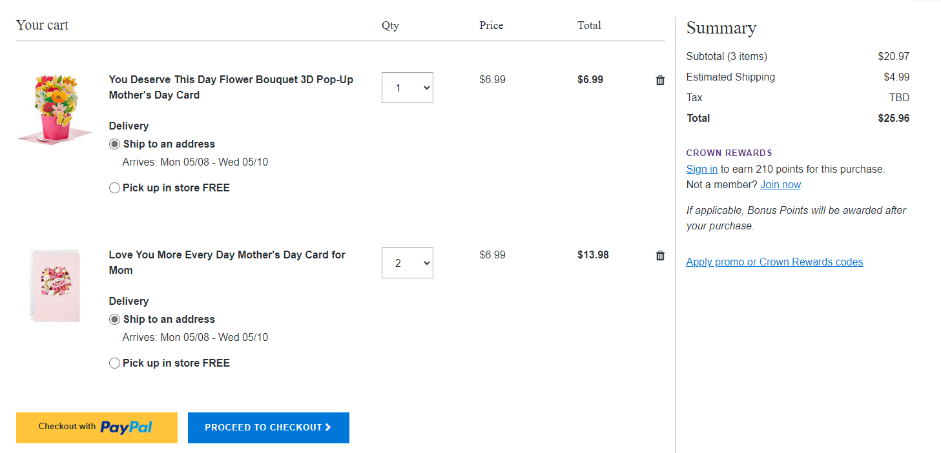
Submit Payment

