Slide 1

TITLE
Birthday
Congrats
Mother Days

Slide 2
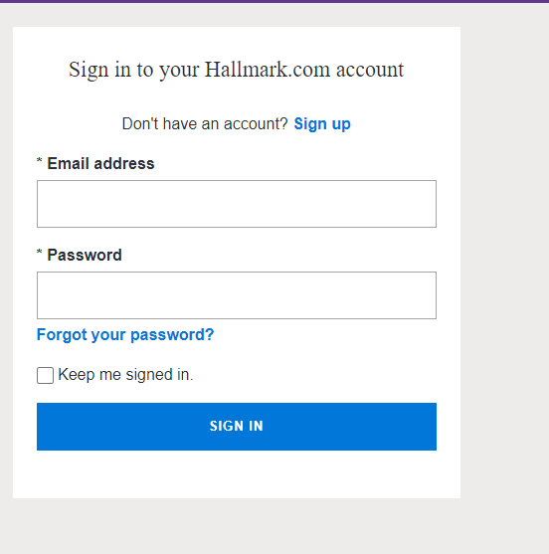
Login Page
Username Field
Password Field
Login Button
New User Register

Slide 3

Post Card Template
Front
Back
Title Text goes here
Text goes here

Slide 4
Standard Card Template
Cover page
Inside Left Page
Inside Right Side
Title goes here
Free text goes here
Image goes here
Broiler plate text goes here
(Not customizable)

Slide 5
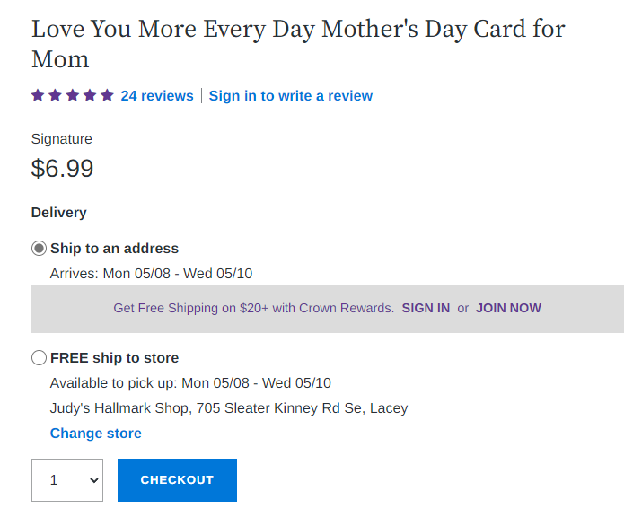
Login Page

Slide 6
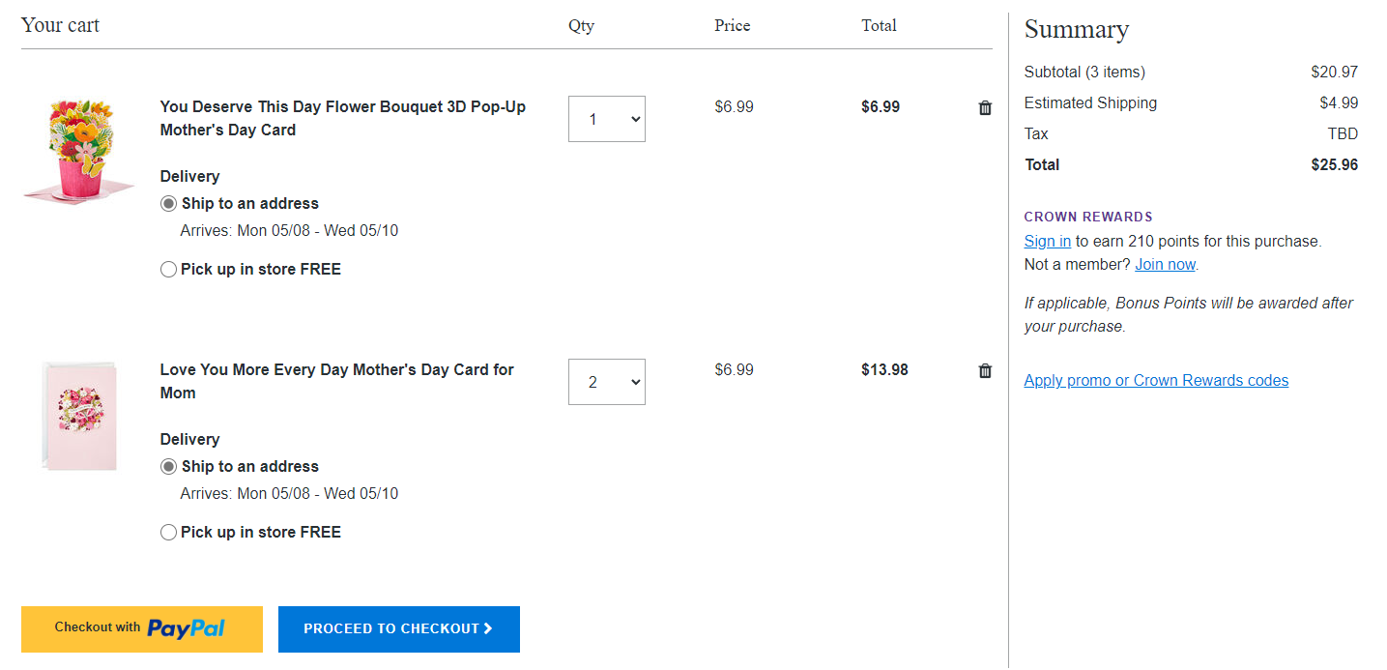
Login Page

