Slide 1
Todd_Garner_Week4_Part2
Todd Garner

Slide 2
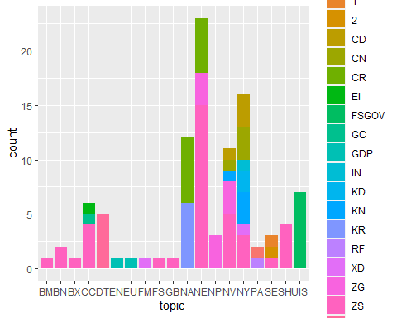
FLS Part 2: Freestyle!
Install and load one of the packages given in the list for downloading APIs (or another API you have found and are interested in). >>>>>>>>Initially, I used Intrinio but gave up trying to grab extra data. I am using WDI and am pulling GDP data from Namibia, Nepal and Niger.
Download data from that API and create a slide that clearly describes the package and how (the code) to download data from that API. >>>>>>>>Luckily, R has a function built in that acts as an API with “WDI.” It doesn’t require a key or secret key. I used those when coding in Python and typically put my keys in a .env file which would not translate to GitHub. This is much easier.
Clearly describe the data and the columns / variables that are of interest to your presentation. >>>>>>>>I must admit that I’m basically following your example. But, I loaded up various GDP codes and selected one that had three ” . ” in it. There were numerous lists of data and I picked Namibia, Nepal and Niger. This contracted starkly against the data pulled from the US, Canada and Mexico. These are very poor nations.
Perform a small EDA with your data. Use plots and possibly tests, to find 2 interesting characteristics of the data that you accessed through the API. >>>>>>Mainly I varied the time period over which the GDP was measured. 1960-1980 was not that exciting, but the really interesting one was 2000 - 2012 where Namibia’s GDP grew at almost 33% over 12 years. That’s very impressive growth. Nepal and Niger tracked similarly and only moved a fraction of the amount that Namibia did.
Create a PPT presentation to show in the live session.
Show part or all of the data and make sure to show the data are tidy.
Include at least 1 plot or chart from ggplot.
You should have no more than five slides (including the title slide).
Include your code.
Also include a discussion of any obstacles you ran into and went around or over in the process… there will inevitably be one and likely more. >>>>>>>>I could not get the code to print to PPT. I spent an indordinate amount of time wrestling with this. I consulted posit.com which solved my issue. Other issues were the API not working on Intrinio. I was able to run the code chunks provided but when I went after additional data sets, it completely failed. I did spend a considerable amount of time on that. I used to be able to pull data in from Alpaca but that was in Python, which I suppose I could have done, but that seems outside of the goal set out at the start. I finally punted and used the similar data set from WDI. Admittedly, this is not my finest work, by far! I found that I spun my wheels significantly. But, I did learn quite a bit.

Slide 3
#Goal 1: Create a bar chart of topics relating to gdp. library(WDI) library(tidyr) library(tidyverse)
## ── Attaching packages ─────────────────────────────────────── tidyverse 1.3.2 ── ## ✔ ggplot2 3.4.0 ✔ dplyr 1.0.10 ## ✔ tibble 3.1.8 ✔ stringr 1.5.0 ## ✔ readr 2.1.3 ✔ forcats 0.5.2 ## ✔ purrr 1.0.0 ## ── Conflicts ────────────────────────────────────────── tidyverse_conflicts() ── ## ✖ dplyr::filter() masks stats::filter() ## ✖ dplyr::lag() masks stats::lag()
#search for reports with "gdp" in the description results = as.data.frame(WDIsearch("gdp")) #This line will filter the data frame to leave only those with 4 pieces in the indicator. resultsGoodIndicator = results %>% filter(str_count(indicator,"\\.")==3) #Check out the new data frame with only 4 piece indicators. This function worked and I deleted the calling of the variable to save space in the PPT. # Break the indicator code up into 4 distinct columns. resultsGoodIndicator = as.data.frame(resultsGoodIndicator) %>% separate(indicator,c("topic","general","specific","extension")) head(resultsGoodIndicator)
## topic general specific extension ## 1 BM GSR MRCH ZS ## 2 BN CAB XOTR ZS ## 3 BN CUR GDPM ZS ## 4 BX GSR MRCH ZS ## 5 CC ENTX ENE ZS ## 6 CC GHG MEMG EI ## name ## 1 Merchandise imports (BOP): percentage of GDP (%) ## 2 Curr. acc. bal. before official transf. (% of GDP) ## 3 Current account balance excluding net official capital grants (% of GDP) ## 4 Merchandise exports (BOP): percentage of GDP (%) ## 5 Total energy tax revenue (% of GDP) ## 6 Macro drivers of GHG emissions growth in the period 2012-2018 - Emission Intensity of GDP
#compare the expenditure (NE) and the income (NY) resultsGoodIndicator %>% ggplot(aes(x = topic, fill = extension)) + geom_bar()

Slide 4
#Goal 2: Plot GDP (NY and GDP) per capita (PCAP) of Namibia, Nepal and Niger in constant US dollars (KD) dat = WDI(indicator='NY.GDP.PCAP.KD', country=c('NE','NP','NA'), start=2000, end=2012) new_df <- subset(dat, select = -c(iso2c, iso3c)) #I used the str(dat) function to illuminate what the character types were and then proceeded. library(ggplot2) knitr::kable(new_df)
country | year | NY.GDP.PCAP.KD
Namibia | 2012 | 4476.4217
Namibia | 2011 | 4330.9511
Namibia | 2010 | 4186.0490
Namibia | 2009 | 4007.4918
Namibia | 2008 | 4053.2266
Namibia | 2007 | 4001.7155
Namibia | 2006 | 3845.2946
Namibia | 2005 | 3634.6263
Namibia | 2004 | 3587.8446
Namibia | 2003 | 3235.7520
Namibia | 2002 | 3148.3579
Namibia | 2001 | 3056.4727
Namibia | 2000 | 3082.7642
Niger | 2012 | 460.0322

Slide 5
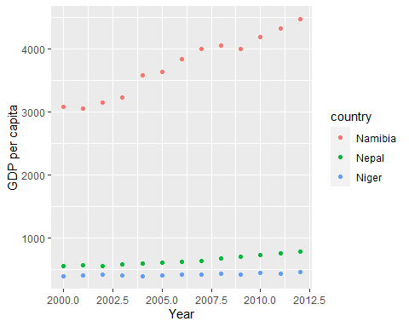
ggplot(new_df, aes(x = year, y = NY.GDP.PCAP.KD, color=country)) + geom_point() + xlab('Year') + ylab('GDP per capita’)
The plot shows the explosive growth in Namibia in the past 12 years.

