Slide 1
Todd Garner
DS 6306 week 6 Part 1
February 87. 2023

Slide 2
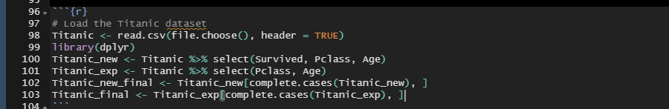
Read in the data and clean – Part 1, #1
The site www.opendatasoft.com proved challenging so I found the .csv files on kaggle.com and also in the class GitHub repo.
Two data sets: training and test. Removed the NA’s and selected the three pertinent columns.
Comment: I used ChatGPT and found it distracted me more than it assisted me. I may use it in a different manner than writing the code base.

Slide 3
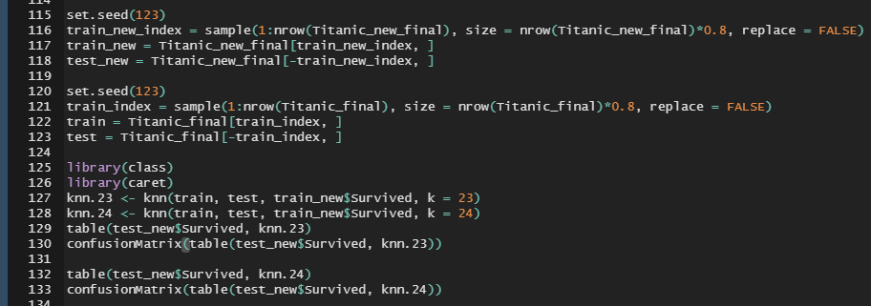
create the training/testing sets, use them and confusion matrix – Part 1, #2
Data set: training -> 571 testing -> 143 (177 NA’s removed)
Transforming in KNN and Confusion Matrix (results on next slide)

Slide 4
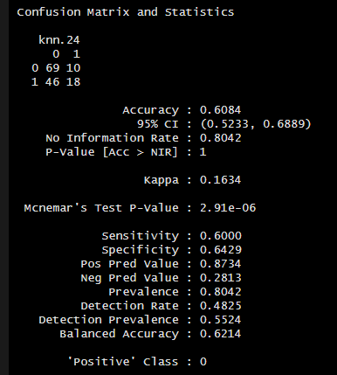
confusion matrix and statistics
Having seen the answers, I know now that my solution was off the mark. I’m impressed with your code. Specific and on target. I have much to learn.

Slide 5
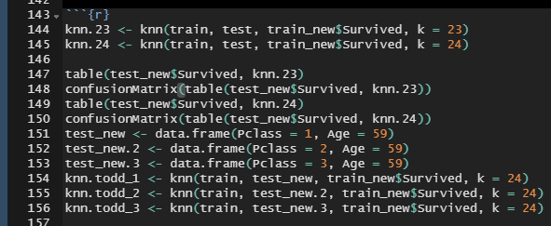
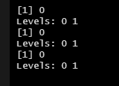
Age and probability of survival, Part 1, #3
Through my research, I found one suggestion on the value to select for k. It was suggested that k can be derived from the square root of the size of the data set.
The result is between k = 23 and k = 24.
I’ve employed them both
I created 3 data sets with my Age (59) in it along with the Pclass. 1st, 2nd, 3rd.
Given the data, it looks bad for someone my age, regardless of the class.

Slide 6
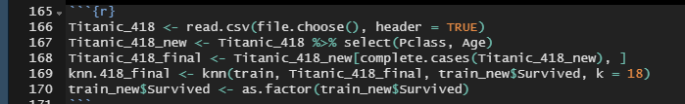
use of the training set and the test set – Part 1 #4
Utilizing the prior training set (571 observations), I’ve loaded in the test_set.csv. This is where I got stuck and moved to Part 2.

Slide 7
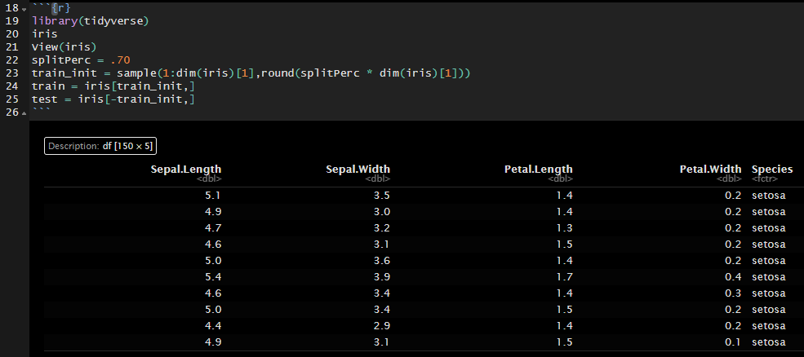
part 2 # a. iris data set – 70/30 training set, plot xaxis

Slide 8
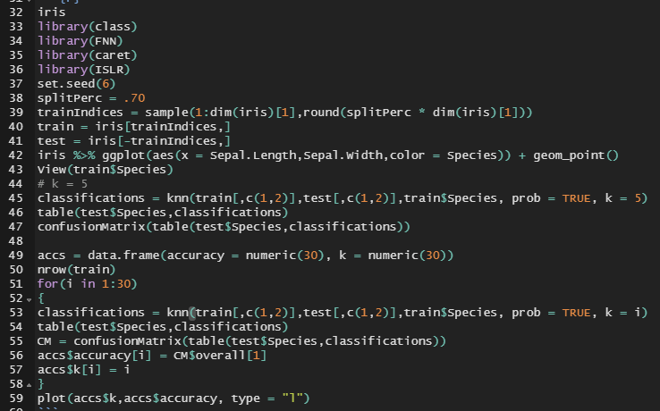
70/30 train/test | iterate all k values
Iris – Split the data into 70/30 train/test sets, plot the results (plots on the following slide), classify and employ the confusion matrix.
Create a “for loop” to test the k values to find the best possible fit.

Slide 9
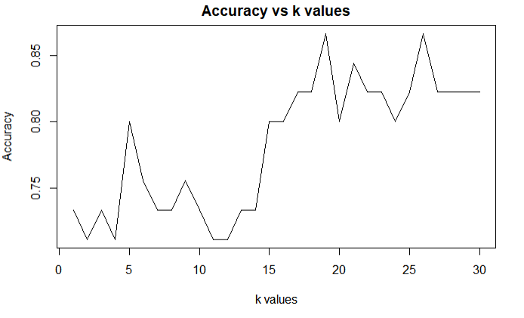
determination of best k value | answer = 18

Slide 10
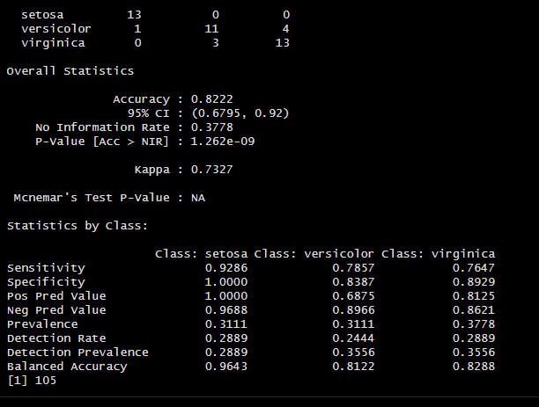
confusion matrix results

Slide 11
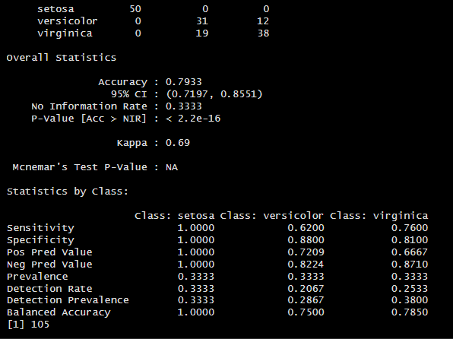
bonus question: repeat prior analysis with loocv methodology - results
These results are lower slightly than the k = 18 confusion matrix results on the prior page.
I think this highlights that LOOCV is great to use on small-ish data sets. On data sets with hundreds of values/observations, it appears that LOOCV is not superior to determining an external (XX%/XX%) versus an internal (LOOCV) methodology.

