Slide 1
Todd Garner
DS 6306 week 7 Part 2
February 14. 2023

Slide 2
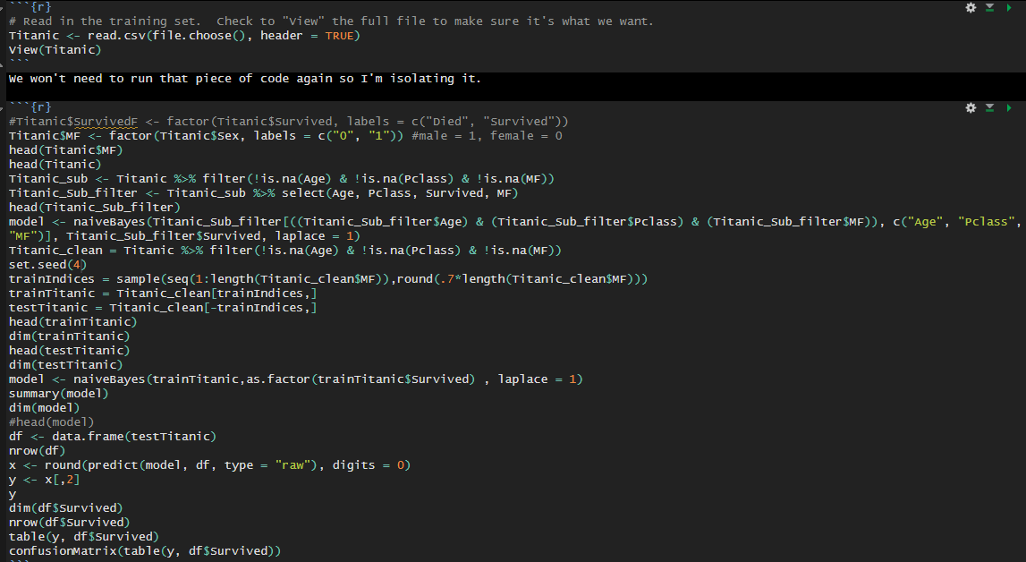
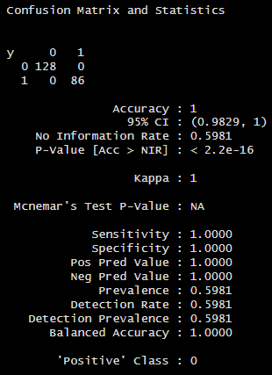
Part 2, #1
Read in the data, add sex, run code as below with seed(4), view results.
Perhaps I’m missing the point, but this looks identical to the prior exercise.

Slide 3
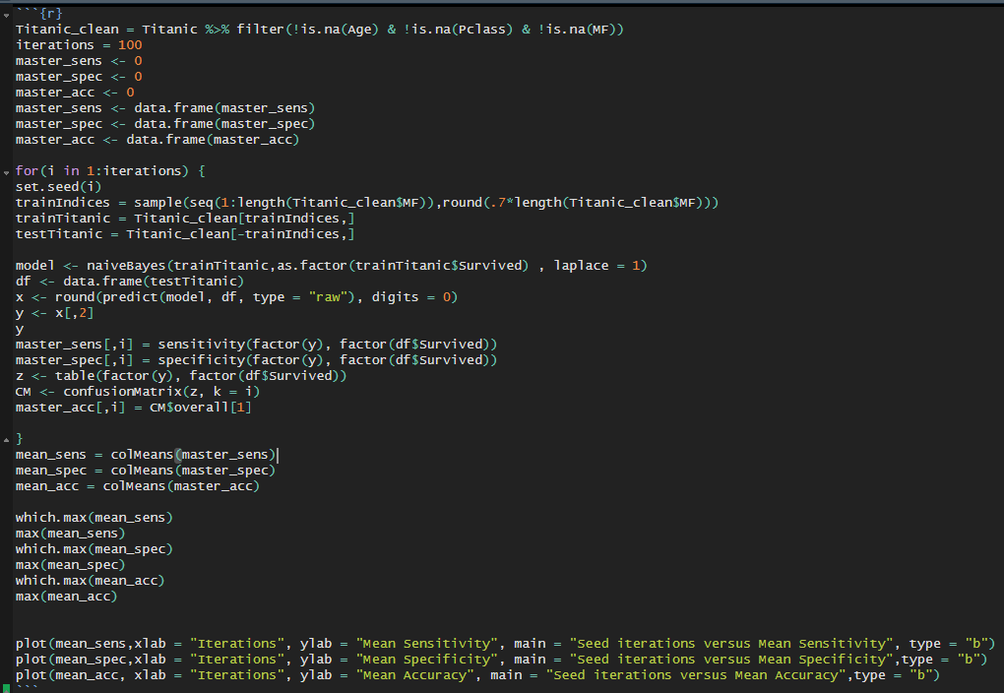
P2 #2, write loop(100) and gather results
Code:

Slide 4
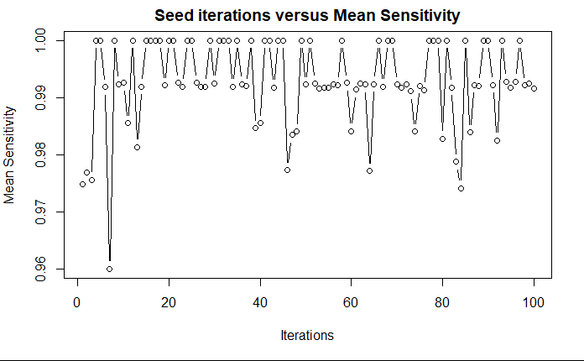
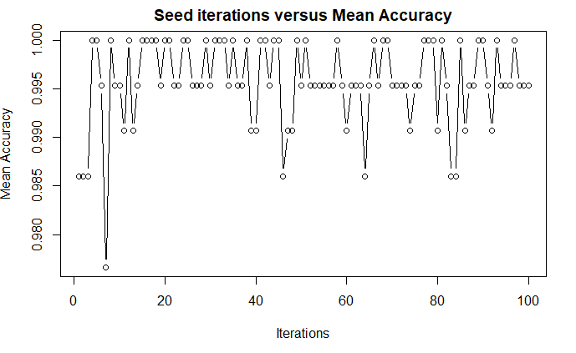
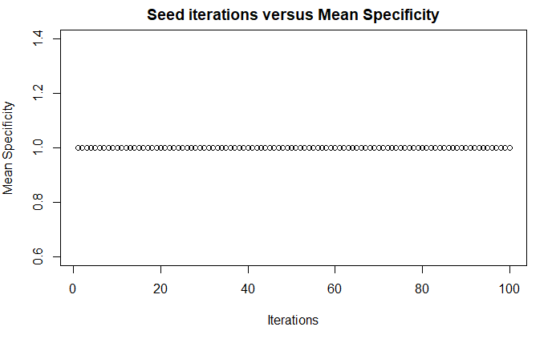
P2 #3, plots of accuracy, sensitivity, specificity
Means were all identical: 1

Slide 5
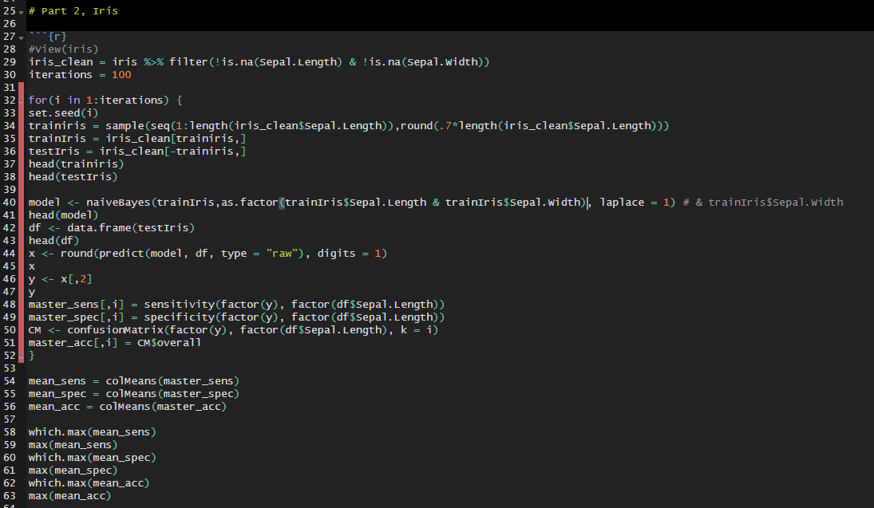
P2 iris, Cross validation sepal length & width
I must say I was stumped by this one. My code is found below. Perhaps in Live Session we can go through it to find out what I’m doing wrong?

Slide 6
questions
Questions:
I’m not sure I fully grasped the concept on the last question. How does one use two variables to predict an outcome?
Can you provide a real-world example of how this scheme would work? In what industry might this be used? And on what type of question might it answer? I read the example of medical testing. How might this be used in the oil and gas industry?
I got 100% accuracy on Part 2. I can’t help but feel that may be an error. I checked and rechecked the inputs and I believe I’ve done it correctly. What are the odds of obtaining a 100% accuracy in “the real world?”

Slide 7
Key takeaways
This (machine learning) is why I am pursuing the data science degree. I presume I can anticipate learning much more in machine learning 1 & 2. Are there any books out there or resources that might allow me to take a deep dive? (guess this is actually a question)

