Slide 1
Todd Garner
DS 6306 week 7 Part 1
February 14. 2023

Slide 2

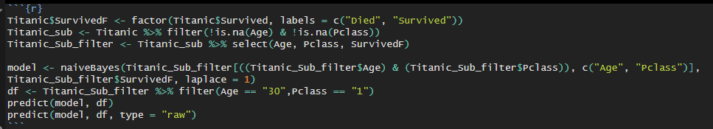
Part 1, #1
Read in the data in the first chunk, so I don’t have to continually reload the .csv:
Find the probability that a 30 y/o survived in each Pclass: 1, 2, 3
Results: Age Pclass Survived? Died/Survived
30 1 Yes .2898412, .7101588
30 2 No .5877154, .4122846
30 3 No .7730445, .2269555

Slide 3
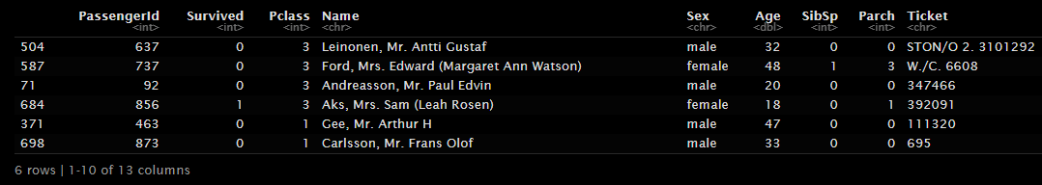
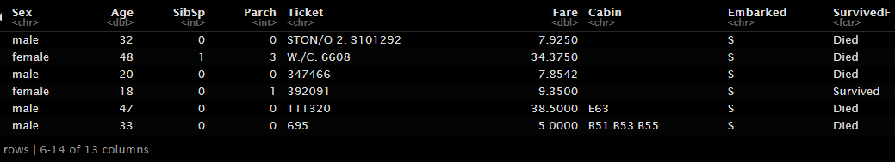
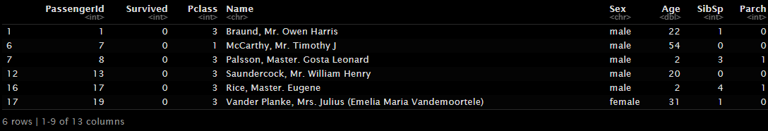
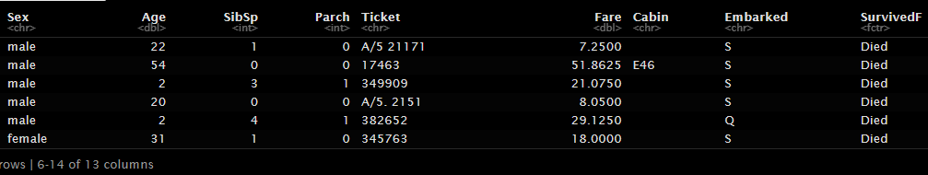
P1 #2, Split 891 into 70%/30% train/test set
head(trainTitanic)
head(testTitanic)

Slide 4
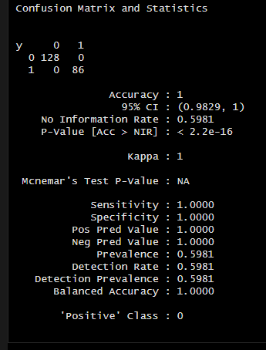
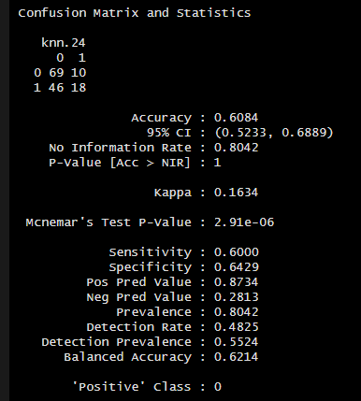
P1 #3, Train NB model and compare against KNN
Last week’s results: KNN
This week’s results: Naïve Bayes
100% Accuracy certainly gives me concern. Any model that provides 100% Accuracy should. I checked and rechecked my inputs and I cannot find an error.

Slide 5
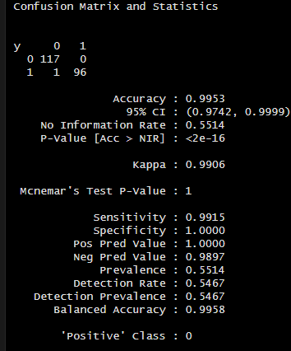
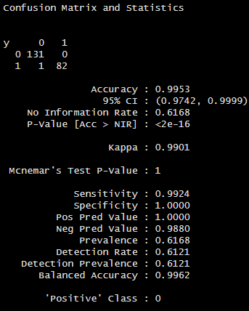
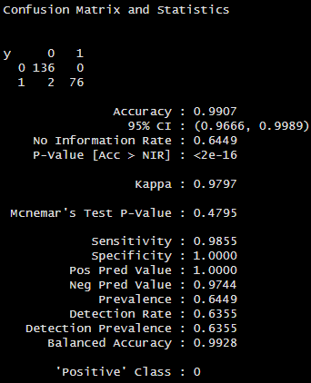
P1 #4, varying the seed numerous times on nb model
By changing the seed, the metrics in the confusion matrix changed. Likely because there were more or less NA's in each instance, but the accuracy never wavered much away from 100%. I must say this is surprising as it just doesn't seem likely to have a model that is 100% accurate. I checked and rechecked my model and my data.frame and made sure that the model was fed by training data via the model and testing data via the other variable in the table/confusionMatrix. 100% sure made me think I was comparing train to train or test to test. I still have a nagging feeling that I've missed something somewhere.
Seed: 4
Seed: 53
Seed: 147
Seed: 11

Slide 6
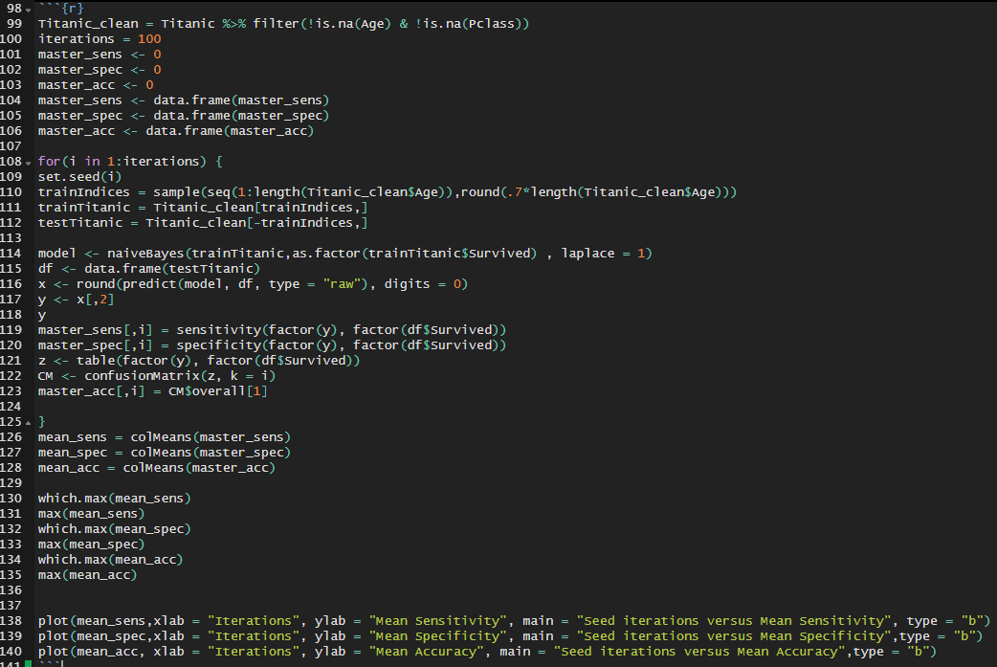
P1 #5, write a loop for 100 different seed values – obtain mean accuracy, sensitivity, specificity
Code:

Slide 7
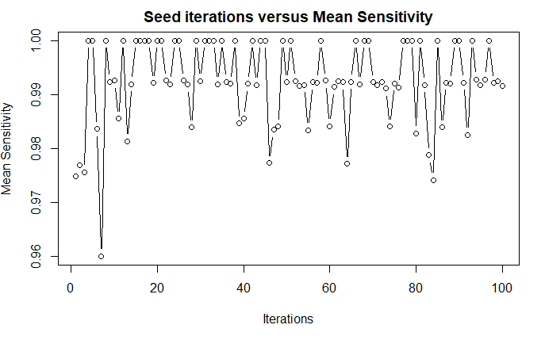
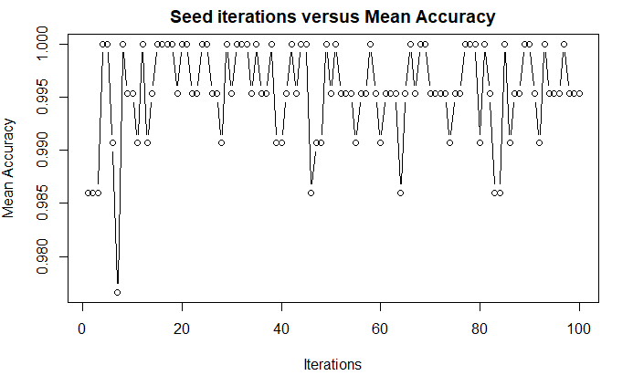
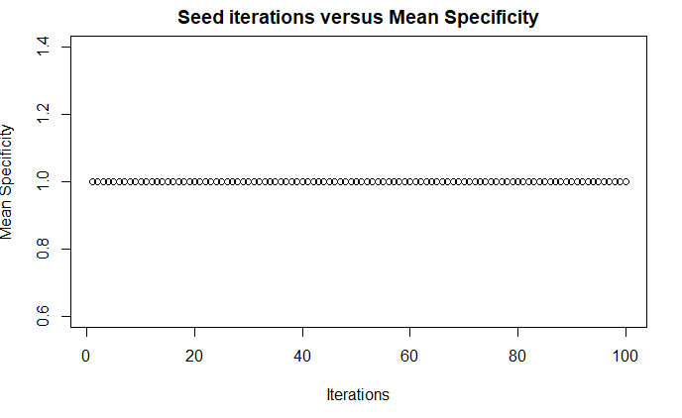
P1 #5, results: mean values, plots of each mean
In each instance, accuracy, specificity, and sensitivity: Mean = 1

