Slide 1
Todd Garner
DS 6306 week 7 Part 2
February 14. 2023

Slide 2
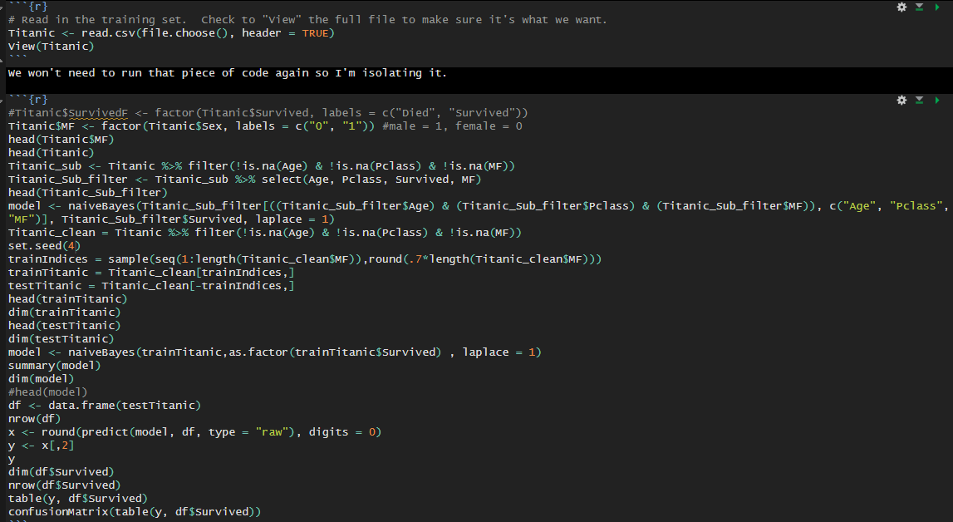
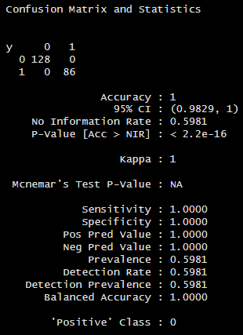
Part 2, #1
Read in the data, add sex, run code as below with seed(4), view results.
Perhaps I’m missing the point, but this looks identical to the prior exercise.

Slide 3
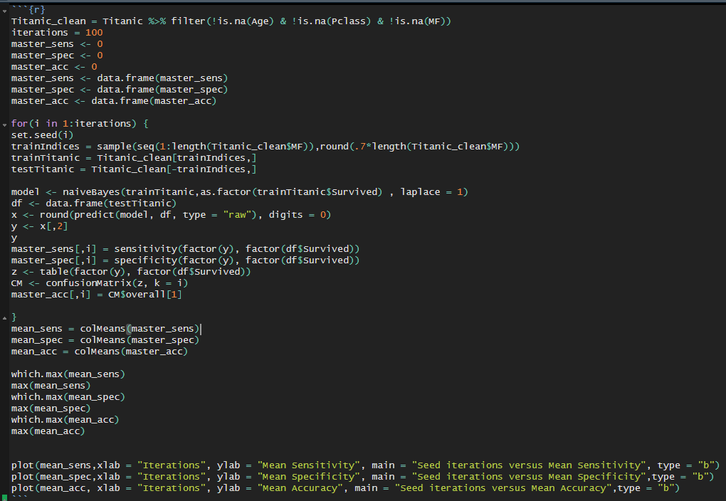
P2 #2, write loop(100) and gather results
Code:

Slide 4
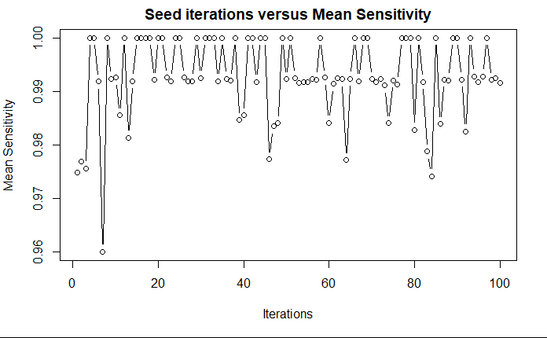
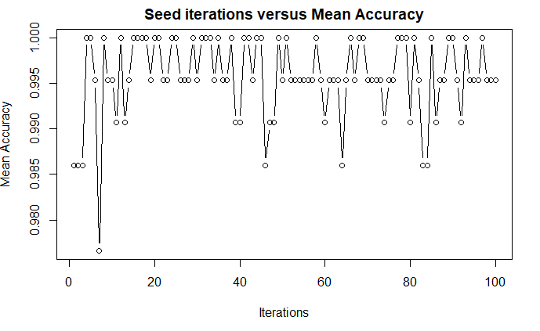
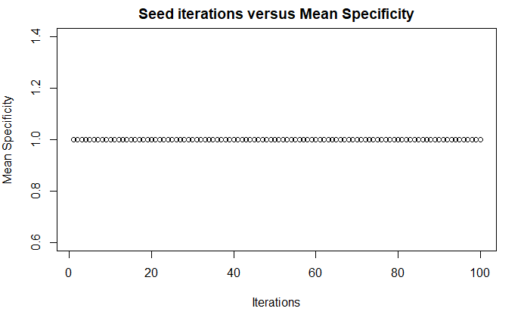
P2 #3, plots of accuracy, sensitivity, specificity
Means were all identical: 1

Slide 5
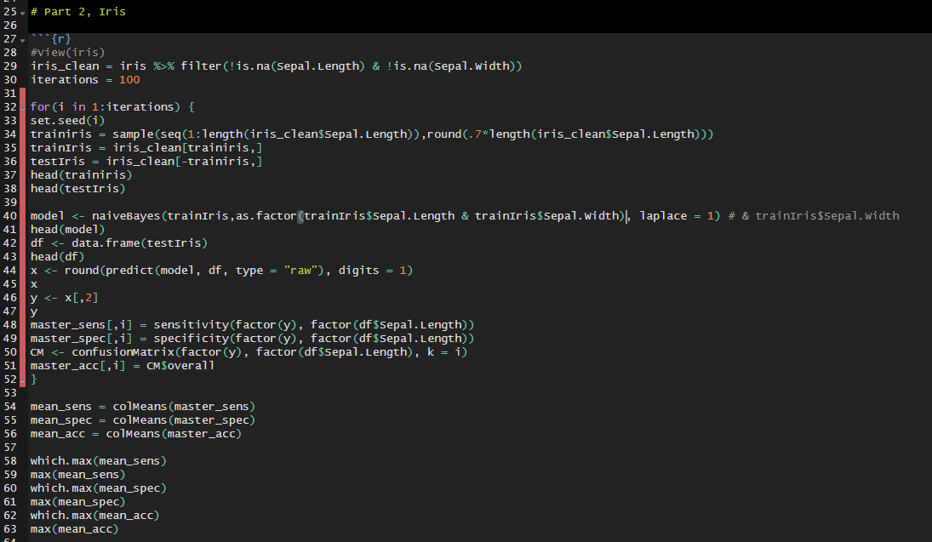
P2 iris, Cross validation sepal length & width
I must say I was stumped by this one. My code is found below. Perhaps in Live Session we can go through it to find out what I’m doing wrong?

