Slide 1

Running QAOA on IBM Quantum Hardware
A hands-on walkthrough: solve a small knapsack, then run it on a real QPU
Follow along in: part01/knapsack_qaoa.ipynb → part01/ibm_hardware_qaoa.ipynb
Problem → QUBO → QAOA • Access IBM Quantum • Transpile · submit · read results
Monit Sharma
SMU Quantum Optimisation Group · Part 01 Hands-On Tutorial
Japan–Singapore Workshop on Applied Quantum Optimisation · 25 Aug 2026
Notes:
Welcome to the hands-on part. In the next half hour we'll take a small optimisation problem — a knapsack — all the way from a plain problem statement to a circuit running on a real IBM Quantum processor. We'll use two notebooks: knapsack_qaoa.ipynb builds and solves the problem with QAOA on a simulator, and ibm_hardware_qaoa.ipynb takes the same circuit to actual hardware. The slides are just the map — the real action is in the notebooks, which we'll run together. If you have the repo open and your IBM account ready, you're set. Please open part01/knapsack_qaoa.ipynb now.

Slide 2
What You'll Do in the Next 30 Minutes
A complete problem → quantum → hardware workflow
1
2
3
4
Model
Solve
Access
Run
Turn a knapsack into a QUBO, then an Ising Hamiltonian
Build a QAOA circuit and optimise it on a simulator
Connect to IBM Quantum and pick a real backend
Transpile, submit a live job, and read the results
You'll leave able to
Ground rules
Formulate a real problem for a quantum computer, and
submit and interpret a job on IBM Quantum yourself.
QAOA is heuristic — measurement gives samples, not a guaranteed optimum.
Hardware cells are opt-in: nothing submits until you say so.
Hands-On Tutorial · Part 01 · Knapsack QAOA on IBM Quantum · SMU Quantum Optimisation Group
1
Notes:
Here's the shape of the session. Four moves. First we MODEL: take the knapsack and turn it into the form a quantum computer wants — a QUBO, then an Ising Hamiltonian. Second we SOLVE: build a QAOA circuit and tune its parameters on a fast local simulator. Third we ACCESS: connect to IBM Quantum and choose a real backend. Fourth we RUN: transpile the circuit for that device, submit a live job, and read the results back. By the end you'll be able to do this yourself. Two ground rules to keep in mind throughout: QAOA is a heuristic — when we measure, we get samples from a distribution, not a guaranteed best answer, so we'll always check feasibility and compare to the exact optimum. And every hardware action is opt-in: the notebook never submits anything until you deliberately flip a flag.

Slide 3
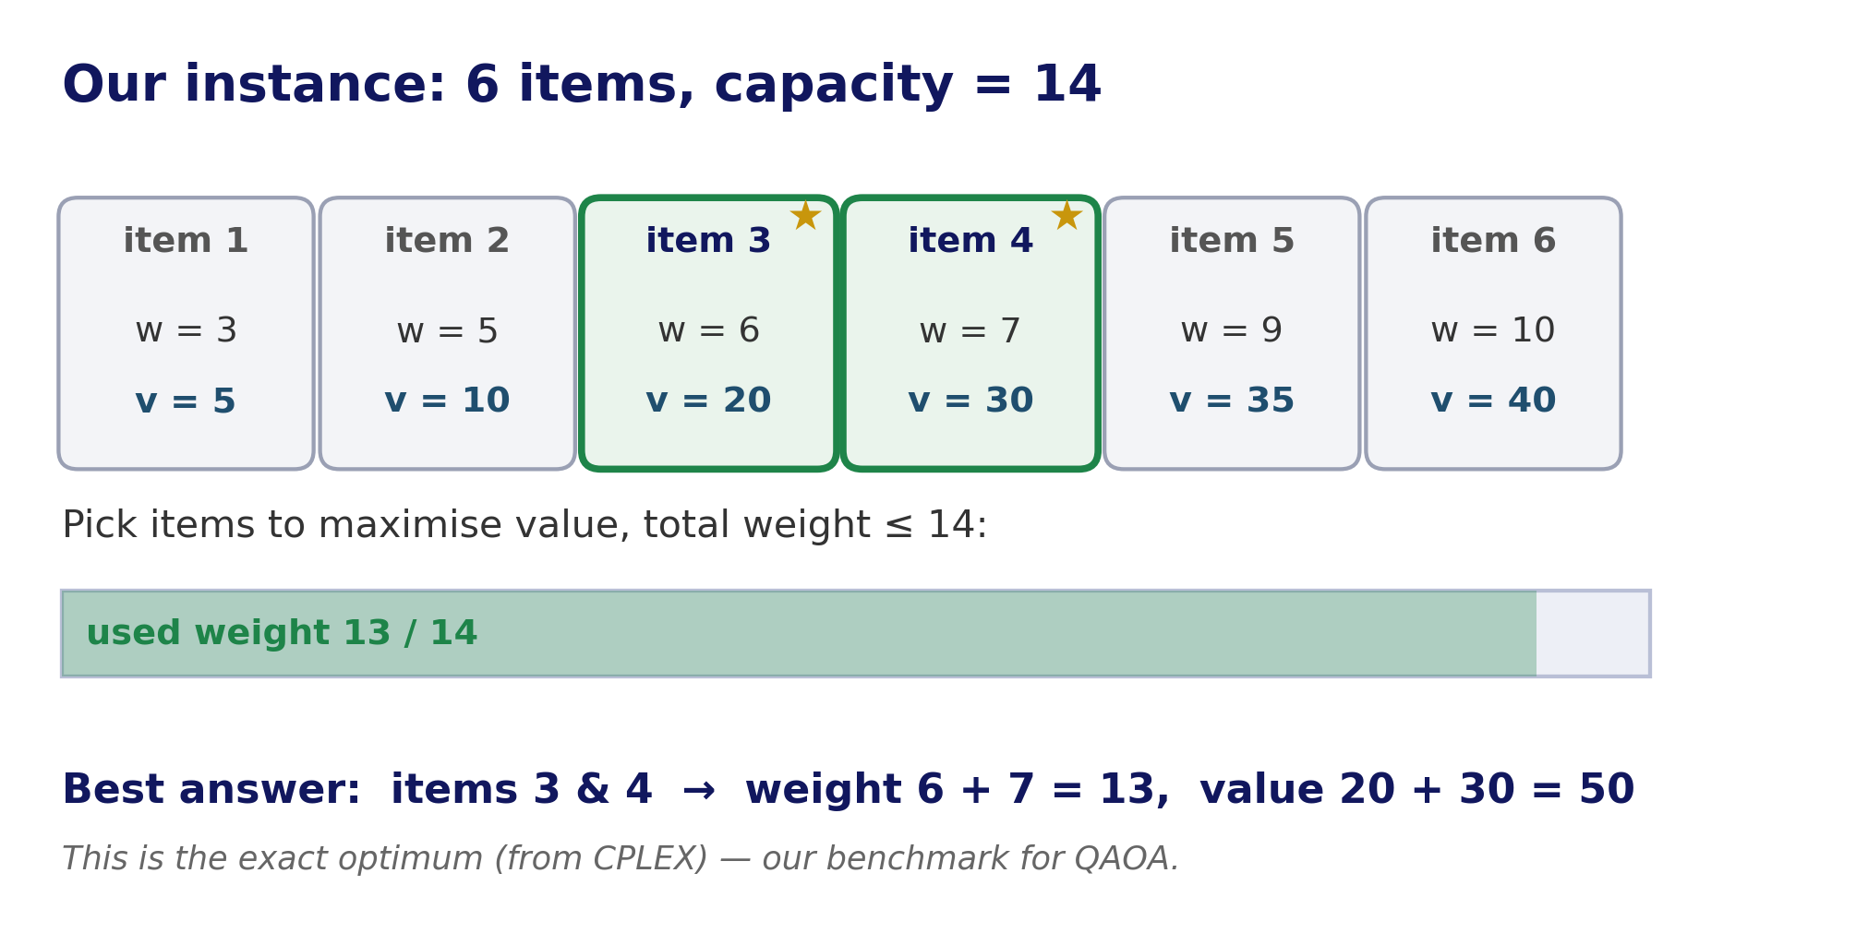
Step 1 — The Problem: A Small Knapsack
Pick items to maximise value without exceeding the weight capacity
• 6 items, each with a weight and a value.
• Capacity = 14 — total weight can't exceed it.
• Binary choice: each item is in or out.
• Exact optimum: value 50 (items 3 & 4).
• We compute this with CPLEX first — our benchmark.
Hands-On Tutorial · Part 01 · Knapsack QAOA on IBM Quantum · SMU Quantum Optimisation Group
2
Notes:
Let's meet the problem. It's deliberately small so everything is inspectable. Six items, each with a weight and a value, and a knapsack that can carry a total weight of at most 14. For each item you make a binary choice — take it or leave it — and you want to maximise total value without breaking the weight limit. Because it's small, we can compute the exact optimum classically with CPLEX: the best you can do is value 50, by taking items 3 and 4, which weigh 6 and 7 for a total of 13. Keep that number, 50, in mind — it's the benchmark we'll hold QAOA against. In the notebook this is the first few cells: define the weights, values, and capacity, and solve it exactly.

Slide 4
Step 1 — The Full Workflow
Every quantum-optimisation tutorial follows this same pipeline
Problem
Quadratic
Program
QUBO
Ising H
QAOA
circuit
Sample
Decode
knapsack
Qiskit model
+ slack vars
Pauli Z, ZZ
cost + mixer
shots →
bitstrings
feasible
best
The first four boxes are automatic in Qiskit (a few lines). The interesting quantum work is the QAOA circuit and how we decode noisy samples into a feasible answer.
Same pipeline you saw for VQE and TSP — only the circuit in the middle changes.
Hands-On Tutorial · Part 01 · Knapsack QAOA on IBM Quantum · SMU Quantum Optimisation Group
3
Notes:
This is the single most important slide to anchor the whole tutorial, because every notebook in this workshop follows exactly this pipeline. Left to right: you start with the PROBLEM; Qiskit turns it into a Quadratic Program — a standard mathematical form; that becomes a QUBO, adding slack variables to handle the weight constraint; the QUBO maps to an Ising Hamiltonian written in Pauli Z and ZZ terms; from that Hamiltonian we build the QAOA circuit with its cost and mixer layers; we run it for many shots to sample bitstrings; and finally we decode those bitstrings into an actual item selection, keeping the best FEASIBLE one. The first four steps are essentially automatic — a few lines of Qiskit. The parts that need our attention are the QAOA circuit and the decoding of noisy samples. And notice: this is the very same pipeline you saw for VQE and for the travelling-salesperson notebooks — only the circuit in the middle changes.

Slide 5
Step 1 — QUBO and Slack Variables
Why 6 items become ~10 qubits
• A quantum computer wants an unconstrained objective — but 'weight ≤ 14' is a constraint.
• QUBO conversion adds slack variables to turn the ≤ into an equality, folded into the objective as a penalty.
• Result: 6 item qubits + ~4 slack qubits ≈ 10 qubits.
• More qubits = deeper circuits — this is why constraints are 'expensive' on hardware.
• (Part 02 shows a custom-penalty trick to avoid slack qubits.)
the three lines that matter
converter = QuadraticProgramToQubo()
qubo = converter.convert(problem)
qubit_op, offset = qubo.to_ising()
# variables jump from 6 → 10
# because of slack variables
Hands-On Tutorial · Part 01 · Knapsack QAOA on IBM Quantum · SMU Quantum Optimisation Group
4
Notes:
One concept worth pausing on, because it surprises people: our problem has 6 items, but the quantum circuit will use about 10 qubits. Why? A quantum optimiser wants an UNCONSTRAINED objective, but our problem has a constraint — total weight at most 14. The QUBO conversion handles this by introducing extra 'slack' variables that turn the inequality into an equality and fold it into the objective as a penalty term. For this instance that's about 4 slack variables, so 6 plus 4 is roughly 10 qubits. The practical lesson: constraints cost you qubits, and more qubits mean deeper, noisier circuits on real hardware — which is exactly why handling constraints efficiently is an active research topic, and why Part 02 shows a custom-penalty trick that avoids slack qubits altogether. In the notebook, watch the printed variable count jump from 6 to 10 right after the QUBO conversion.

Slide 6
Step 2 — QAOA in One Picture
Alternating cost and mixer layers, tuned by a classical optimiser
|+⟩ⁿ
equal super-
position
COST layer
e^{-iγH}
MIXER layer
e^{-iβX}
measure
→ bitstrings
repeat × reps (=2)
A classical optimiser (COBYLA) tunes the angles γ, β to lower the energy — the same hybrid loop as VQE. Lower energy ⇒ better knapsack solutions.
• reps = how many cost+mixer layers (we use 2). More layers = more expressive but deeper.
Hands-On Tutorial · Part 01 · Knapsack QAOA on IBM Quantum · SMU Quantum Optimisation Group
5
Notes:
A quick, intuitive look at QAOA itself — you've seen this in the earlier notebooks so I'll be brief. You start every qubit in an equal superposition — all possible item selections at once. Then you apply two alternating layers: a COST layer, built from our Ising Hamiltonian, which stamps in information about which selections are good; and a MIXER layer, which lets amplitude flow between selections. You repeat that pair a few times — 'reps', and we use 2 — and then measure to get candidate bitstrings. The magic is in the angles gamma and beta on those layers: a classical optimiser, COBYLA, tunes them to push the measured energy down, and lower energy corresponds to better knapsack solutions. It's exactly the hybrid quantum-classical loop you saw with VQE — classical optimiser outside, quantum circuit inside. More reps make the circuit more expressive but also deeper and noisier, which matters once we're on hardware.

Slide 7
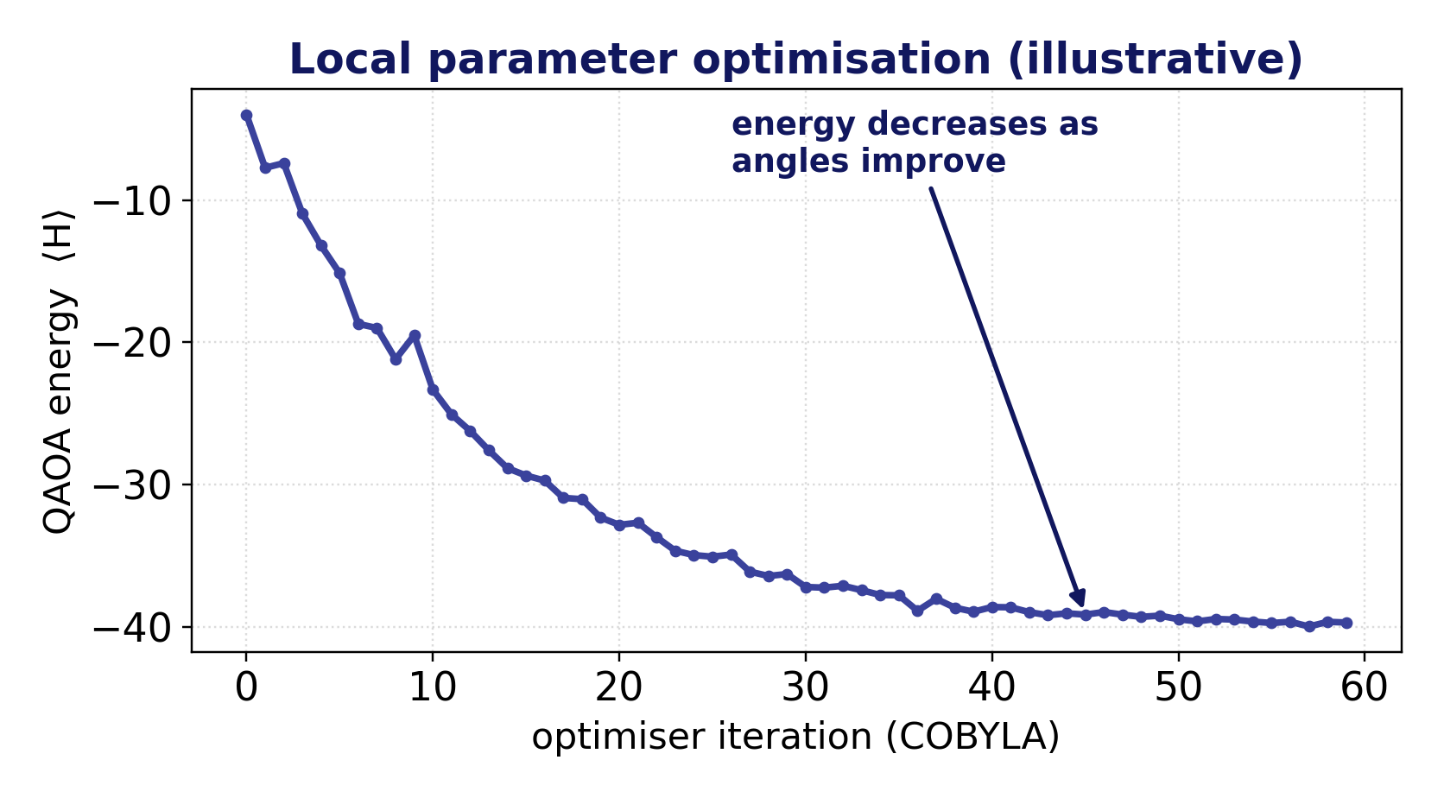
Step 2 — Optimise on the Simulator First
Tune the angles locally; send only the final circuit to the QPU
• Parameter search needs many circuit evaluations — far too slow and costly on hardware.
• So we optimise locally on Aer (your laptop).
• Watch the energy fall then flatten — that's convergence.
• Only the single final circuit goes to the QPU.
• This keeps the live demo short and predictable.
Hands-On Tutorial · Part 01 · Knapsack QAOA on IBM Quantum · SMU Quantum Optimisation Group
6
Notes:
Here's a strategy point that's easy to miss but really matters for using hardware sensibly. Finding good QAOA angles takes many, many circuit evaluations — the optimiser tries angles, measures energy, adjusts, and repeats dozens of times. Doing that on real hardware would be painfully slow and would burn your quota in a queue every iteration. So we do the entire parameter search on a fast local simulator — Aer, running on your laptop. The plot shows what you'll see: the energy drops as the angles improve, then flattens out — that flattening is convergence. Once we have good angles, we freeze them and send just that ONE final circuit to the quantum computer. This 'optimise locally, run the best circuit on hardware' pattern is standard practice and it's what keeps today's live demo short and predictable.

Slide 8
Step 3 — Accessing IBM Quantum
Your token lives in .env — never in the notebook
credentials & connection
• Get a free token from quantum.ibm.com.
• Store it in .env — the repo's .gitignore keeps it private.
• QiskitRuntimeService is your handle to all backends and jobs.
• An instance ties usage to your plan / allocation.
• The notebook confirms the token loaded — without printing it.
# .env (never committed — in .gitignore)
IBM_QUANTUM_TOKEN = ...
IBM_QUANTUM_INSTANCE = ...
from dotenv import load_dotenv
load_dotenv(repo_root / '.env')
service = QiskitRuntimeService(
channel='ibm_quantum_platform',
token=token, instance=instance)
Hands-On Tutorial · Part 01 · Knapsack QAOA on IBM Quantum · SMU Quantum Optimisation Group
7
Notes:
Now the part you came for — getting onto real hardware. First, credentials. You get a free API token from quantum dot ibm dot com. The golden rule: that token never goes in the notebook or into git. We keep it in a .env file, which the repository's .gitignore explicitly excludes, and load it at runtime with python-dotenv. The notebook prints only whether the token loaded — true or false — never the token itself. With the token and your instance, you create a QiskitRuntimeService — think of it as your remote control for IBM Quantum: it lists backends, submits jobs, and retrieves results. The 'instance' ties your usage to your plan or allocation. In the notebook, the first hardware cell just establishes this connection and confirms the credentials are present. Please make sure your .env is filled in now if you haven't already.

Slide 9
Step 3 — Pick a Backend & Pre-Flight Checks
Be a good citizen of a shared, queued resource
Choosing a backend
Pre-flight checks (before you submit)
service.least_busy(
operational=True, simulator=False,
min_num_qubits=...)
→ picks a real device with enough qubits and the shortest queue.
Or name one explicitly via IBM_BACKEND.
Runtime capacity — do you have seconds left?
Reachable QPUs with enough qubits?
Backend operational & pending-job count?
Least-busy device right now?
These catch problems before you wait in a queue.
Hands-On Tutorial · Part 01 · Knapsack QAOA on IBM Quantum · SMU Quantum Optimisation Group
8
Notes:
Real quantum computers are shared, queued resources, so it pays to choose well and check before you leap. For choosing: the simplest approach is service.least_busy with the filters operational, non-simulator, and a minimum qubit count — it returns a real device that fits your circuit and currently has the shortest queue. Or, if your allocation gives you a specific machine, you can name it explicitly through the IBM_BACKEND variable. Before submitting anything, the notebook runs pre-flight checks — the responsible-use step: does your instance still have Runtime seconds; are there reachable QPUs with enough qubits; is your chosen backend actually operational and how many jobs are pending on it; and which device is least busy right now. None of these submit a job — they just make sure that when you do submit, you're not about to wait in a queue only to hit an error. It's a small habit that saves a lot of frustration.

Slide 10
Step 4 — Transpilation: Virtual → Physical
Your circuit must be rewritten for the real device
• Hardware only runs its own native gates, on a fixed qubit connectivity.
• Transpilation maps your abstract circuit onto real qubits and native gates.
• optimization_level 0→3: higher = more effort, usually shallower circuits.
• Watch the depth grow — extra SWAPs are inserted to satisfy connectivity.
• Runtime V2 requires an ISA (hardware-native) circuit — you can't submit the abstract one.
transpile for the backend
pm = generate_preset_pass_manager(
backend=hardware_backend,
optimization_level=1)
isa_circuit = pm.run(optimal_circuit)
# depth: 12 → ~40+ after mapping
# (SWAPs added for connectivity)
Hands-On Tutorial · Part 01 · Knapsack QAOA on IBM Quantum · SMU Quantum Optimisation Group
9
Notes:
Here's a step that doesn't exist on a simulator: transpilation. A real device only runs a small set of native gates, and its qubits are wired in a fixed pattern — not every qubit talks to every other. Your nice abstract QAOA circuit has to be rewritten to respect both facts. That's transpilation: it maps your logical qubits onto physical ones and translates your gates into the device's native set. The optimization_level, 0 to 3, controls how hard the transpiler works — higher levels usually produce shallower, better circuits but take longer to compile. The thing to watch, and to point out to your audience, is that the circuit DEPTH grows — often a lot — because the transpiler inserts SWAP gates to move information between qubits that aren't directly connected. And a practical must-know: IBM Runtime V2 requires an ISA circuit — one already expressed in the backend's native gates — so you cannot submit the abstract circuit; you submit the transpiled one. The notebook lets you compare all four optimization levels side by side.

Slide 11
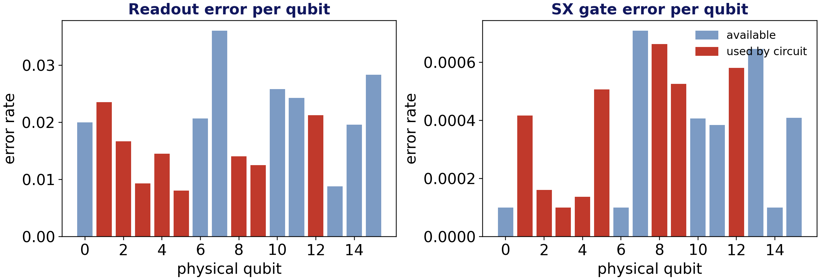
Step 4 — Read the Device: Per-Qubit Errors
Not all qubits are equal — layout matters
• Every qubit has its own readout and gate error.
• Red bars = the physical qubits your circuit was mapped onto.
• A good layout avoids the noisiest qubits.
• This is why the same circuit can give different results on different qubits.
Hands-On Tutorial · Part 01 · Knapsack QAOA on IBM Quantum · SMU Quantum Optimisation Group
10
Notes:
Once we've chosen a backend, we can look at its health, and this is one of my favourite teaching moments. Every physical qubit on a real device has its own error rates — how reliably it can be read out, and how cleanly it performs gates. The notebook pulls the backend's calibration data and plots these across all qubits. The red bars mark the specific physical qubits the transpiler chose for our circuit. The point to make: layout matters — a smart transpiler tries to place your circuit on the better qubits and avoid the noisy ones, and this is a big reason the exact same circuit can give noticeably different results depending on which qubits it lands on. It also motivates why people care about error mitigation and qubit selection. You don't have to memorise numbers here — just internalise that the device is non-uniform, and layout is a lever.

Slide 12
Step 4 — Submit & Monitor a Live Job
The one cell that actually uses the QPU
submit (opt-in)
Queues are unpredictable — plan for it
sampler = SamplerV2(mode=hardware_backend)
job = sampler.run([isa_circuit], shots=1024)
job_id = job.job_id() # save this!
# statuses: QUEUED → RUNNING → DONE
Submit early (even before this slide) so results are ready to show.
A job id lets you reconnect and monitor a job submitted minutes ago.
Fallback: the monitor cell has a pre-run job id, so the demo never stalls.
Statuses: QUEUED → RUNNING → DONE; V2 has no queue-position API.
1024 shots is plenty for this small circuit.
Live-demo safety
Flip SUBMIT_HARDWARE_JOB = True only when ready.
Keep the job id — you can reconnect anytime.
Hands-On Tutorial · Part 01 · Knapsack QAOA on IBM Quantum · SMU Quantum Optimisation Group
11
Notes:
This is the moment — the only cell in the entire tutorial that actually consumes QPU time. We create a SamplerV2 bound to our chosen hardware backend, run the transpiled circuit for 1024 shots, and — crucially — we grab and save the job id. That job id is your reconnection handle: you can close everything and come back to that exact job later. A few live-demo realities, because queues are unpredictable. Best practice, and what I'll actually do: submit the job EARLY — even a few minutes before this point in the talk — so that by the time we get here the results are already coming back. If the queue is long, we don't sit and watch a spinner: the monitoring cell accepts any job id, so we can reconnect to a job I submitted earlier, and it also has a pre-run fallback job id baked in so the demo never stalls. The status goes QUEUED, then RUNNING, then DONE; note Runtime V2 doesn't expose your exact queue position. And for a circuit this small, 1024 shots is plenty. Only flip SUBMIT_HARDWARE_JOB to True when you're actually ready to spend the time.

Slide 13
Step 4 — Simulator vs Hardware: What to Expect
Noise is part of the result — report it honestly
 | Local simulator | Real hardware
Noise | none (ideal) | real — readout, gate, decoherence
Feasible-shot rate | high | lower — more invalid bitstrings
Best answer | usually value 50 | often 50, sometimes suboptimal
What we do | pick best feasible sample | same — and report the feasible rate
Honest reporting: we keep the best FEASIBLE sample and report the feasible-shot rate — not just the single most frequent bitstring.
Hands-On Tutorial · Part 01 · Knapsack QAOA on IBM Quantum · SMU Quantum Optimisation Group
12
Notes:
Finally, what to expect when the hardware result comes back, and how to talk about it honestly. On the simulator there's no noise, the feasible-shot rate is high, and you'll almost always recover value 50. On real hardware there's readout error, gate error, and decoherence, so the distribution is messier: a lower fraction of the shots are even feasible, and while you often still recover 50, sometimes the best feasible sample is a bit suboptimal. The right way to handle this — and what the notebook does — is NOT to blindly report the single most frequent bitstring, which might be infeasible garbage. Instead we scan the samples, keep the best FEASIBLE one, and we report the feasible-shot rate alongside it. That honesty is the whole point: noise is part of the experiment, so we measure it and state it, rather than cherry-picking a good-looking number. When our live job finishes, we'll compare its feasible rate and best value directly against the simulator.

Slide 14
Wrap-Up & Your Turn
You now have an end-to-end recipe for hardware QAOA
What we did
Try next
Modelled a knapsack → QUBO → Ising.
Built QAOA and tuned it on a simulator.
Connected to IBM Quantum, checked capacity, chose a backend.
Transpiled, inspected qubit errors, and ran a live job.
Compared simulator vs hardware honestly.
Change reps or the optimization level — watch depth & results.
Try a different backend and compare error maps.
Run knapsack_vqe / tsp — same pipeline, new circuit.
Part 02: custom penalties to shrink the qubit count.
Questions? monitsharma@smu.edu.sg · repo: part01/ · keep your job id to revisit results later.
Hands-On Tutorial · Part 01 · Knapsack QAOA on IBM Quantum · SMU Quantum Optimisation Group
13
Notes:
To wrap up: in half an hour we went the whole distance — modelled a knapsack, converted it to a QUBO and an Ising Hamiltonian, built and tuned a QAOA circuit on a simulator, connected to IBM Quantum, ran pre-flight capacity and backend checks, transpiled for a real device, inspected its per-qubit errors, submitted a live job, and compared simulator against hardware honestly. That's a complete, reusable recipe. If you want to go further: change reps or the optimization level and watch how depth and results move; try a different backend and compare its error map; run the VQE and TSP notebooks, which follow the identical pipeline with a different circuit; and look at Part 02, where a custom-penalty formulation shrinks the qubit count by avoiding slack variables. Keep your job id — you can reconnect and pull results anytime. Thanks, and I'm happy to take questions or help debug your connection now.

