Slide 1
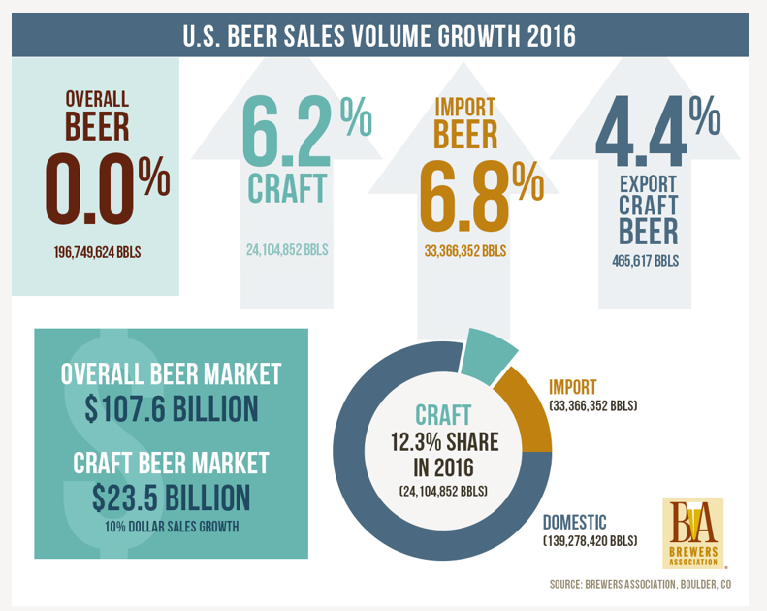

Slide 2
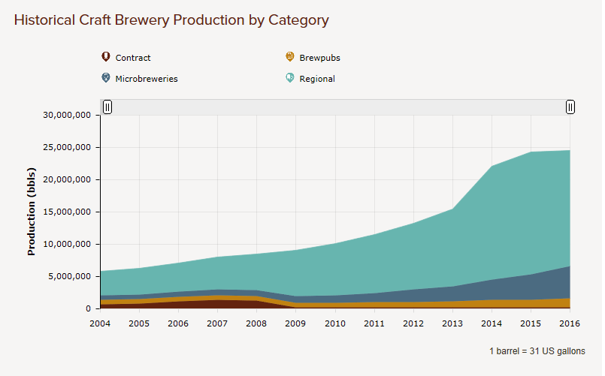

Slide 3
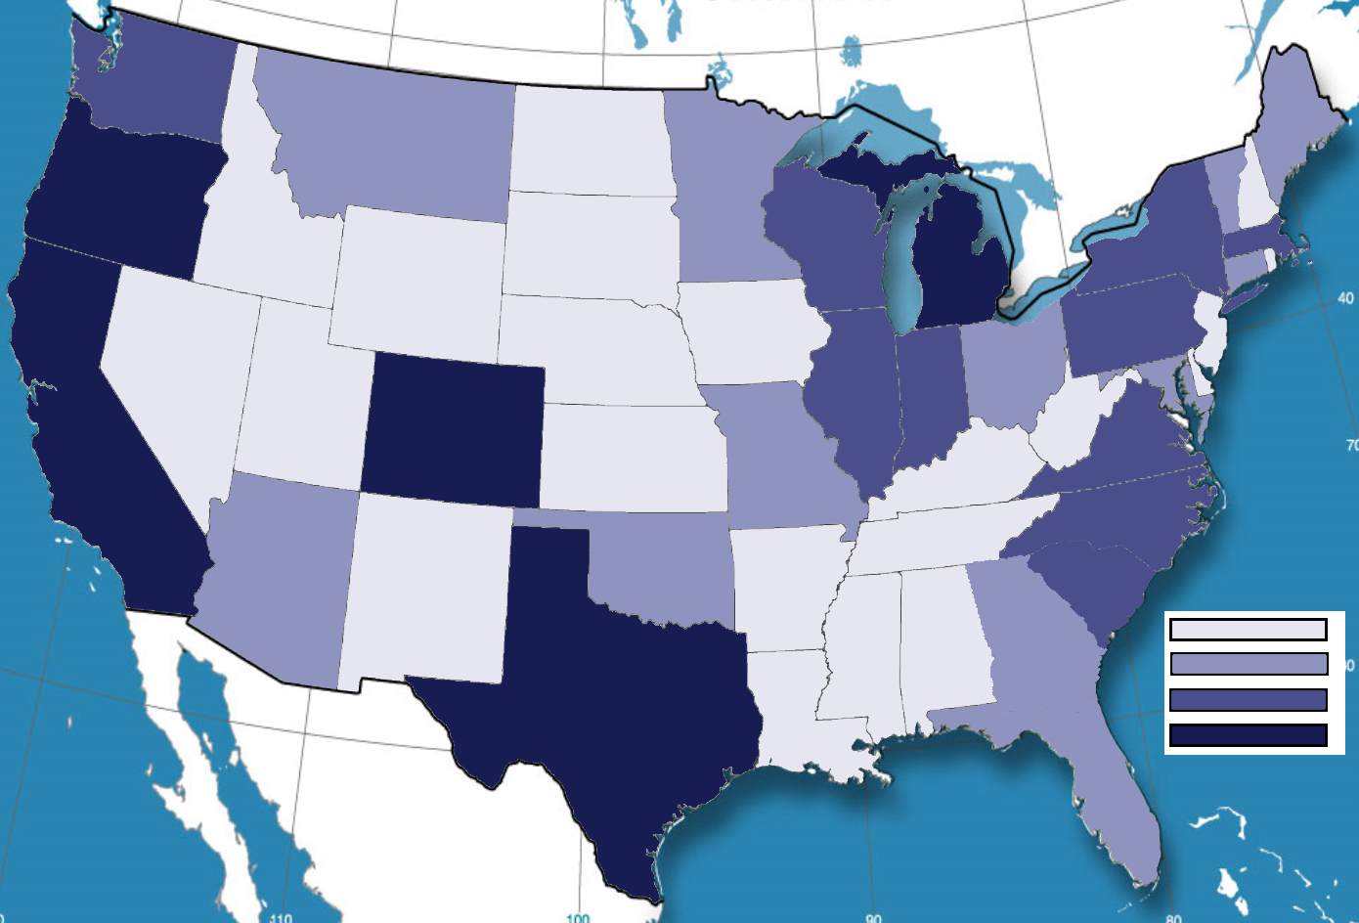
Number of Craft Breweries Per State
1-5
6-15
16-25
26+

