Slide 1
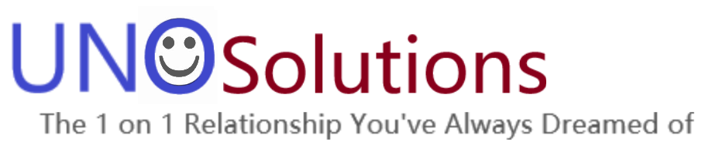
Craft Brewery Presentation
As Prepared By Team Uno Solutions, LLC
Afreen Siddiqui
Anthony Egbuniwe
Bruce Kimbark

Slide 2
Goals for this Presentation
You are interested in opening a craft brewery in the United States
We have been hired to identify:
The best locations to place a new brewery
Strong market opportunity
Consider existing competition against regional economic strength
Based upon current craft brewery landscape
The best products to offer
Most popular products on the market today
Opportunity to choose popular choices as a baseline while offering a chance to produce some uncommon options to create a market niche

Slide 3
Overview
This presentation we will touch upon the following topics:
A general overview of the craft beer industry
A brief discussion of our data gathering and analysis
Discussion of best opportunities for a new brewery
An analysis of the craft beer data
Discussion of the beer options available
Conclusion with our recommendations

Slide 4
Craft Beer Industry

Slide 5
Types of Craft Breweries
Contract Brewery
Two Types
A company that hires another brewery to produce all the beer and they only handle distribution, marketing, sales, etc.
A brewer hired to produce and bottle beer only
Brewpub
A small brewery where the beer usually primarily brewed for on-site business
At least 25% of the beer must be sold on-site
Microbrewery
Still a small brewery that produces less than 15,000 barrels per year
75% of sales must be sold off-site
Regional Brewery
A brewery that produces over 15,000 barrels and produces beer in a traditional or non-mechanized way
Definitions from Brewers Association

Slide 6
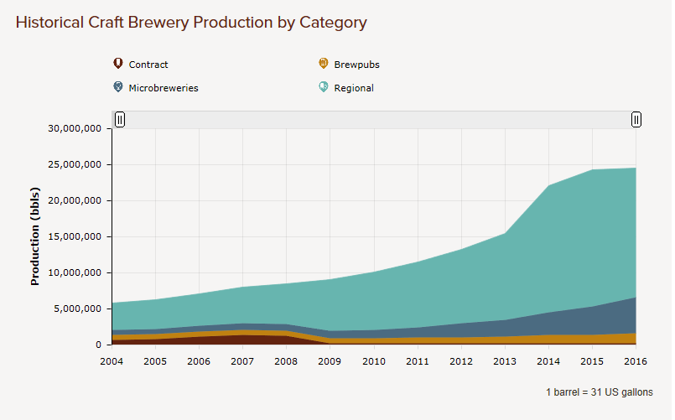

The Craft Beer Industry is Still Growing
After explosive growth the past few years, growth has slowed.
But there is still opportunity for a smart brewer.
Regional breweries make up approximately 71% of the craft beer industry
Microbreweries are gaining traction

Slide 7
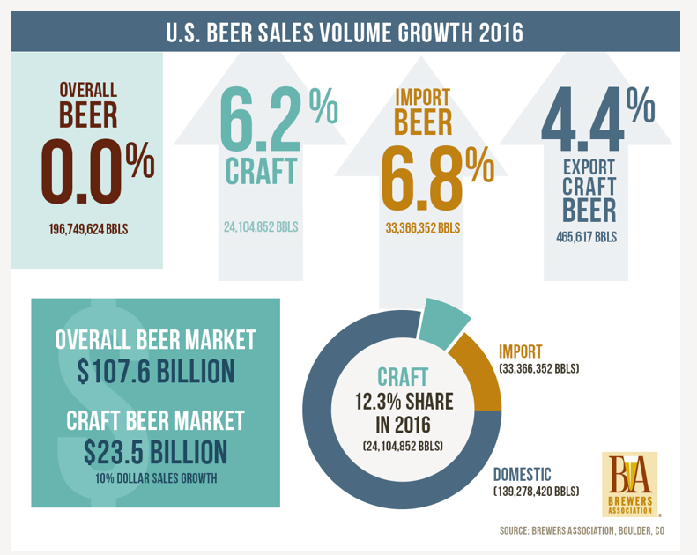
The Craft Beer Industry is Gaining Larger Market Share
While overall beer production is stagnant, craft beer grew 2016
12.3% of volume sold was craft. An increase of 6.2%
21.8% of the dollar sales was craft. An increase of 10%.

Slide 8
What we are looking for
We want to be in the Microbrewery or Regional Brewery Space
Both still growing, both significant opportunity
Craft Selections that mimic other successful breweries

Slide 9
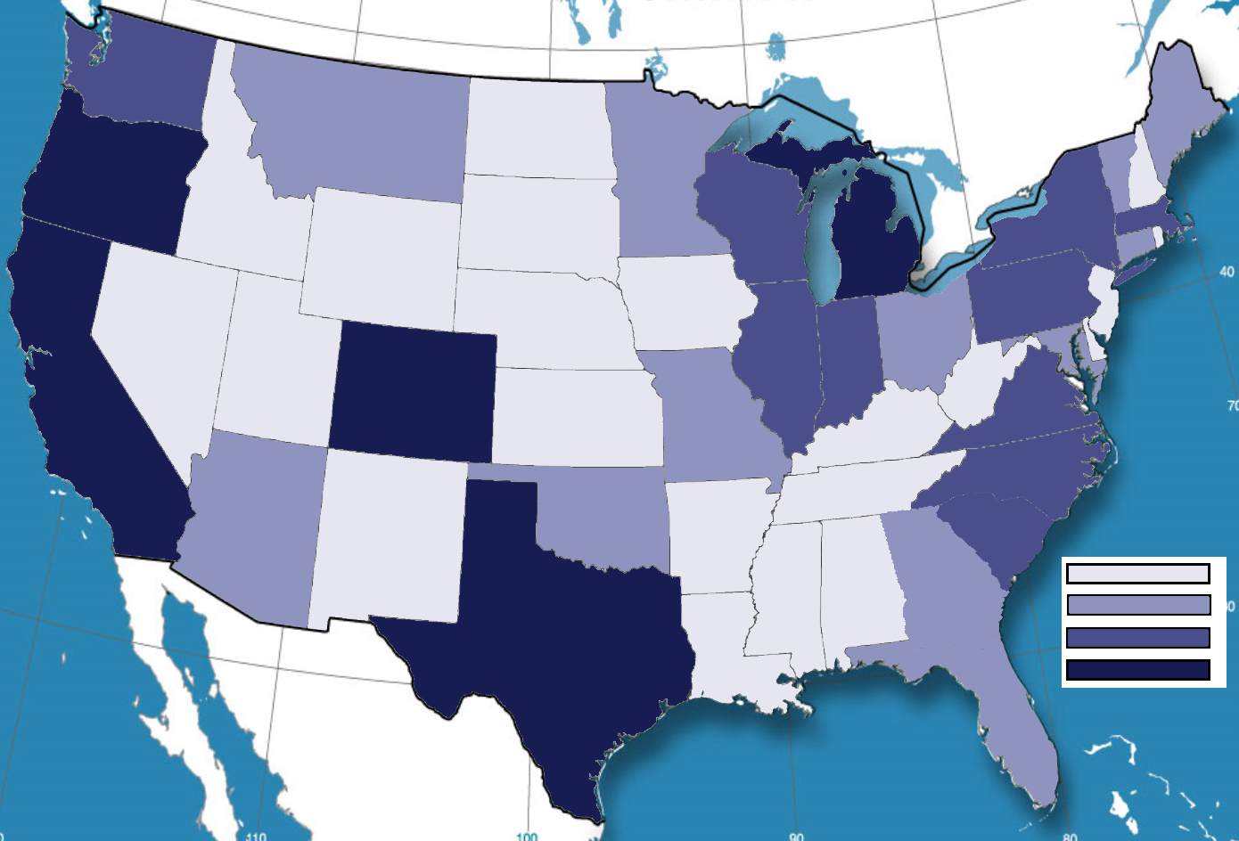
Number of Craft Breweries Per State
1-5
6-15
16-25
26+

