Slide 1

QF623 Portfolio Management
Statistical Arbitrage using
ETF Pair Trading and Machine Learning
Group Members:
Jung Hyung-yun
Lim Jeng
Nguyen Ngo Duy Quang
Shao Jiayu
Sun Qiaozhen
Tan Hui Shan

Slide 2
Overview
Outline of our presentation
ETF Universe Construction
Strategy Formulation
Portfolio Construction
Portfolio Implement-ation
Performance Attribution

Slide 3
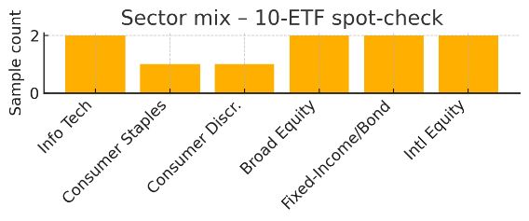
ETF Universe Construction
Construct and validate our choice in the chosen ETF Universe
Step by Step
2000 US listed ETFs
(investpy snapshot, Dec 2024)
1
Load top 2000 US - listed ETFs (investpy snapshot, December 2024)
2
Filter out leveraged / inverse funds
Remove tickers with any missing prices
→ 100% complete matrix
3
Download 5 year daily prices via yfinance
4
Remove tickers with any missing values → 100% complete matrix
Random sample
500 ETFs (seed = 42)
5
Uniform random sample 500 ETFs (NumPy seed = 42) for modelling
Trading days 1257 | Missing 0% | 11/11 sectors | Leveraged / inverse remaining 0
Notes:
The notebooks intentionally avoid any fundamental or liquidity screens—after ensuring the price matrix is complete, we sample 500 tickers purely at random. That keeps the experiment unbiased: our clustering & pair-trading pipeline should work on any large, clean set of ETFs—not just hand-picked ones.

Slide 4
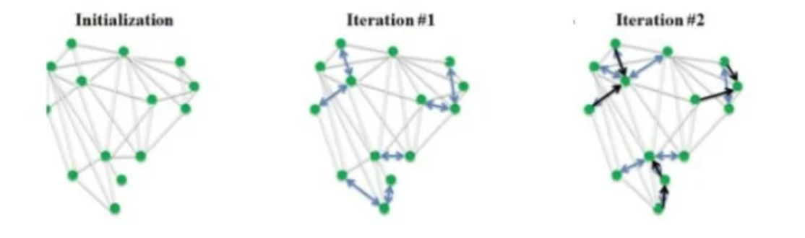
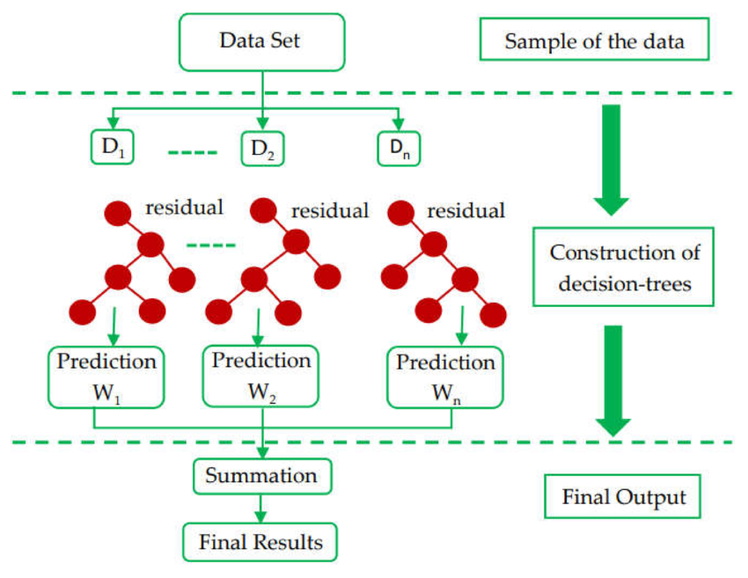
Strategy Formulation
Methodology
Our Methodology
1
Dimension reduction using Principal Component Analysis (PCA)
Affinity Propagation
2
Clustering via Affinity Propagation (AP) to identify statistically coherent asset pairs based on latent common factors
3
Estimate hedge ratio for each pair using Ordinary Least Squares (OLS) regression. Verify cointegration using Augmented Dickey-Fuller (ADF) test
XGBoost
4
eXtreme Gradient Boosting (XGBoost) to forecast next time step of spread
5
Trading signal generated based on forecasted vs observed spread
6
Allocate capital based on mean-variance optimisation

Slide 5
Strategy Formulation
Clustering results
Extracted 252-day rolling log return as base input
Standardized features using z-score normalization for consistency
Applied Principal Component Analysis (PCA) to reduce dimensionality and filter noise from return data & retain latent common factors
Used Affinity Propagation (AP) to form clusters
No need to pre-specify number of clusters
Identifies exemplars automatically
Final clusters used as boundaries for pairs selection, improve robustness and reduce spurious relationship

Slide 6
Strategy Formulation
Pairs selection
Within each cluster, evaluate all the pairs to identify cointegrated relationships (Engle –Granger)
Run Ordinary Least Squares (OLS) regression to estimate the hedge ratio (β)
Compute the spread:
spread = asset1 − β × asset2
Apply Augmented Dickey-Fuller (ADF) test on the residuals to verify stationarity
Ensure the spread is mean-reverting
Select on pairs that pass both test to ensure robust and statistically valid trading opportunity
Output: list of valid pairs with cointegration, β and confidence scores

Slide 7
Strategy Formulation
Signal generation
Engineered predictive features from spread:
Lagged spread, Moving Averages, EMAs, RSI, MACD
Trained an XGBoost Regressor to forecast the next day spread value
Generate trading signals based on predictions:
+1: spread is expected to widen → go long
-1: spread is expected to narrow → go short
0: no difference → hold

Slide 8
Portfolio Construction
Portfolio construction
Portfolio Type
Mean Variance Optimisation
Constructed a long-short portfolio of ETF pairs
Not strictly dollar-neutral but constrained so that:
∑∣weights∣=1
This avoids excessive leverage while allowing directional bets
Calculate daily percentage returns from each pair’s spread
Estimate mean return vector from historical pair returns
Estimate covariance matrix to capture risk relationship across pairs
Apply mean-variance optimization w = Σ⁻¹ × μ
Normalize the weights to ensure capital fully allocated and positions are market neutral
Higher weights given to pairs for higher returns and lower correlation

Slide 9
Portfolio Implementation
Portfolio implementation
Time t
Time t + 1
Time t + 2
Signal Preparation
Extracts the most recent 252-day data window
Performs clustering
Selects cointegrated ETF pairs
Calculates spreads & generates signals via HMM + XGBoost
Computes optimal weights via inverse-variance MVO
Portfolio Rebalancing
Implement positions based on signals at time t
Simulate return from time t to time t + 1 based on actual price movement
Return Realisation
Returns from trades initiated at time t + 1 are measured on t + 2 using the change in spread.

Slide 10
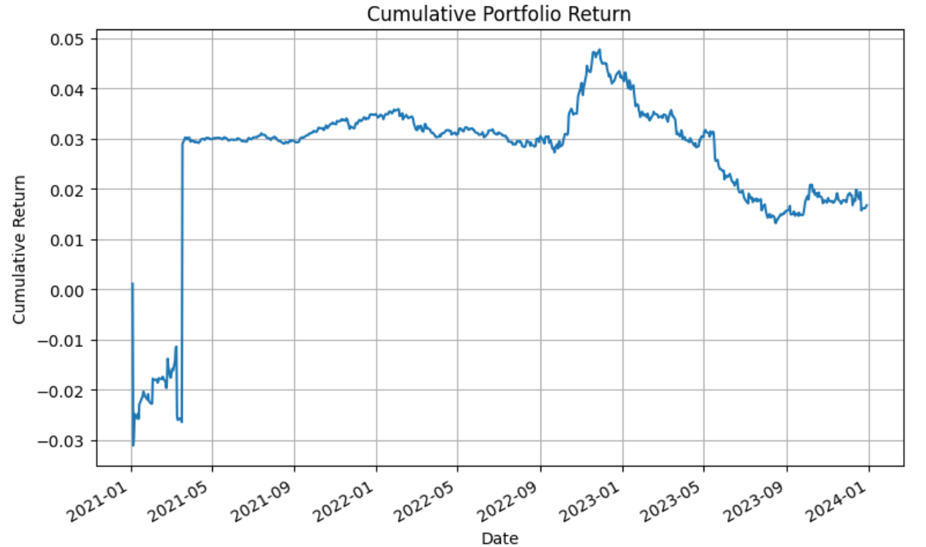
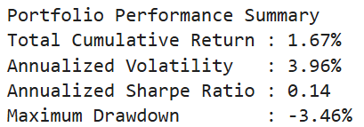
Performance Attribution
Analysis of portfolio performance
Early Instability (Jan 2021 – Apr 2021)
The portfolio starts with a sharp drawdown (~–3%), followed by volatile swings and a sudden jump upward.
This pattern typically reflects:
Model instability in early data windows
Possible incomplete data or sparse signals
A one-off spike (possibly due to an outlier signal or a structural error)
Interpretation: Model may need better warm-up or signal filtering early in backtest

Slide 11
Performance Attribution
Analysis of portfolio performance
Stable & Flat Returns (Mid 2021 – Late 2022)
Portfolio stabilizes around +3% return.
This period likely reflects:
Strong pair stability from cointegrated spreads
Well-hedged portfolio with no major macro exposure. Hedged worked against Fed rate hikes and inflation spikes.
Interpretation: Strategy is effectively hedged but underwhelming in alpha generation.

Slide 12
Performance Attribution
Analysis of portfolio performance
Outperformance Spike (Late 2022 – Early 2023)
Sharp climb in cumulative return from +3% to nearly +5%
Possible causes:
A few high-conviction pairs performing strongly
Market volatility enabling better spread convergence
Signals capturing strong reversals
Interpretation: Short-term alpha burst, captured uptrend from favorable market conditions.

Slide 13
Performance Attribution
Analysis of portfolio performance
Steady Drawdown (2023 onward)
Return declines from ~+5% to ~+2%
Possible causes:
Signal decay: model performance deteriorating in new regimes
Did not ride on SPY market recovery
Interpretation: Signal reliability eroded, leading to poor performance.

Slide 14
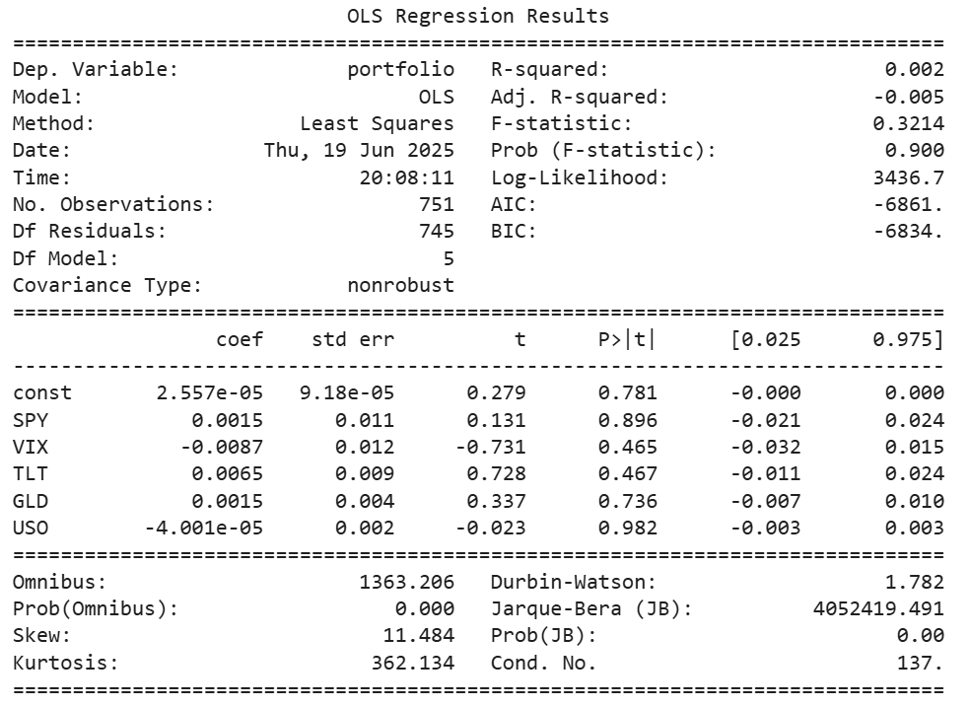
Performance Attribution
Factor exposure to common macro factors
Only 0.2% of the variation in the portfolio returns is explained by the five macro factors
→ portfolio is largely uncorrelated with common macro drivers. Alpha source is likely the statistical arbitrage on ETF pairs based on cointegration and XGBoost signals
p-values < 0.05
→ none of these factors have a statistically significant effect.

Slide 15
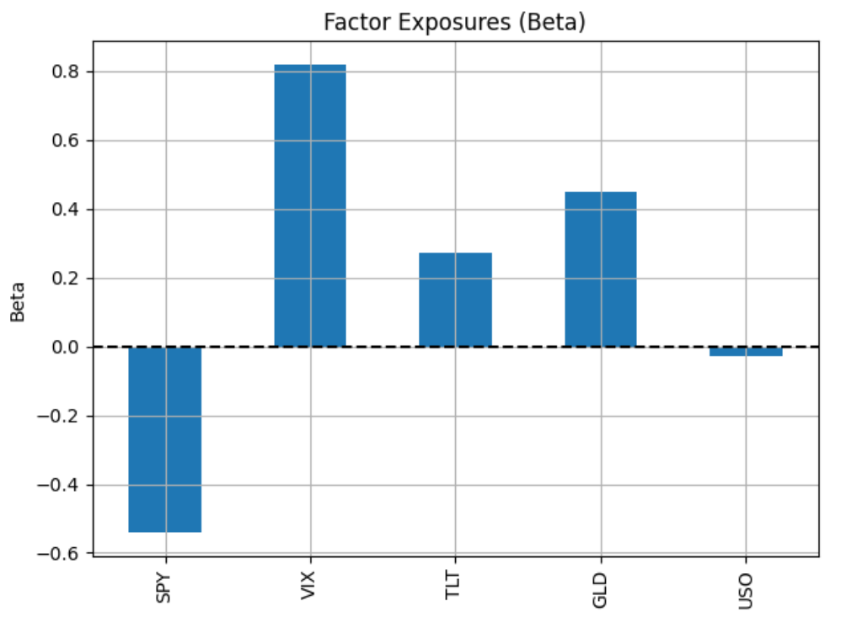
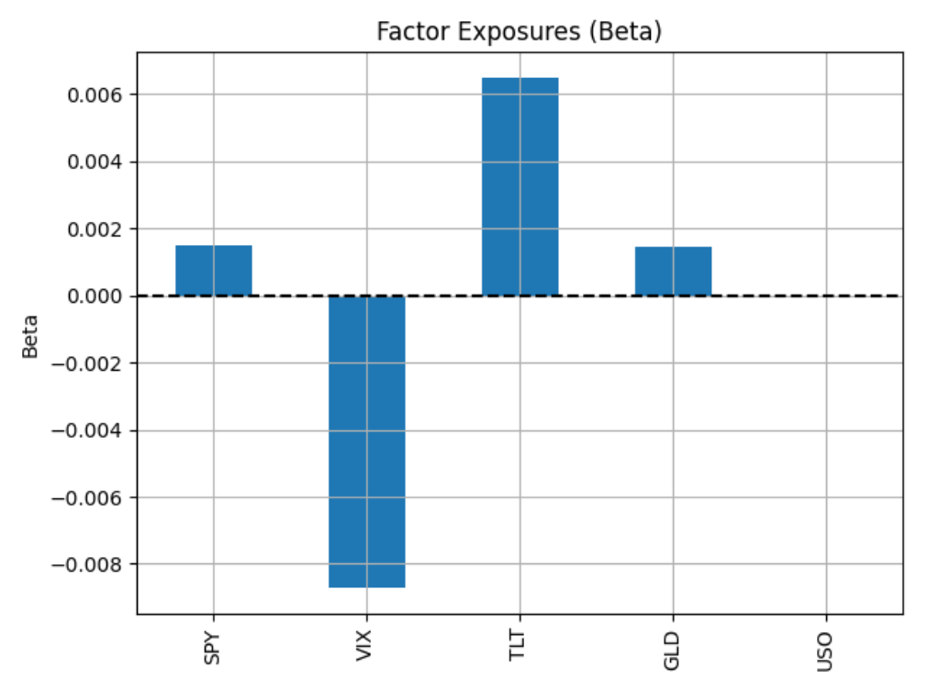
Performance Attribution
Effects of MVO on beta exposures
Equal-weighted PnL
Mean Variance Optimised PnL
Allocate trades equally across all valid spread pairs
Allocate more capital to spread pairs with higher expected returns, lower variance, and lower correlation
VIX beta ≈ +0.8: Strong positive exposure to volatility → strategy benefits in turbulent markets.
SPY beta ≈ -0.5: Strong negative equity beta → implies the portfolio tends to gain when the market falls.
Conclusion: Equal weighting unintentionally loads on SPY/VIX
All betas are small (≈ 0.00–0.006)
This reflects successful hedging across macro factors.
Conclusion: MVO portfolio is more neutral, diversified, and robust, removing unintended bets and likely improving Sharpe ratio.

Slide 16
Conclusion
Effects of hedging
Hedging (via beta-neutral or dollar-neutral construction) is designed to protect the portfolio from market-wide movements
Reduced volatility and avoided major drawdowns in early 2022
Trade-off is reduced potential alpha from market trends
Drawdown in 2023 shows hedging can’t fix broken signals e.g.
Pair spreads that no longer behave stationarily
Cointegration breaking down over time
XGBoost model overfitting past regimes, underperforming in new conditions
Structural shifts (e.g., macroeconomic or sector-specific changes)
This highlights the importance of continuously validating pair relationships and updating signal models under shifting regimes.

