Slide 1

ETF Portfolio Management
QF623 Group9
Group Member: Yu Shuhang
Feng Zibin
Chen Jisen
Guo Jianfeng
Chang Jiayi

Slide 2
Contents
01
ETF Selection
Keyword + average trading volume filtering
02
Alpha Signal
Short/long term MA difference
03
Optimization
Maximizing Sharpe ratio + constraints
04
T Simulation
T generates the signal, T+1 executes, and T+2 counts the payoff

Slide 3
01
ETF Selection

Slide 4
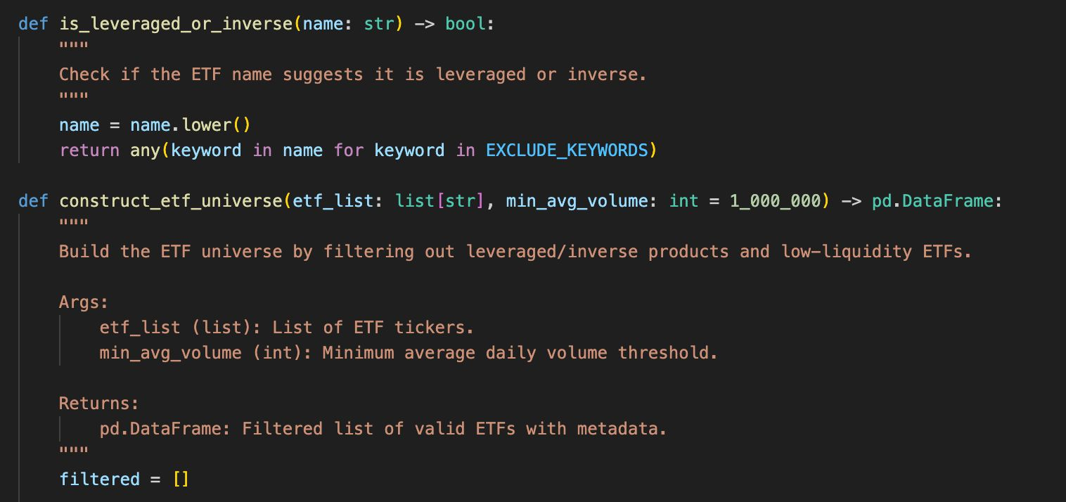
Building an ETF Screening Universe
To ensure portfolio robustness, the strategy first constructs a core ETF universe by removing leveraged and inverse products that are not suitable for long-term allocation.
To achieve this, the code applies a keyword-based filtering method, excluding ETFs with names containing terms such as ‘Ultra’2x, 3xBear or Short. These products often exhibit nonlinear compounding effects in their daily returns, resulting in higher volatility and unpredictable long-term performance.
After this screening step, the resulting ETF list consists of relatively stable instruments, well-suited for trend-following strategies and serving as a reliable base for signal generation and portfolio optimization.

Slide 5
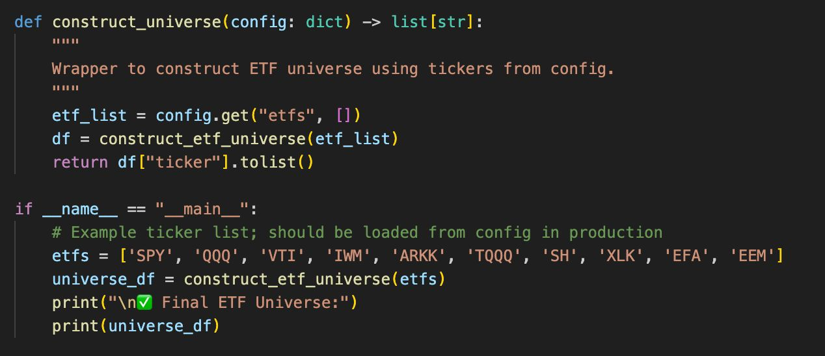
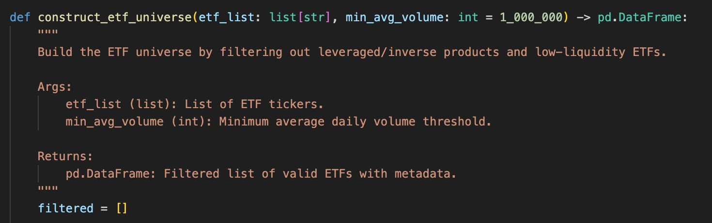
Building an ETF Screening Universe
Research results and presentation
Using yfinance, the strategy retrieves fundamental information for each ETF and filters out products that either contain high-volatility keywords in their names or have an average daily trading volume below USD 1 million.
This ensures the resulting ETF universe is aligned with long-term investment objectives and liquidity requirements.
To facilitate seamless integration, the ETF universe construction process is encapsulated into a modular function that requires only a configuration file as input.
The filtering logic is automatically executed to return a list of investable tickers. A built-in test case is also provided to validate the screening logic under practical conditions.

Slide 6
02
Generating Alpha Signals

Slide 7
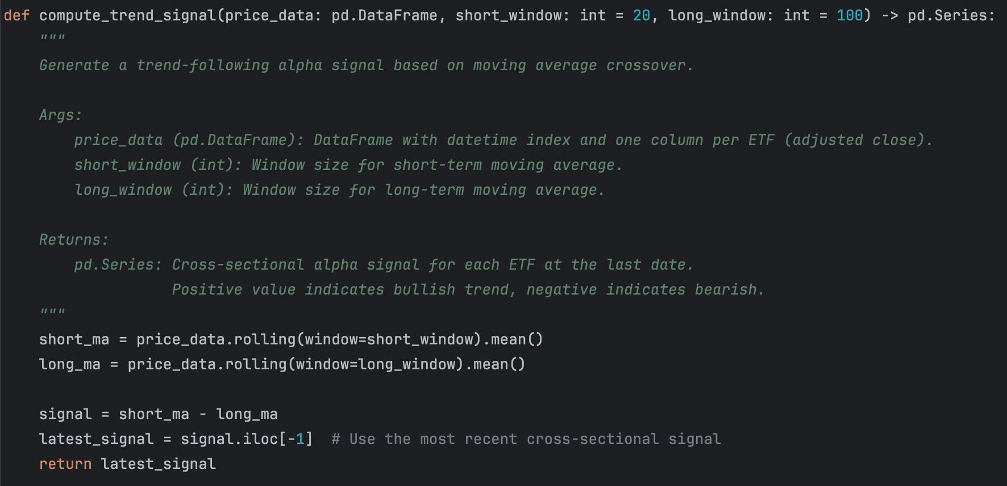
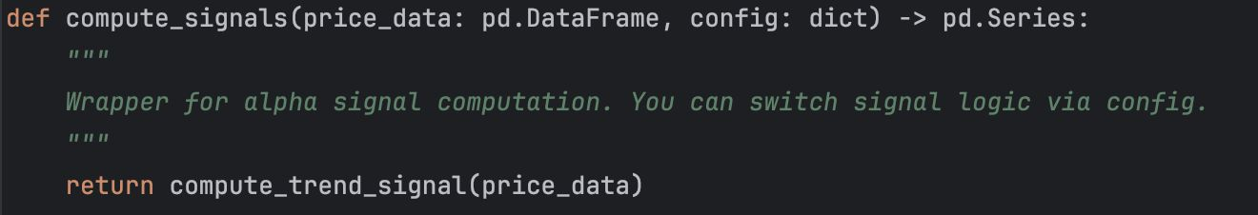
To identify assets exhibiting sustained market momentum, the strategy incorporates a trend-following alpha signal. This signal is derived from the difference between a short-term (e.g., 20-day) and a long-term (e.g., 100-day) moving average. A positive signal—when the short-term average crosses above the long-term average—indicates a bullish trend, while a negative signal suggests a bearish trend.
Based on adjusted closing prices of ETFs, the strategy calculates both short-term and long-term moving averages and derives their difference as the trend signal. This value reflects the relative strength of recent price trends: the greater the value, the stronger the short-term upward momentum; a negative value indicates downward pressure. The final output is a cross-sectional signal across all ETFs at the latest observation date
To accommodate the need for multi-factor signal integration, the alpha signal generation process is designed in a modular structure, allowing for flexible switching between different signal types or combining them for optimization in future implementations.

Slide 8
03
Portfolio Optimization

Slide 9
ETF Optimization & Execution System
Background significance of the topic
Objective
Key Requirements
Responsibilities
Long-only portfolios with L1-norm ≤ 1
Risk calculation based on 1-year daily returns
T+1 execution with T+1 to T+2 returns calculation
Portfolio Optimization (Max Sharpe + Constraints)
Realistic Execution Simulation (T+1 lag)
Construct Sharpe-maximizing ETF portfolios with minimum 3% risk

Slide 10

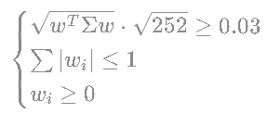
Portfolio Optimization Model
Background significance of the topic
Objective Function
Constraints
Key Parameters
Covariance matrix: 252-day rolling window
Minimum annualized volatility: 3%

Slide 11

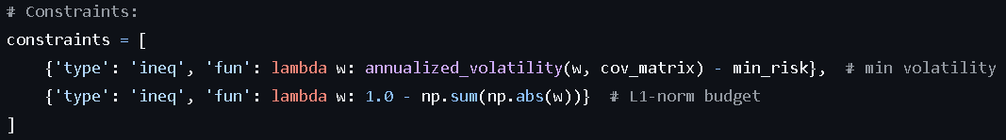
Implementing Portfolio Constraints
Volatility Floor:
L1-Norm Limitation:
Long-only Enforcement:

Slide 12


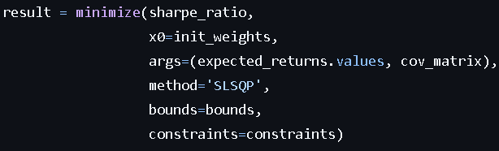
Sharpe Ratio Maximization
Background significance of the topic
Solver: Sequential Quadratic Programming (SLSQP)
Workflow
Compute covariance matrix from daily returns
Initialize equal weights
Solve constrained optimization
Validate convergence

Slide 13
04
Simulation

Slide 14
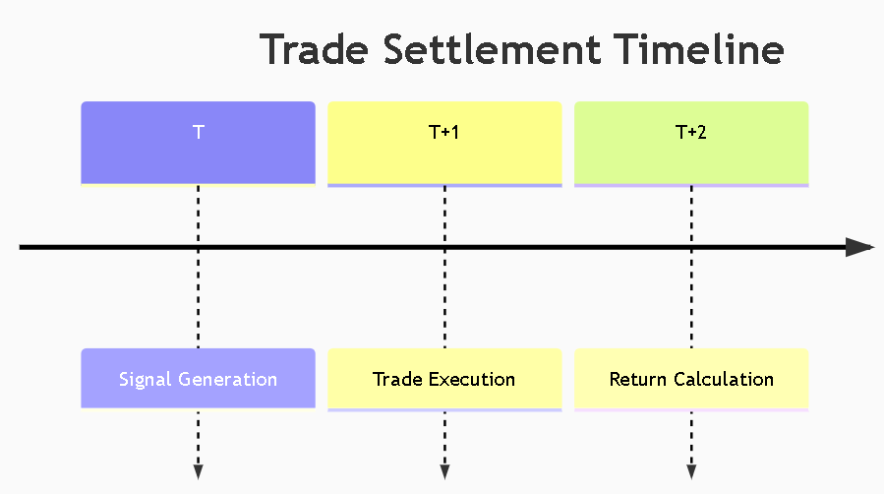
Realistic T+1 Settlement
Research method and process
Key Assumption: Portfolio rebalance implemented only at close of T+1

Slide 15
Implementing T+1 to T+2 Returns
Alignment Logic:
Portfolio Return Calculation :
Edge Handling :

Slide 16
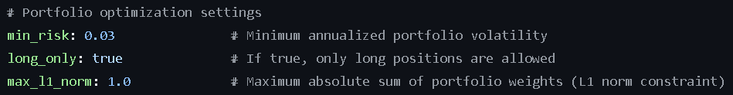

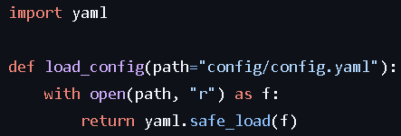
Implementing T+1 to T+2 Returns
Key Optimization Parameters :
Execution Timing :
Configuration Loader :

Slide 17
Module Interdependencies
Background significance of the topic
Critical Interfaces
Optimizer input: expected returns from alpha signal
Rebalance input: weights from optimizer
Data dependency: price from the data loader
Data Flow

Slide 18
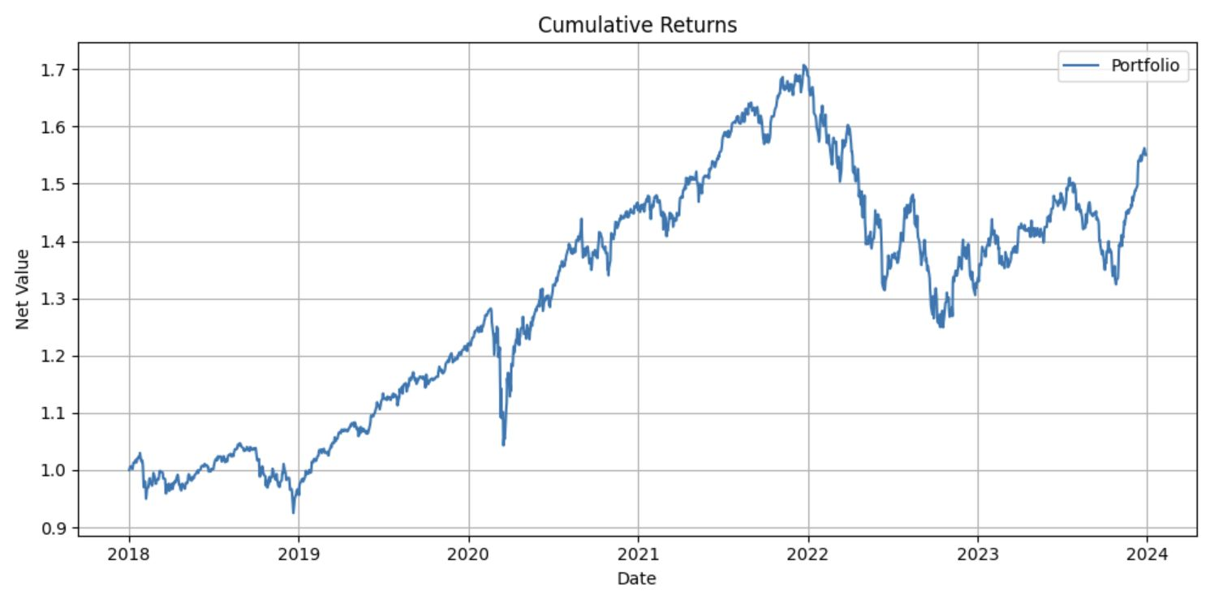
Performance Metrics (2018-2023)
Background significance of the topic
Key Statistics
Critical Interfaces
Annual Return: 8.18%
Annual Volatility: 13.10%
Sharpe Ratio: 0.62
Risk Control Validation
Minimum observed volatility: 3.2% > 3% requirement
Max L1-norm: 0.98 < 1.0 constraint

Slide 19
Implementation Insights
Research results and presentation
Key
Challenges
Numerical instability in covariance estimation
Optimization convergence issues with tight constraints
Data alignment across T/T+1/T+2 timelines
Proposed
Enhancement
Regularized covariance matrix estimation
Transaction cost incorporation
Parallel optimization backend

Slide 20
Thanks!

