Slide 1
QF623 ETF Portfolio Management
Morris Teo | 01508789
Lim Dao Wen | 01452934
Teai Juin Wen | 01246224 Tian Jun Hao | 01502287 Tan Mei Ling | 01521249
Jeremy Low | 01245359

Slide 2
Executive Summary QF623
 | Sharpe Ratio Comparison
 | In-Sample (2022-2023) | S&P 500 | Out-Sample Sharpe (2024) | S&P 500
Equal Weight | 0.0919 | -0.03 | 1.1080 | 0.78
Alpha Weight | 0.2317 | -0.03 | 1.0991 | 0.78
Risk Parity | 0.0930 | -0.03 | 1.1463 | 0.78
MVO | 0.5028 | -0.03 | 1.1618 | 0.78
Black-Litterman | 0.5028 | -0.03 | 1.2087 | 0.78
Portfolio Construction Process
Sectors | ETF counts | Examples
Broad Market | 9 | 'SPY', 'IVV', 'VTI', 'VOO’, …
Technology | 19 | 'QQQ', 'XLK', 'VGT', 'IYW’, …
Healthcare | 10 | 'XLV', 'VHT', 'IYH', 'FHLC’, …
Financials | 10 | 'XLF', 'VFH', 'IYF', 'FNCL’, …
Energy | 16 | 'XLE', 'VDE', 'IYE', 'FENY’, …
Consumer | 10 | 'XLP', 'XLY', 'VDC', 'VCR’, …
Industrials | 10 | 'XLI', 'VIS', 'IYJ', 'FIDU’, …
Materials | 14 | 'XLB', 'VAW', 'IYM', 'FMAT’, …
Utilities | 9 | 'XLU', 'VPU', 'IDU', 'FUTY’, …
Real Estate | 14 | 'XLRE', 'VNQ', 'IYR', 'SCHH’, …
International Developed | 20 | 'VEA', 'IEFA', 'EFA', 'IXUS’, …
Emerging Markets | 18 | 'VWO', 'IEMG', 'EEM', 'EWZ’, …
Fixed Income | 20 | 'AGG', 'BND', 'IUSB', 'SCHZ’, …
Growth/Value | 15 | 'VUG', 'IVW', 'VTV', 'IVE’, …
Small/Mid Cap | 15 | 'IWM', 'VB', 'IJH', 'VO’, …
Dividend | 14 | 'VYM', 'DVY', 'SCHD', 'VIG’, …
Commodities | 15 | 'GLD', 'SLV', 'DJP', 'PDBC’, …
Volatility/Alternative | 14 | 'VXX', 'UVXY', 'SVXY', 'VIXY’, …
Unconstrained MVO
Carhart 5 Factor Model
ETFs Universe consists of 248 ETFs ranked by AUM for liquidity (>$100 M AUM), US-listed only, unbiased in sector selection, geographic regions, styles and asset classes
Our strategy is to build a portfolio based on broad market analysis on historical 3y data
We used the Carhart 5 Factor model as a base model before applying different optimizations to maximize Sharpe ratio.
The model out-performed the S&P500 Sharpe both in In-Sample and Out-Sample testing.
We concluded that the Black-Litterman model applied on factor-based portfolio was the best performing portfolio.
Cross-sector Portfolio
Portfolio selection
Black-Litterman

Slide 3
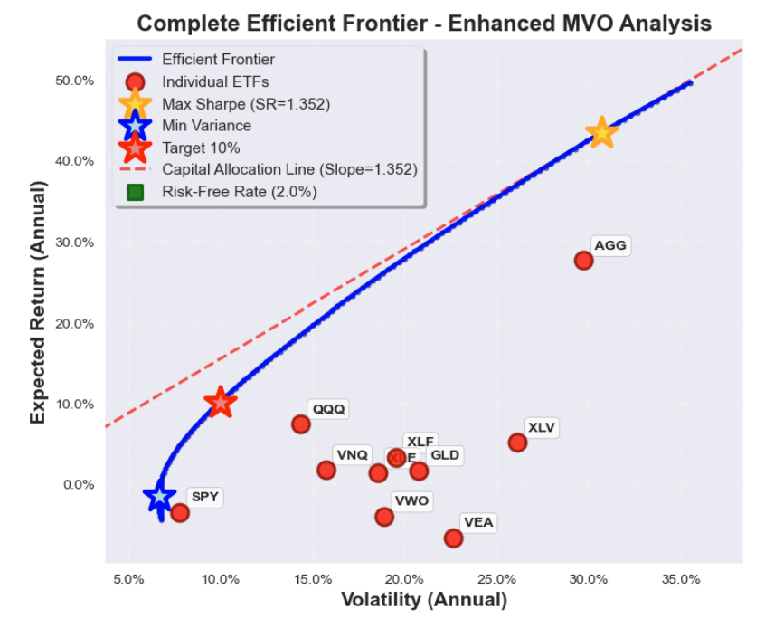
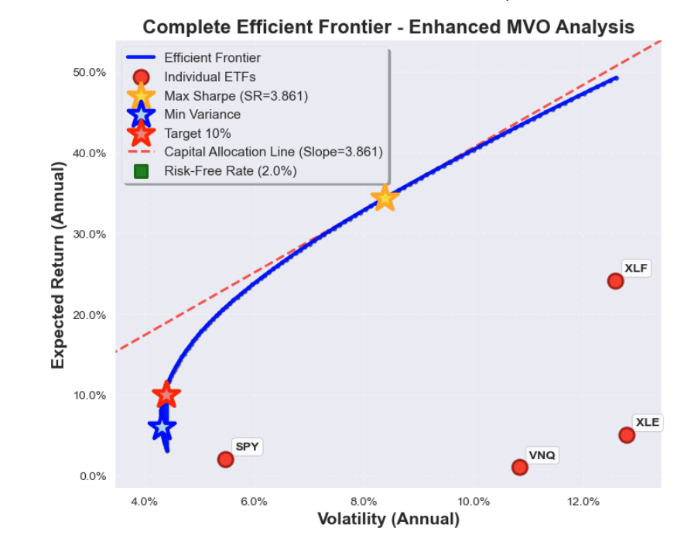
Unconstrained MVO QF623
Short Selling Allowed - Can bet against assets (negative weights up to -50%)
Flexible Position Sizes - Individual assets can exceed traditional limits (up to 150%)
Weight Sum = 1 - Total investment stays at 100% (no leverage in this version)
No Sector Limits - Optimizer freely allocates across all asset classes
Portfolio (2022-2023) | Expected return | Volatility | Sharpe Ratio | Weight Sum
Max Sharpe | 43.51% | 30.70% | 1.3519 | 1
Min Variance | -1.56% | 6.66% | -0.5341 | 1
Target 10% | 10% | 9.98% | 0.8017 | 1
Long-Only | 21.26% | 21.91% | 0.8794 | 1
Equal Weight | 3.36% | 14.58% | 0.0930 | 1
Portfolio (2024) | Expected return | Volatility | Sharpe Ratio | Weight Sum
Max Sharpe | 34.34% | 8.38% | 3.8611 | 1
Min Variance | 6.1% | 4.3% | 0.9544 | 1
Target 10% | 10% | 4.39% | 1.8237 | 1
Long-Only | 25.62% | 10.34% | 2.2839 | 1
Equal Weight | 13.29% | 9.25% | 1.2203 | 1

Slide 4
Strategy Description QF623
Factor-Based Analysis
Using the Carhart 5-factor model, we calculate factor loadings to identify ETFs with high alpha, small-cap tilt, value exposure, momentum, or low volatility.
ETF daily returns are regressed against the daily Factor Loading Beta in Kenneth French's data library
ETFs are then ranked based on their exposure to each of the 5 factors
A portfolio of each factor loading is created comprising of the top ranked ETFs based on their exposure
Multiple Weighting Strategies
Portfolios are constructed using various approaches to access their individual performances
Equal weighting
Alpha-based
Risk parity
Mean-variance optimization (MVO)
Black-Litterman Optimization
Incorporates our view on Healthcare underperformance for (Trump Trade)

Slide 5
Carhatt 5 Factor Model QF623
Rᵢ - RF = αᵢ + β₁(MKT-RF) + β₂(SMB) + β₃(HML) + β₄(WML) + β₅(VMG) + εᵢ
Factor | Description | Economic Rationale
Market ( MKT – RF) | Market return - Risk-free rate | Systematic risk compensation
Size (SMB) | Small Cap – Large Cap Returns | Small firms carry higher risk
Value (HML) | Value Stocks – Growth Stocks | Value premium (high book-to-market) from distress risk
Momentum (WML) | Past winners – Past Losers | Behavioral biases & information diffusion
Volatility (VMG) | High Vol – Low Returns | Volatility risk premium
Total ETFs analyzed: 248 (719 data points) Average R-squared: 0.596 ETFs with R-squared > 0.7: 107 (43.1%) ETFs with significant alpha: 7 (2.8%)
5-factor model explains 59.6% of the variation in ETF returns
Factor | Mean Loading | Significance | Std dev
Market | 0.677 | 96.4% | 0.927
SMB | 0.138 | 58.5% | 0.402
HML | 0.170 | 77.0% | 0.408
WML | -0.093 | 76.6% | 0.164
VMG | 0.010 | 42.3% | 0.208
The average ETF has negative momentum exposure
Factor data source: Fama-French Data library and Volatility-Minus-Growth (VMG) custom factor using 60-days rolling volatility of market returns
VMG: high volatility periods coincides with market stress and panic selling, and low volatility periods signals calm markets and steady growth
Factor loading: OLS regression for each ETF which leads to factor-based selection of strategies
 | MKT_RF | SMB | HML | WML | VMG
MKT_RF | 1 | 0.335 | -0.316 | -0.248 | -0.843
SMB | 0.335 | 1 | -0.067 | -0.406 | 0.221
HML | -0.316 | -0.067 | 1 | 0.179 | -0.308
WML | -0.248 | -0.406 | 0.179 | 1 | -0.374
VMG | 0.843 | 0.221 | -0.308 | -0374 | 1
SMB ↔ WML: -0.406 (Small caps hate momentum)
HML ↔ MKT: -0.316 (Value is defensive)

Slide 6
Portfolio Selection QF623
 | Selection | R² | ETF counts | Description
Small_Cap_Tilt | SMB Loading > 0.316 | > 0.5 | 46 | Small cap factor exposure
Value_Tilt | HML Loading > 0.393 | > 0.5 | 39 | Value factor exposure
Momentum_Tilt | WML Loading > 0.012 | > 0.5 | 40 | Momentum factor exposure
Volatility_Tilt | VMG Loading > 0.094 | > 0.5 | 38 | Volatility factor exposure
Low_Volatility | VMG Loading < -0.117 | > 0.5 | 33 | Low Volatility factor exposure
Multi_Factor | Alpha > 0, |Beta| < 1.5 | > 0.7 | 36 | Diversified, positive alpha
We analysed 6 different portfolio strategies.
For each strategy, we investigated the effects of different weighting in each portfolio component.
Equal weight, Alpha weight – proportional to alpha, normalized. Equal weight – proportional to volatility, normalized. MVO.
Amongst the different weightage portfolios, for in-sample data, MVO performed the best (obvious)
However, for out-sample data, MVO does not always perform the best, although it still did for the Multi_Factor portfolio.
 | Sharpe Ratio Comparison
 | In-Sample (2022-2023) |  |  |  | Out-Sample (2024)
 | Equal Weight | Alpha Weight | Equal Risk | MVO | Equal Weight | Alpha Weight | Equal Risk | MVO
Small_Cap_Tilt | -0.3511 | 0.3664 | -0.2716 | 0.9027 | -0.0597 | 0.5787 | 0.1361 | -0.1385
Value_Tilt | 0.0339 | 0.7866 | 0.0829 | 0.8818 | 0.3849 | 0.2756 | 0.5167 | 0.201
Momentum_Tilt | 0.2164 | 0.6949 | 0.1493 | 1.9143 | 0.4684 | 0.6037 | 0.6051 | -0.7598
Volatility_Tilt | -0.1536 | 0.7714 | 0.0894 | 0.9195 | 0.7246 | 0.5391 | 0.8655 | 0.3907
Low_Volatility | -0.3064 | 0.4112 | -0.3212 | 1.2625 | 0.1317 | 0.4905 | 0.2017 | -0.7224
Multi_Factor | 0.0919 | 0.2317 | 0.093 | 0.5028 | 1.108 | 1.0991 | 1.1463 | 1.1618
Black_Litterman | 0.1779 | 0.2782 | 0.1818 | 0.5028 | 1.2087 | 1.1459 | 1.1936 | 1.1618
The multi-factor portfolio strategy combines positive alpha, high R-squared and reasonable market beta.
Leveraging the Carhart 5-factor model (Market, SMB, HML WML, VMG), rather than stripping out one factor at a time

Slide 7
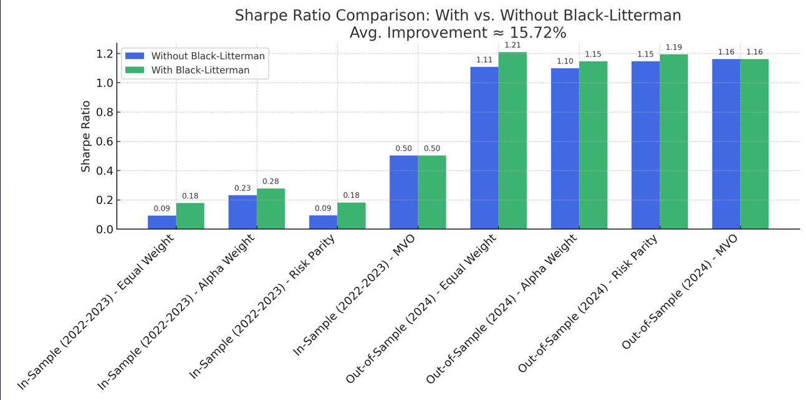
Performance Attribution Analysis QF623
Key Insights
Black-Litterman View: Incorporates view that Healthcare (e.g., XBI) underperforms Broad Market
In-Sample Data: 2022–2023 (500 dates, 247 ETFs)
Out-of-Sample Data: 2024 (250 dates, 244 ETFs analyzed after 4 delistings).
Performance Impact: Black-Litterman improves Sharpe Ratio (e.g., Balanced Multi-Factor: 0.0919 → 0.1779 in-sample, 1.1074 → 1.2087 out-of-sample).

Slide 8
Performance Attribution Analysis QF623
In-Sample (2022-2023)
Method | Small Cap Tilt (46) | Value Tilt (39) | Momentum Tilt (40) | Volatility Tilt (38) | Low Volatility (32) | Balanced Multi Factor (36) | Balanced Multi Factor (with BL) (36)
Equal Weight | -0.3515 | 0.0334 | 0.2161 | -0.1543 | -0.3008 | 0.0919 | 0.1779
Alpha Weight | 0.3664 | 0.7866 | 0.6949 | 0.7714 | 0.4112 | 0.2317 | 0.2782
Risk Parity | -0.2718 | 0.0826 | 0.1492 | 0.0891 | -0.3133 | 0.0930 | 0.1818
Mvo | 0.9027 | 0.8804 | 1.9045 | 0.9177 | 1.2625 | 0.5028 | 0.5028
Market Context: In-sample period (2022-2023) includes volatile market conditions, with 2022’s bear market impacting early performance
Balanced_Multi_Factor, showing initial promise with Black-Litterman (e.g., Sharpe from 0.0919 to 0.1779) despite 2022 volatility
2022’s downturn likely suppressed early Sharpes (e.g., -0.3515 for Small_Cap_Tilt)

Slide 9
Performance Attribution Analysis QF623
Out-Sample (2024)
Method | Small Cap Tilt (46) | Value Tilt (39) | Momentum Tilt (40) | Volatility Tilt (38) | Low Volatility (32) | Balanced Multi Factor (36) | Balanced Multi Factor (with BL) (36)
Equal Weight | -0.0548 | 0.3923 | 0.4735 | 0.7354 | 0.1380 | 1.1080 | 1.2087
Alpha Weight | 0.5787 | 0.2756 | 0.6037 | 0.5391 | 0.4905 | 1.0991 | 1.1459
Risk Parity | 0.1382 | 0.5195 | 0.6069 | 0.8688 | 0.2129 | 1.1463 | 1.1936
Mvo | -0.1385 | 0.2243 | -0.7062 | 0.4195 | -0.7224 | 1.1618 | 1.1618
The 2024 out-of-sample period benefited from a bull market, with the S&P 500 up ~20% from its 2023 low, driving strong returns like 1.1080 for Balanced_Multi_Factor
This validates our in-sample work, with Black-Litterman boosting the Sharpe to 1.2087, proving the strategy’s effectiveness
Shows method variation (e.g., Risk Parity’s 0.8688 vs. Mvo’s -0.7062), reinforcing diversification benefits

Slide 10
Risk Management QF623
Diversification Across ETFs and Factors
247 ETFs in sample, 244 out-sample; 36 used in Balanced Multi Factor
Risk Managed: Reduces concentration risk by spreading investments across multiple assets and risk factors, mitigating the impact of any single ETF or factor underperforming
Allocation Risk
The Black-Litterman model adjusts portfolio weights based on a view that Healthcare (e.g., XBI) underperforms Broad Market (e.g., SPY)
Risk Managed: Mitigates allocation risk by proactively shifting exposure away from potentially underperforming sectors, enhancing risk-adjusted returns
Method Diversification
The project tests four weighting methods across portfolios, with Balanced_Multi_Factor showing consistent Sharpes
Risk Managed: Reduces method-specific risk by evaluating multiple allocation techniques, avoiding over-reliance on a single approach
Liquidity Risk
The project includes 244 ETFs out-of-sample, with high-volume ETFs
Risk Managed: Mitigates liquidity risk by prioritizing ETFs with sufficient trading volume and bid-ask spread stability, ensuring ease of entry/exit and reducing price impact during volatile periods
Avoid overexposure to low liquidity niche ETFs during volatile periods

Slide 11
Recommendations QF623
Data collection and preprocessing
Extend look back period
Incorporate macroeconomic indicators (inflation, interest rate, unemployment figure etc.)
Adjust for survivorship bias
Inclusion of trading costs
Factor model enhancements
Addition of new factors such as sector exposure, liquidity and ESG factors.
Black-Litterman Model Enhancements
Addition of confidence levels to different views
Model views using scenarios or probability distributions
Use bayesian theory in updating beliefs and view points dynamically
Backtesting evaluations
Use rolling-window back tests, report max drawdown and drawdown periods etc.
Inclusion of trading and financing related fees
Additional Risk Management
Stress Testing & Scenario Analysis
Set ETF portfolio VaR at 1-5% daily, stress-tested against market downturns
Stop-Loss Strategies
Set stop-loss at 1-2% of portfolio value or 5-10% below ETF NAV entry price
Apply trailing stops to capture gains in trending sector ETFs

