Slide 1
CONFIGURATION MANAGEMENT USING ANSIBLE

Slide 2
What is configuration management tool ?
Configuration management tool is something which helps the user to perform any configurations like installing packages, software dependencies, deploying new application versions either be in local system or in remote servers.
We can either have shell/python/JS/golang scripts written to do configurations as well.

Slide 3
Types Of Configuration Management Tools
Push Based Configuration Management Tools
  Main server pushes the configuration to the servers, best tool to use if all your systems are online and you need to push changes to all the servers
  Examples: Ansible, Saltstack, etc...
Pull Based Configuration Management Tools
  An agent installed on the servers runs periodically to pull the latest definitions from a central repository and apply them to the server, helpful when we have offline systems that rarely connect to internet or network
  Examples: Chef, puppet, etc...

Slide 4
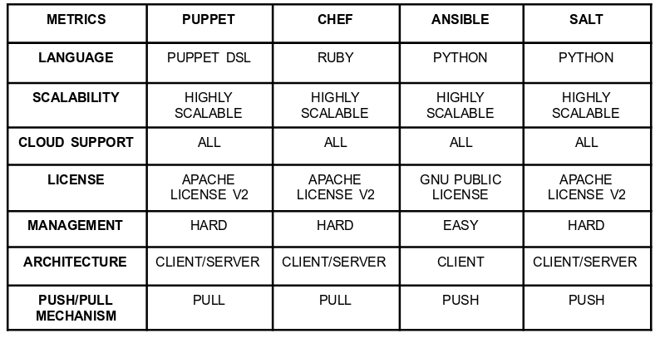
Comparision between configuration management tools.

Slide 5
Why Choose Ansible as Configuration management tool?
It is agentless.
It used python2.7 which is default in any operating system.
No need to maintain any intermediate server for pushing confgurations.
Simple yaml syntax.
Open Source tool.

Slide 6
Problems with traditional approah
Configuring ten thousand servers for hackathon with custom software and dependencies on fresh servers, how many IT staff is required.
System/Server OS patching for security and performance.
Deploying and scaling the applications on need.
Manual mistakes by humans in software installations.

Slide 7
How using Ansible Solves major configuration and operations problems ?
Problem 1: Configuring ten thousand servers for hackathon with custom software and dependencies on fresh servers, how many IT staff is required.
  Detail down the steps to install the custom software and dependencies and have an ansible playbook created via jenkins or centralized server.
  IT Staff required = 1 or no IT staff required.

Slide 8
How using Ansible Solves major configuration and operations problems ?
Problem 2: System/Server OS patching for security and performance.
  Take the patch information, create a script and have criteria for applying patch
  Create an ansible role and apply the patch via jenkins or centralized server.
  IT Staff required = 1 or no IT staff required.

Slide 9
How using Ansible Solves major configuration and operations problems ?
Problem 3: Deploying and scaling the applications on need.
  Analize the load, predict the usage and have webhooks triggered which will run th playbooks and scale/deploy your applications.
  Write ansible playbooks/roles and let it do the job for you.
  IT Staff required = 1 or no IT staff required.

Slide 10
How using Ansible Solves major configuration and operations problems ?
Problem 4: Manual mistakes by humans in software installations.
  Since it is the same scripts which is going to run all the time, if it works one time, it’ll work all the time and we won’t miss out on anything possible.
  IT Staff required = 1 or no IT staff required.

Slide 11
Configuration Management - Anisble
LIVE DEMO
Install Basic Packages and dependencies for Linux servers.
Configure Apache Web browser and deploy website in ubuntu server.

Slide 12
About Me
GITHUB : https://github.com/smyaltamash
LINKEDIN: https://www.linkedin.com/in/s-m-y-altamash-67b07910a/
MAIL: smy.altamash@gmail.com
PROJECTS:
  SUNBIRD: https://sunbird.org/ [Open Source LMS Platform]
  DIKSHA: https://diksha.gov.in/ [Mission to provide free education to 200 Million Students]
  VIDEO TRANSLATE: https://translate.diksha.gov.in/ [Translate video into any indian regional language so it is easy for students to understand the concepts]
ACHIEVEMENTS:
  Github arctic code vault contributer.
  Open Source Contributor.
  AWS Certified Solutions Architect Professional.

