Slide 1
How not to write a thesis
Paul Cairns
paul.cairns@york.ac.uk

Slide 2
Five ways to annoy your examiner
Paul Cairns
paul.cairns@york.ac.uk

Slide 3
What is a thesis for?

Slide 4
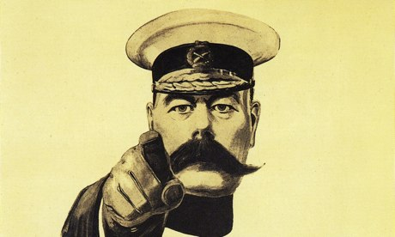
YOU are a FRAUD

Slide 5
Principles
Don’t be found out!
Appear smart
Endogeneous simplicity
Exogeneous complexity

Slide 6
1. Conventions are dangerous
Well understood
Reveal simplicity
Lack innovation

Slide 7
Conventions to avoid
Study designs
Statistical methods
Evaluation
Never admit weakness
Benchmarks
Others?

Slide 8
2. Assure the verisimilitude of intellectual accomplishment
Written language is full of complexity
Words
Sentences
Structures

Slide 9
Words
Sesquipedalianism
Fancy words
Acronyms

Slide 10
Example
Subsequent to diligent eradication of language infelicities, the codebase achieved executable status

Slide 11
Example
Subsequent to diligent eradication of language infelicities, the codebase achieved executable status.
After careful debugging, the code ran.

Slide 12
Example
Prior to commencing the experiment, participants were requested to respond to supplementary questions.

Slide 13
Example
Prior to commencing the experiment, participants were requested to respond to supplementary questions.
Before starting the experiment, participants were asked to answer some more questions.

Slide 14
Some fancy words
Do not use | Use
Because | due to the fact that
Do, make | Implement
Before/after | Prior to/subsequently
Use | Utilize
Start/end | Commence/conclude or cease
Think/understand | Comprehend
Is made up of | Comprise
Part | Component
Wrong | Erroneous

Slide 15
Example
In the FP condition the GS, MS, AS were all significantly higher than in the TP or TPS conditions.

Slide 16
Example
In the FP condition the GS, MS, AS were all significantly higher than in the TP or TPS conditions.
In the First Person condition the Group Salience, Maximum Score and Average Stopping were all significantly higher than the Third Person or Third Person Static conditions.

Slide 17
Sentences
One (very complex) idea per sentence
Long sentences
Smothered verbs

Slide 18
Long sentences
Short sentences are clear and vigorous
Tools to lengthen
Subclauses
Conjunctions
Compound nouns
Punctuation
Sesquipedalianism

Slide 19
Simple style
The algorithm has six functions. The main function is there to coordinate the interaction of four of them. The sixth function structures the output ready for display.

Slide 20
Thesis style
The algorithm, which has six functions led by a coordinating component that is responsible for controlling the interaction of four of the constituent elements, structures its output through the final display preparation module.

Slide 21
Exercise: use punctuation
The experiment uses a repeated measures design. The two experimental conditions are high load and low load. The high load condition requires participants to complete a secondary task. The low load has no secondary task. The secondary task is an auditory attention task.

Slide 22
Thesis style
The two experimental conditions comprising the repeated measures design are: high load condition in which participants are required to complete a secondary task which is an auditory attention task; and a low load condition in which there is no secondary task.

Slide 23
Smothered verbs
Verbs are easily imagined
“to be” or “to have”
Nominalization
Passive voice
Fancy words help

Slide 24
Example
The research intended to clarify the trade off between power consumption and reliability.

Slide 25
Example
The research intended to clarify the trade off between power consumption and reliability.
The intention of the research was to produce a clarification of how power consumption and reliability are traded off against each other.

Slide 26
Active voice
The results suggest that power consumption does not affect reliability.

Slide 27
Passive voice
The results suggest that power consumption does not affect reliability.
It is suggested by the results that reliability is not affected by power consumption.

Slide 28
Even better…
The results suggest that power consumption does not affect reliability.
It is the suggestion of the results that there is no effect on reliability of power consumption.

Slide 29
Exercise:
The function notifies the database at the start of the cycle.

Slide 30
Exercise:
The function notifies the database at the start of the cycle.
A notification, which is generated by the function at the commencement of the cycle, is received by the database.

Slide 31
Structures
Long paragraphs
Sections, subsections, subsub…
Bullets/numbered lists

Slide 32
3. A picture paints 1,000 words
Use one or other but not both
Long complicated explanations
Detailed, complicated diagrams

Slide 33
Complex diagrams
Lots of elements
Lots of text
Inconsistent semantics
Not easily fitting on one page

Slide 34
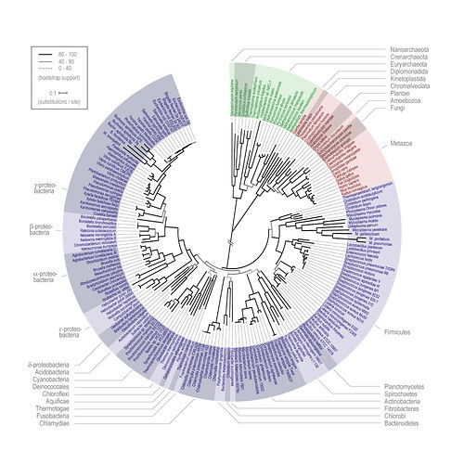

Slide 35
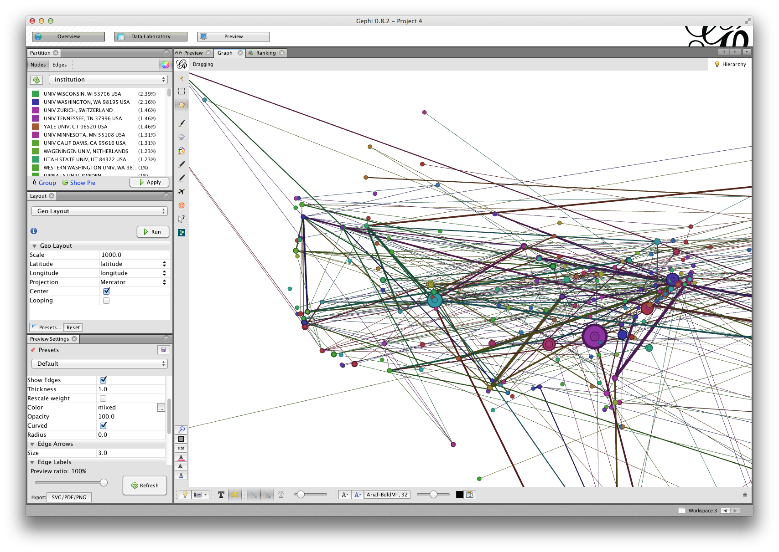

Slide 36
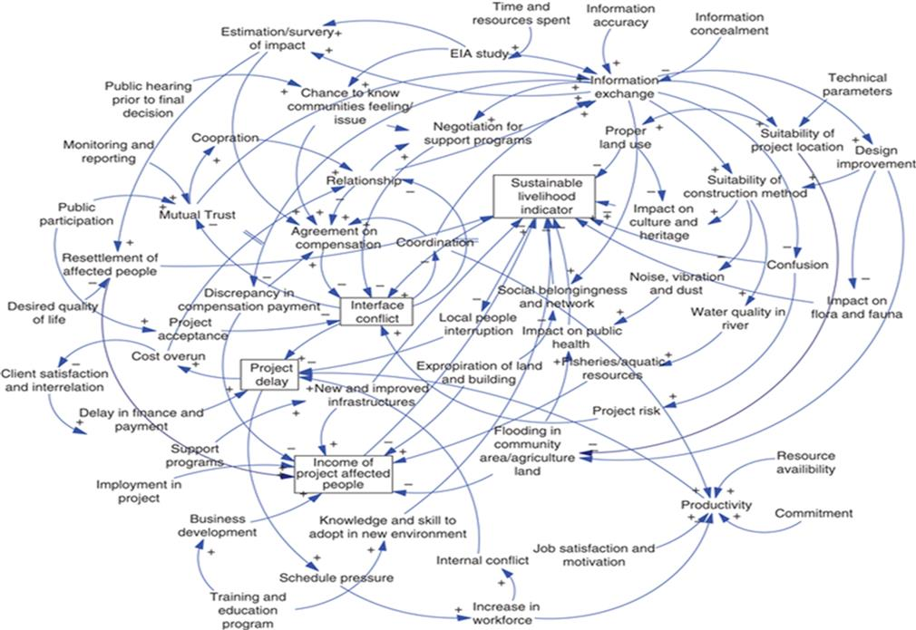

Slide 37
Easy words
Code, data, test descriptions…
Clearly represents effort
Shrink font to fit
Ideally over two pages

Slide 38
import java.util.*;
//At the moment this is just for a small world network
//As there is no general graph class.
public class Analyser{
private SWSmallWorld fSmallWorld;
private Hashtable fLabels;
private final static int UNLABELLED = -1;
public Analyser( SWSmallWorld pSmallWorld ){
fSmallWorld = pSmallWorld;
}
public PathProfile pathSummaries(){
PathProfile lAnswer = new PathProfile();
PathProfile lPartialProfile;
int lNumNodes = fSmallWorld.size();
int i,j;
Node lNode;
for( i = 0; i < lNumNodes; i++ ){
refreshLabels();
lPartialProfile = pathSummariesFrom( i );
lAnswer.add( lPartialProfile );
}//for i
return lAnswer;
}//pathSummaries
private void refreshLabels(){
int lNumNodes = fSmallWorld.size();
int i;
Node lNode;
fLabels = new Hashtable();
for( i = 0; i< lNumNodes; i++ ){
lNode = fSmallWorld.getNode( i );
fLabels.put( lNode, new Label() );
}//for i
}
private PathProfile pathSummariesFrom( int pNodeIndex ){
PathProfile lAnswer;
Vector lQueue = new Vector();
int lQueuePos = 0;
Node lStartNode = fSmallWorld.getNode( pNodeIndex );
Node lThisNode;
Label lThisLabel;
int lLabelValue;
lThisLabel = (Label)fLabels.get( lStartNode );
lThisLabel.setLabel( 0 );
addNodesToQueue( lQueue, lStartNode );
//Assume at least one element goes on here!
while( lQueuePos < lQueue.size() ){
lThisNode = (Node) lQueue.elementAt( lQueuePos );
addNodesToQueue( lQueue, lThisNode );
lQueuePos++;
}//while
lAnswer = generateProfile( pNodeIndex );
return lAnswer;
}//pathSummaries
private void addNodesToQueue( Vector pQueue, Node pNode ){
EdgeList lEdges = pNode.getOutEdges();
int lCurrentDistance;
int lNumEdges = lEdges.size();
int lEdgeCount;
Node lEndNode;
Edge lThisEdge;
Label lThisLabel;
int lLabelValue;
lThisLabel = (Label) fLabels.get( pNode );
lCurrentDistance = lThisLabel.getLabel();
for( lEdgeCount = 0; lEdgeCount < lNumEdges; lEdgeCount++ ){
lThisEdge = lEdges.elementAt( lEdgeCount );
lEndNode = lThisEdge.getEnd();
lThisLabel = (Label) fLabels.get( lEndNode );
lLabelValue = lThisLabel.getLabel();
if( lLabelValue == UNLABELLED ){
lThisLabel.setLabel( lCurrentDistance + 1 );
pQueue.add( lEndNode );
}//if lLabelValue
}//for lEdgeCount
}//addNodesToQueue
private PathProfile generateProfile( int pStartNode ){
PathProfile lAnswer = new PathProfile();
int lNumNodes = fSmallWorld.size();
int lNodeCount;
Node lThisNode;
Label lThisLabel;
int lLabelValue;
PathSummary lSummary;
for( lNodeCount = 0; lNodeCount < lNumNodes; lNodeCount++ ){
lThisNode = fSmallWorld.getNode( lNodeCount );
lThisLabel = (Label) fLabels.get( lThisNode );
lLabelValue = lThisLabel.getLabel();
lSummary = new PathSummary( pStartNode, lNodeCount, lLabelValue );
lAnswer.add( lSummary );
}//for lNodeCount
return lAnswer;
}//generateSummaries
private class Label{
private int fLabel;
public Label(){
fLabel = UNLABELLED;
}
public boolean isUnlabelled(){
return ( fLabel == UNLABELLED );
}
public int getLabel(){
return fLabel;
}
public void setLabel(int pLabel ){
fLabel = pLabel;
}
}//class LabelledNode
}

Slide 39
4. “The secret to wit is surprise”
Need suspense
Never give the game away
Shows how hard it is

Slide 40
Useful tricks
“Studies were done”
“As will be discussed in chapter…”
Silence!
Burying
Literature review

Slide 41

5. Don’t seek feedback
“Better to remain silent and be thought a fool than to speak out and remove all doubt.”

Slide 42
Feedback traps
Conference talks
Conversations with experts
Seminars
Supervisions
Writing

Slide 43
Write at the end
Commitment in black and white
Self-articulation
Writing isn’t that hard
Practice never helped anyone

Slide 44
To be easily found out
Use conventions
Write plainly
Take time on diagrams and text
Set out your contributions
Seek feedback
Write now!

Slide 45
Reading to avoid
Pinker, The Sense of Style
Cutts, Plain English Guide
Thimbleby, Write Now! in Cairns and Cox (2008)
Heath and Heath, Made to Stick

