Slide 1
Artificial Intelligence Group

Slide 2
Artificial Intelligence Group
The Group's research is concerned with the theoretical principles of artificial intelligence and their practical application to real-world domains
Constraint programming
Machine learning
Bayesian network learning
Statistical relational learning
Inductive logic programming
Reinforcement learning
Natural language processing
Games and interactive drama
The Group's research is strongly interdisciplinary with links into biology, human computer interaction, linguistics, psychology and biochemistry.
Group seminar 11:30-12:30 Wednesday – email me (mark.bartlett@york.ac.uk) if you want adding to the mailing list

Slide 3
Suresh Manandhar
Zaha Aljohani
Taghreed Alqaisi
Reem Alqifari
Reem Alrashdi
Chaitanya Kaul
Alexandros Komninos
Nils Mönning
Di Wang
Baoguo Yang
James Cussens
Teny Handhayani
Durdane Kocacoban
Sorush Lajevardi
Elizabeth Vialls
Sam Devlin
Daniel Hernandez
Adam Sattaur
Peter York
Alan Frisch
Dimitar Kazakov
Noof Alfear
Eyad Algahtani
Hani Elgabou
Nurul Qomariyah
Haizhou Qu
Marcelo Sardelich
Mudita Sharma
Daniel Kudenko
Mao Li
Nourah Al-Rossais
Andrea Bassich
Matthew Bedder
John Burden
Cathryn Henderson
George Mason
Hanting Xie
Tommy Yuan
Sultan Alahmari
Mark Bartlett

Slide 4
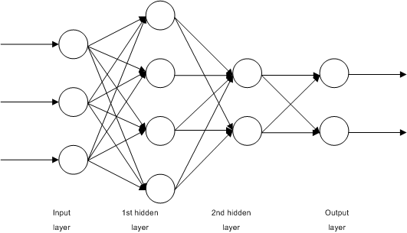
Suresh Manandhar – Natural Language Processing
Zaha Aljohani - Process Mining in Healthcare Environment
Taghreed Alqaisi - Phrase Embeddings and Machine Translation
Reem Alqifari - Machine Learning Models of Universal Grammar Parameter Dependencies
Reem Alrashdi - Early Event Detection and Event Extraction for Crisis Response Using Twitter Information
Chaitanya Kaul - Deep Learning for 3D Face Landmarking
Alexandros Komninos - Feature Rich Networks for Knowledge Base Completion
Nils Mönning - Complex Numbers for Neural Networks
Di Wang - Relation Extraction with Memory Network
Baoguo Yang - User Information Modelling in Social Communities and Networks
By John Salatas - https://jsalatas.ictpro.gr/implementation-of-elman-recurrent-neural-network-in-weka/, CC BY-SA 3.0, https://commons.wikimedia.org/w/index.php?curid=56969207

Slide 5
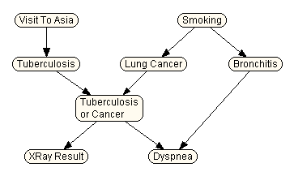
James Cussens – Probabilistic Graphical Models
Teny Handhayani – Causal Probabilistic Graphical Models
Durdane Kocacoban - Online Structure Learning for Causal Bayesian Networks
Sorush Lajevardi
Elizabeth Vialls - Discrete Models and Algorithms to Create a More Satisfying and Strategic Opponents

Slide 6
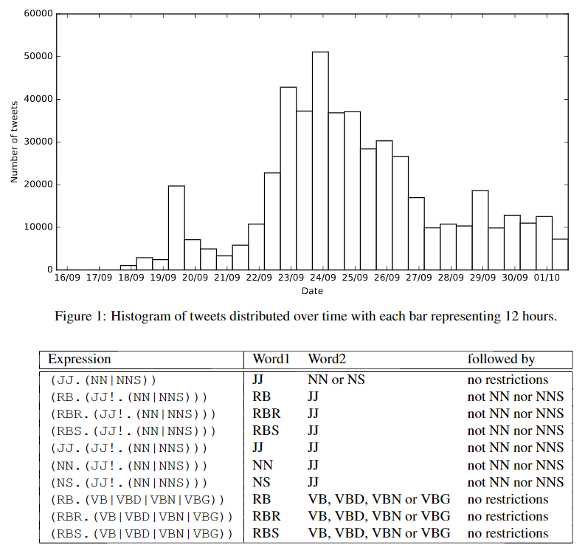
Dimitar Kazakov - Computational Linguistics, AI in Finance
Noof Alfear - Arabic Natural Language Processing
Eyad Algahtani - Inductive Machine Learning using Social Media and Open Linked Data
Hani Elgabou - Challenges in Arabic Natural Language Processing
Nurul Qomariyah - Learning User Preferences for Recommender Systems
Haizhou Qu - Financial Forecasting using Online News
Marcelo Sardelich - Financial Forecasting with Twitter Data
Mudita Sharma - Local Search Algorithms and the Concept of Extended Fitness

Slide 7
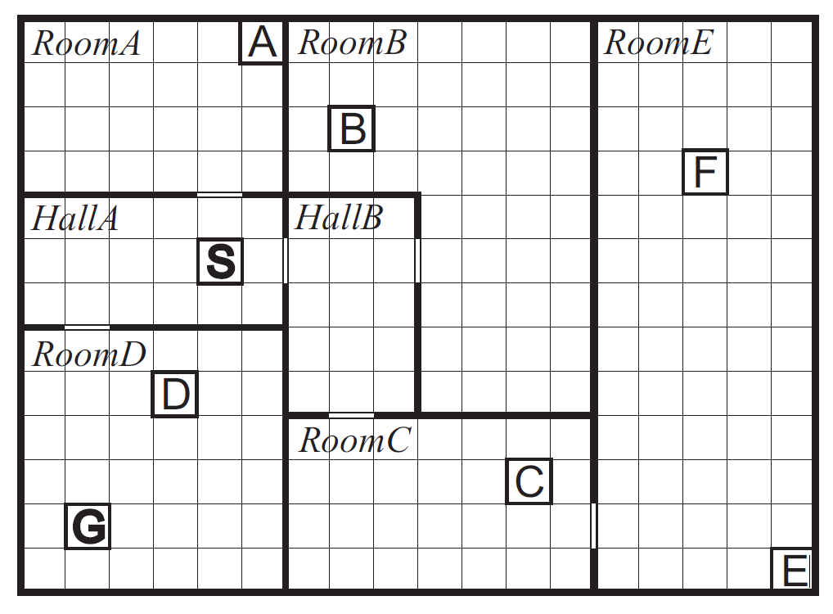
Daniel Kudenko – Reinforcement Learning
Mao Li - Reinforcement Learning from Demonstrations
Nourah Al-Rossais – Stereotypes for Recommender Systems
Andrea Bassich - Curriculum Learning for Reinforcement Learning
Matthew Bedder - Abstraction-Based Monte Carlo Tree Search
John Burden - Hierarchical Abstraction for Reinforcement Learning
Cathryn Henderson – Vignette Games
George Mason - Assured Reinforcement Learning with Formally Verified Abstract Policies
Hanting Xie - Predicting Player Disengagement and Purchases in Online Games

Slide 8
Others
Sam Devlin
Daniel Hernandez - Multi-Agent Reinforcement Learning for Game AI and Robotic Control
Adam Sattaur - The Use of Gameplay Data to Inform High-level AI Decision Making
Peter York - Applying Tree Search and Reinforcement Learning to Competitive and Human-Like MOBA AI
Tommy Yuan
Sultan Alahmari - Reinforcement Learning for Abstract Argumentation
Alan Frisch
Mark Bartlett

