Slide 1
An Introduction to Computer Vision& Pattern Recognition Group
Chengliang Hu
University of York, 15 February, 2018

Slide 2
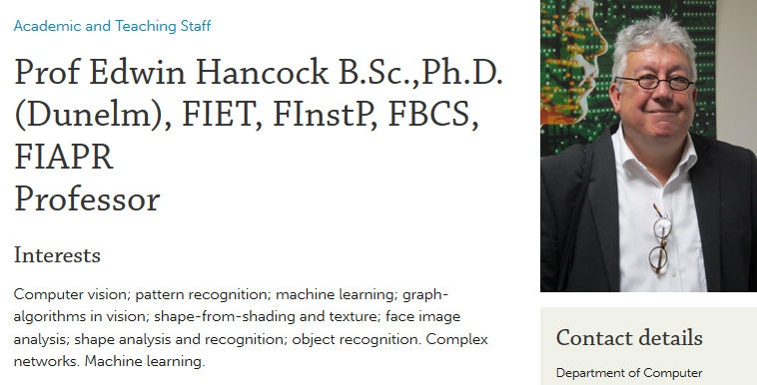
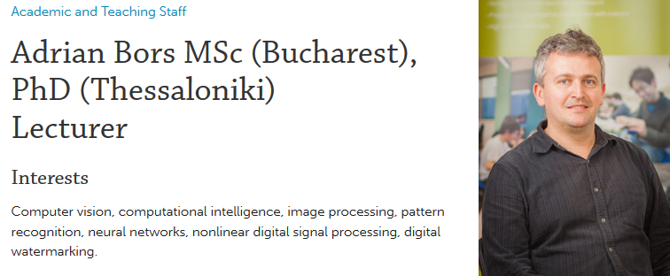
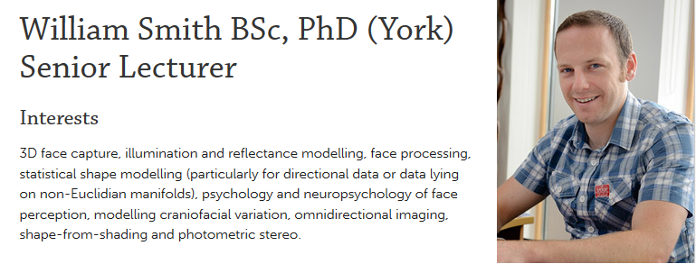
Computer Vision& Pattern Recognition Group (Staff)

Slide 3
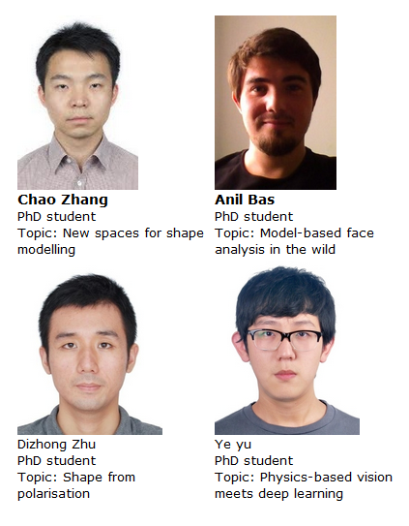
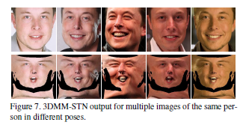
Computer Vision & Pattern Recognition Group ( PhD Students and their work)
around 10 PhD students. Some available photos are:
“3D mesh steganalysis using local shape feature” Zhengyu Li & Adrian Bors
“Functional faces: Groupwise dense correspondence using functional maps” Chao Zhang et al.
“3D morphable models as spatial transformer network” Anil bas et al.

Slide 4
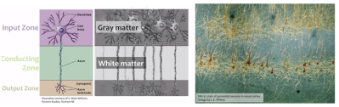
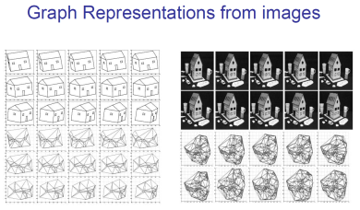
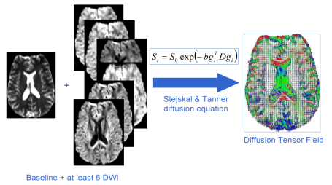
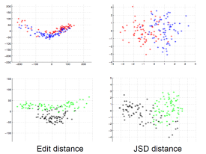
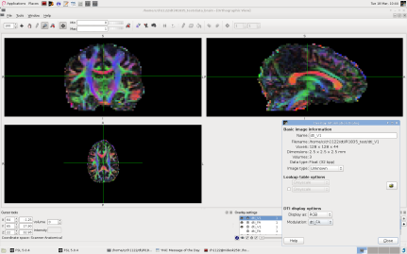
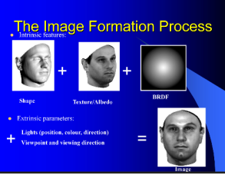
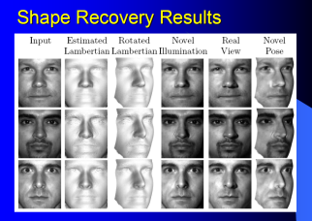
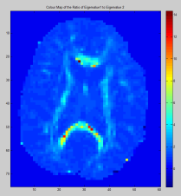
Computer Vision& Pattern Recognition Group (Research and applications)
Graph theory: creating new shape descriptors and shape analysis methods, graph embedding, manifold learning; complex networks; graph matching and characterisation,…
Shape analysis for diffusion MR images
Face recognition; shape modelling; shape from shading, shape from motion, …

Slide 5
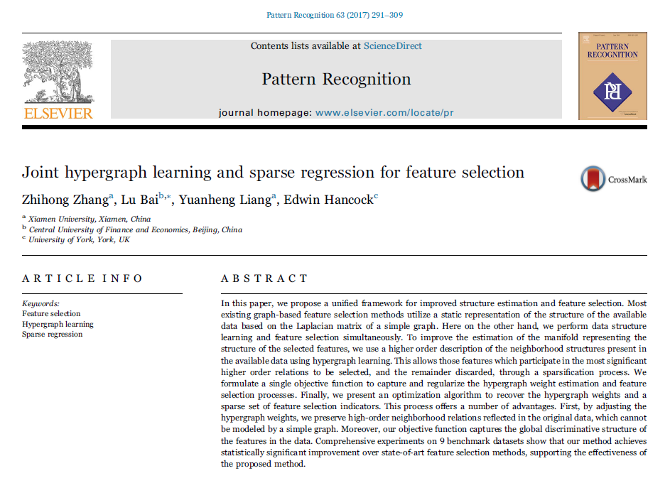
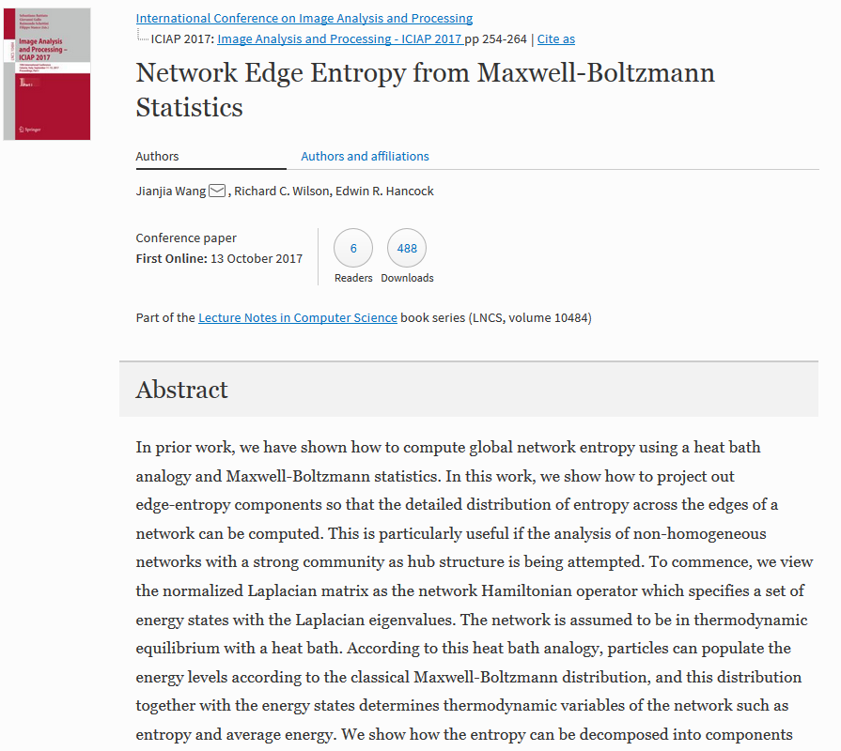
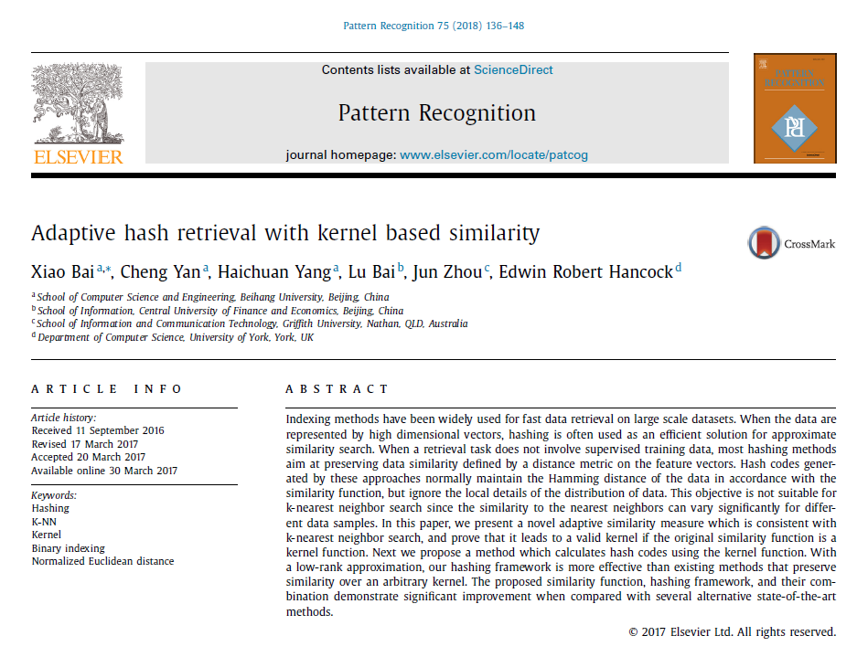
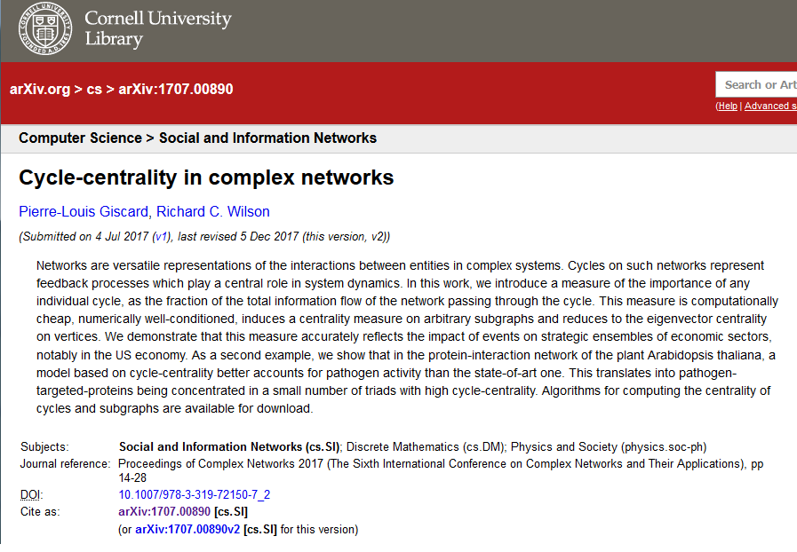
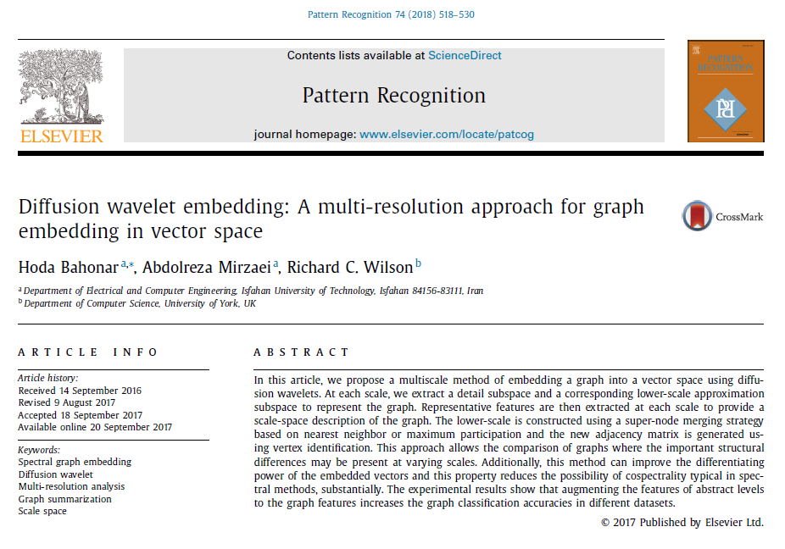
Computer Vision & Pattern Recognition Group ( Selected publications)

